Slide 1
WARSON RESIDENTIAL BUILDING, DUBAI
FAÇADE CONCEPT DESIGN
April 2023

Slide 2
EXISITNG PROPOSAL
GRID

Slide 3
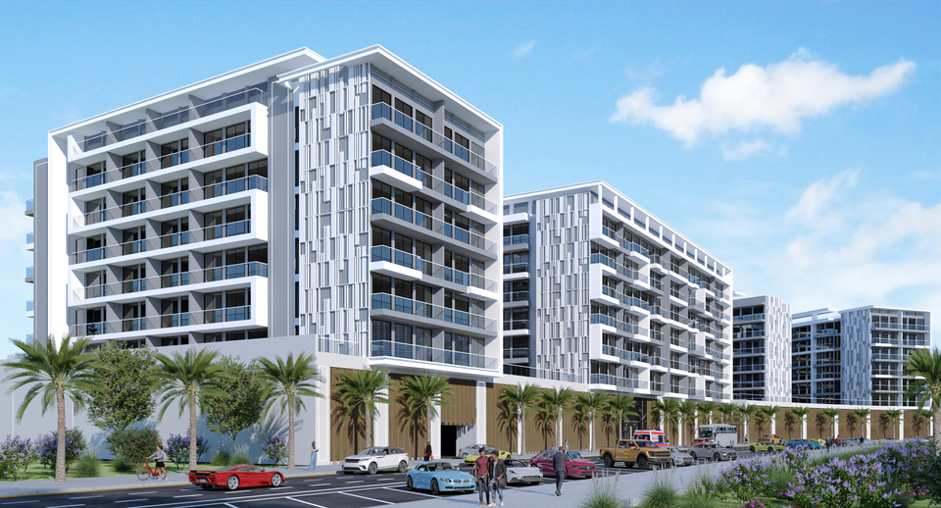
EXISITNG PROPOSAL
| EXISTING REFERENCES |

Slide 4
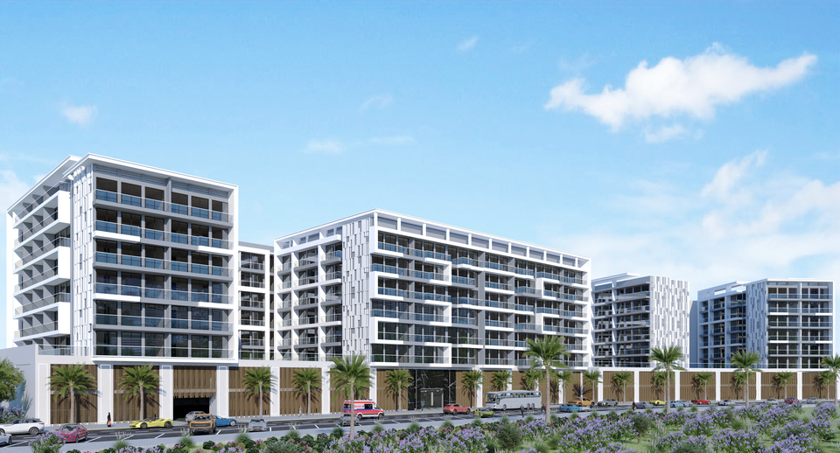
CLIENT REFERENCES
| EXISTING REFERENCES |

Slide 5
CLIENT REFERENCES
GRID

Slide 6
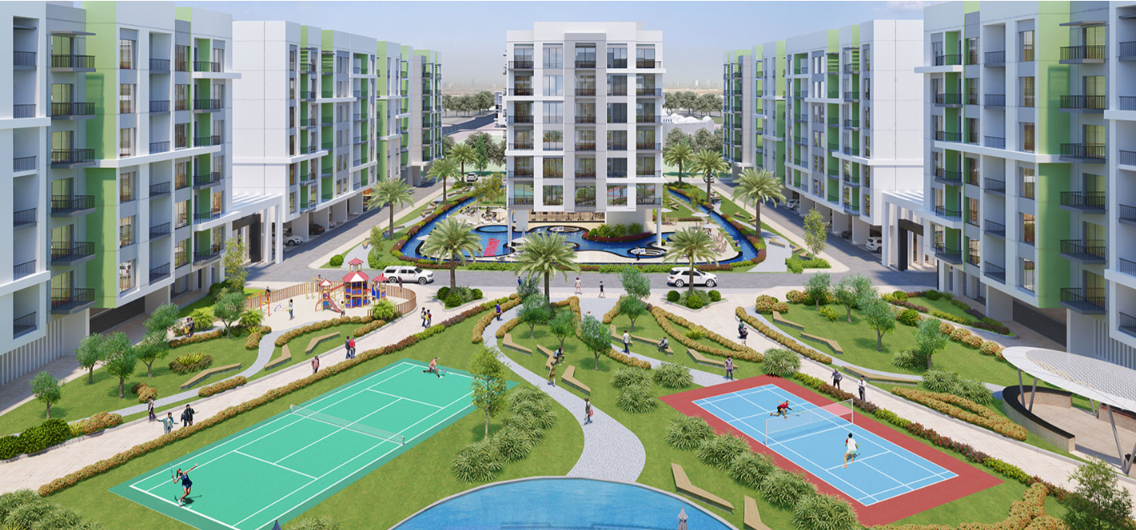
Olivz, Dubai
| CLIENT REFERENCES |

Slide 7
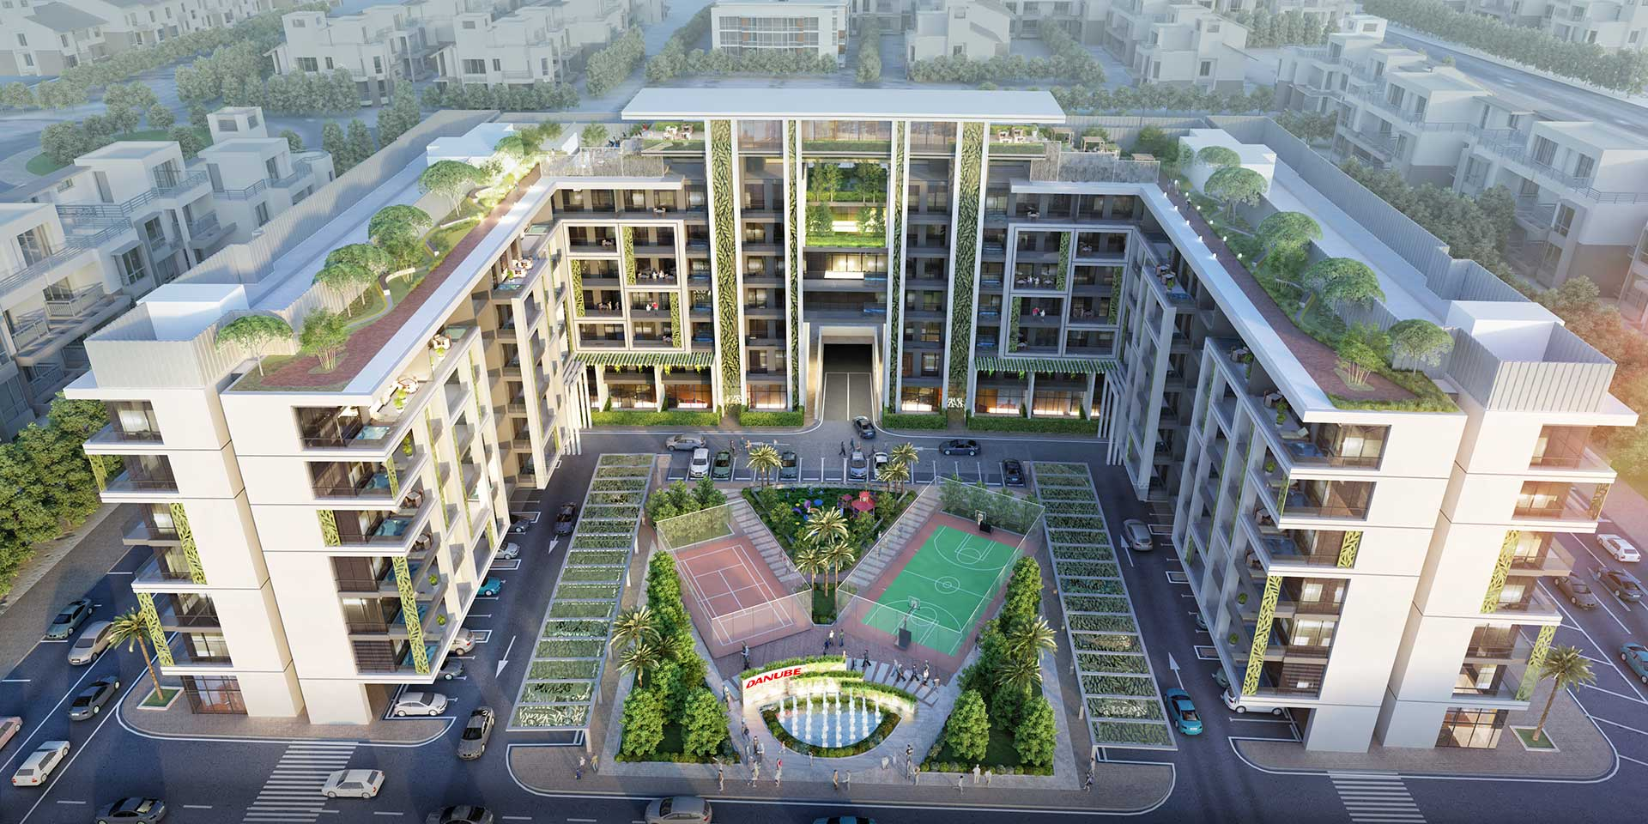
Petalz, Dubai
| CLIENT REFERENCES |

Slide 8
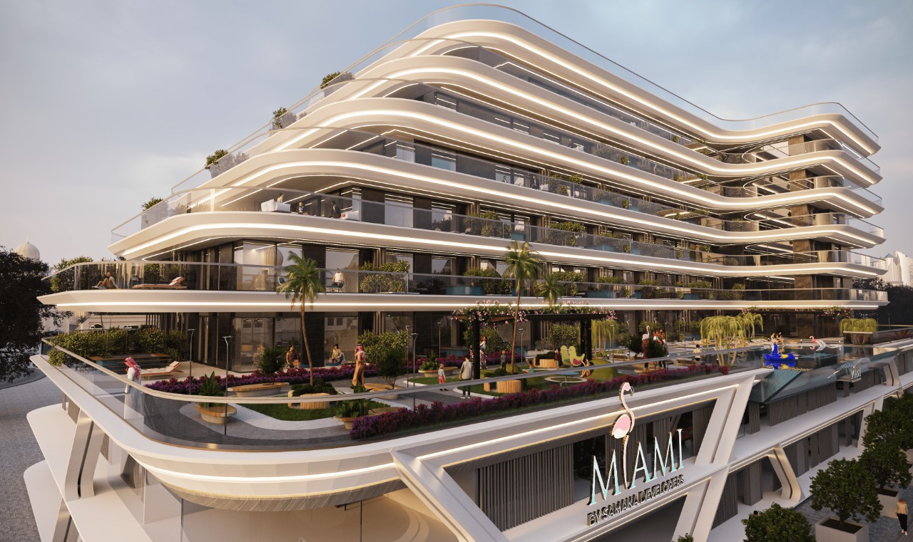
Miami, By Samana Developers
| CLIENT REFERENCES |

Slide 9
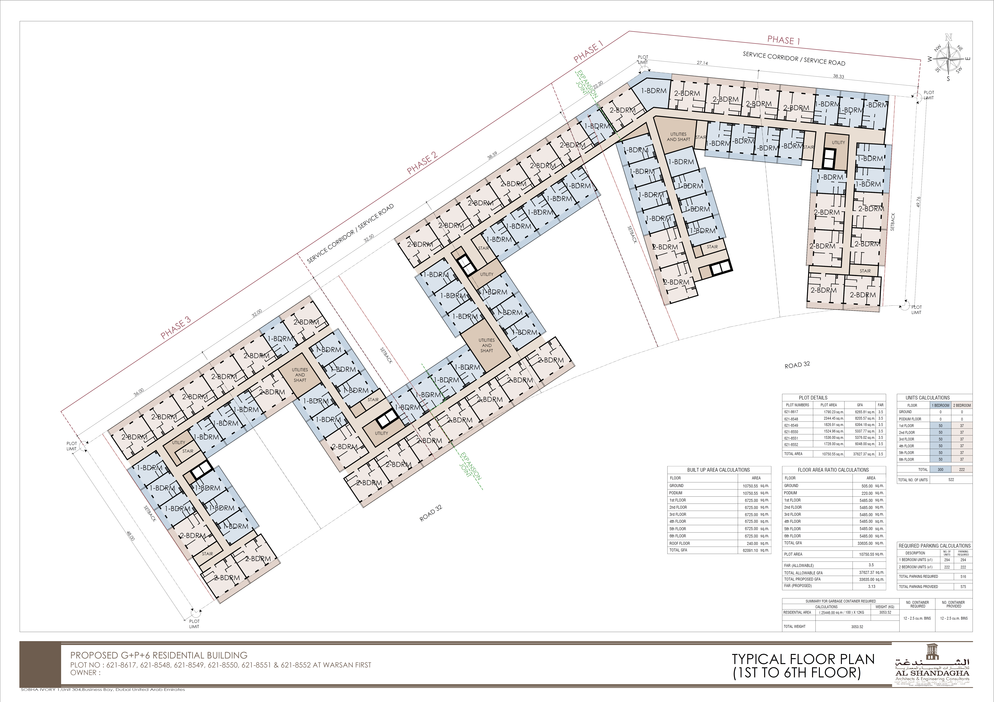
SELECTED FAÇADE FOR DESIGN PROPOSAL

Slide 10
PROPOSED - OPTION 1
GRID
GRID

Slide 11
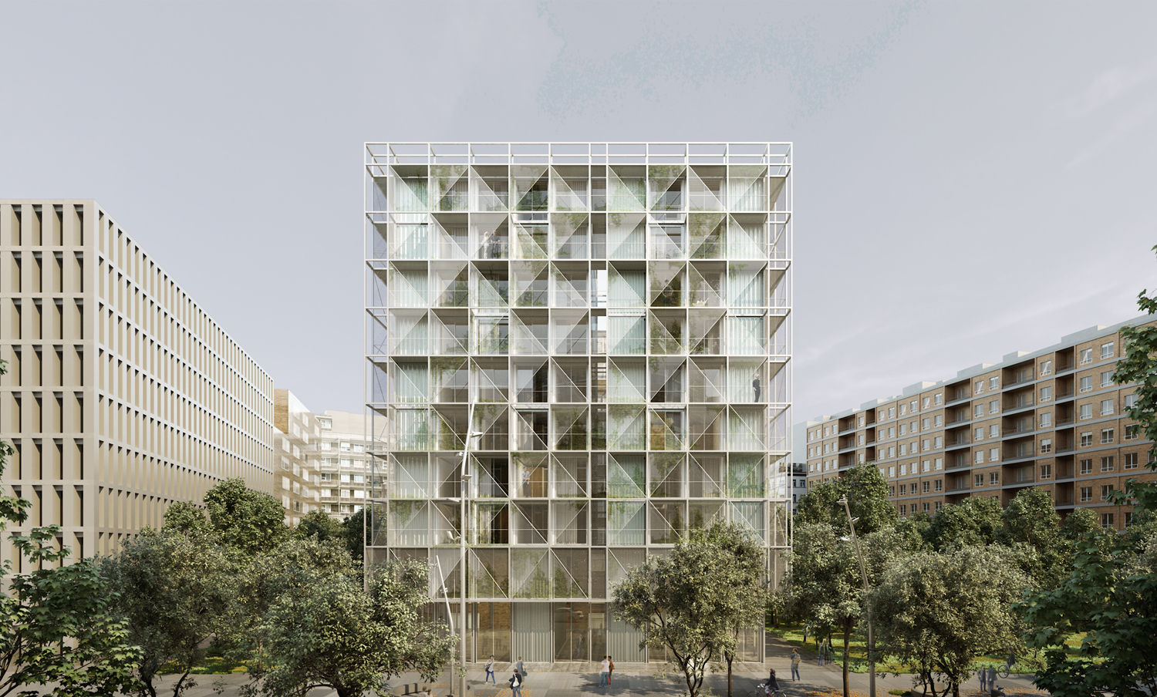
| OPTION 1 – GRID | REFERENCES

Slide 12
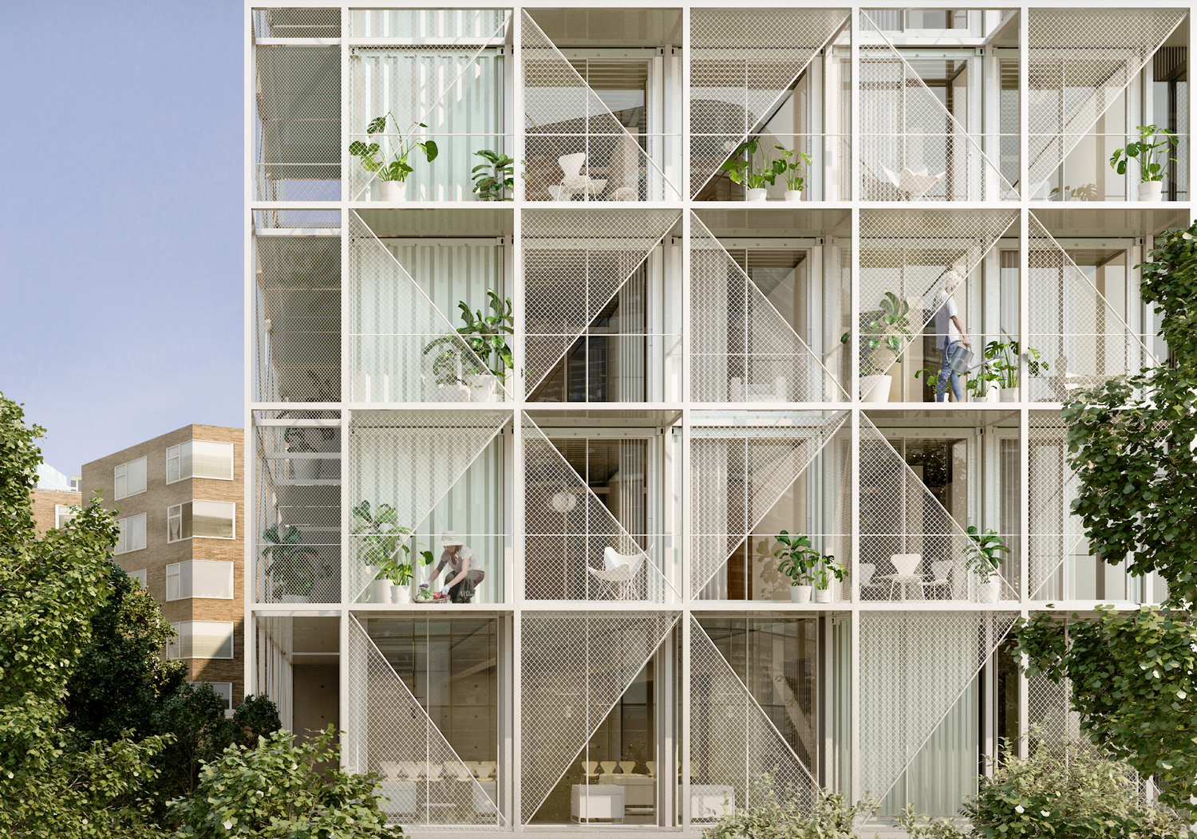
| OPTION 1 – GRID | REFERENCES

Slide 13
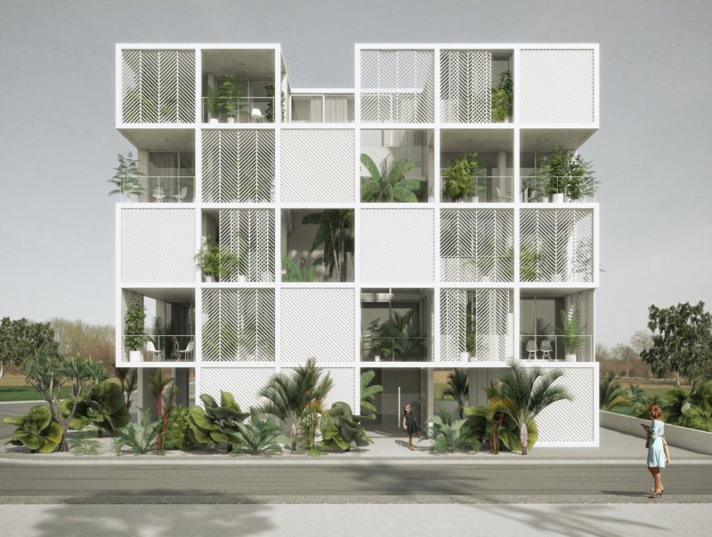
| OPTION 1 – GRID | REFERENCES

Slide 14
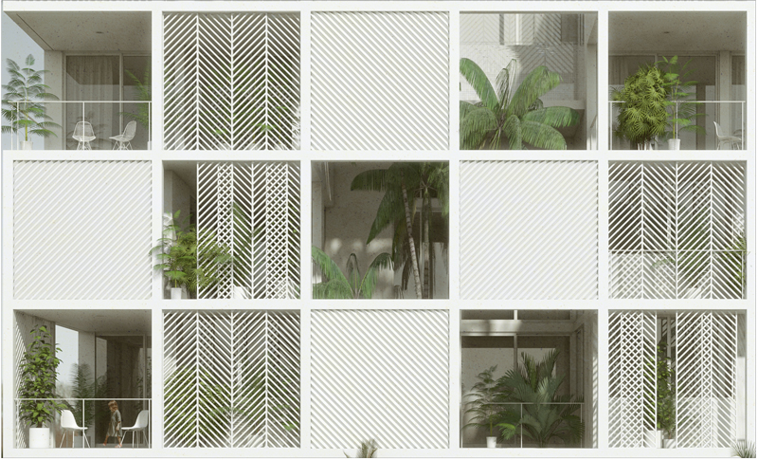
| OPTION 1 – GRID | REFERENCES

Slide 15
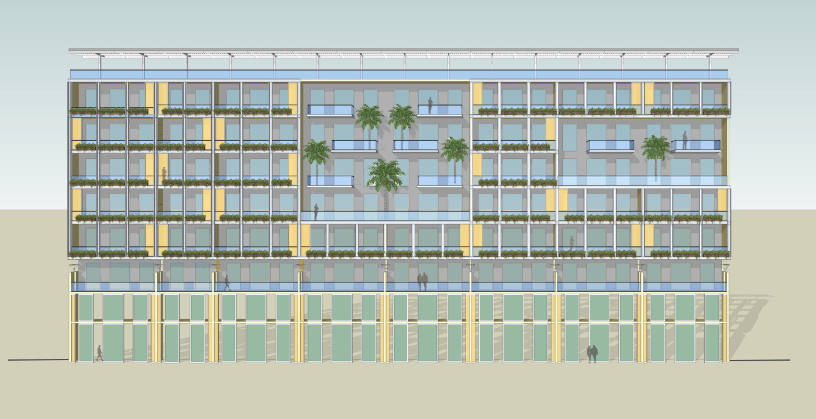
| OPTION 1 – GRID | PROPOSED DESIGN

Slide 16
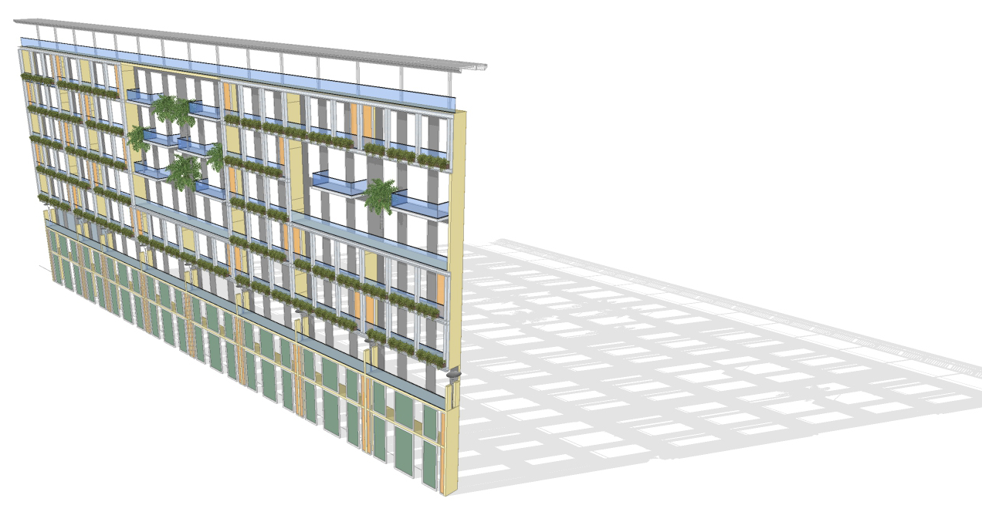

| OPTION 1 – GRID | PROPOSED DESIGN

Slide 17
PROPOSED - OPTION 2
SCALES
SCALES

Slide 18
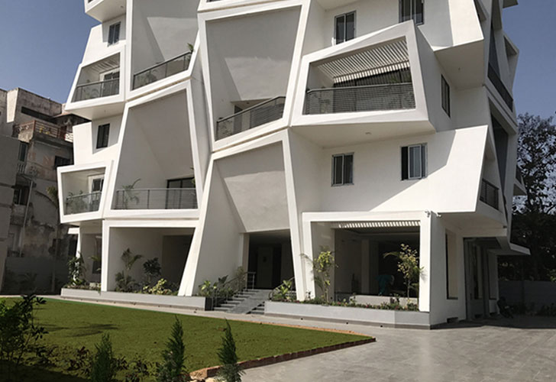
| OPTION 2 – SCALES | REFERENCE

Slide 19
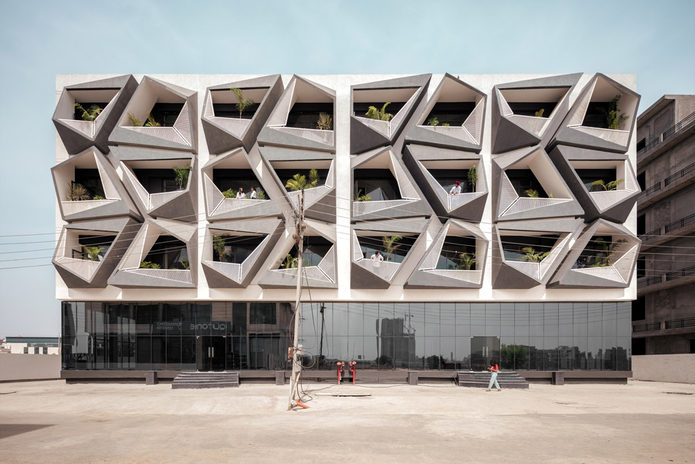
| OPTION 2 – SCALES | REFERENCE

Slide 20
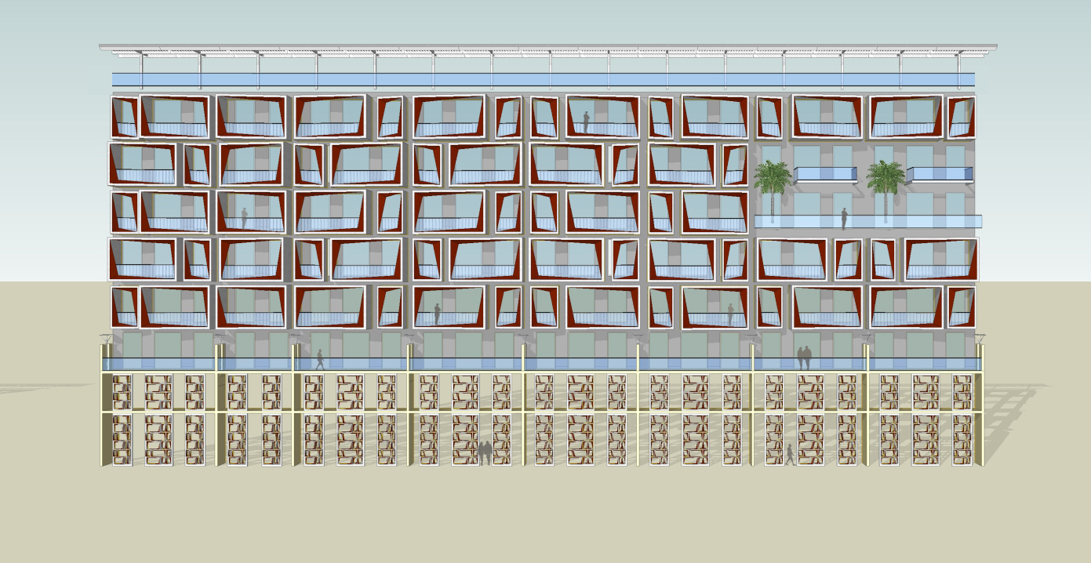
| OPTION 2 – SCALES | PROPOSED DESIGN

Slide 21
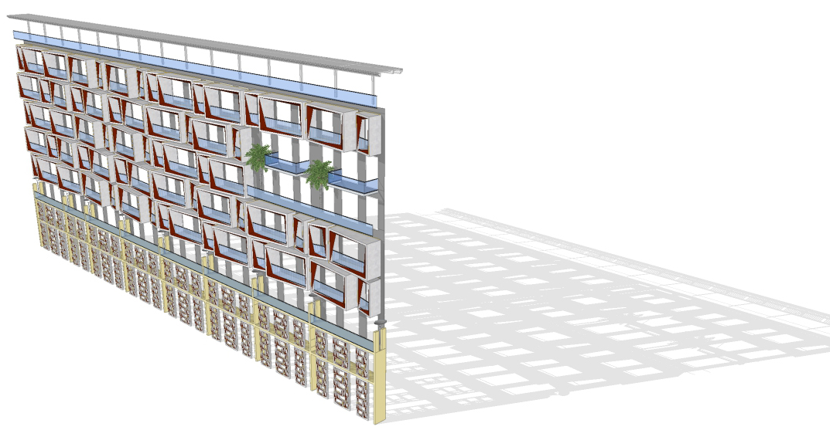
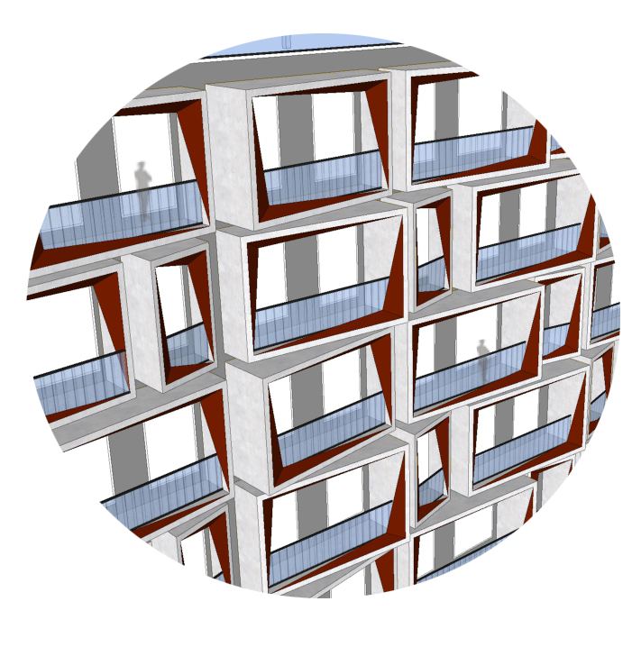
| OPTION 2 – SCALES | PROPOSED DESIGN

Slide 22
PROPOSED - OPTION 3
GRID
CUBES

Slide 23
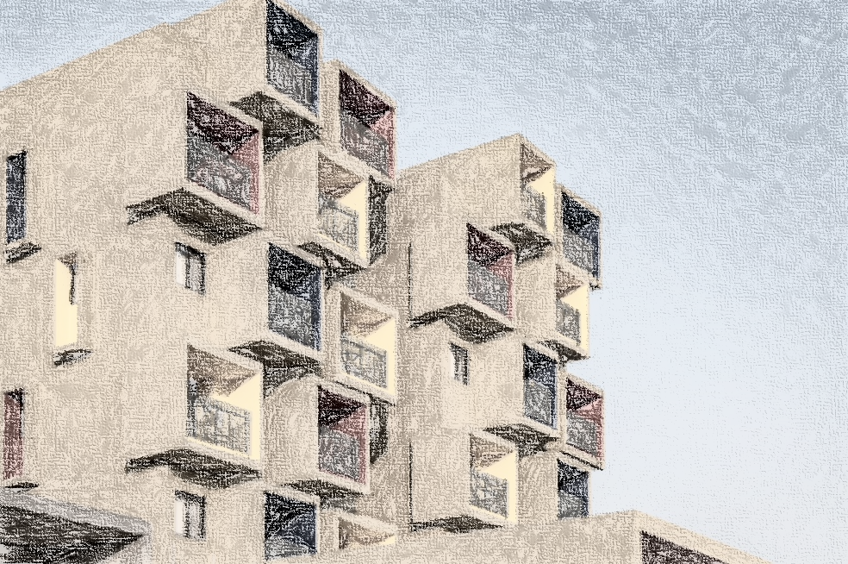
| OPTION 3 – CUBES | PROPOSED DESIGN

Slide 24
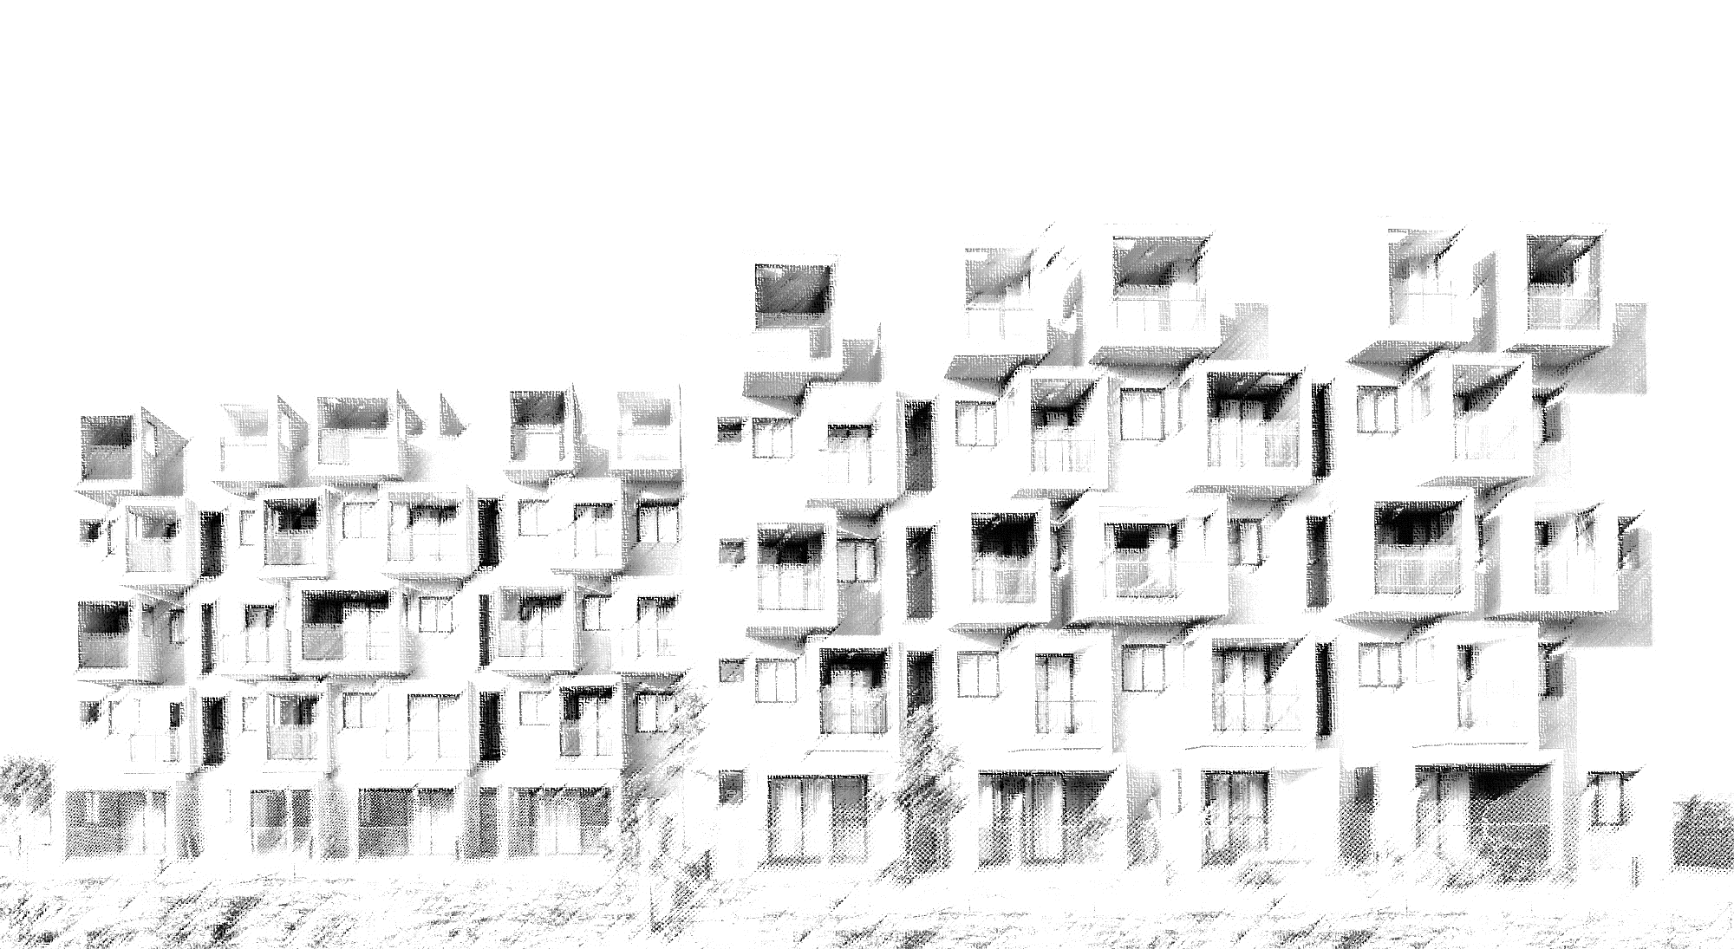
| OPTION 3 – CUBES | PROPOSED DESIGN

Slide 25
PROPOSED - OPTION 4
GRID
ELLINGTON

Slide 26
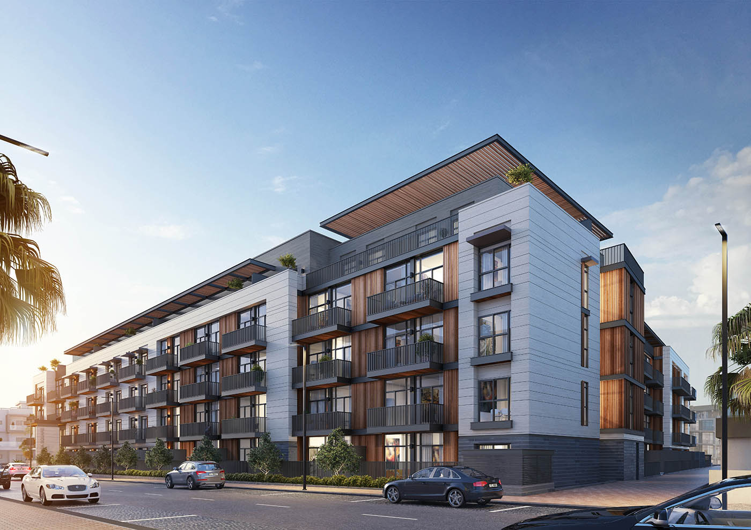
| OPTION 4 – ELLINGTON | REFERENCES

Slide 27
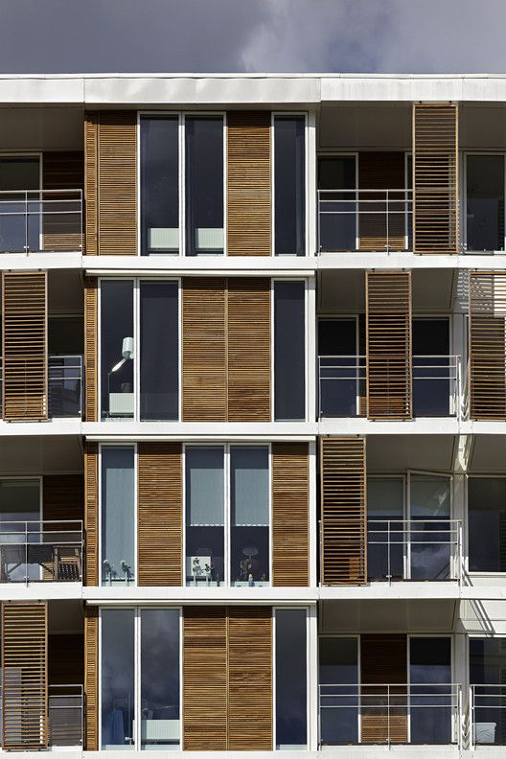
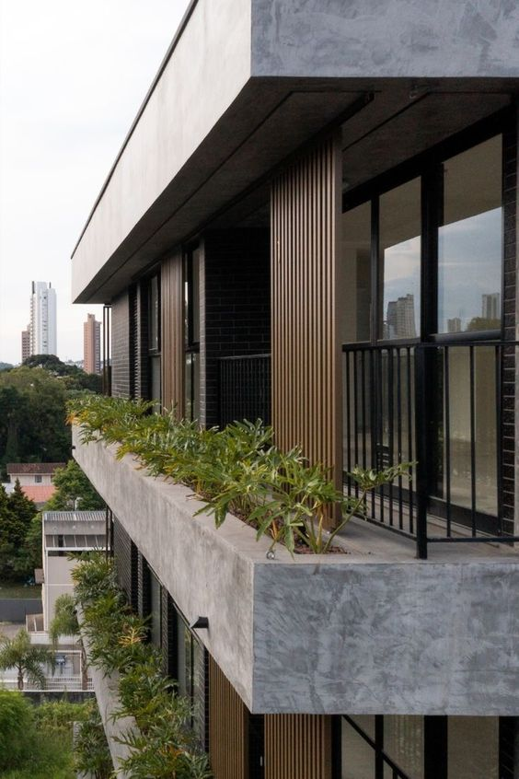
| OPTION 4 – ELLINGTON | REFERENCES

Slide 28
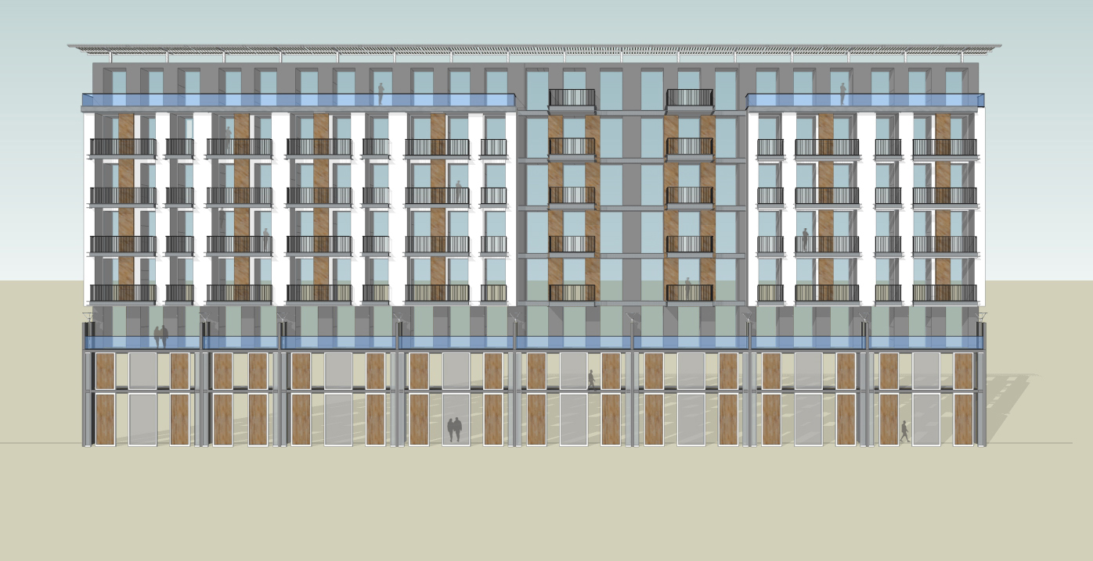
| OPTION 4 – ELLINGTON | PROPOSED DESIGN

Slide 29
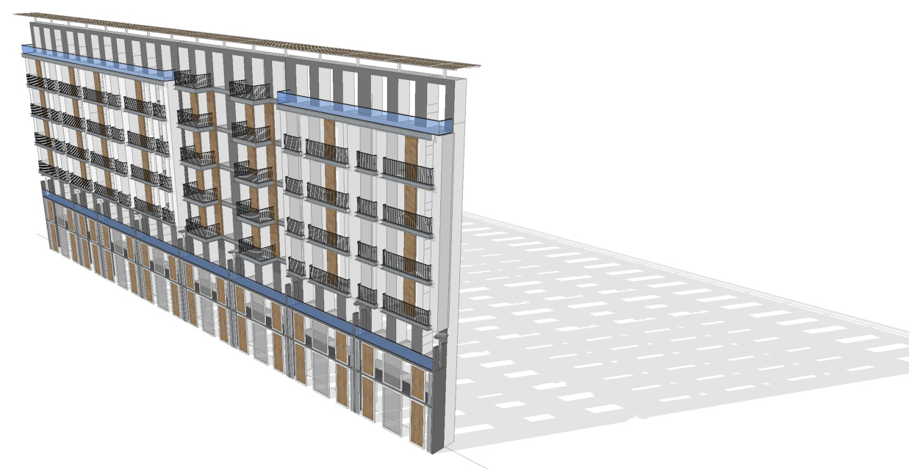

| OPTION 4 – ELLINGTON | PROPOSED DESIGN

Slide 30
PROPOSED - OPTION 5
GRID
SIMPLE GRID

Slide 31

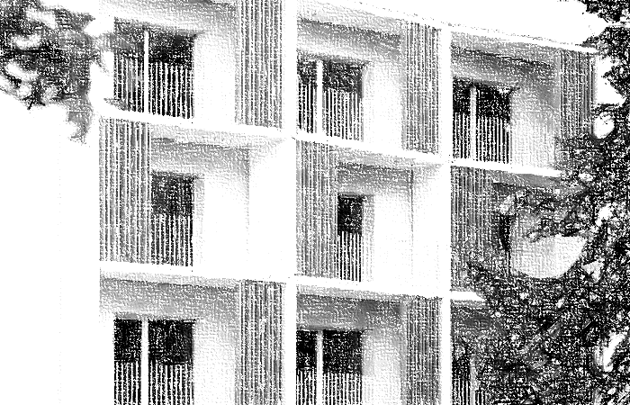
| OPTION 5 – SIMPLE GRID | REFERENCES

Slide 32
PROPOSED - OPTION 6
GRID
MIAMI

Slide 33
| OPTION 6 – MIAMI | REFERENCES

Slide 34
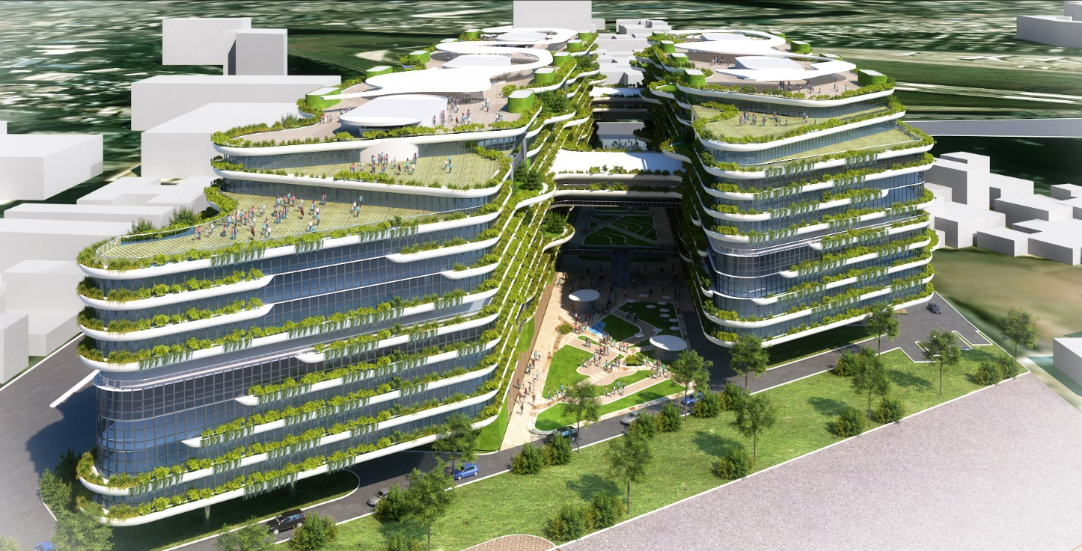
| OPTION 6 – MIAMI | BKC COMMERCIAL CENTRE

Slide 35
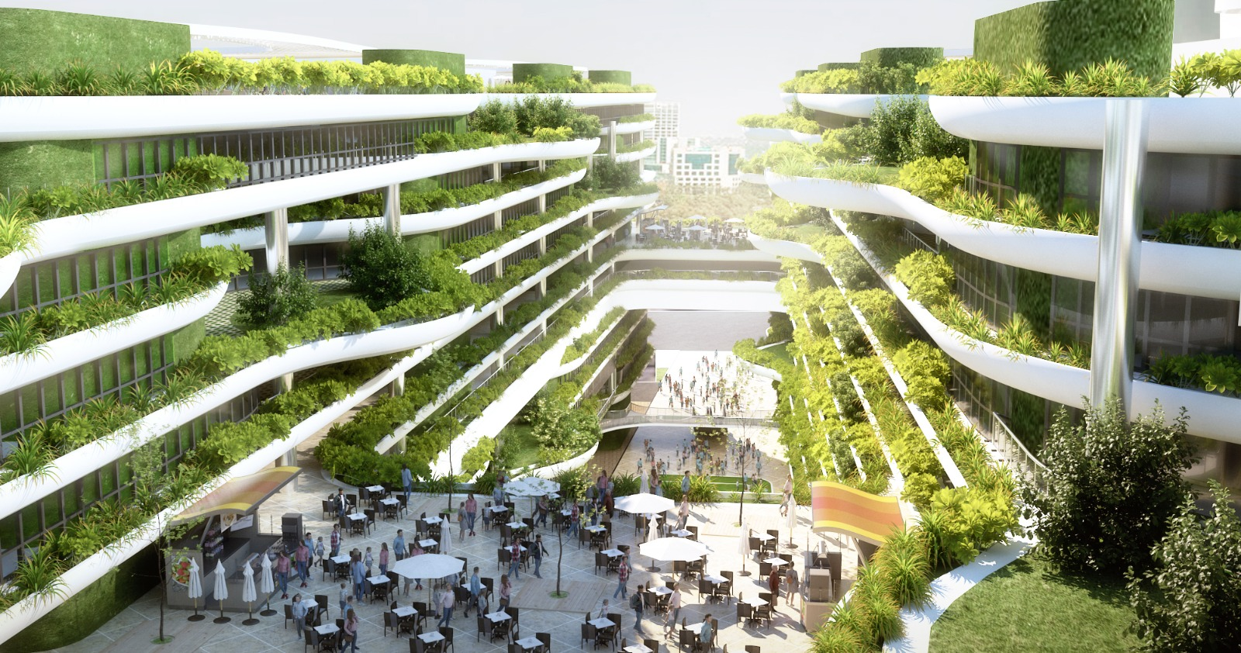
| OPTION 6 – MIAMI | BKC COMMERCIAL CENTRE

Slide 36
THANK YOU

