Slide 1
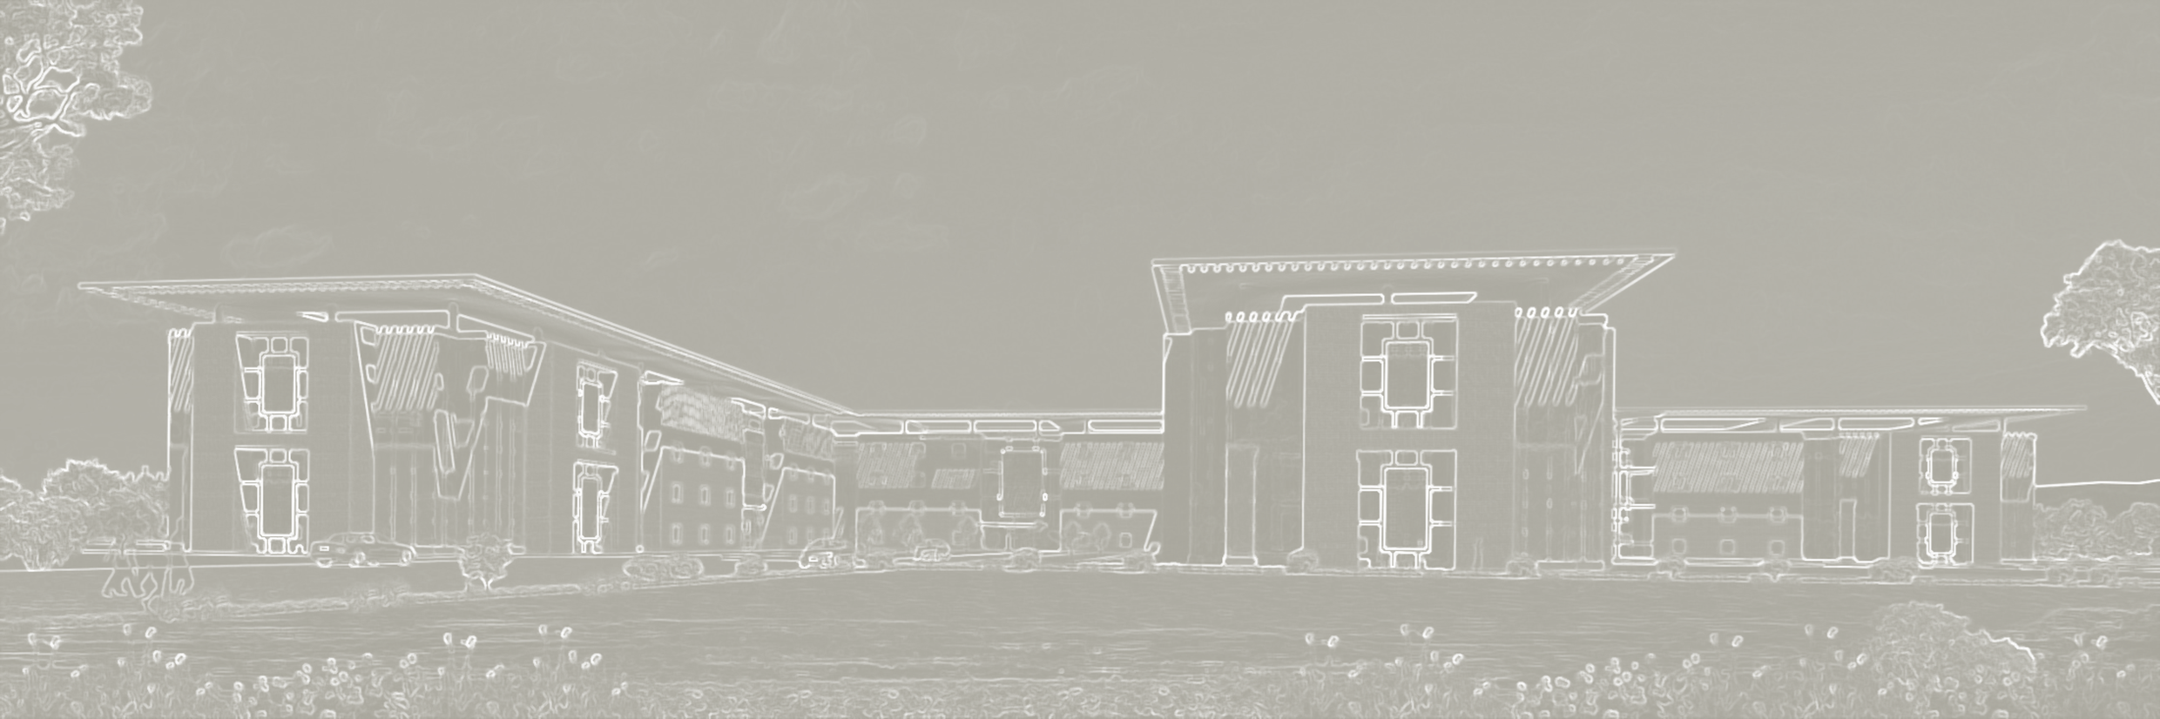
Mozambique Healthcare Project
Hospital Design Presentation
4th March 2021

Slide 2
Contents
Hospital Program - Program as per BRIEF from client
- Program as per MEDI Planners
Proposed Hospital Design - Site plan
- Conceptual massing
- Circulation
Hospital Building - Typical floor plan
- Grid & Zoning plans
- Typical Ward plan
- Typical I.C.U. plan
- Typical standard ward & Deluxe room plans

Slide 3
HOSPITAL PROGRAM

Slide 4
BED STRENGTH

Slide 5
BED DISTRIBUTION

Slide 6
CLINICAL SPECIALITY

Slide 7
SPACE DEPARTMENT

Slide 8
PROPOSED HOSPITAL DESIGN

Slide 9
SITE PLAN

Slide 10
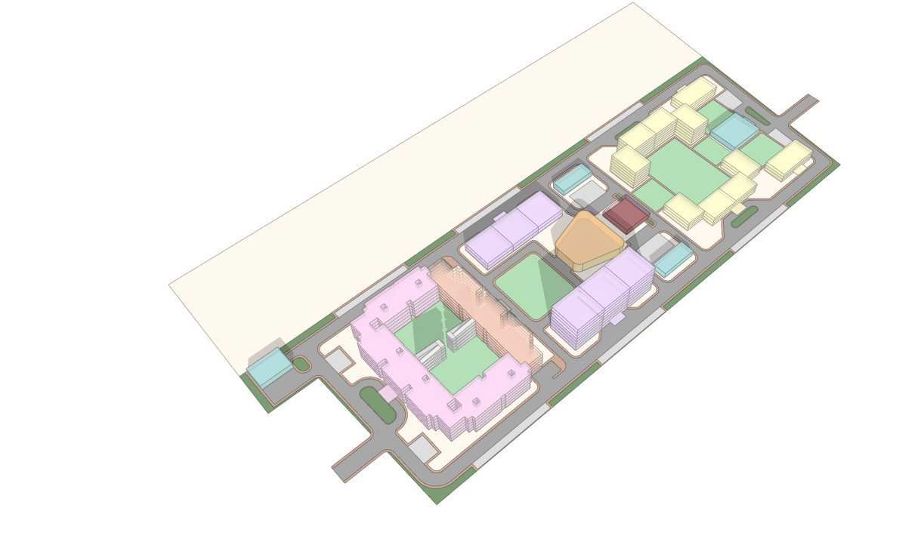
MASSING MODEL
5
5
7
5
7
8
5
3
6
4
7
8
3
2
1
HOSPITAL
8
2
HOSPITAL EXT.
7
8
3
COLLEGE
1
4
AUDITORIUM
5
HOSTEL
6
KITCHEN
7
SERVICES
8
LANDSCAPE

Slide 11
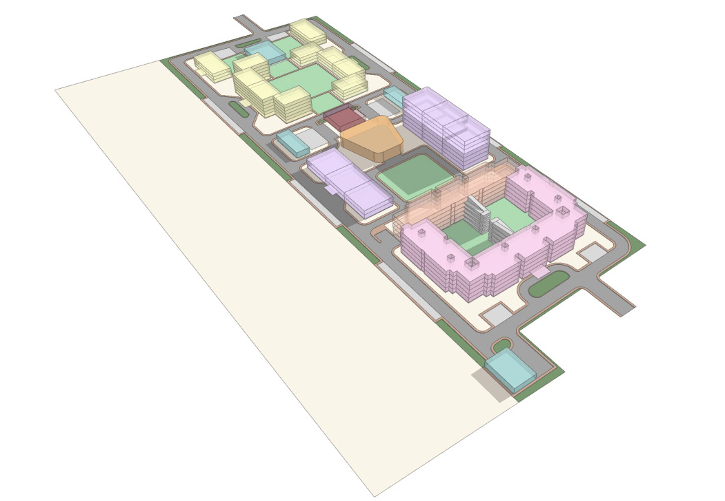
MASSING MODEL
5
7
5
5
5
8
7
6
3
7
4
3
8
2
8
1
8
1
HOSPITAL
2
HOSPITAL EXT.
3
COLLEGE
4
AUDITORIUM
7
5
HOSTEL
6
KITCHEN
7
SERVICES
8
LANDSCAPE

Slide 12
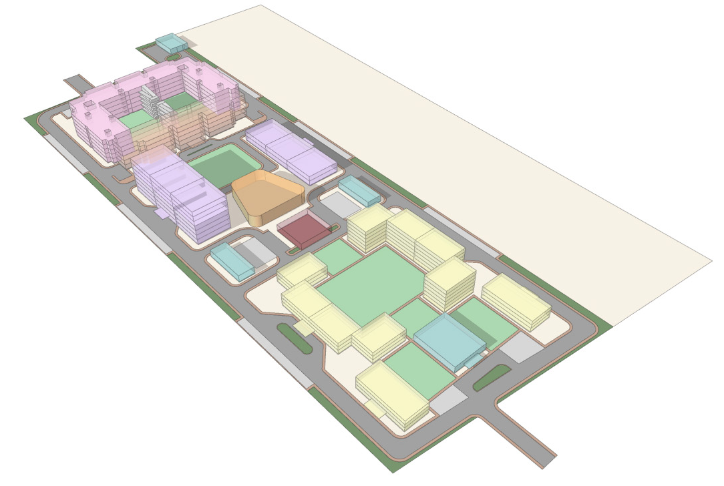
MASSING MODEL
7
1
8
8
2
3
3
8
4
7
6
5
7
1
HOSPITAL
8
5
2
HOSPITAL EXT.
5
8
3
COLLEGE
7
4
AUDITORIUM
8
5
HOSTEL
5
6
KITCHEN
7
SERVICES
8
LANDSCAPE

Slide 13
MAIN AND EMERGENCY ENTRY
Emergency
Main Entrance

Slide 14
VEHICULAR CIRCULATION – DROP/ PARKING
Drop off point
Vehicular movement

Slide 15
FIRE TENDER MOVEMENT
Fire tender movement

Slide 16
PEDESTRIAN MOVEMENT
Drop off point
Pedestrian Pathway

Slide 17
SERVICE MOVEMENT
Services

Slide 18
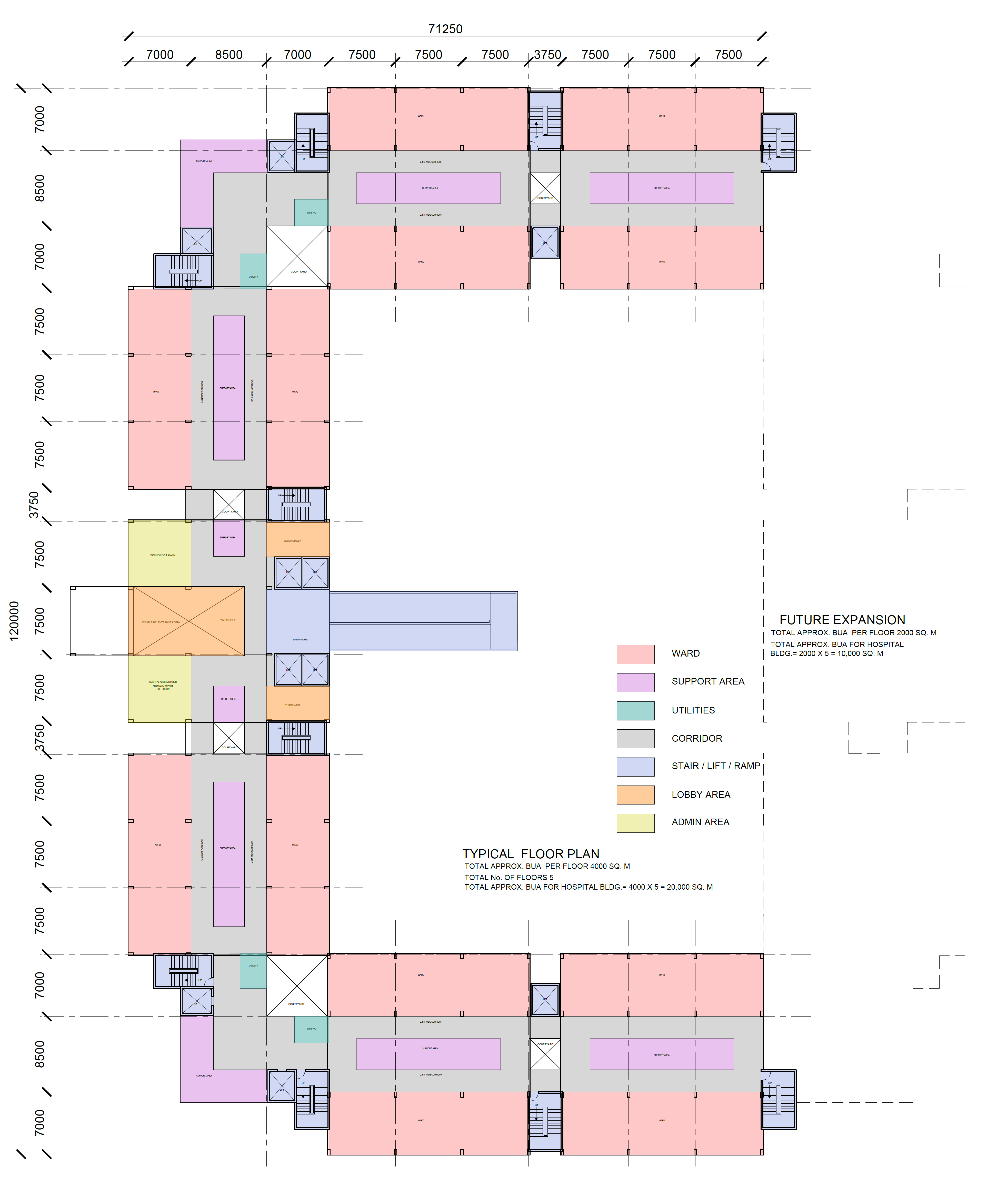
TYPICAL FLOOR PLAN - GRID & ZONING

Slide 19
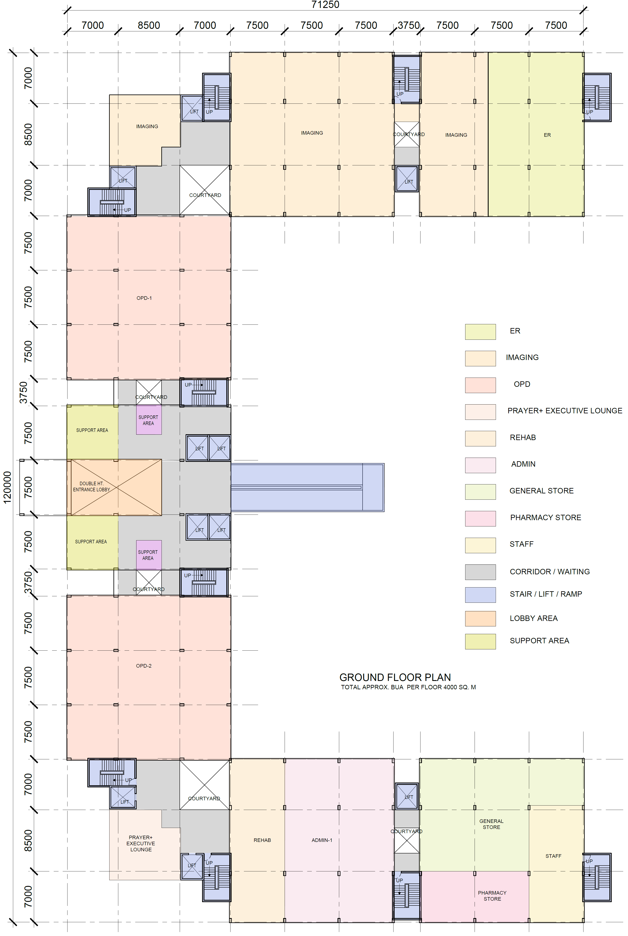
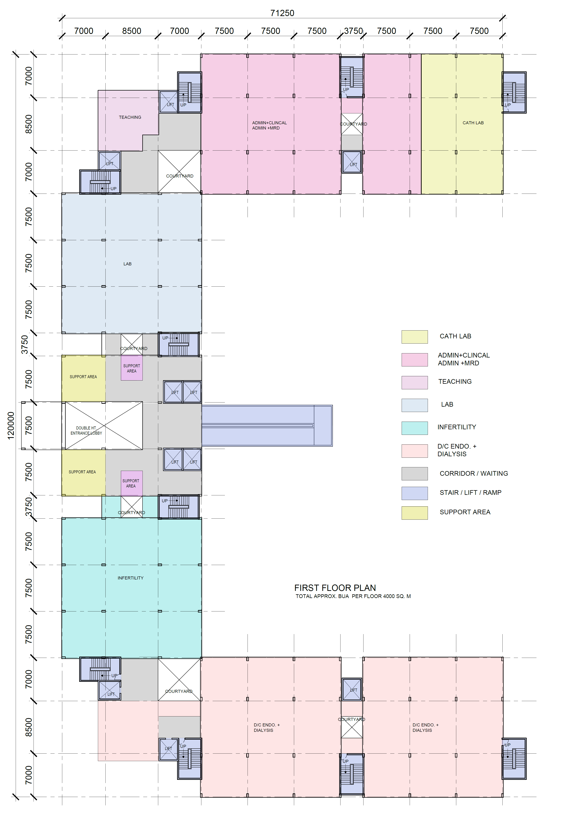
HOSPITAL GRID & ZONING PLANS

Slide 20
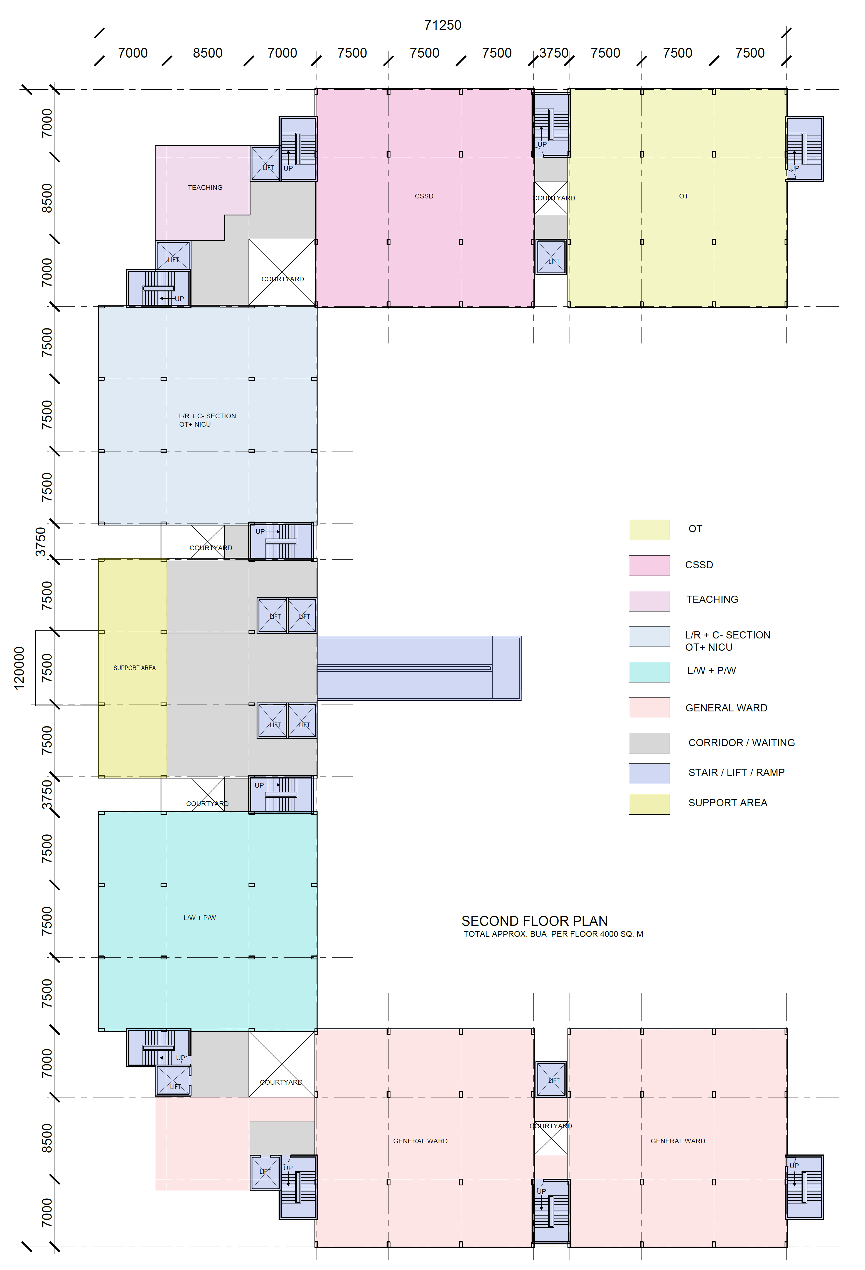
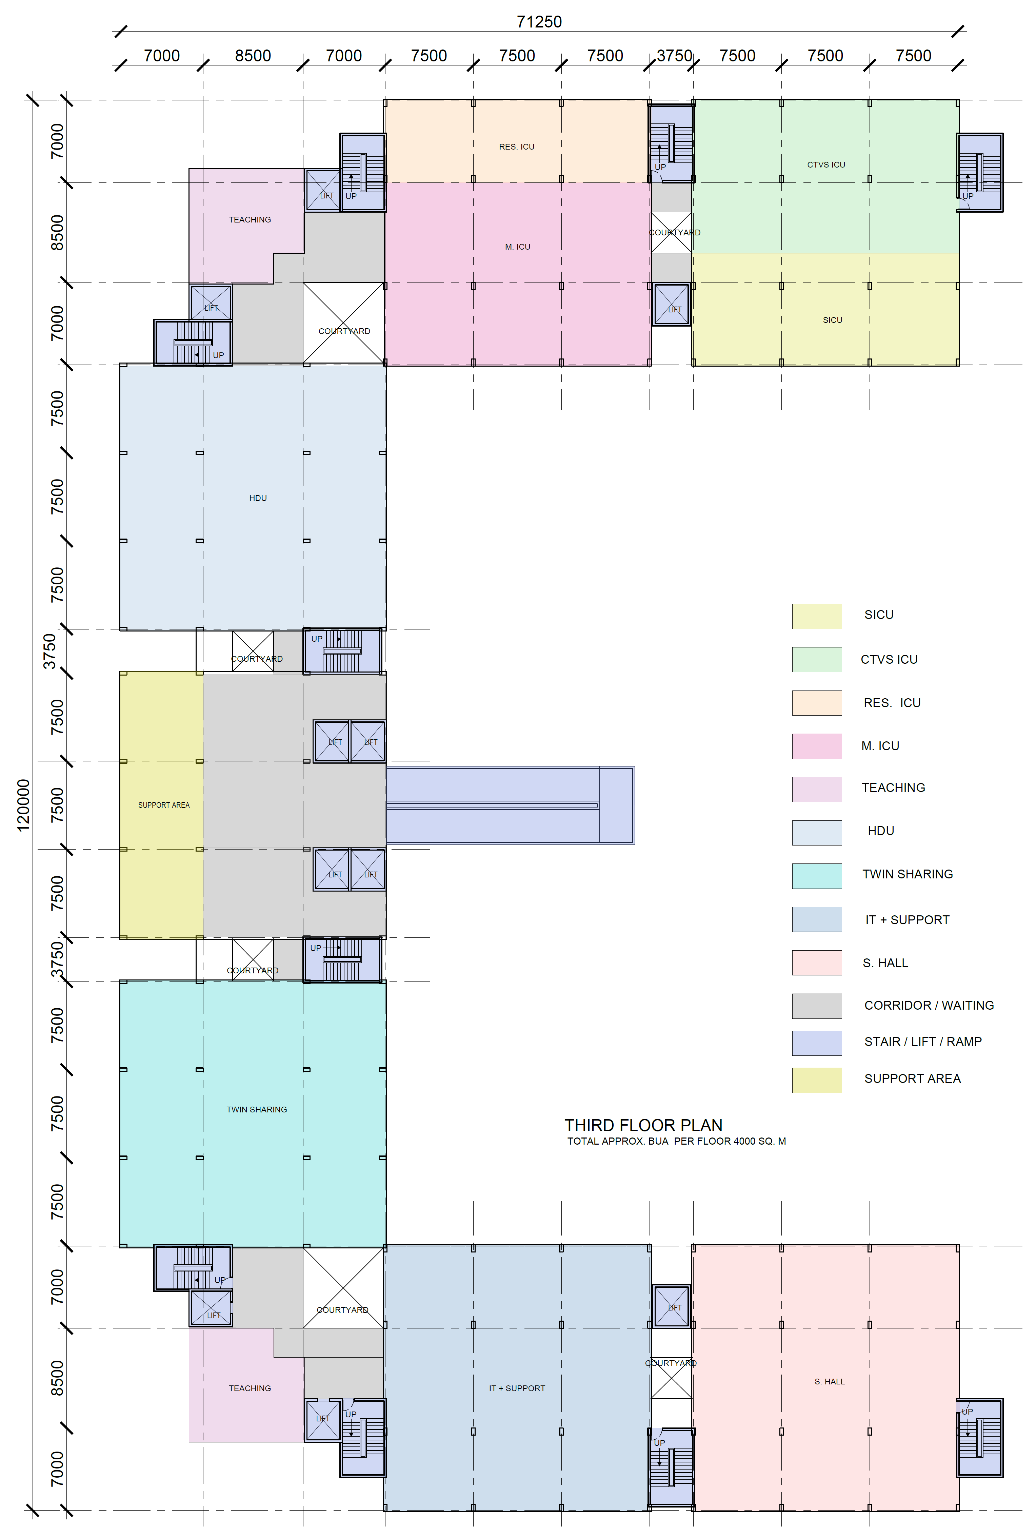
HOSPITAL GRID & ZONING PLANS

Slide 21
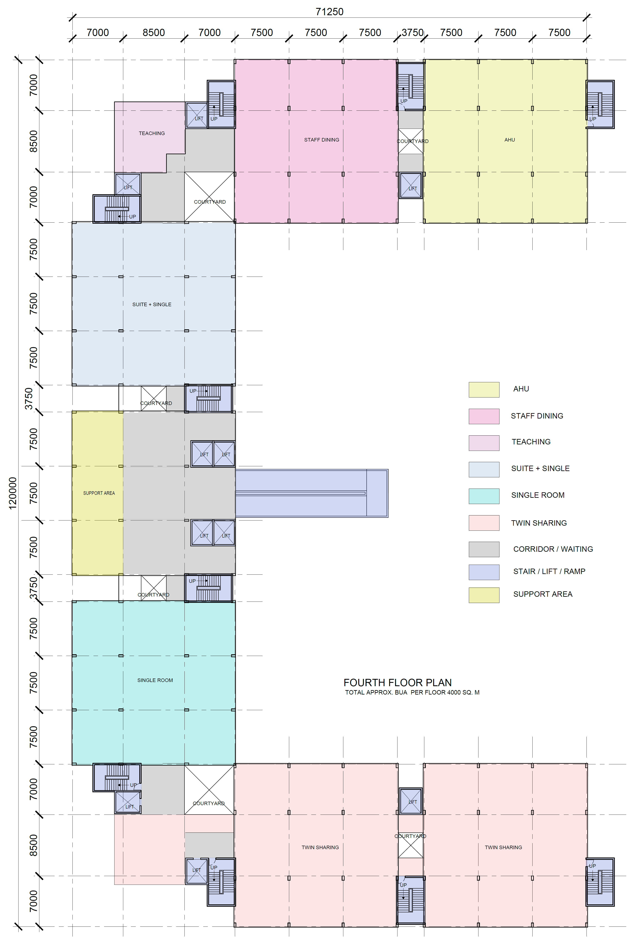
HOSPITAL GRID & ZONING PLANS

Slide 22
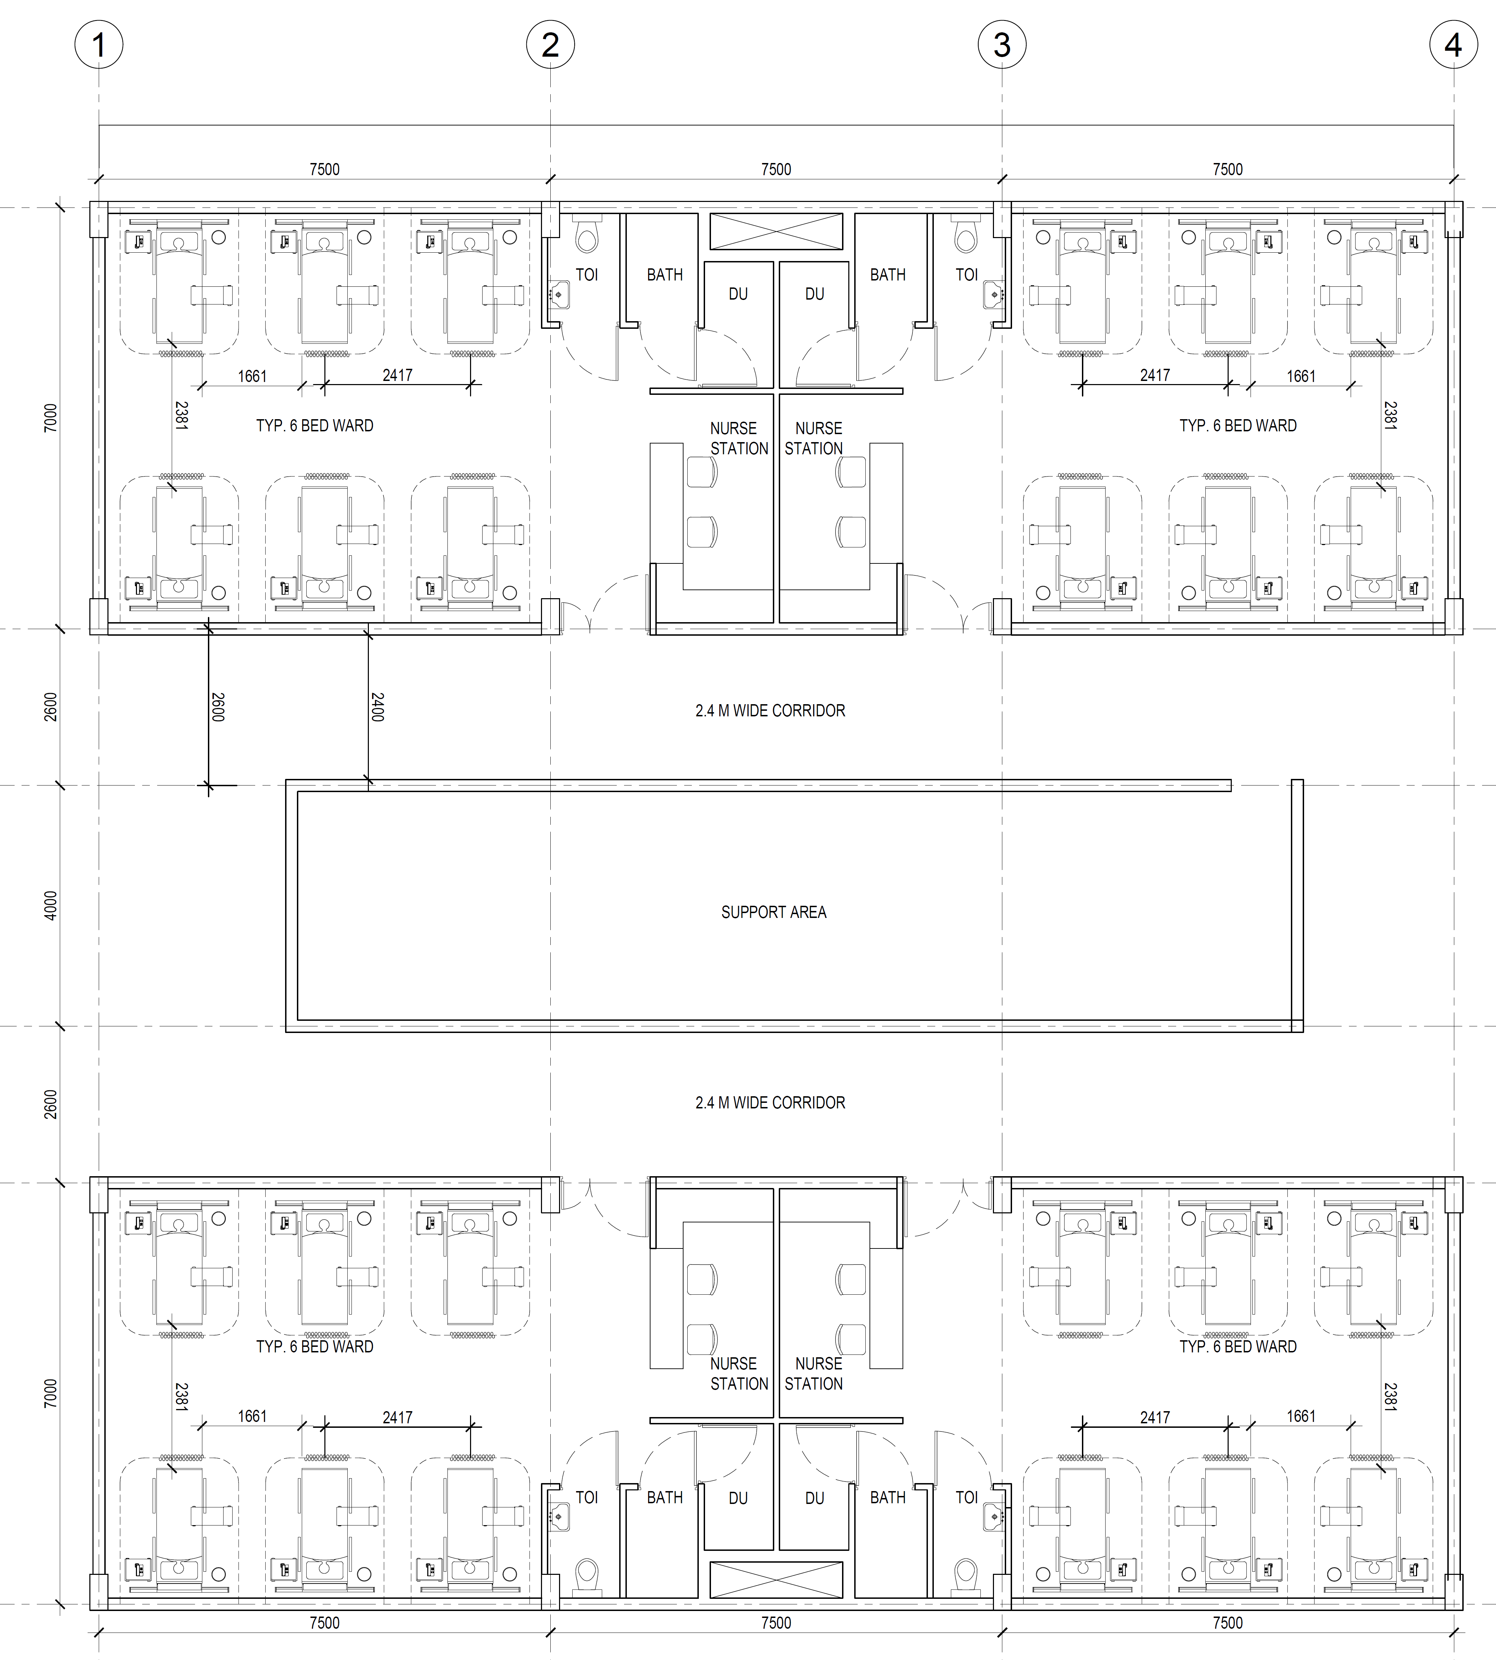
TYPICAL GENERAL WARD

Slide 23
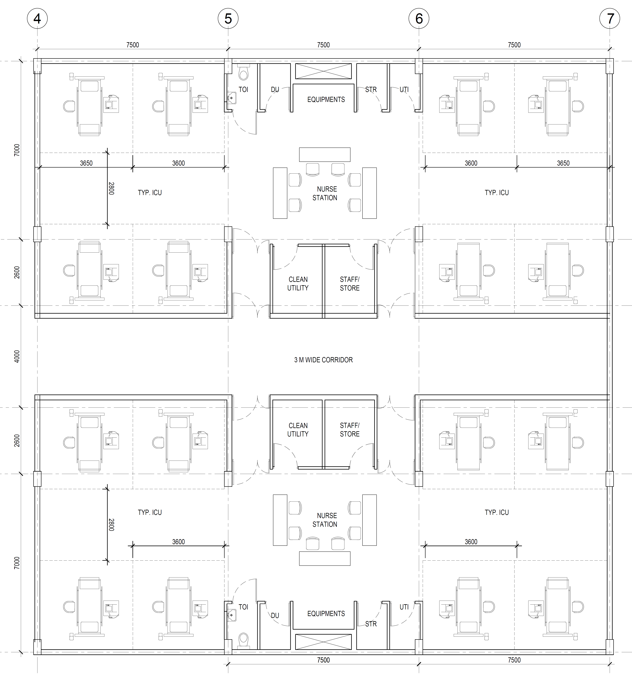
TYPICAL ICU

Slide 24
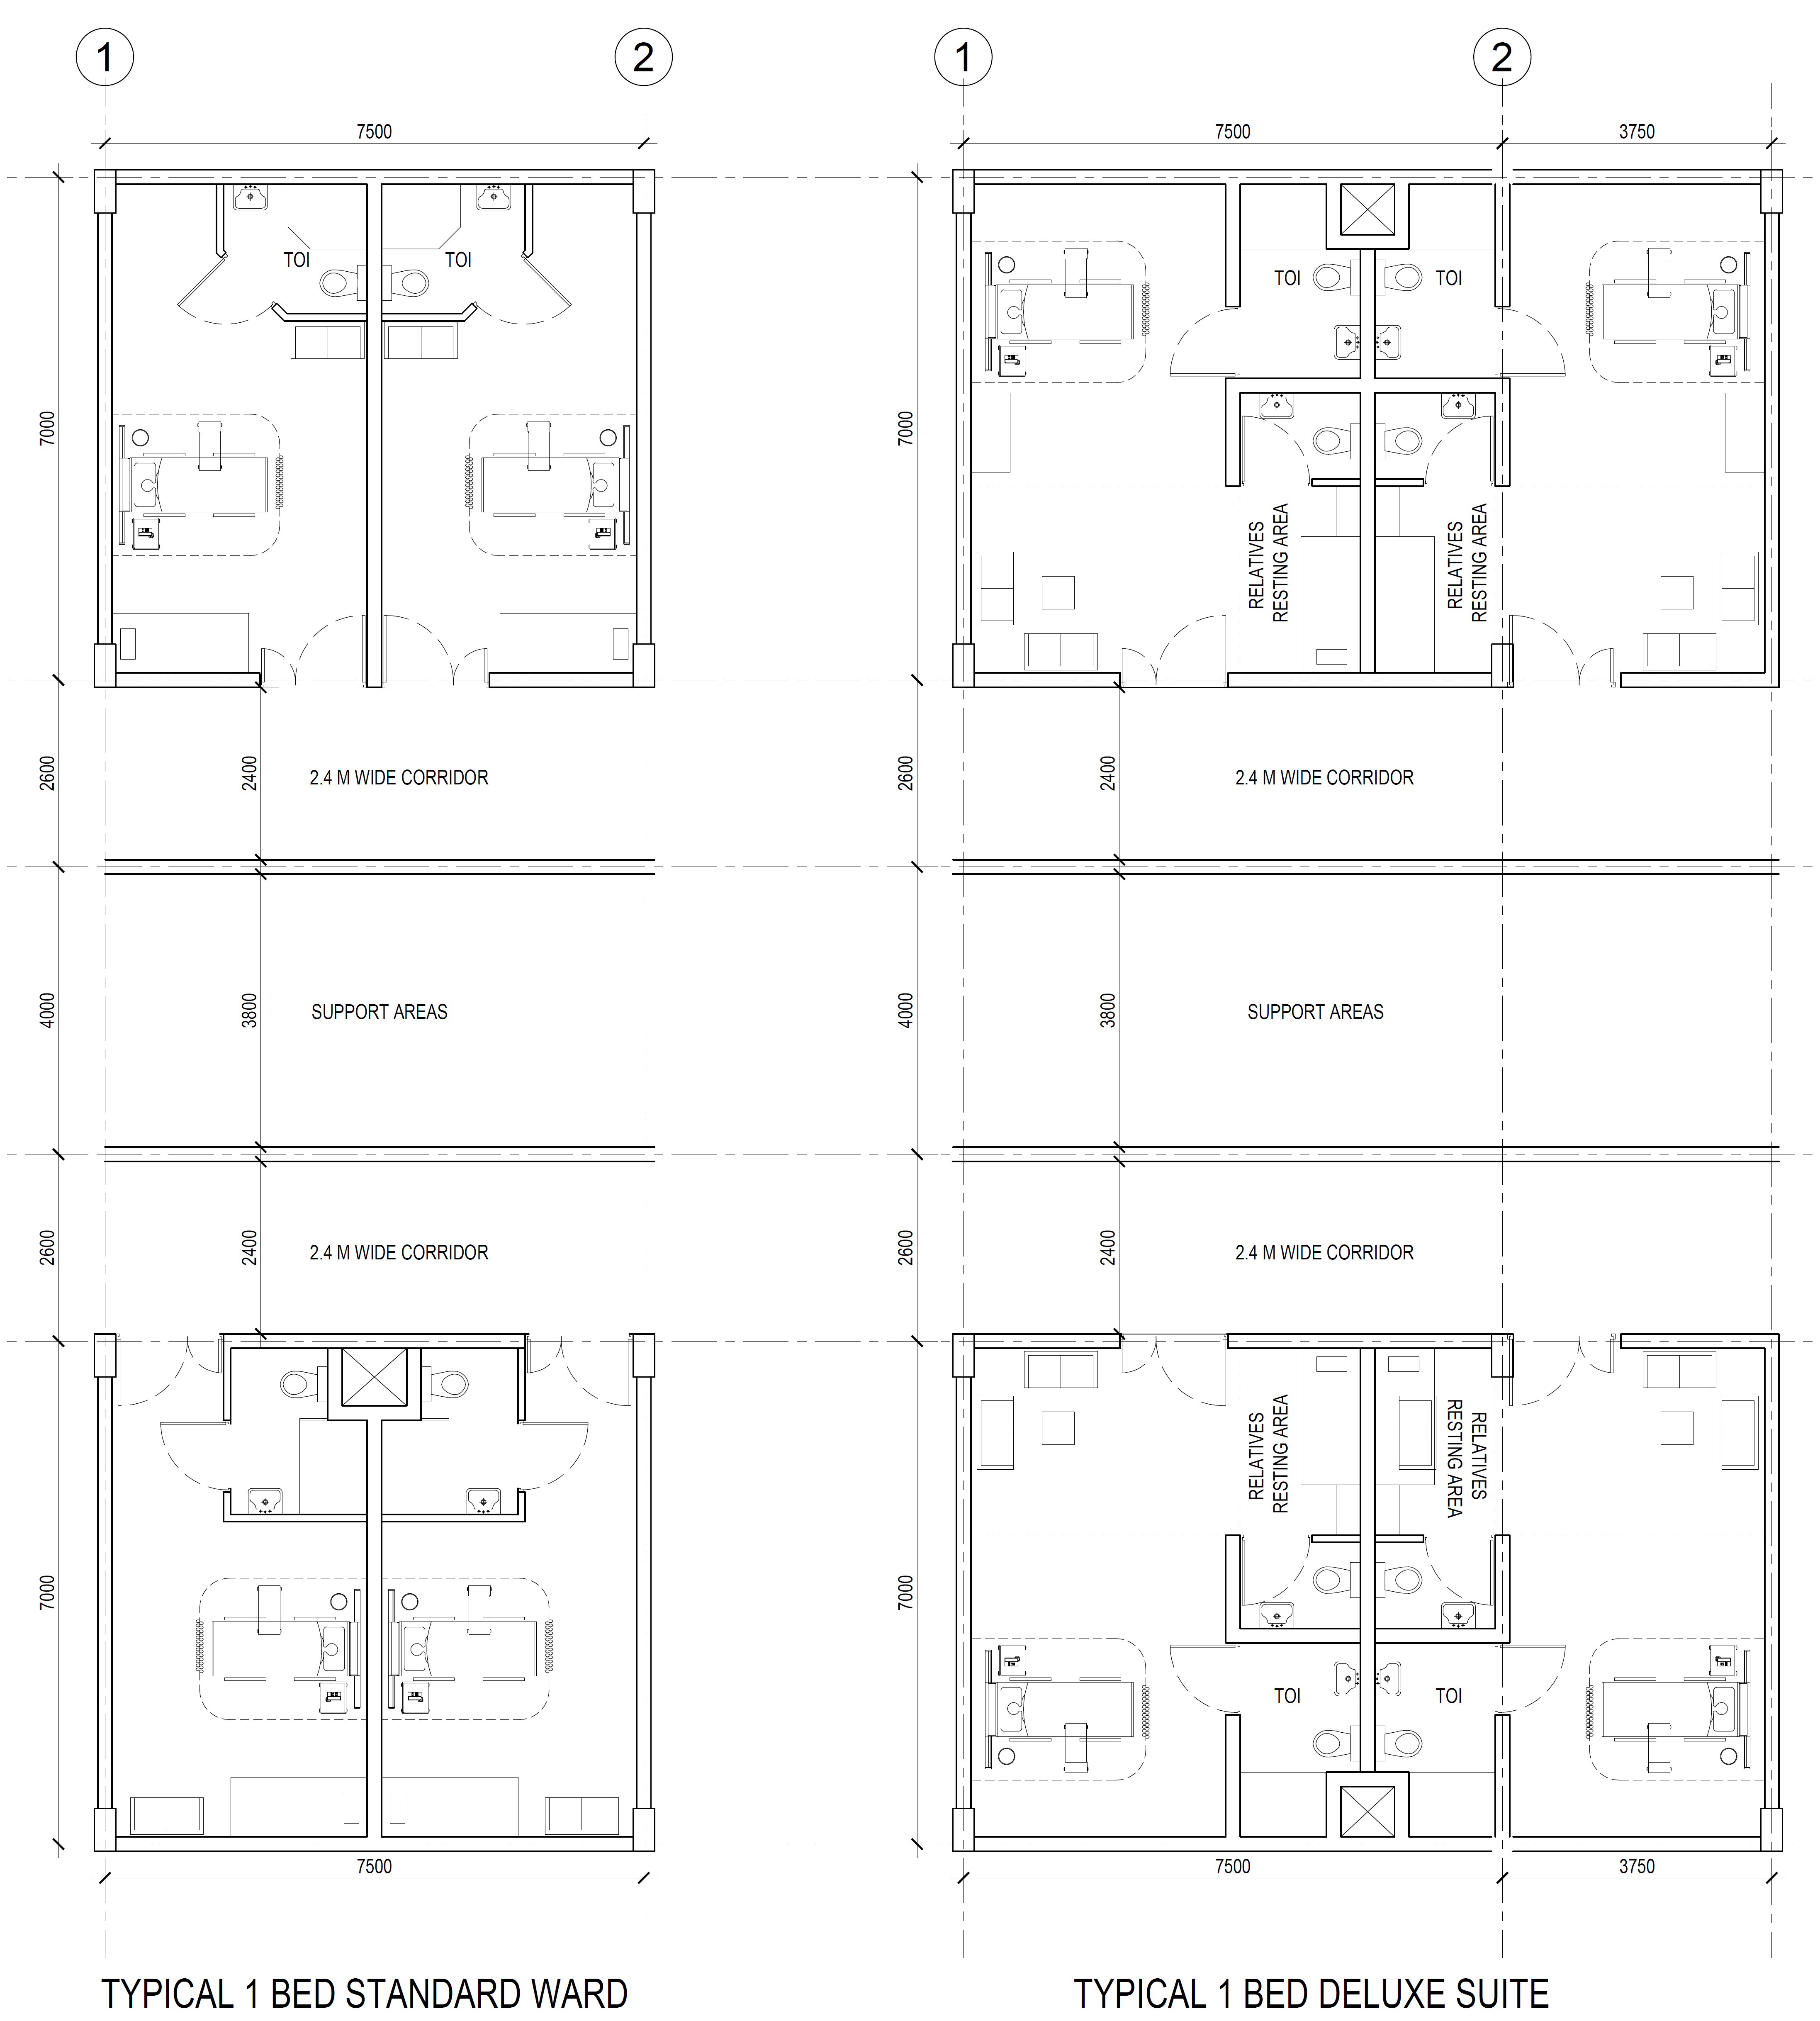
TYPICAL STANDARD WARD & DELUXE SUITE PLANS

Slide 25
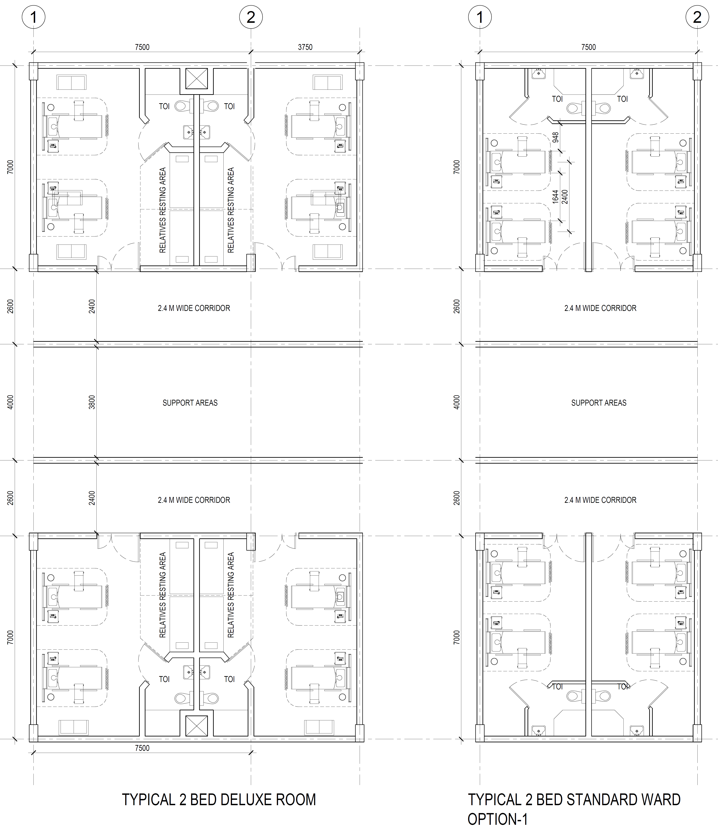
TYPICAL STANDARD WARD & DELUXE SUITE PLANS

Slide 26
Thank you

