Slide 1
RESIDENCE OF MRS JYOTI & MR. SHEKHAR REDDY, HYDERABAD
OPTION – 16 PLANS
JANUARY 2023

Slide 2
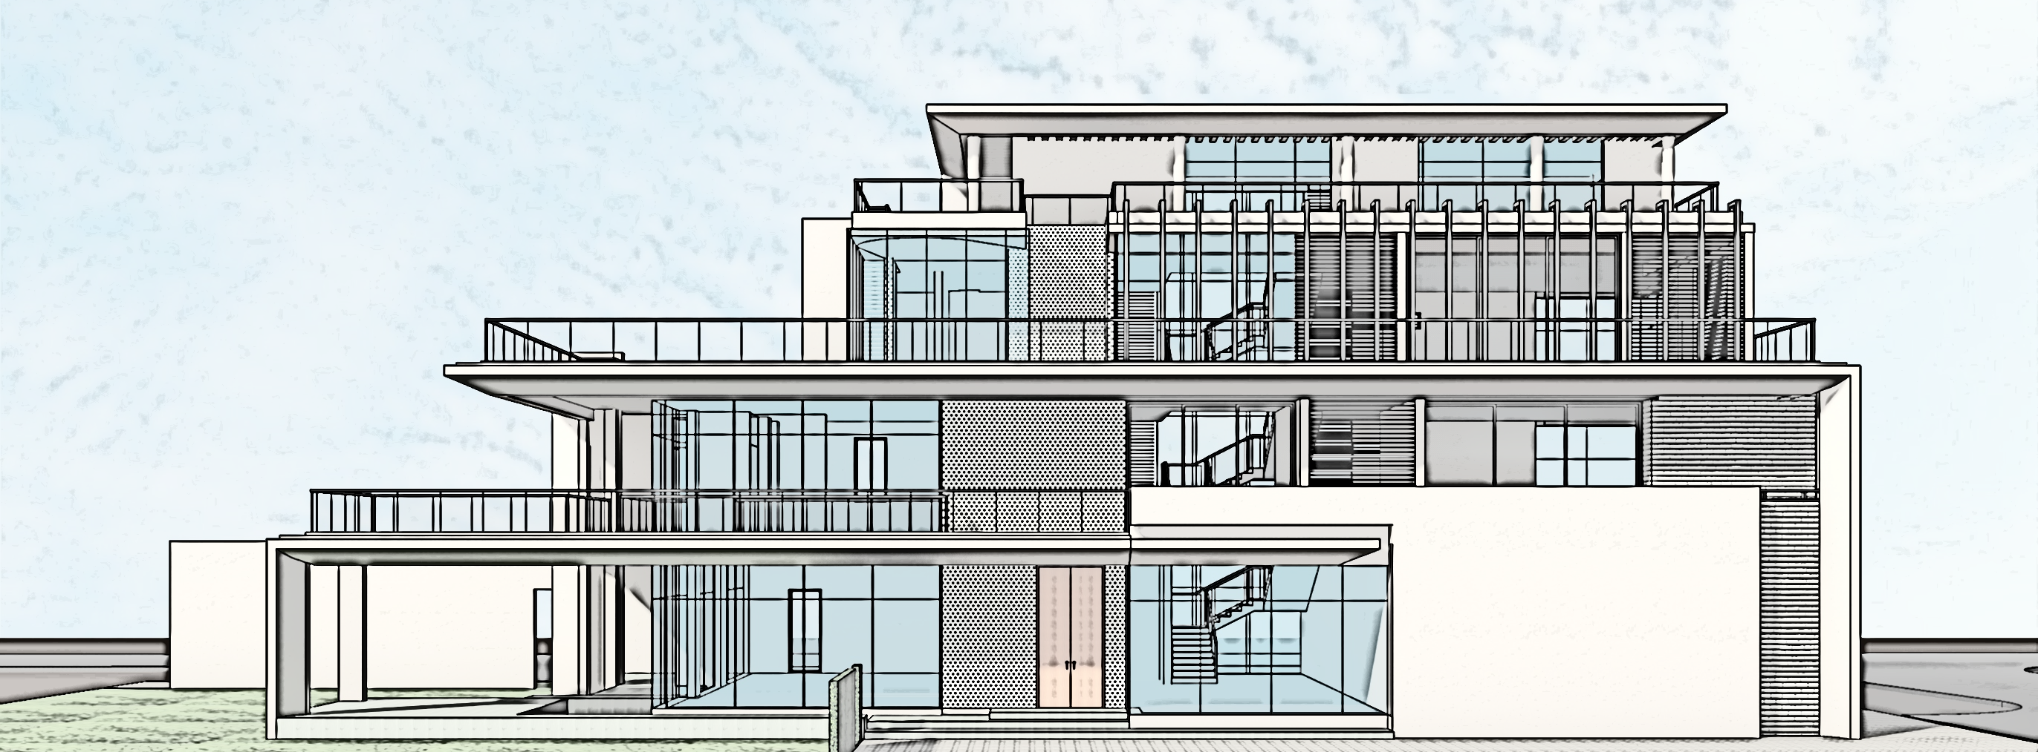
RESIDENCE OF MRS JYOTI & MR. SHEKHAR REDDY, HYDERABAD
OPTION –15- CONCEPT PRESENTATION
JANUARY 2023

Slide 3
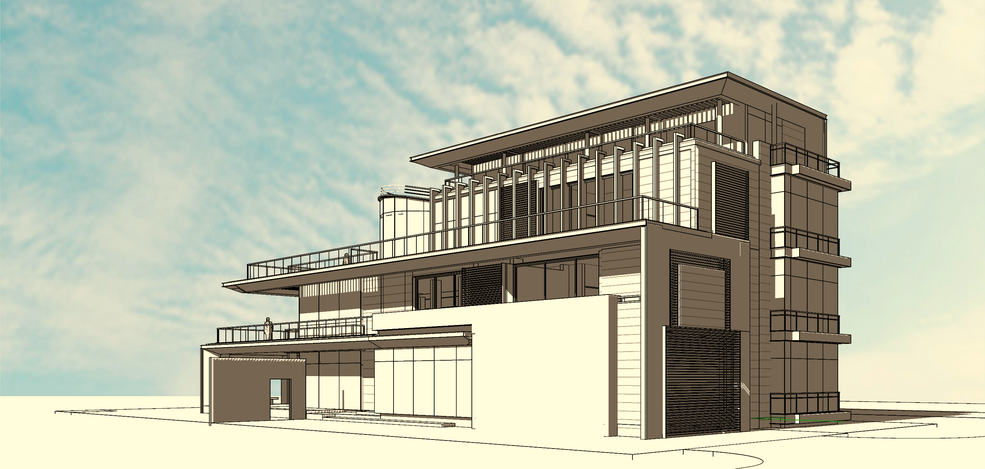
| RESIDENCE OF MRS JYOTI & MR. SHEKHAR REDDY | AREA STATEMENT & BLOCK COSTING |

Slide 4

| RESIDENCE OF MRS JYOTI & MR. SHEKHAR REDDY | PLANS|

Slide 5







| RESIDENCE OF MRS JYOTI & MR. SHEKHAR REDDY | Option15- GROUND FLOOR PLAN – Grid Plan

Slide 6
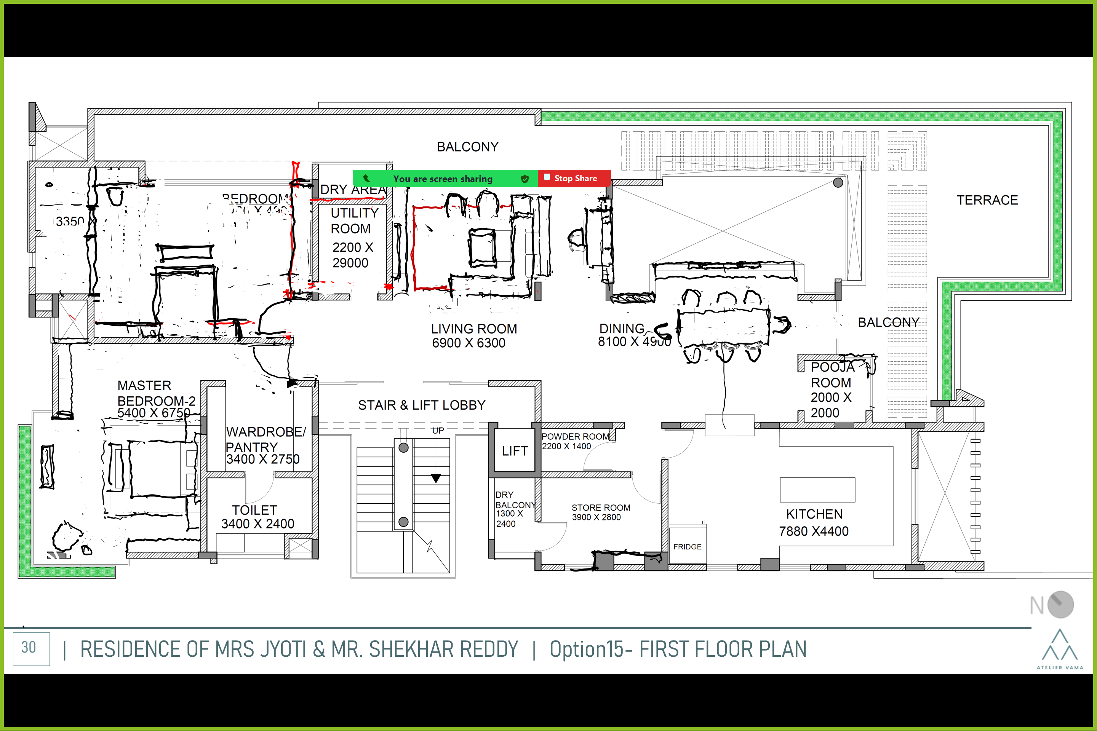


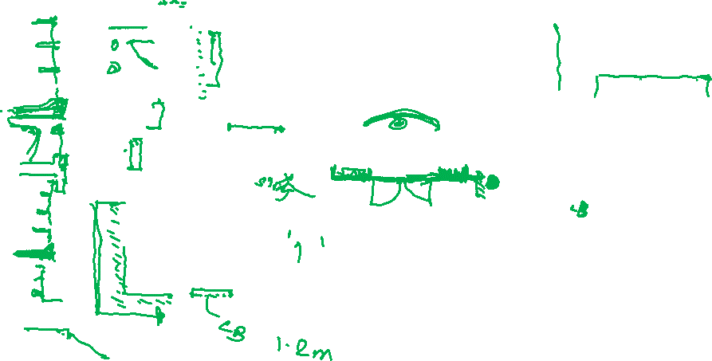






Slide 7
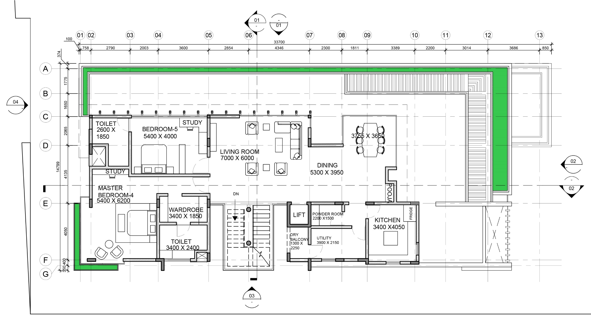

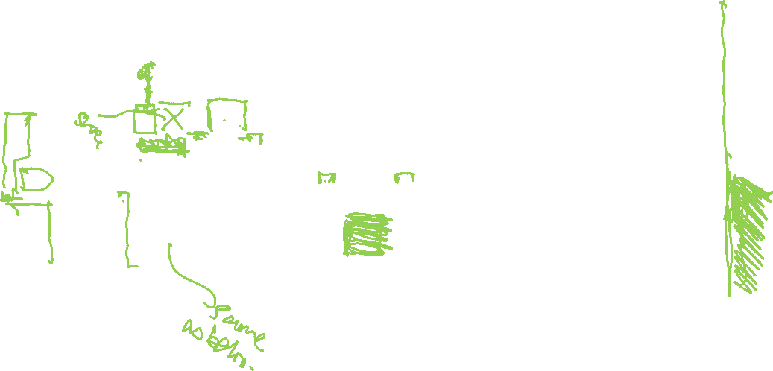


SECOND FLOOR PLAN
| RESIDENCE OF MRS JYOTI & MR. SHEKHAR REDDY | Schematic Line Layout – Second floor plan

Slide 8

| RESIDENCE OF MRS JYOTI & MR. SHEKHAR REDDY | Option15- TERRACE FLOOR PLAN

Slide 9
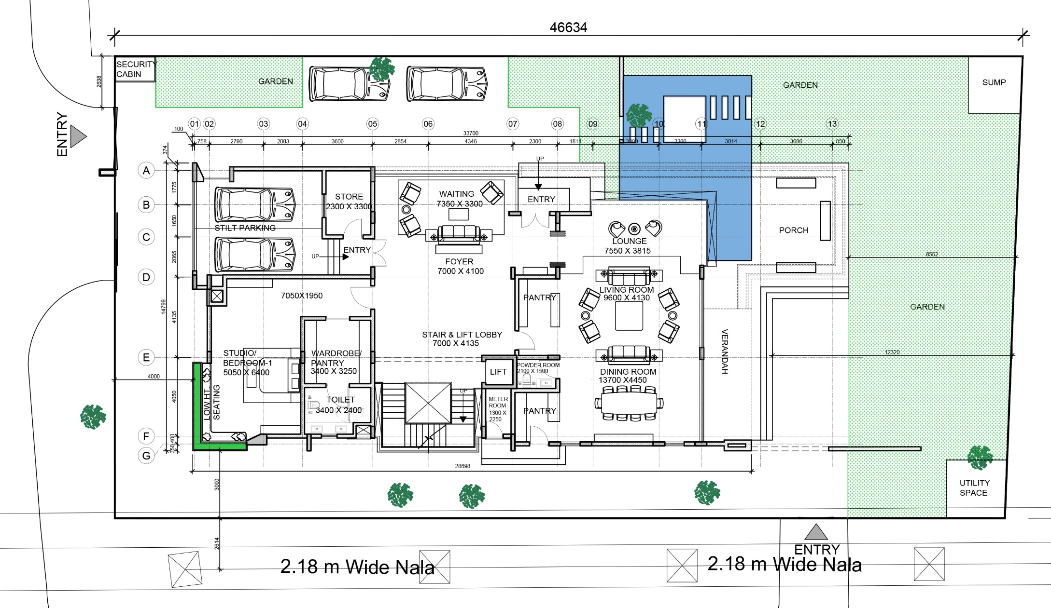
| RESIDENCE OF MRS JYOTI & MR. SHEKHAR REDDY | Option15- GROUND FLOOR PLAN – Grid Plan

Slide 10
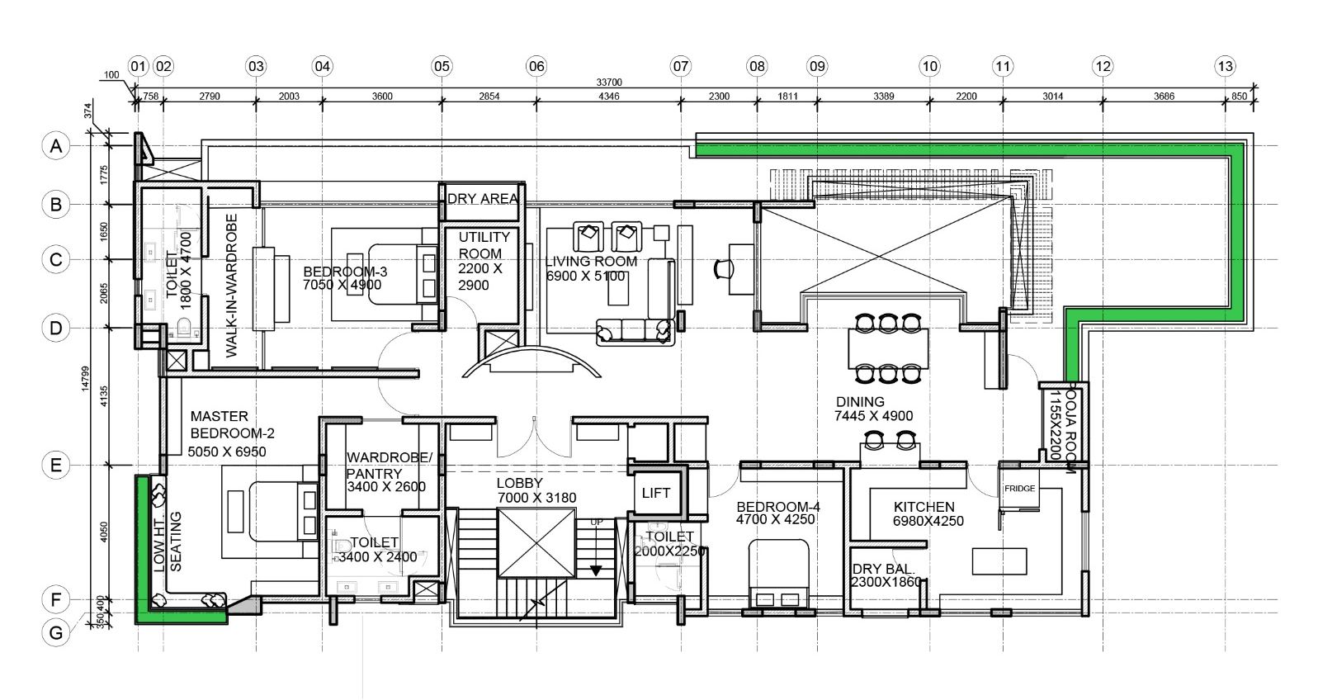
| RESIDENCE OF MRS JYOTI & MR. SHEKHAR REDDY | Option15- FIRST FLOOR PLAN – Grid Plan

Slide 11
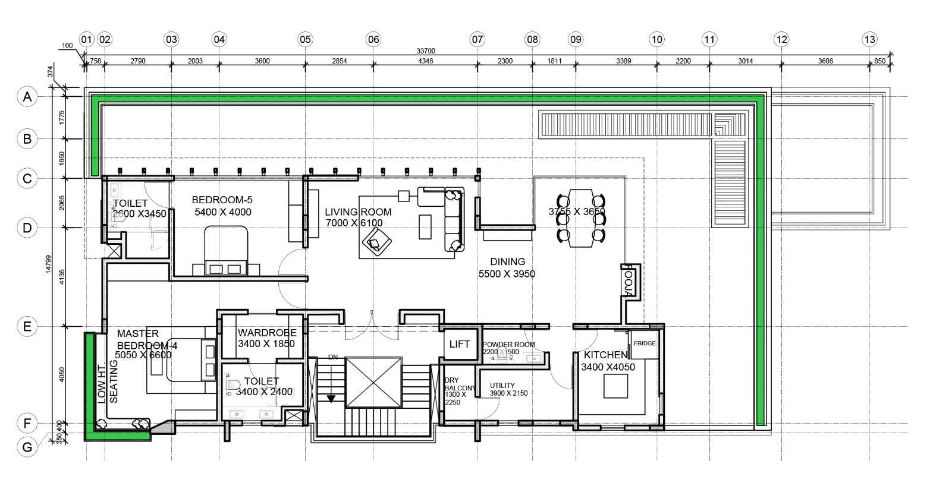
| RESIDENCE OF MRS JYOTI & MR. SHEKHAR REDDY | Option15- SECOND FLOOR PLAN – Grid Plan

Slide 12
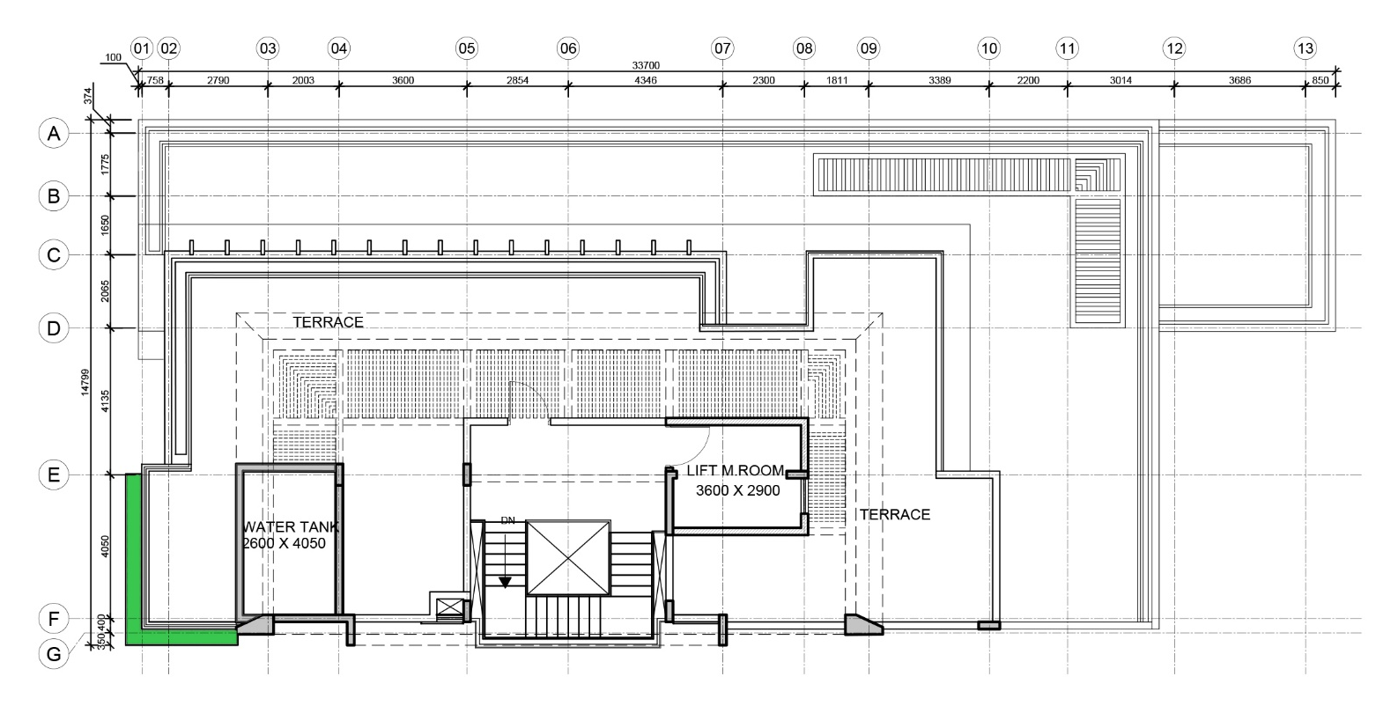
| RESIDENCE OF MRS JYOTI & MR. SHEKHAR REDDY | Option15- TERRACE FLOOR PLAN – Grid Plan

Slide 13
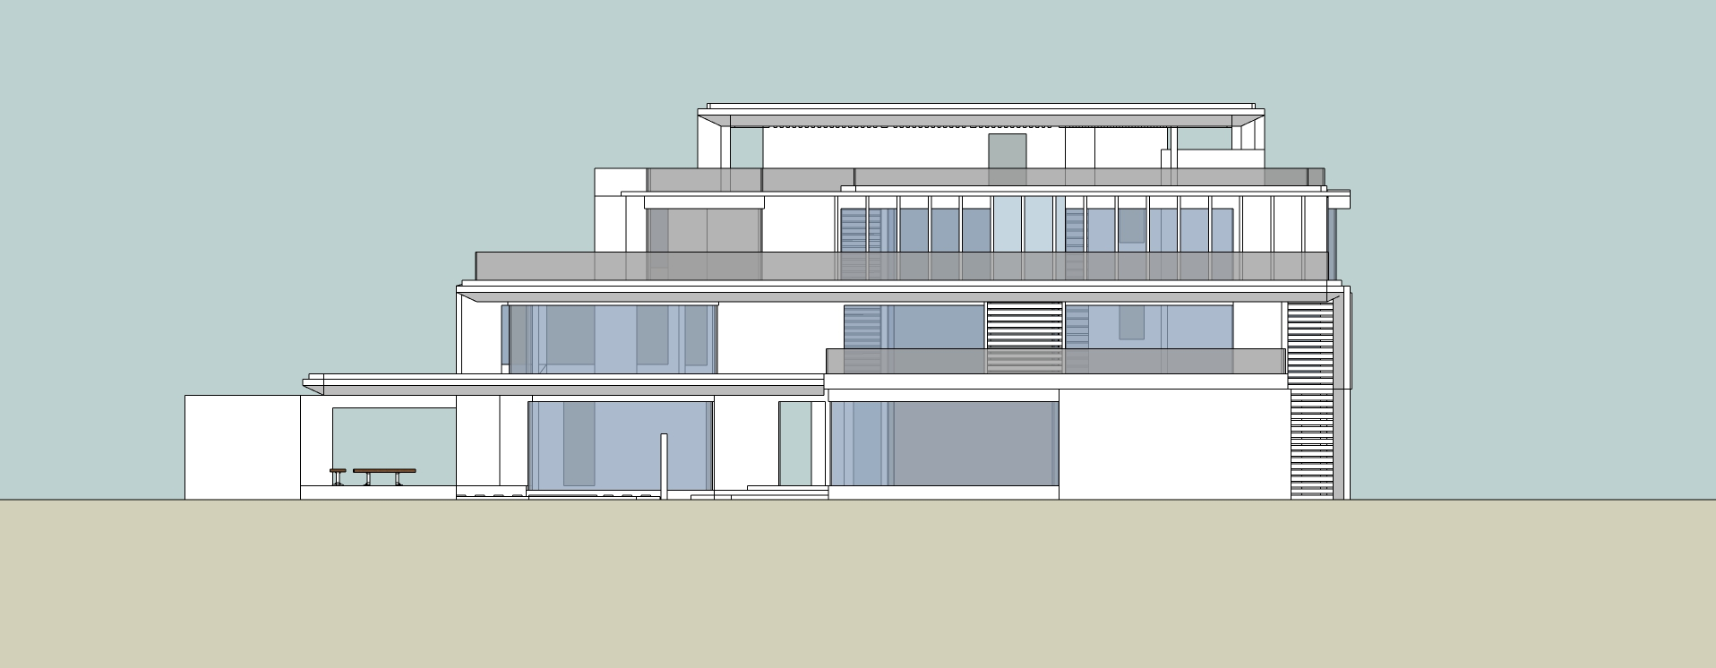
| RESIDENCE OF MRS JYOTI & MR. SHEKHAR REDDY | Option15- ELEVATION - NORTH

Slide 14
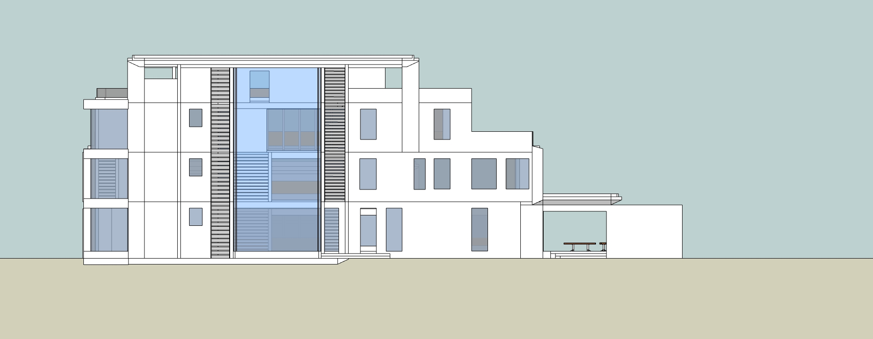
| RESIDENCE OF MRS JYOTI & MR. SHEKHAR REDDY | Option15- ELEVATION -SOUTH

Slide 15
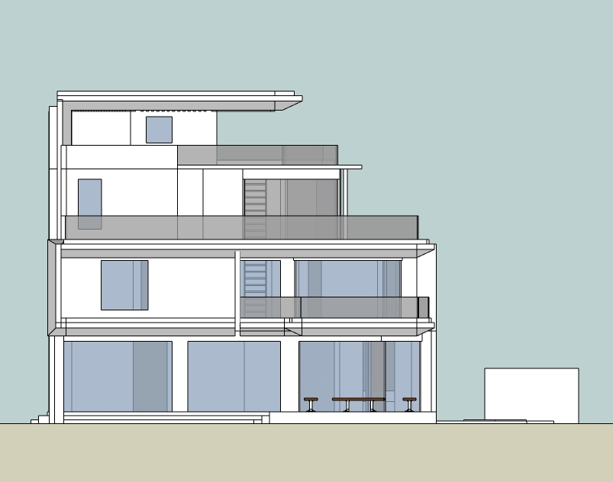
| RESIDENCE OF MRS JYOTI & MR. SHEKHAR REDDY | Option15- ELEVATION –EAST

Slide 16
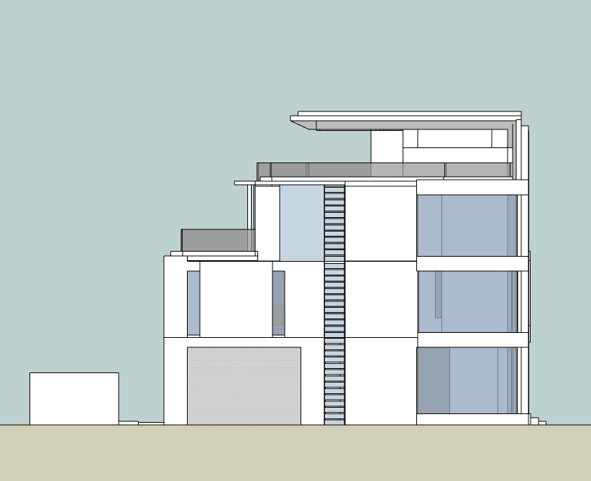
| RESIDENCE OF MRS JYOTI & MR. SHEKHAR REDDY | Option15- ELEVATION -WEST

Slide 17
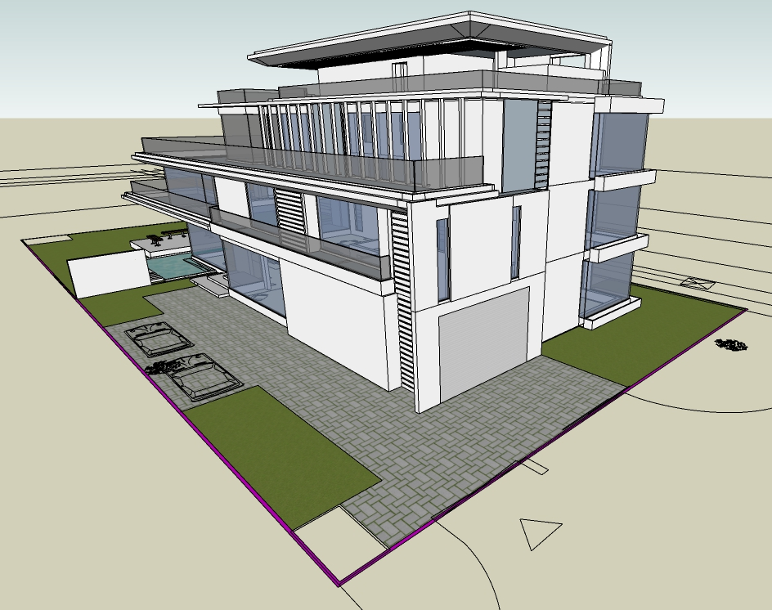
| RESIDENCE OF MRS JYOTI & MR. SHEKHAR REDDY | Option15- VIEW

Slide 18
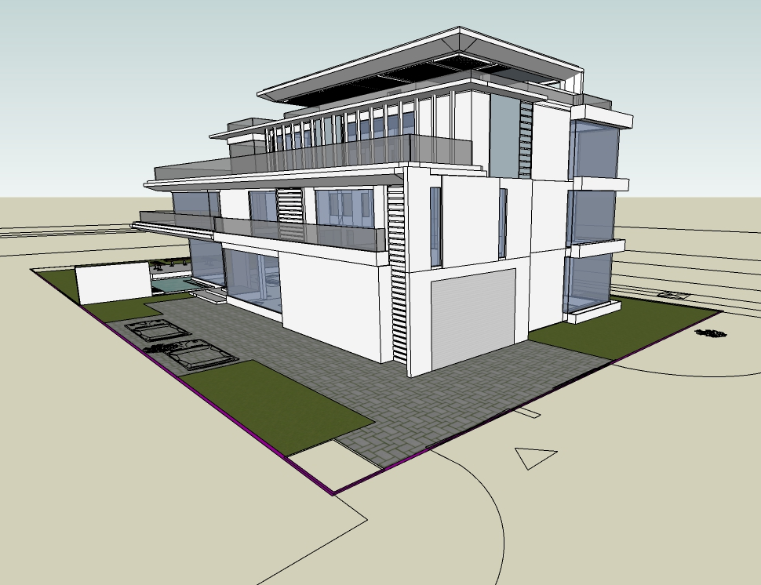
| RESIDENCE OF MRS JYOTI & MR. SHEKHAR REDDY | Option15- VIEW

Slide 19
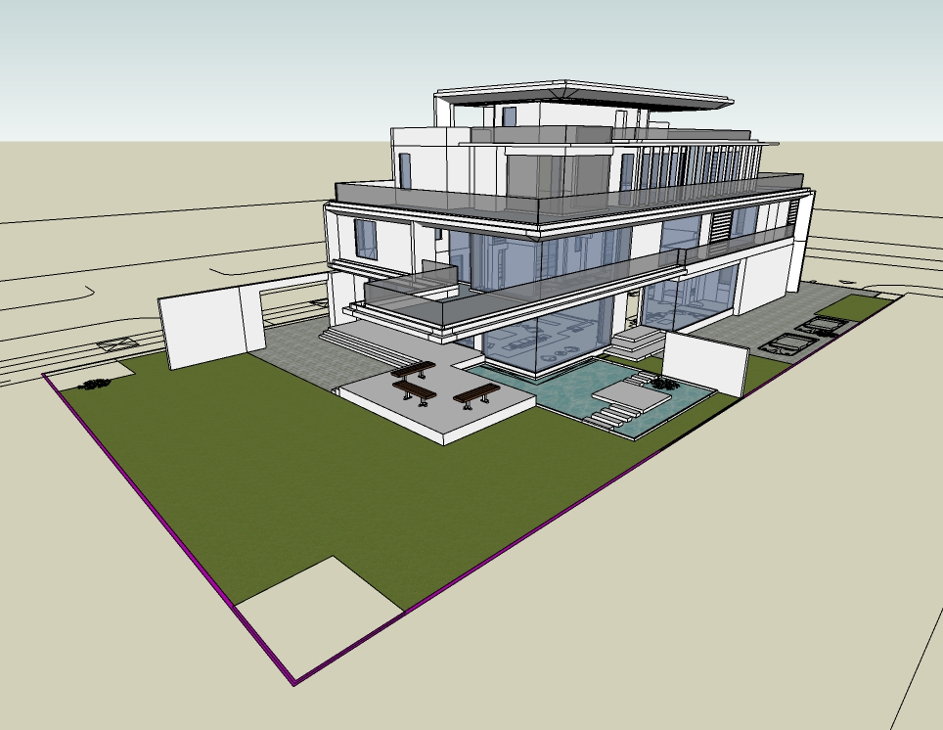
| RESIDENCE OF MRS JYOTI & MR. SHEKHAR REDDY | Option15- VIEW

Slide 20
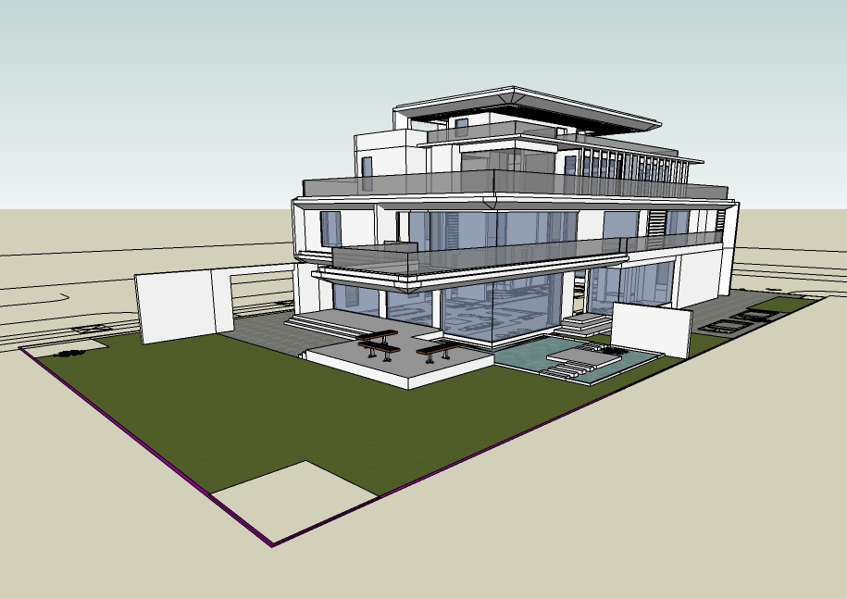
| RESIDENCE OF MRS JYOTI & MR. SHEKHAR REDDY | Option15- VIEW

Slide 21
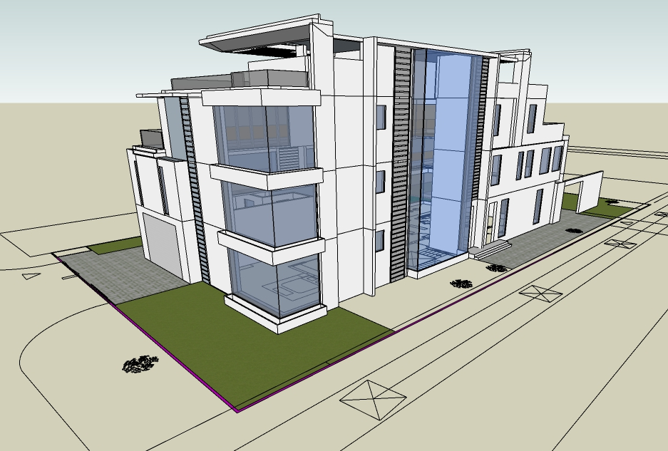
| RESIDENCE OF MRS JYOTI & MR. SHEKHAR REDDY | Option15- VIEW

Slide 22
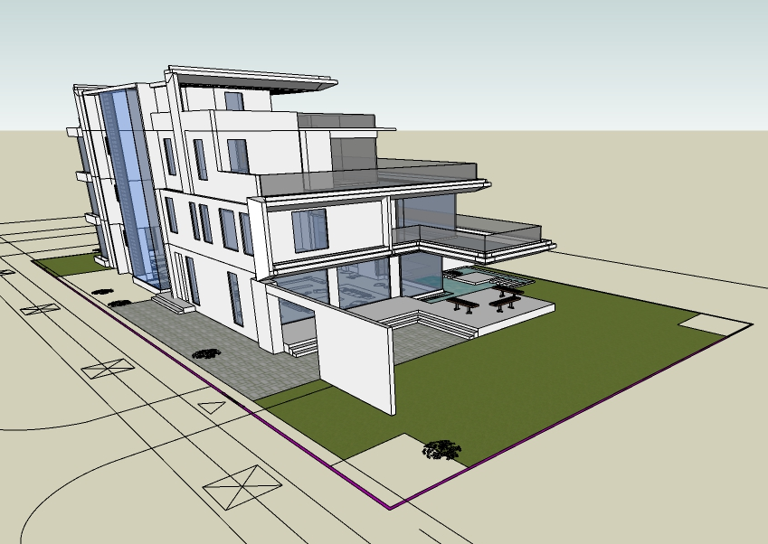
| RESIDENCE OF MRS JYOTI & MR. SHEKHAR REDDY | Option15- VIEW

