Slide 1
RESIDENCE OF MRS JYOTI & MR. SHEKHAR REDDY, HYDERABAD
OPTION – 14B- ELEVATIONS + VIEWS
JANUARY 2023

Slide 2

SITE PLAN
| RESIDENCE OF MRS JYOTI & MR. SHEKHAR REDDY | Schematic Line Layout – Option14- GROUND FLOOR

Slide 3
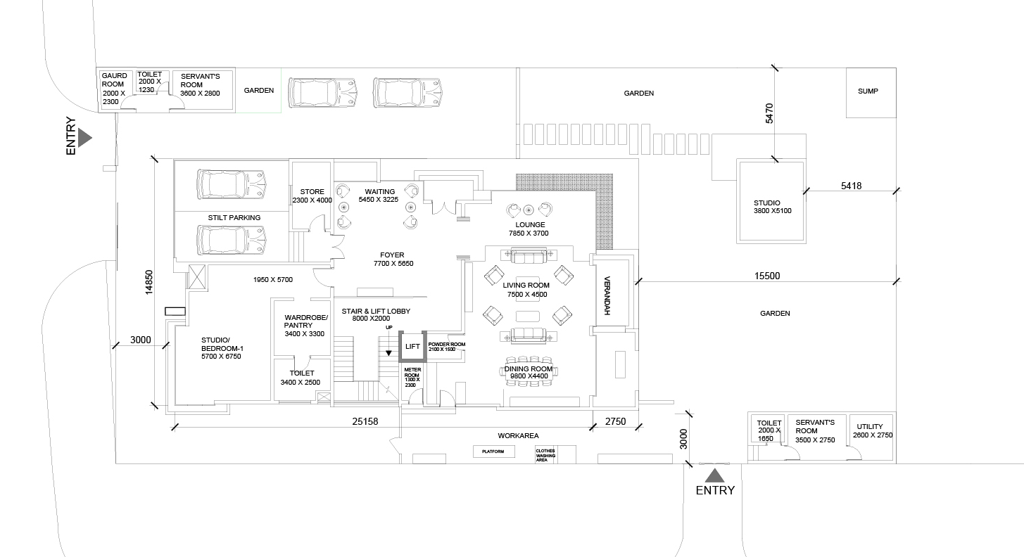
GROUND FLOOR PLAN
| RESIDENCE OF MRS JYOTI & MR. SHEKHAR REDDY | Schematic Line Layout – Option14- GROUND FLOOR

Slide 4
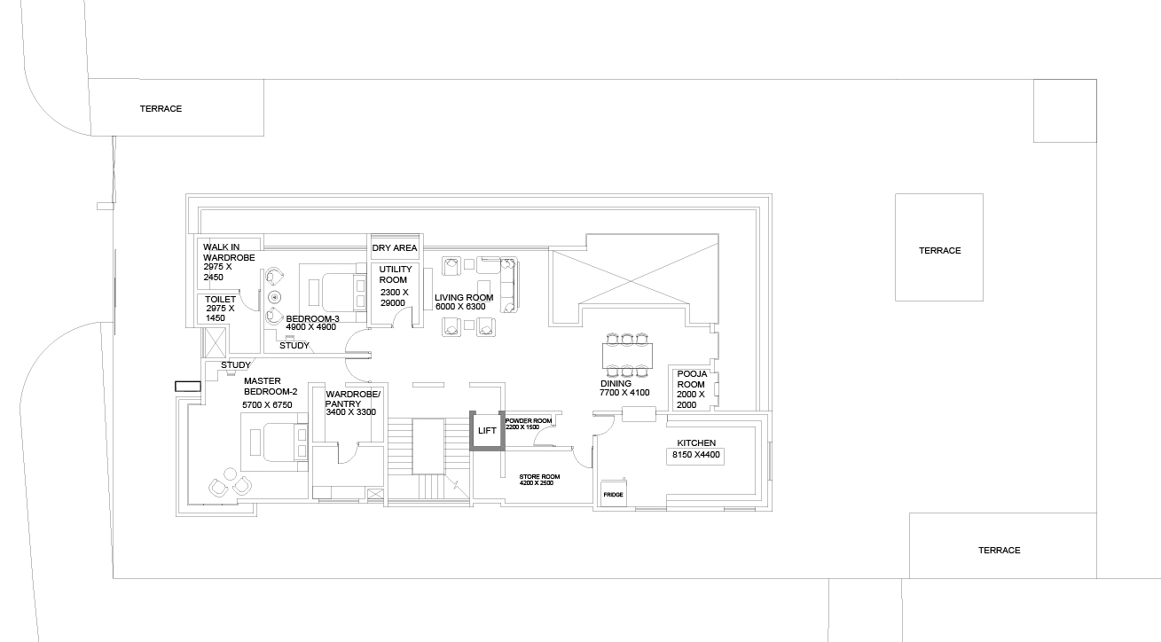
FIRST FLOOR PLAN
| RESIDENCE OF MRS JYOTI & MR. SHEKHAR REDDY | Schematic Line Layout – Option14- GROUND FLOOR

Slide 5
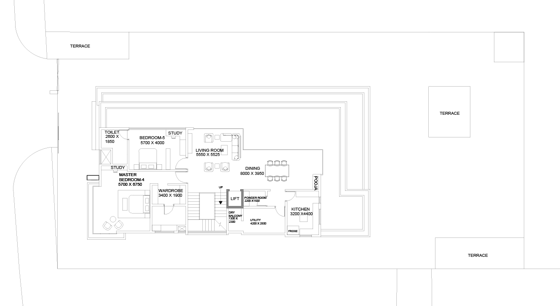
SECOND FLOOR PLAN
| RESIDENCE OF MRS JYOTI & MR. SHEKHAR REDDY | Schematic Line Layout – Option14- GROUND FLOOR

Slide 6
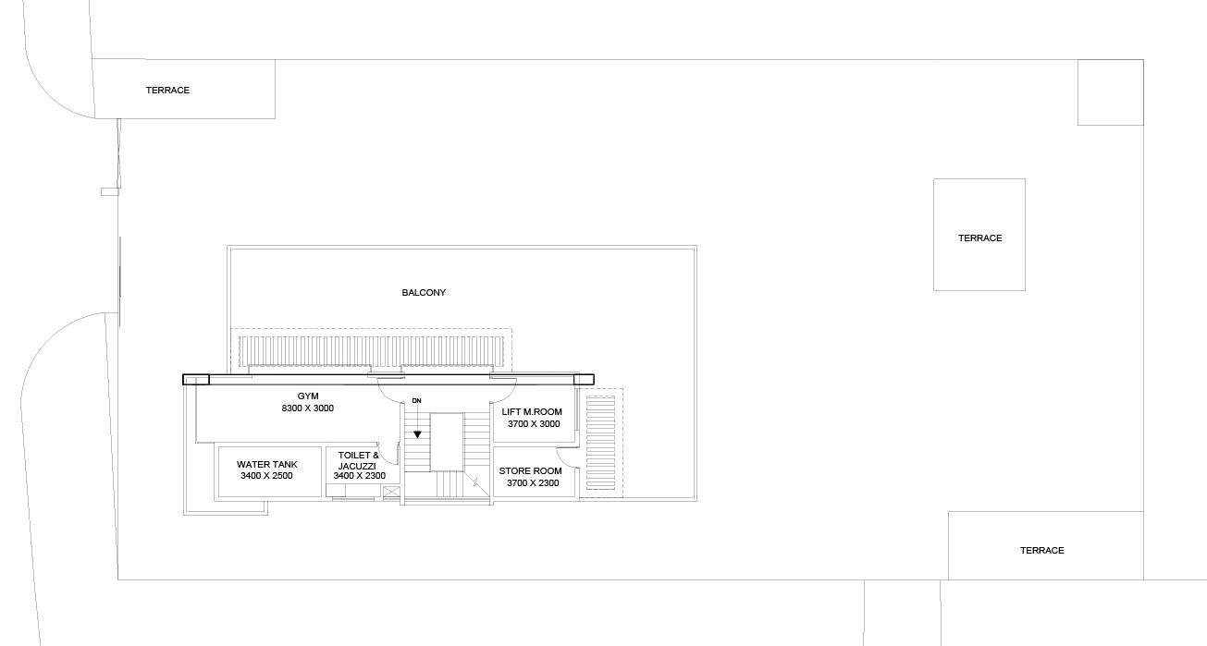
TERRACE LEVEL PLAN
| RESIDENCE OF MRS JYOTI & MR. SHEKHAR REDDY | Schematic Line Layout – Option14- GROUND FLOOR

Slide 7
REFERENCE SKETCH
| RESIDENCE OF MRS JYOTI & MR. SHEKHAR REDDY | Schematic Line Layout – Option14- GROUND FLOOR

Slide 8
REFERENCE SKETCH
| RESIDENCE OF MRS JYOTI & MR. SHEKHAR REDDY | Schematic Line Layout – Option14- GROUND FLOOR

Slide 9
REFERENCE SKETCH
| RESIDENCE OF MRS JYOTI & MR. SHEKHAR REDDY | Schematic Line Layout – Option14- GROUND FLOOR

Slide 10
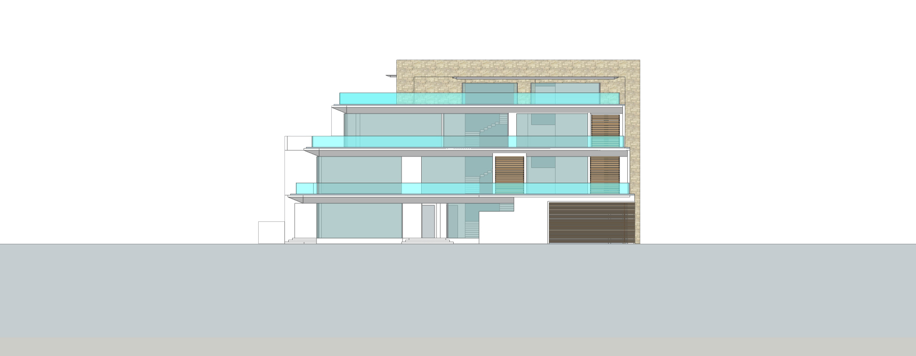
NORTH ELEVATION
| RESIDENCE OF MRS JYOTI & MR. SHEKHAR REDDY | Schematic Line Layout – Option14- GROUND FLOOR

Slide 11
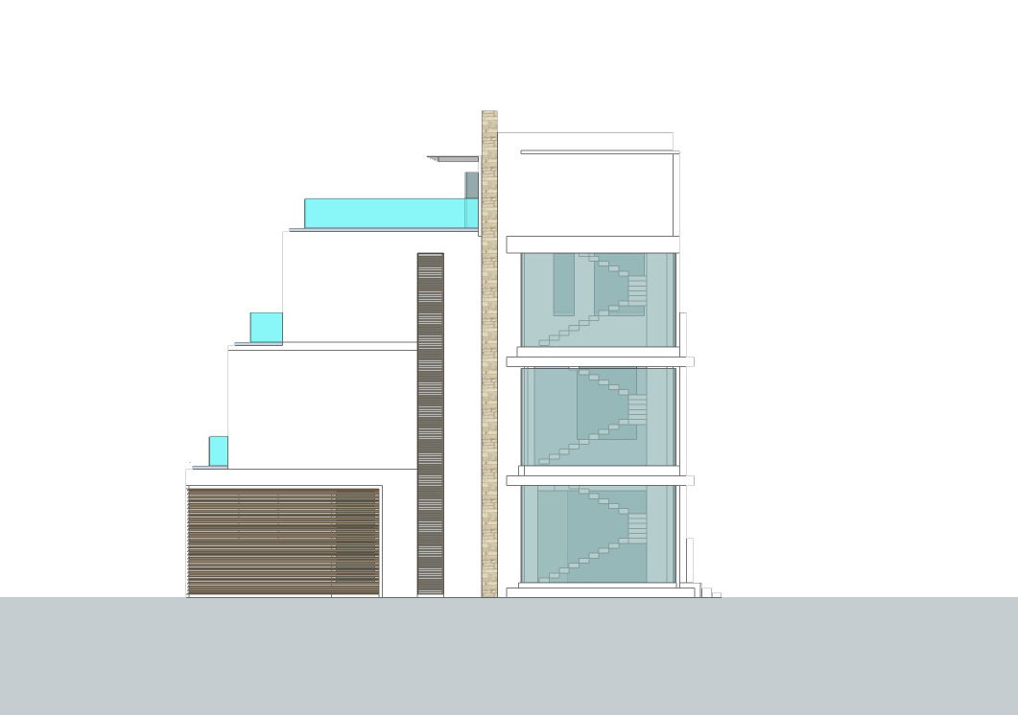
WEST ELEVATION
| RESIDENCE OF MRS JYOTI & MR. SHEKHAR REDDY | Schematic Line Layout – Option14- GROUND FLOOR

Slide 12
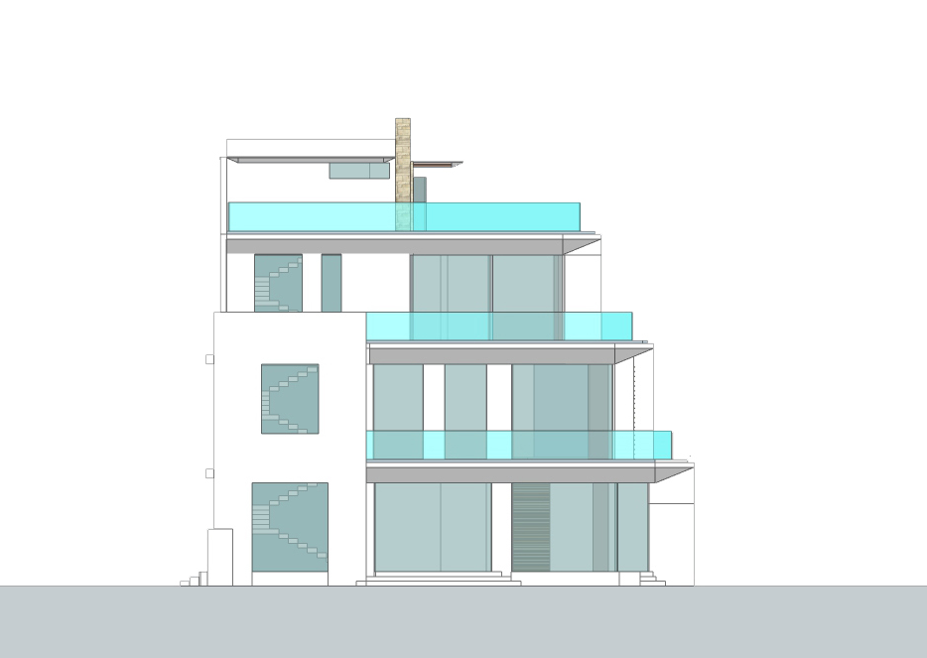
EAST ELEVATION
| RESIDENCE OF MRS JYOTI & MR. SHEKHAR REDDY | Schematic Line Layout – Option14- GROUND FLOOR

Slide 13
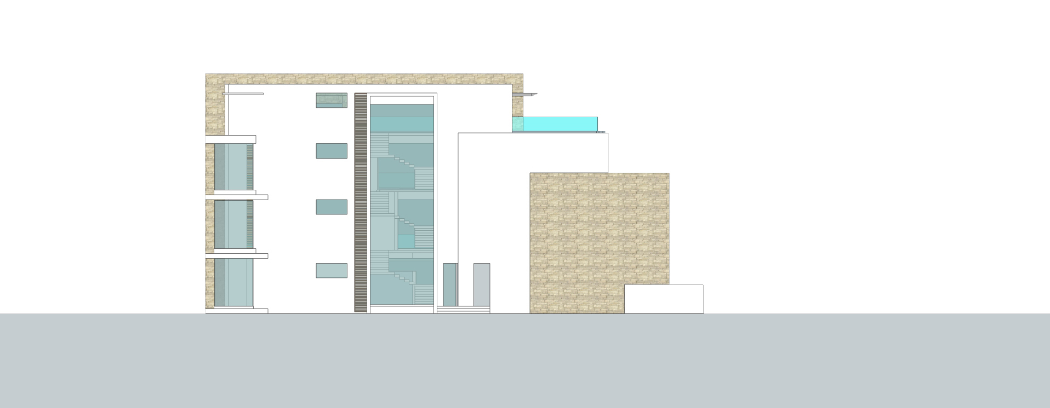
SOUTH ELEVATION
| RESIDENCE OF MRS JYOTI & MR. SHEKHAR REDDY | Schematic Line Layout – Option14- GROUND FLOOR

Slide 14
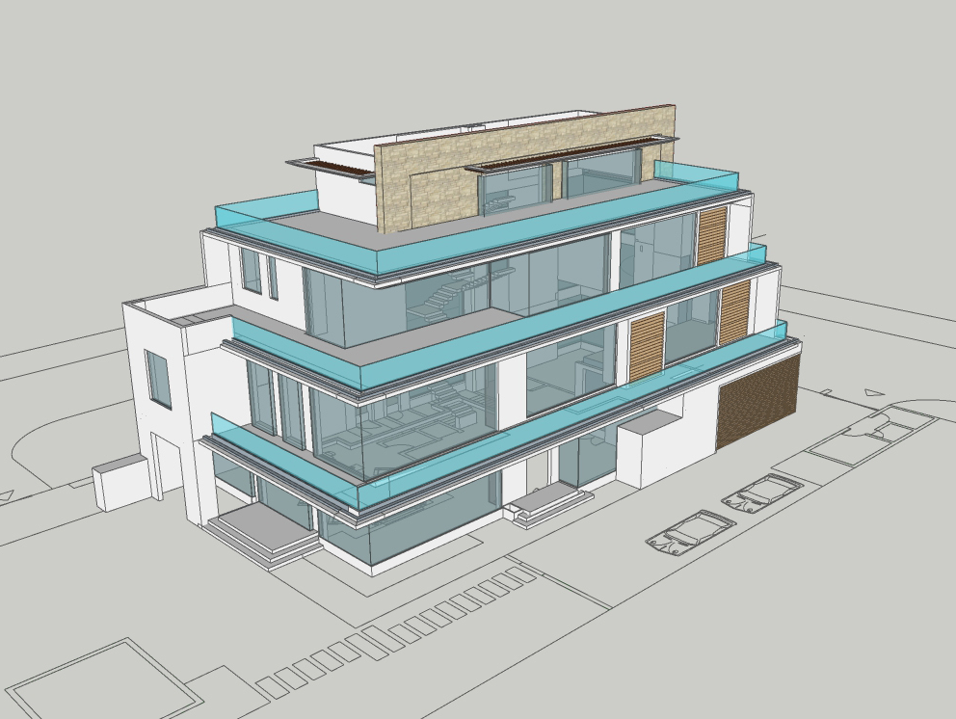
VIEW - 01
| RESIDENCE OF MRS JYOTI & MR. SHEKHAR REDDY | Schematic Line Layout – Option14- GROUND FLOOR

Slide 15
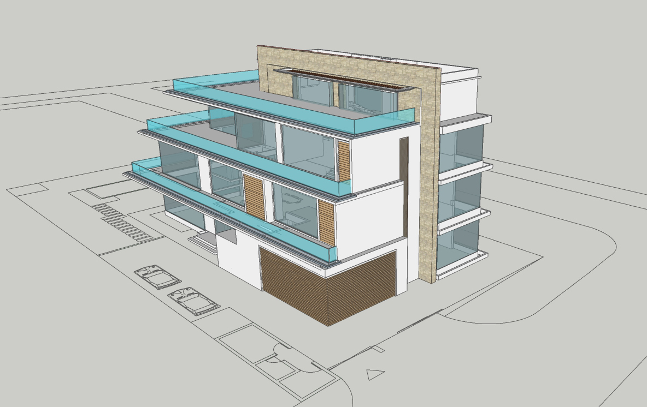
VIEW - 02
| RESIDENCE OF MRS JYOTI & MR. SHEKHAR REDDY | Schematic Line Layout – Option14- GROUND FLOOR

Slide 16
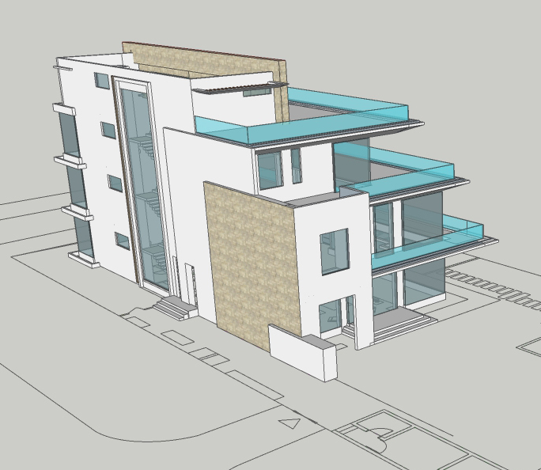
VIEW - 03
| RESIDENCE OF MRS JYOTI & MR. SHEKHAR REDDY | Schematic Line Layout – Option14- GROUND FLOOR

Slide 17
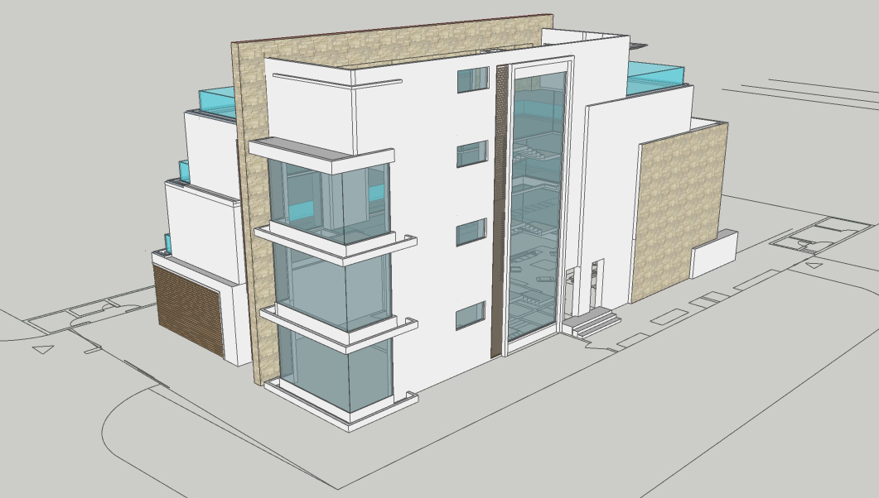
VIEW - 04
| RESIDENCE OF MRS JYOTI & MR. SHEKHAR REDDY | Schematic Line Layout – Option14- GROUND FLOOR

