Slide 1
REFERENCES FOR RESIDENCE OF MRS JYOTHI & MR. SHEKHAR REDDY
September 2021

Slide 2
REFERENCES FOR EXTERIORS

Slide 3
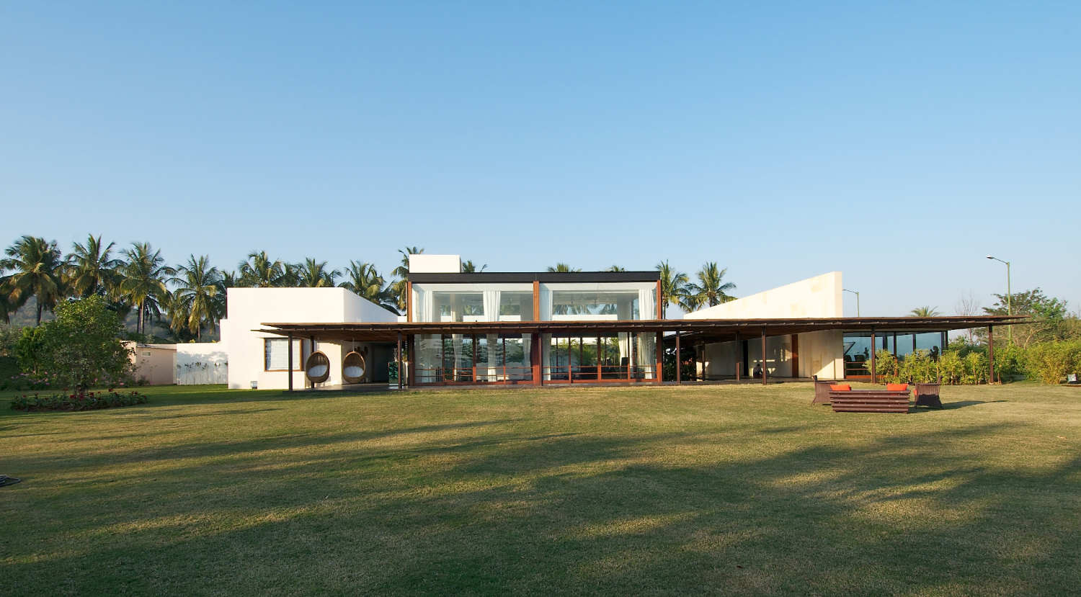
Khadakvasla House, Pune
| RESIDENCE OF MRS JYOTHI & MR. SHEKHAR REDDY | EXTERIOR REFERENCES |

Slide 4
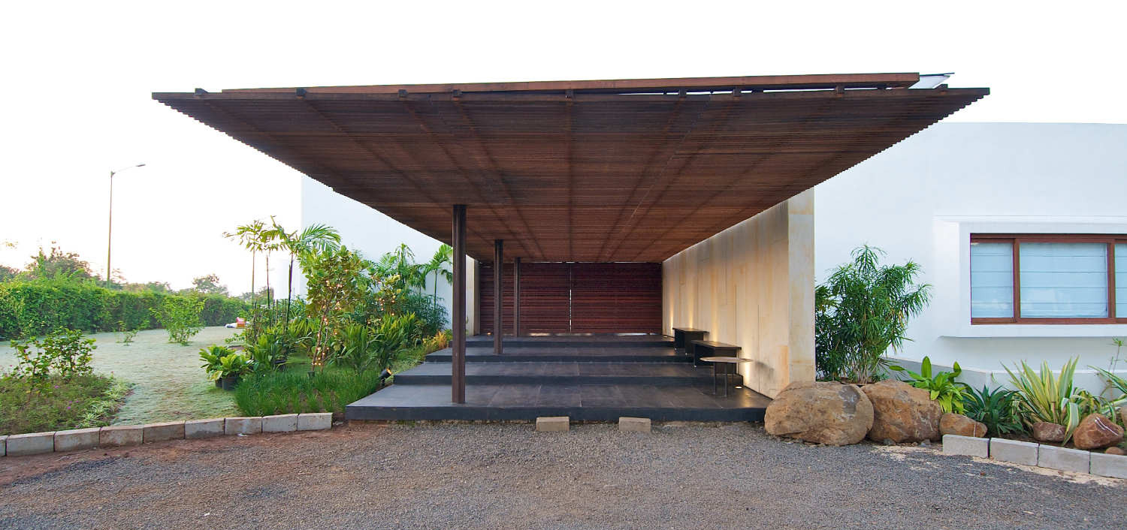
Khadakvasla House, Pune
| RESIDENCE OF MRS JYOTHI & MR. SHEKHAR REDDY | EXTERIOR REFERENCES |

Slide 5
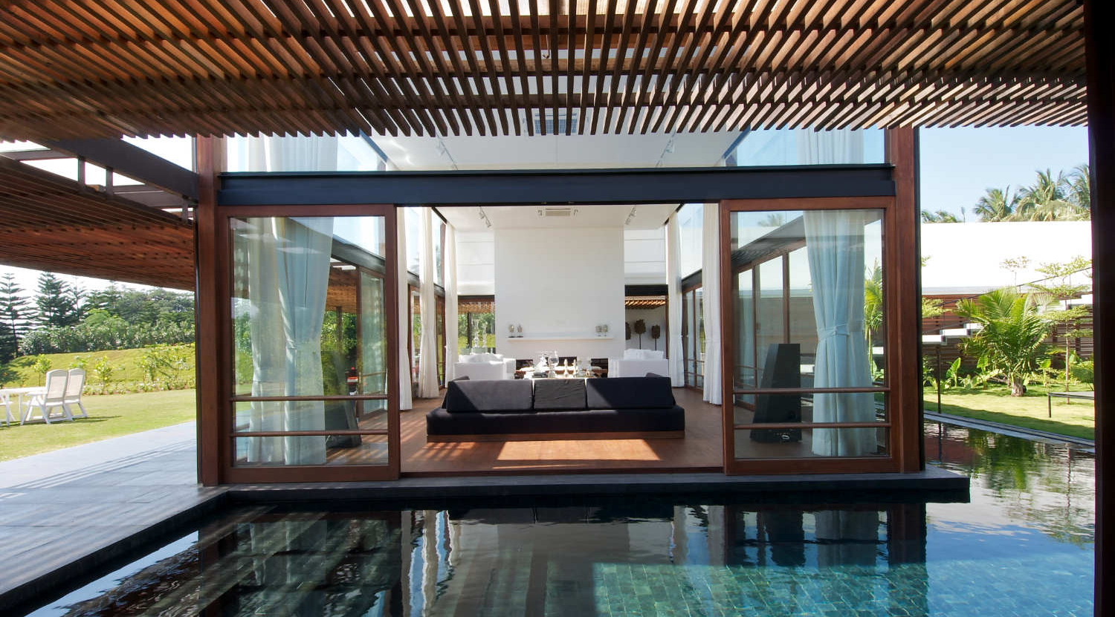
Khadakvasla House, Pune
| RESIDENCE OF MRS JYOTHI & MR. SHEKHAR REDDY | EXTERIOR REFERENCES |

Slide 6
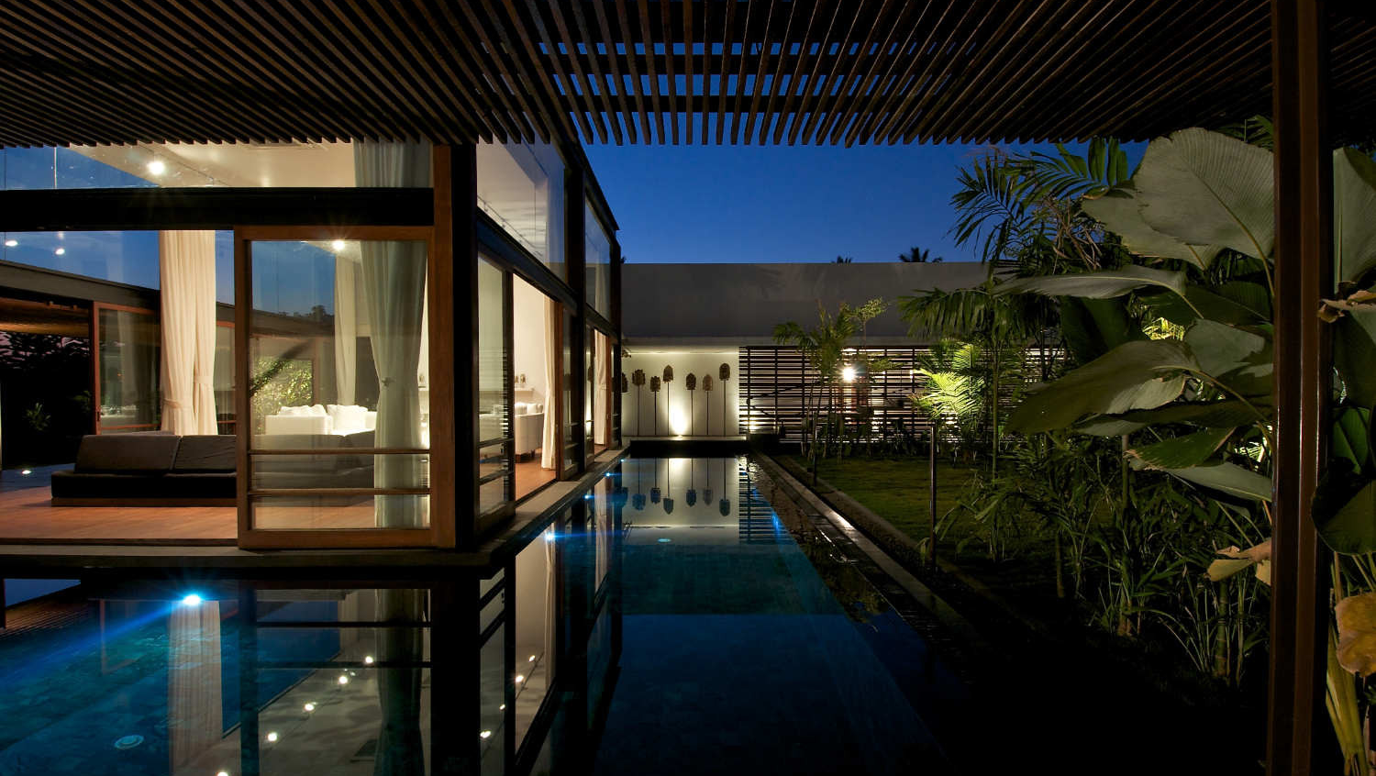
Khadakvasla House, Pune
| RESIDENCE OF MRS JYOTHI & MR. SHEKHAR REDDY | EXTERIOR REFERENCES |

Slide 7
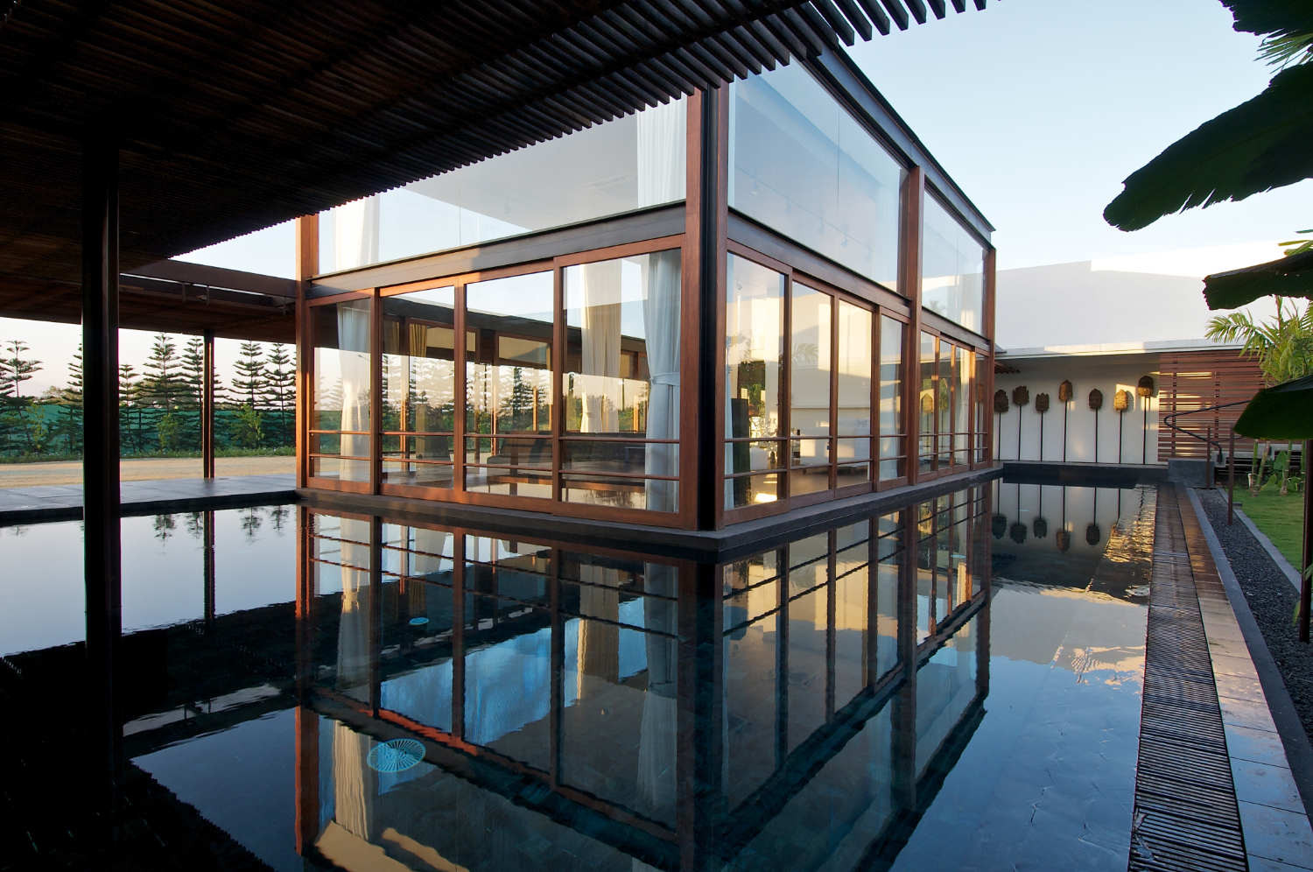
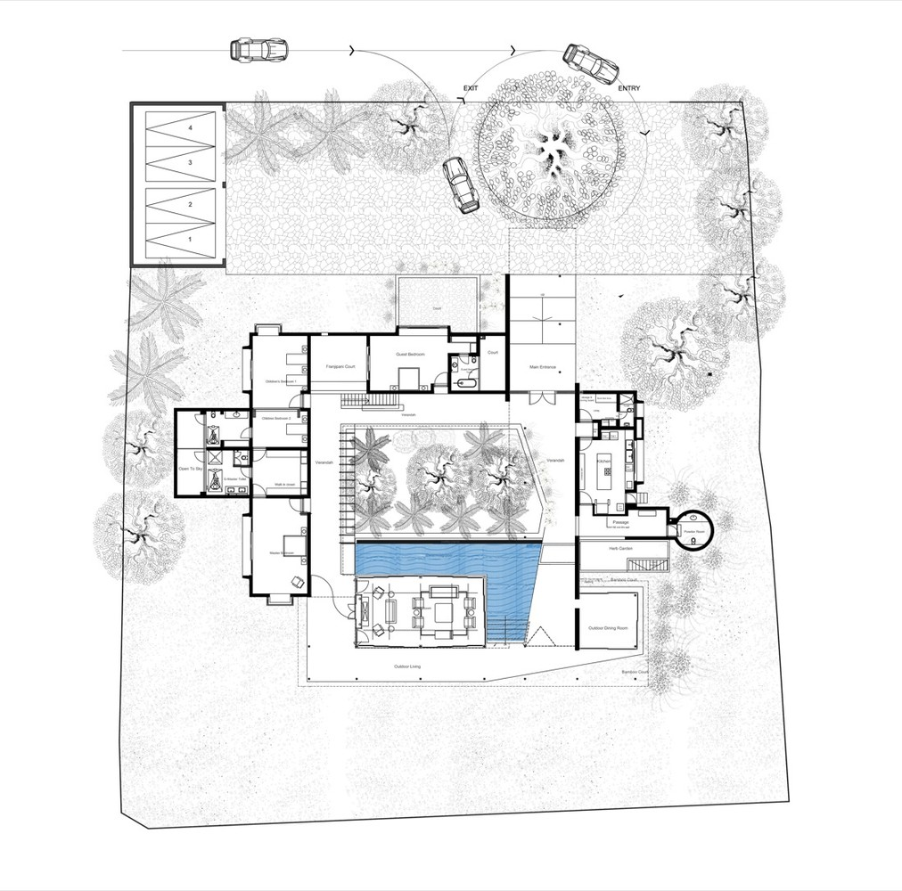
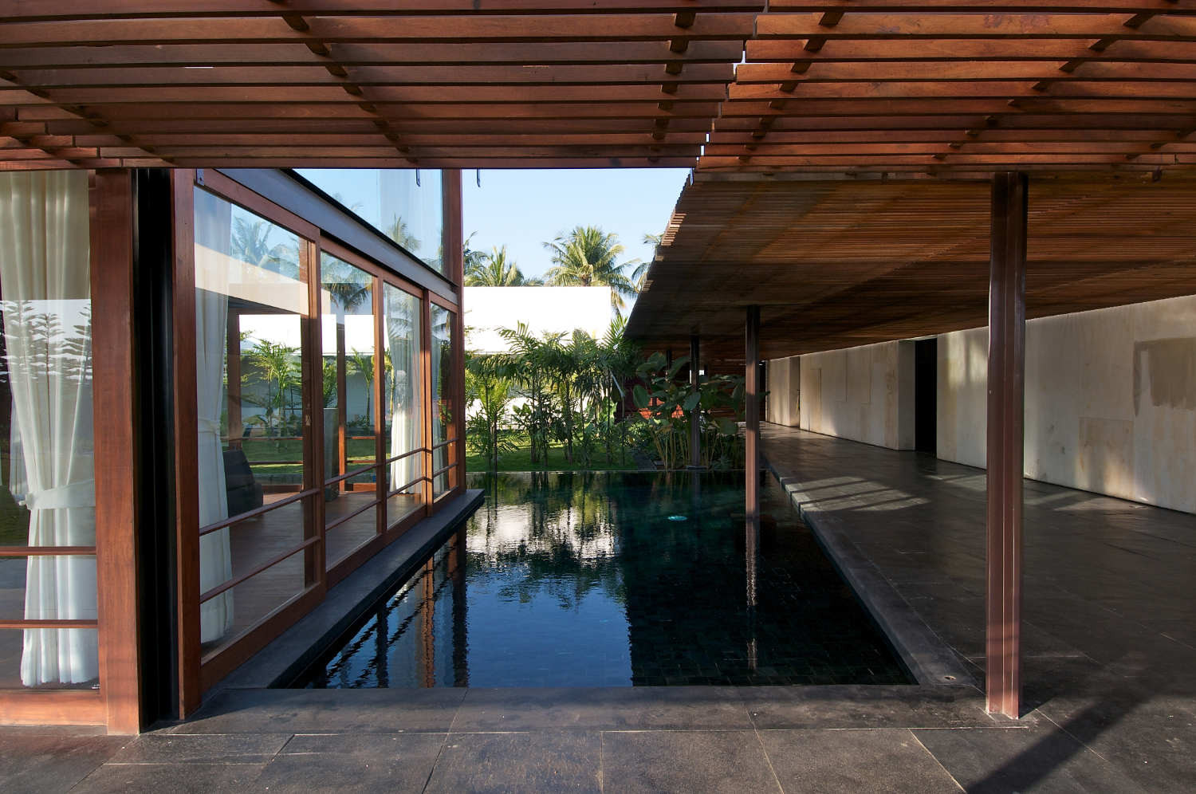
Khadakvasla House, Pune
| RESIDENCE OF MRS JYOTHI & MR. SHEKHAR REDDY | EXTERIOR REFERENCES |

Slide 8
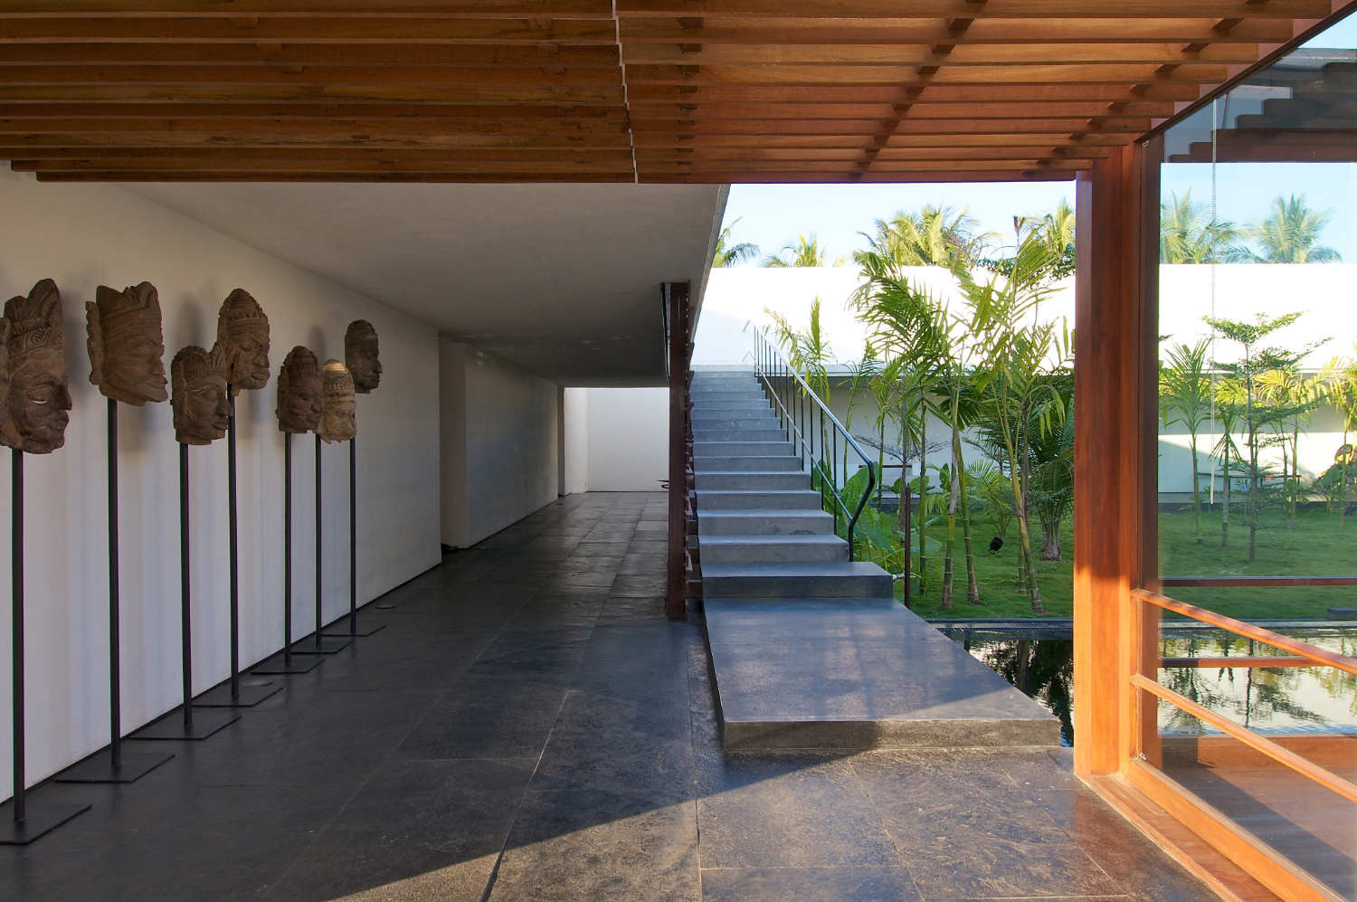
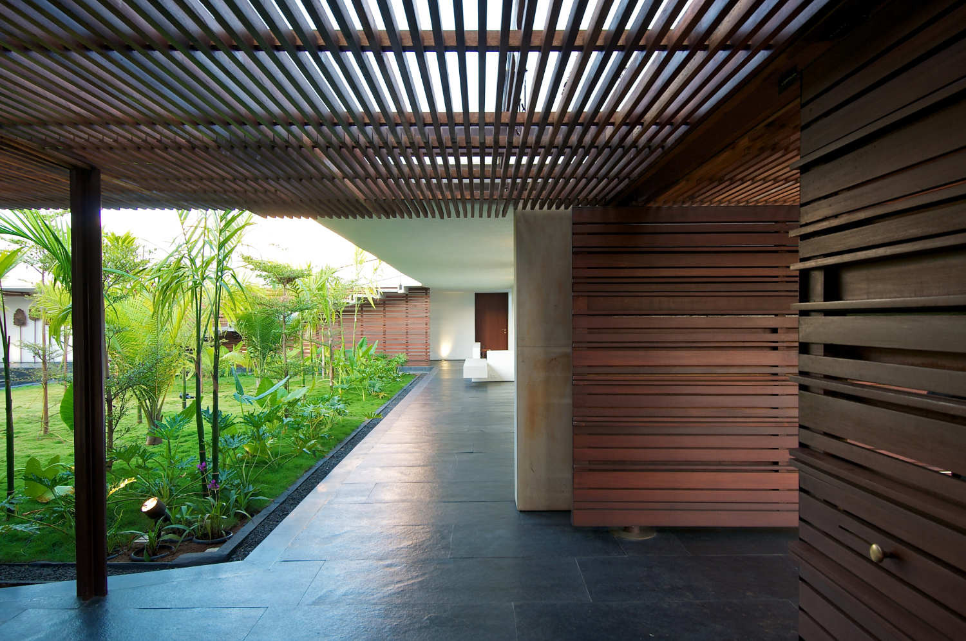
Khadakvasla House, Pune
| RESIDENCE OF MRS JYOTHI & MR. SHEKHAR REDDY | EXTERIOR REFERENCES |

Slide 9
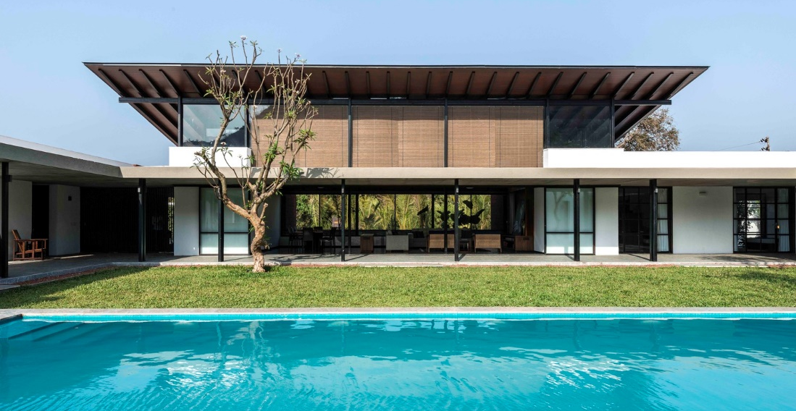
The Twin Houses , Alibag
| RESIDENCE OF MRS JYOTHI & MR. SHEKHAR REDDY | EXTERIOR REFERENCES |

Slide 10
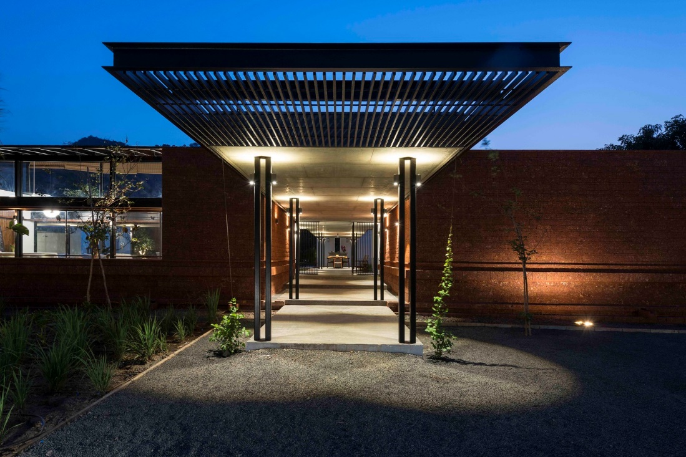
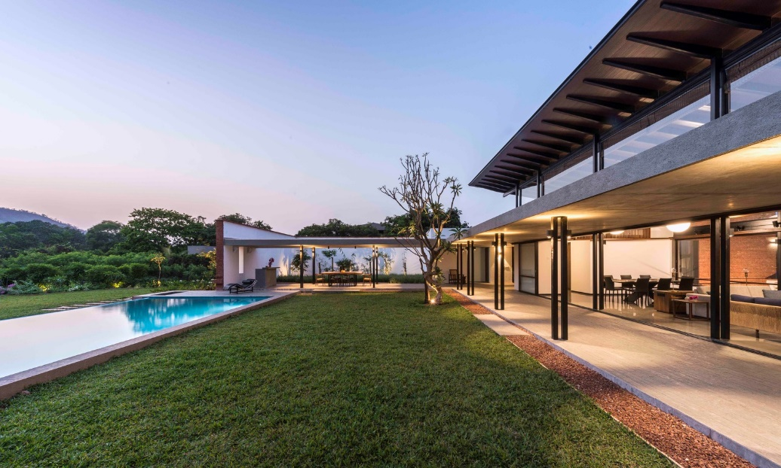
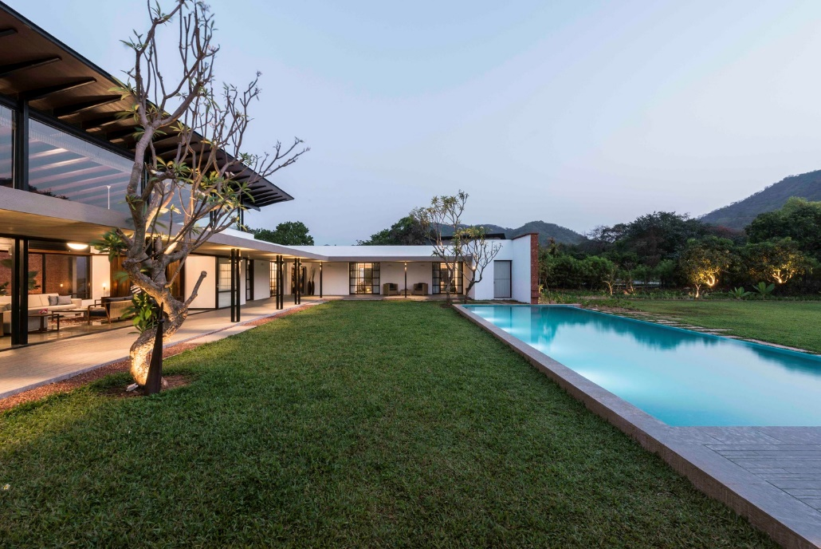
The Twin Houses , Alibag
| RESIDENCE OF MRS JYOTHI & MR. SHEKHAR REDDY | EXTERIOR REFERENCES |

Slide 11
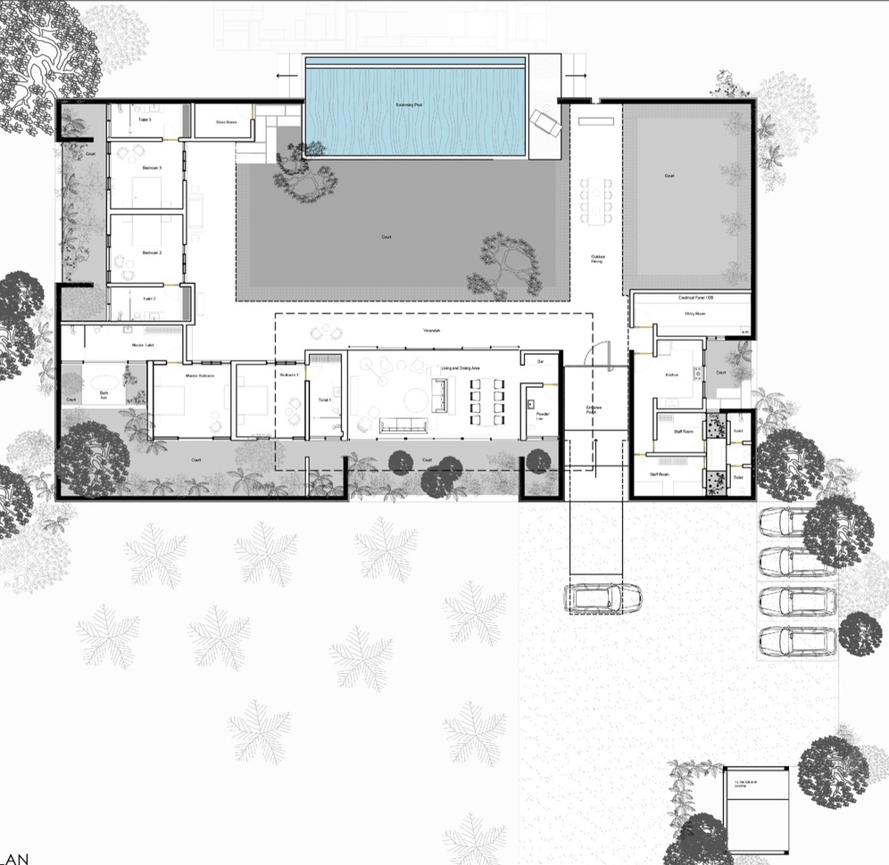
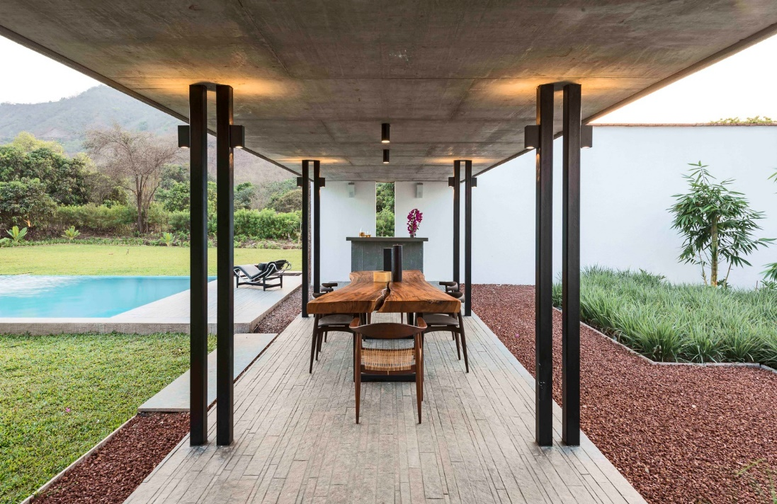
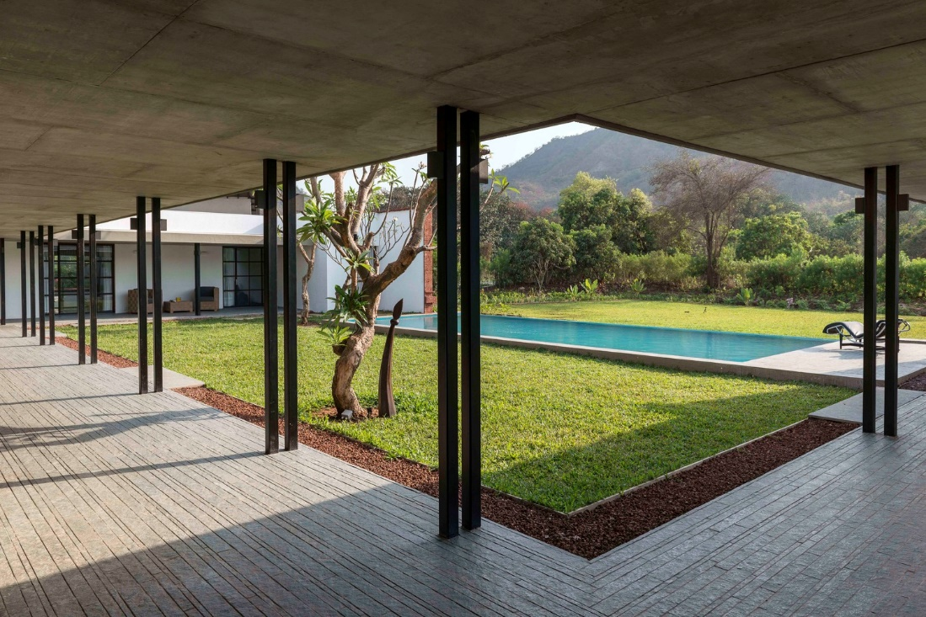
The Twin Houses , Alibag
| RESIDENCE OF MRS JYOTHI & MR. SHEKHAR REDDY | EXTERIOR REFERENCES |

Slide 12
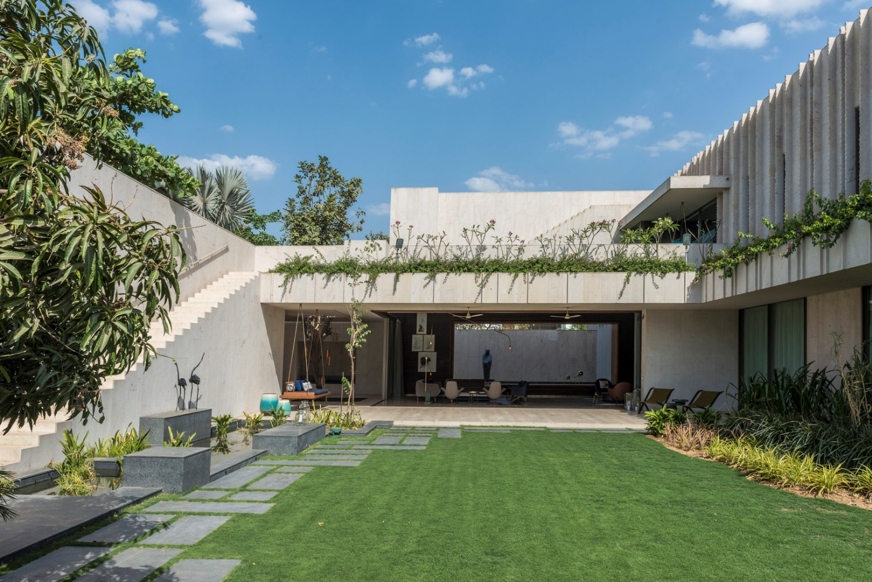
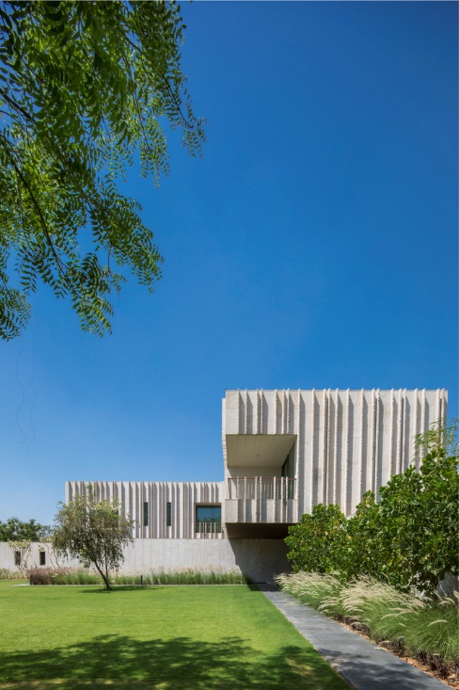
The House Of Secret Gardens , Ahmedabad
| RESIDENCE OF MRS JYOTHI & MR. SHEKHAR REDDY | EXTERIOR REFERENCES |

Slide 13
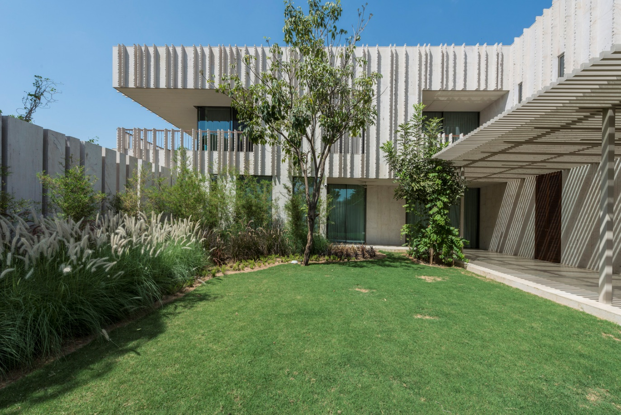
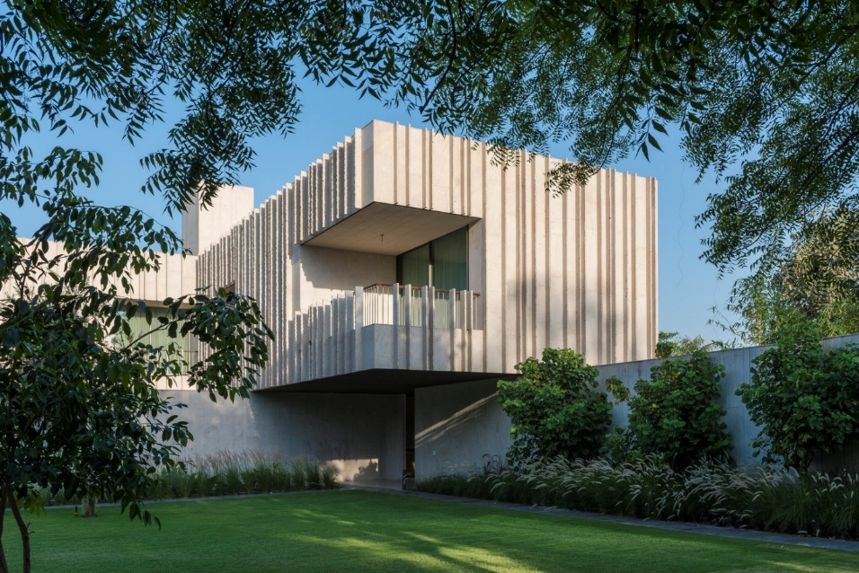
The House Of Secret Gardens , Ahmedabad
| RESIDENCE OF MRS JYOTHI & MR. SHEKHAR REDDY | EXTERIOR REFERENCES |

Slide 14
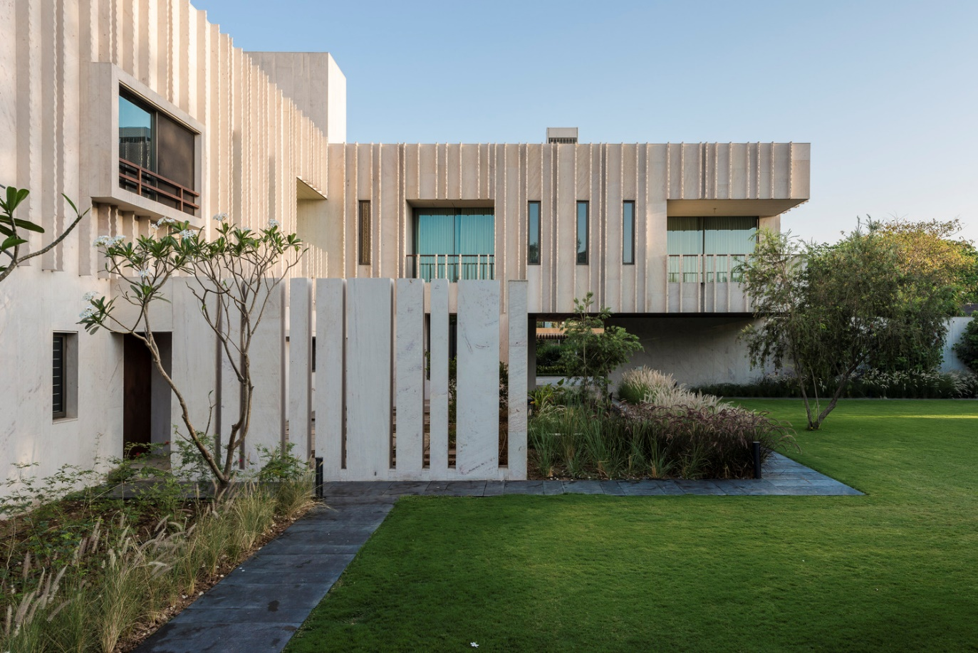
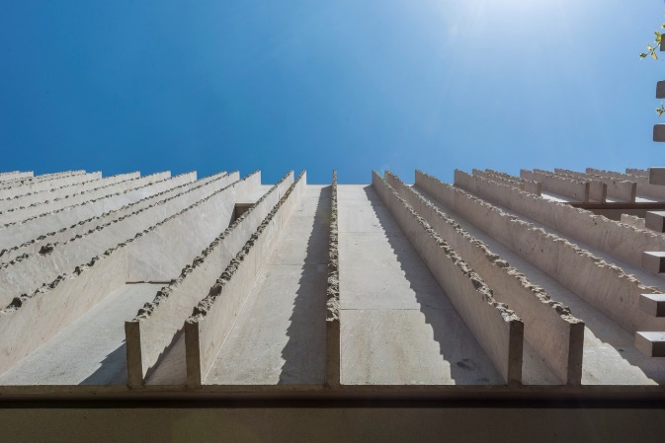
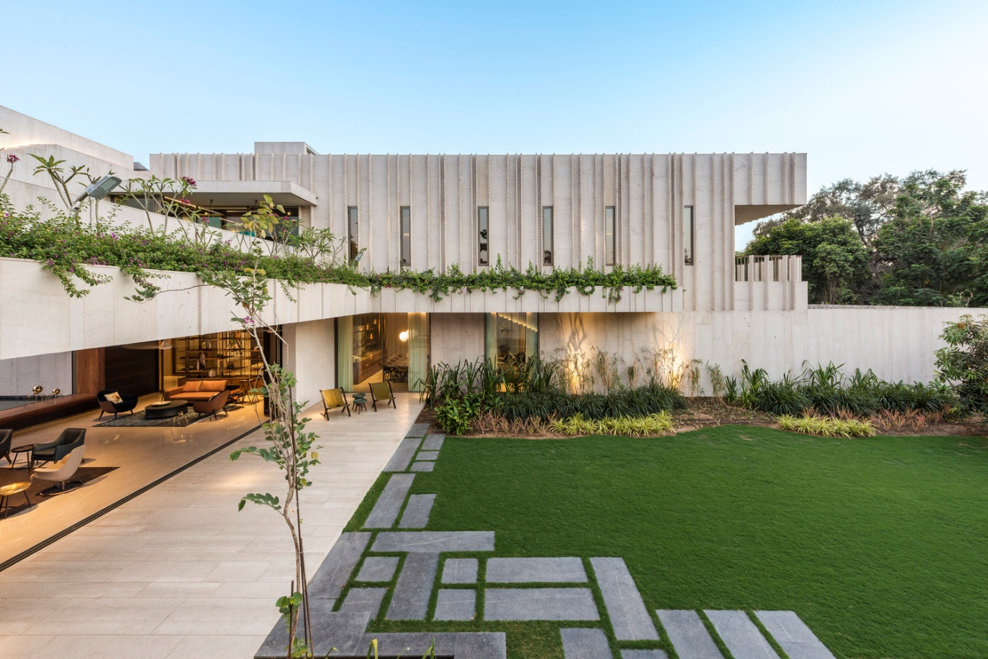
The House Of Secret Gardens , Ahmedabad
| RESIDENCE OF MRS JYOTHI & MR. SHEKHAR REDDY | EXTERIOR REFERENCES |

Slide 15
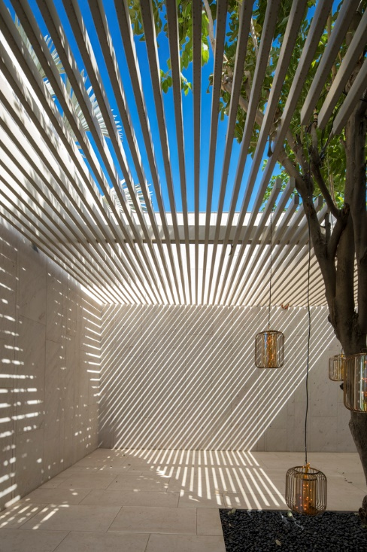
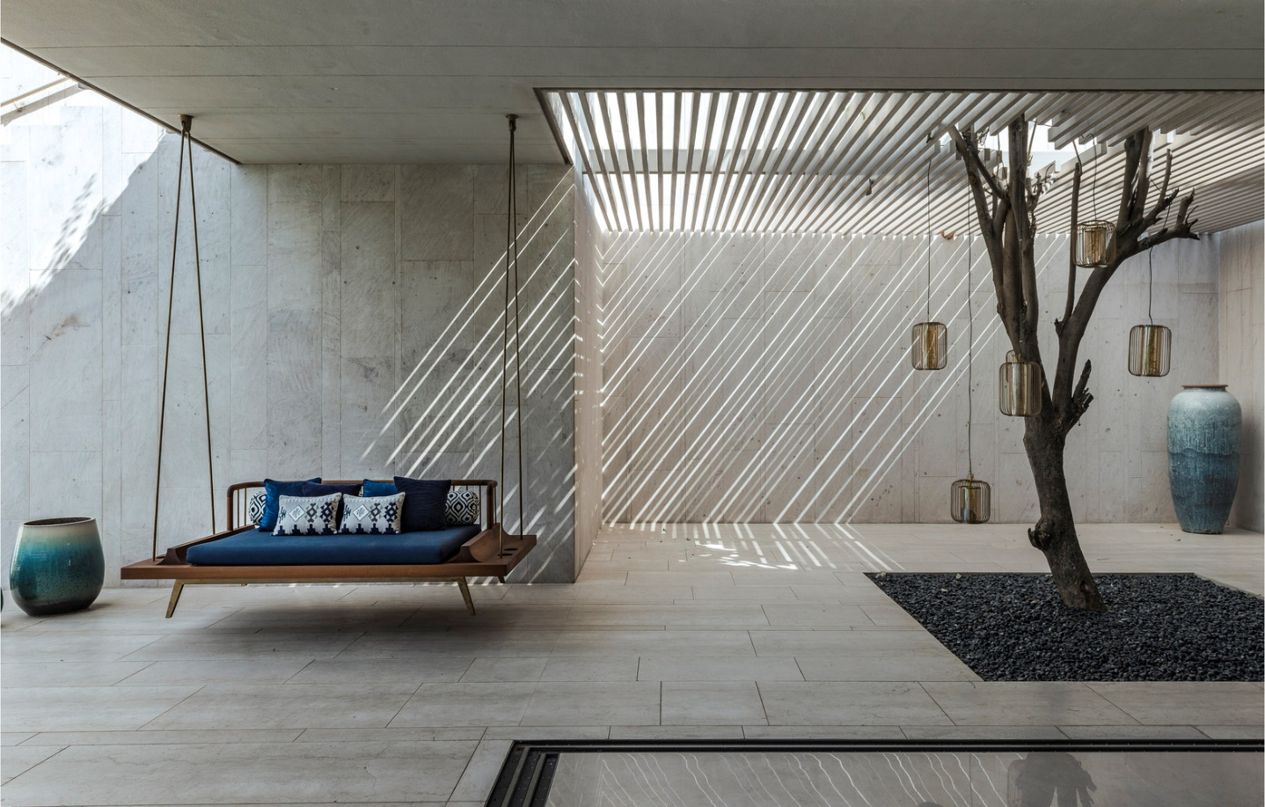
The House Of Secret Gardens , Ahmedabad
| RESIDENCE OF MRS JYOTHI & MR. SHEKHAR REDDY | EXTERIOR REFERENCES |

Slide 16
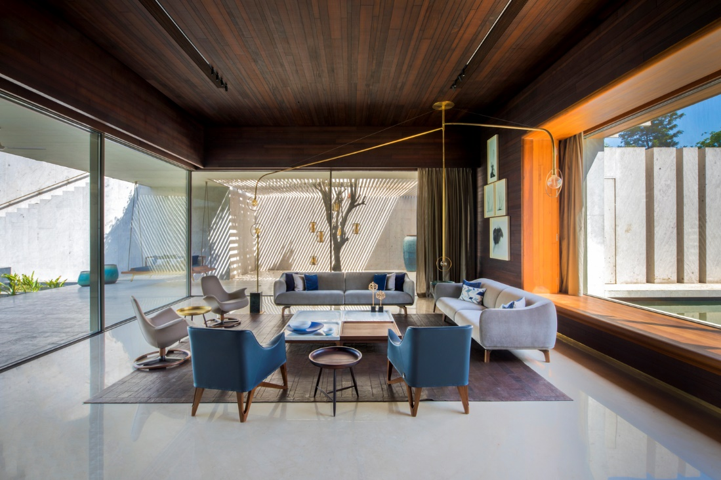
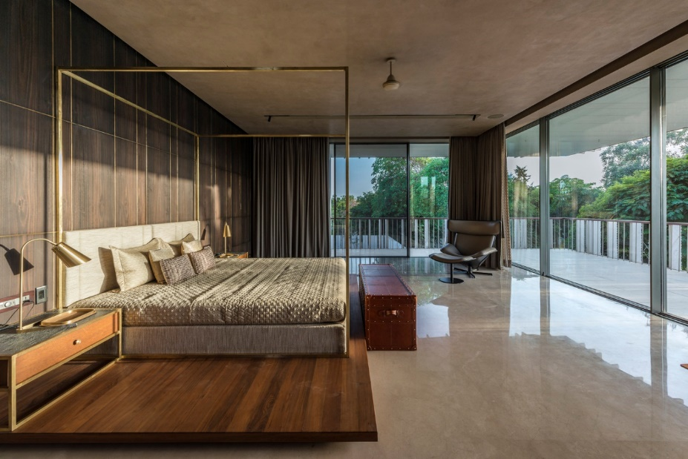
The House Of Secret Gardens , Ahmedabad
| RESIDENCE OF MRS JYOTHI & MR. SHEKHAR REDDY | EXTERIOR REFERENCES |

Slide 17
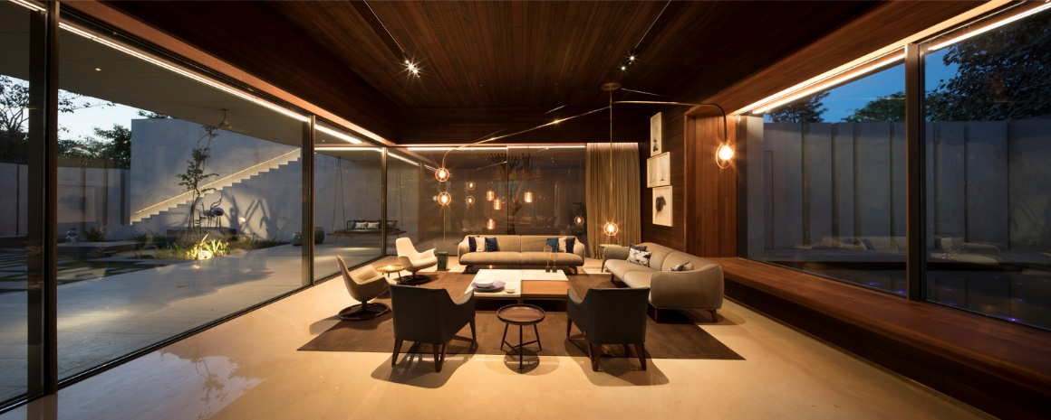
The House Of Secret Gardens , Ahmedabad
| RESIDENCE OF MRS JYOTHI & MR. SHEKHAR REDDY | EXTERIOR REFERENCES |

Slide 18
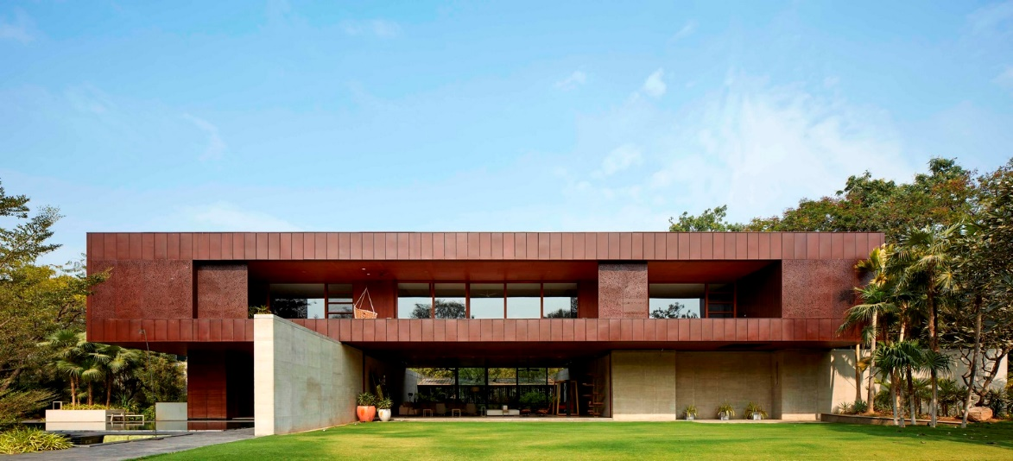
DIYA , Ahmedabad
| RESIDENCE OF MRS JYOTHI & MR. SHEKHAR REDDY | EXTERIOR REFERENCES |

Slide 19
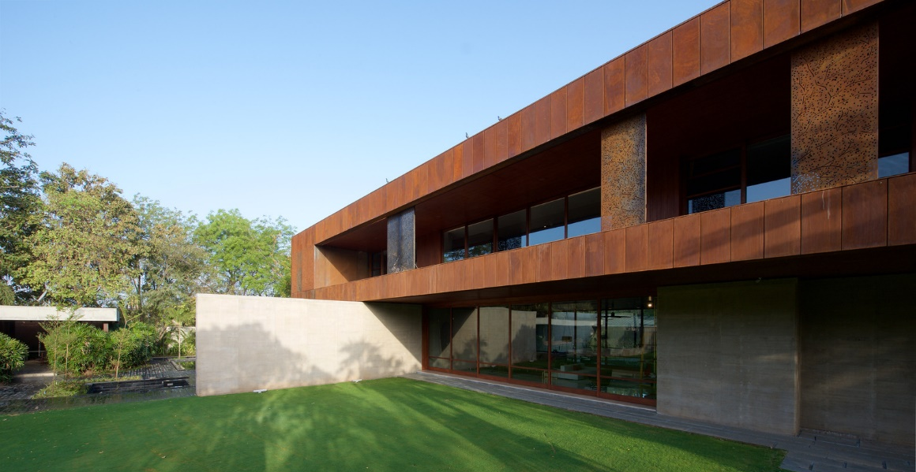
DIYA , Ahmedabad
| RESIDENCE OF MRS JYOTHI & MR. SHEKHAR REDDY | EXTERIOR REFERENCES |

Slide 20
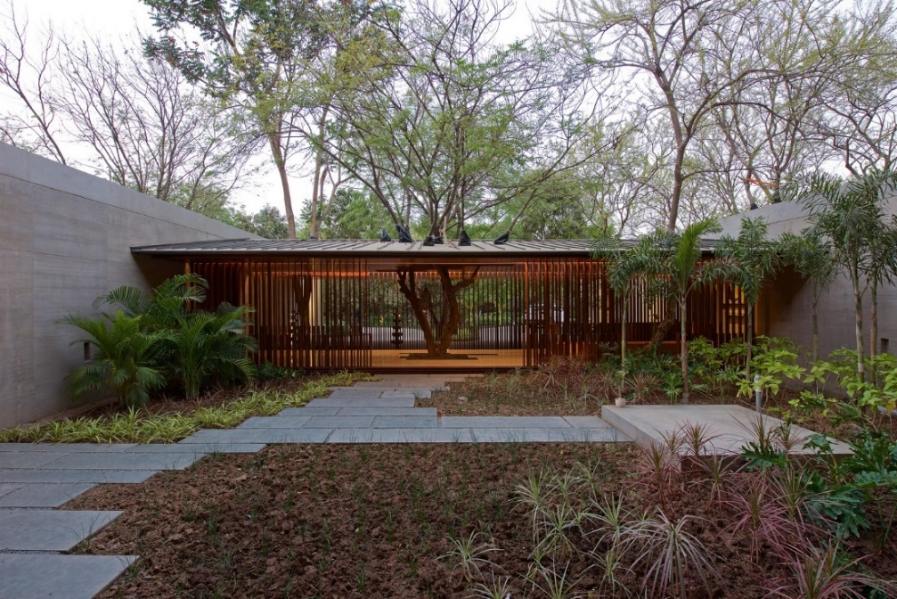
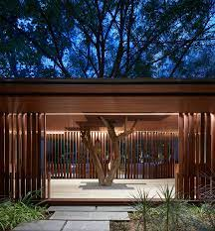
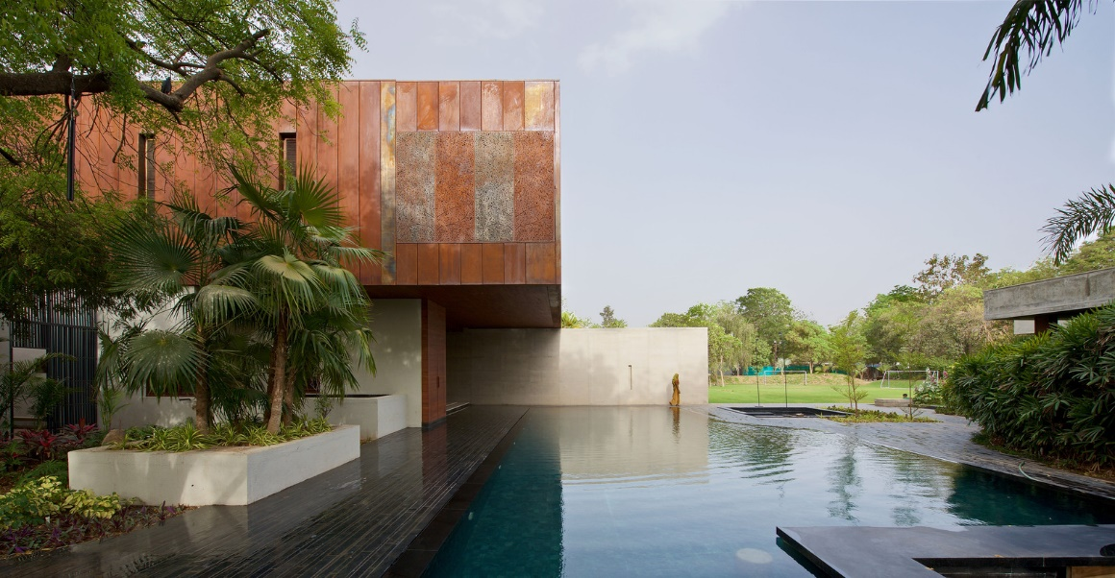
DIYA , Ahmedabad
| RESIDENCE OF MRS JYOTHI & MR. SHEKHAR REDDY | EXTERIOR REFERENCES |

Slide 21
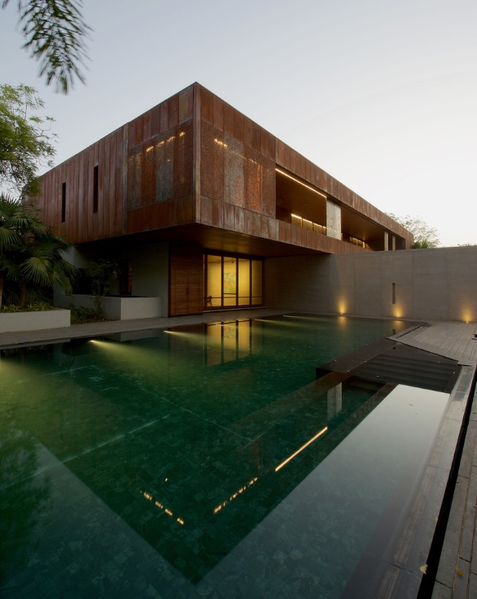
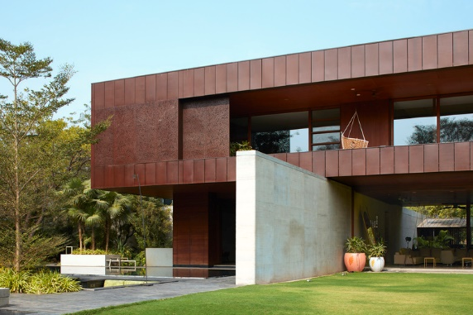
DIYA , Ahmedabad
| RESIDENCE OF MRS JYOTHI & MR. SHEKHAR REDDY | EXTERIOR REFERENCES |

Slide 22
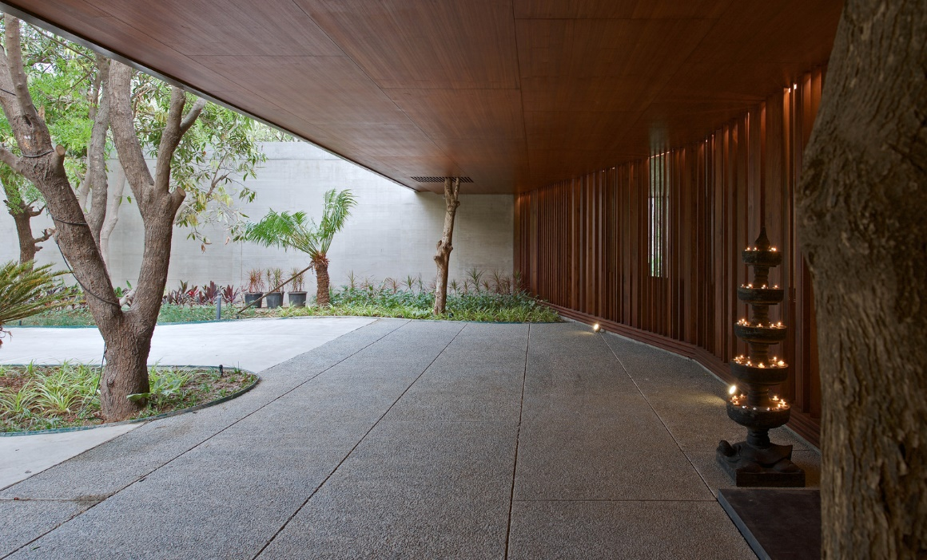
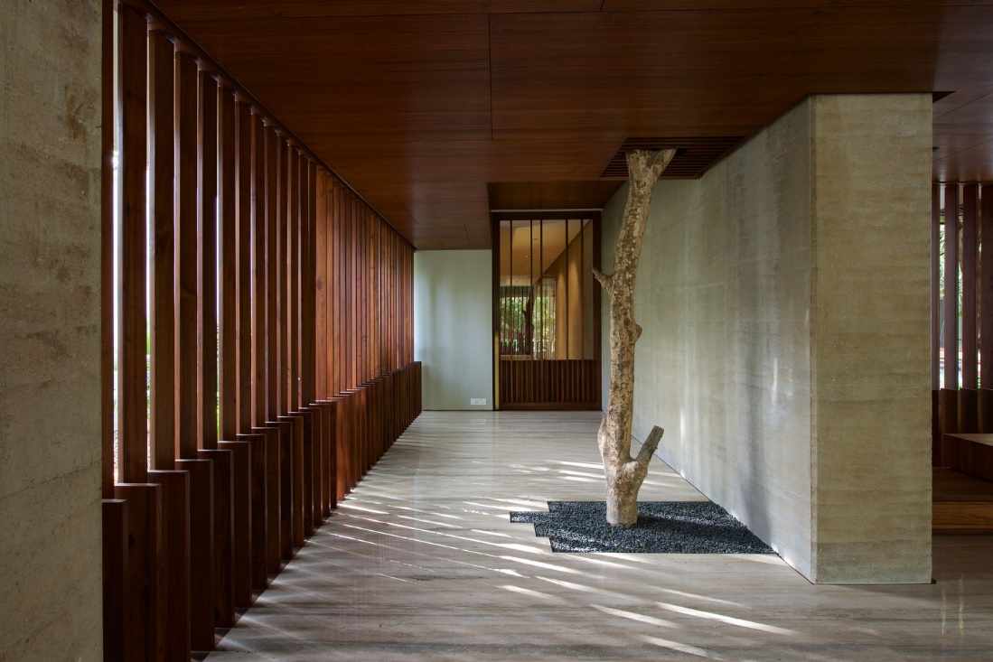
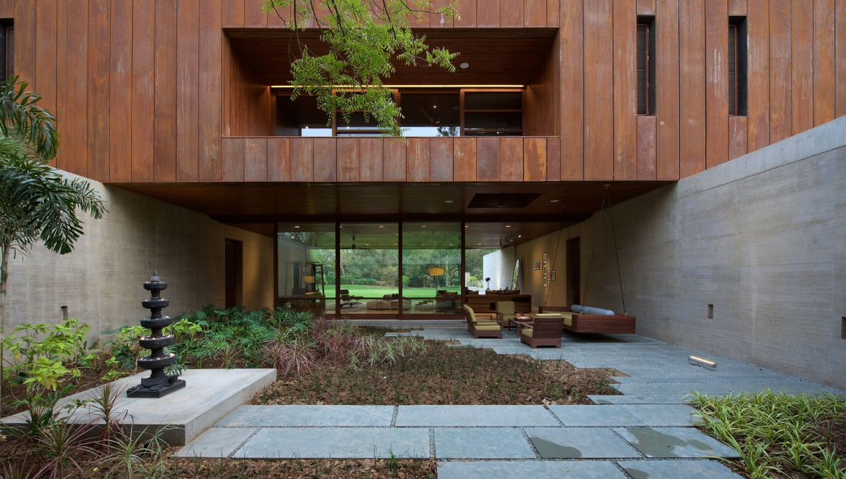
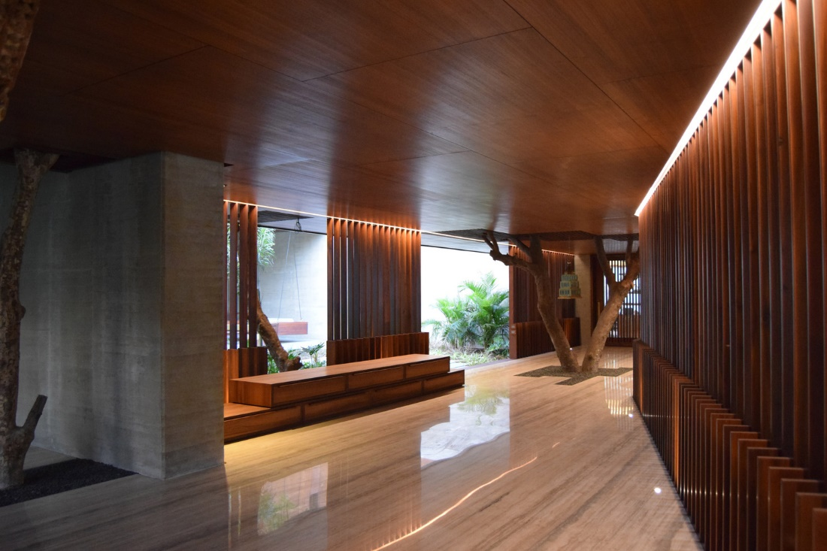
DIYA , Ahmedabad
| RESIDENCE OF MRS JYOTHI & MR. SHEKHAR REDDY | EXTERIOR REFERENCES |

Slide 23
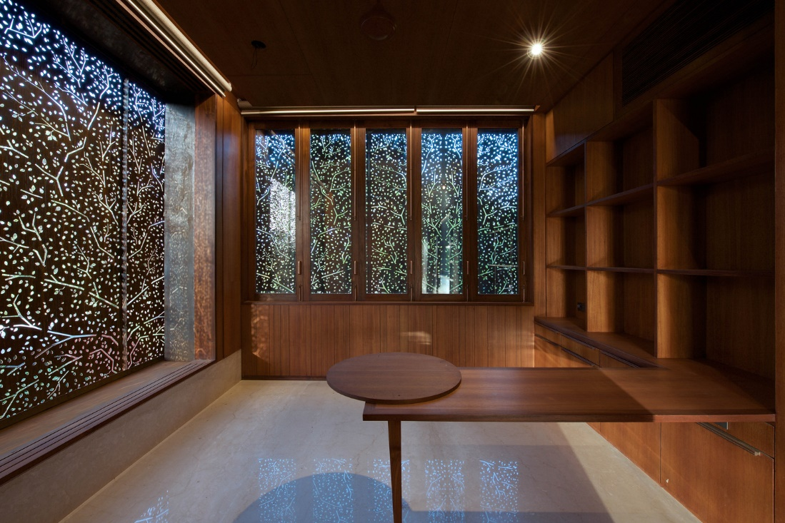
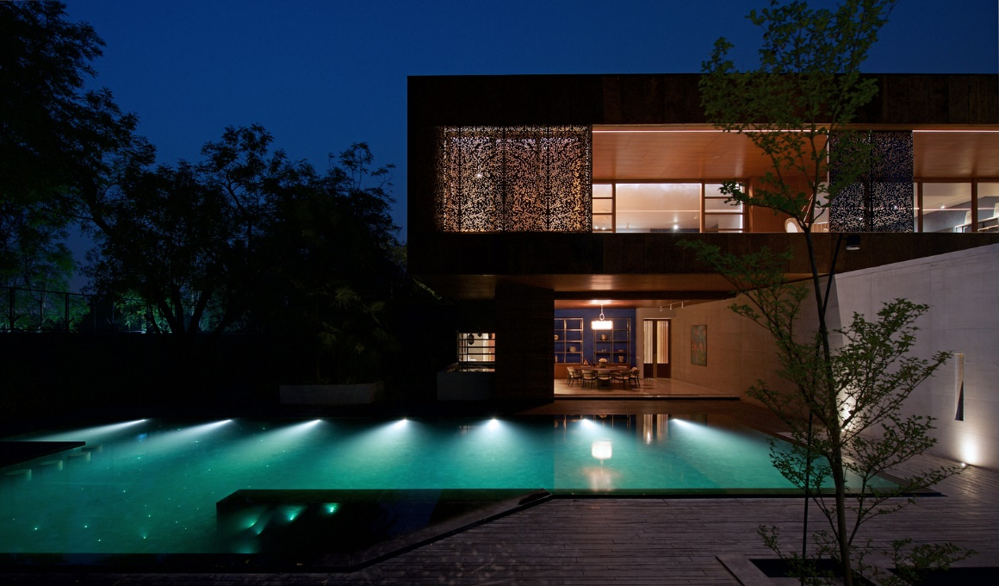
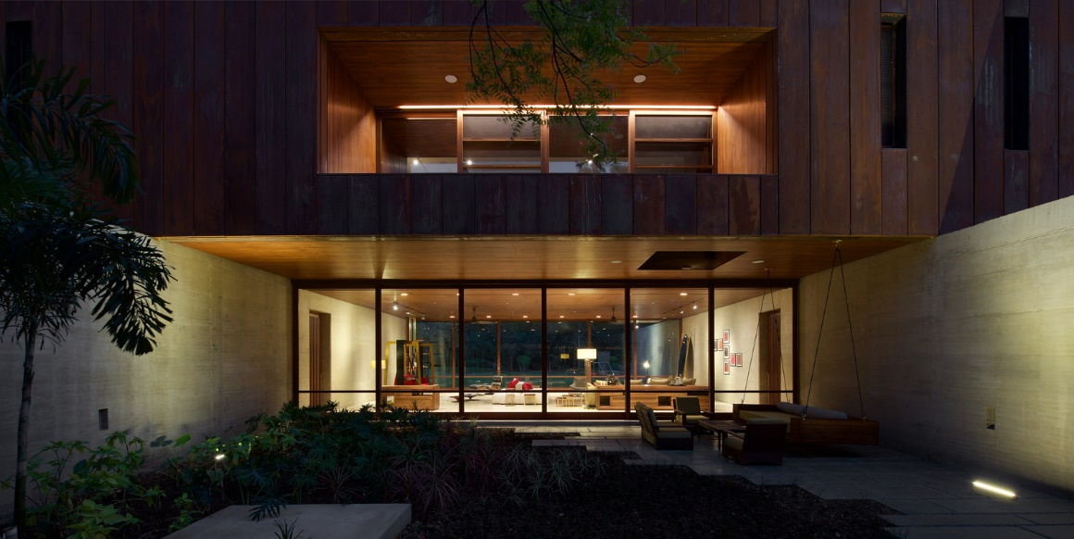
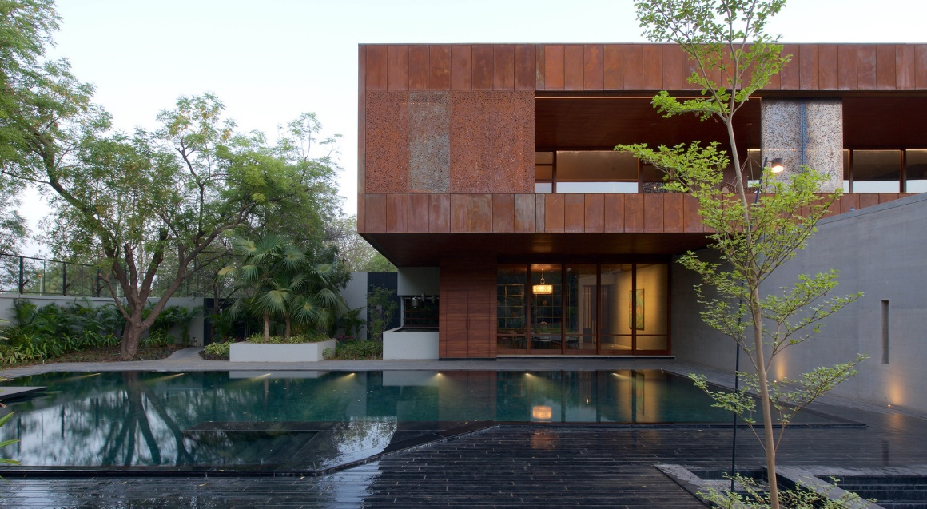
DIYA , Ahmedabad
| RESIDENCE OF MRS JYOTHI & MR. SHEKHAR REDDY | EXTERIOR REFERENCES |

Slide 24
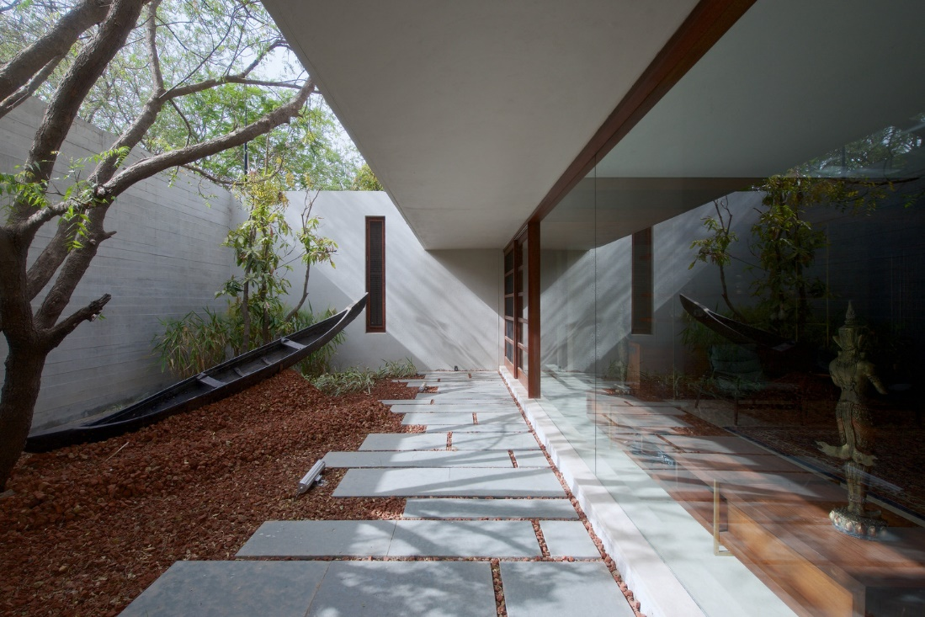
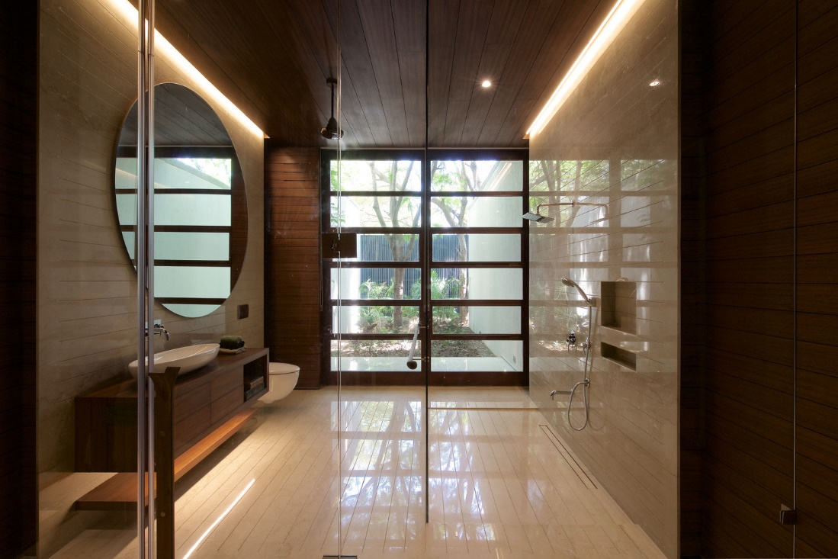
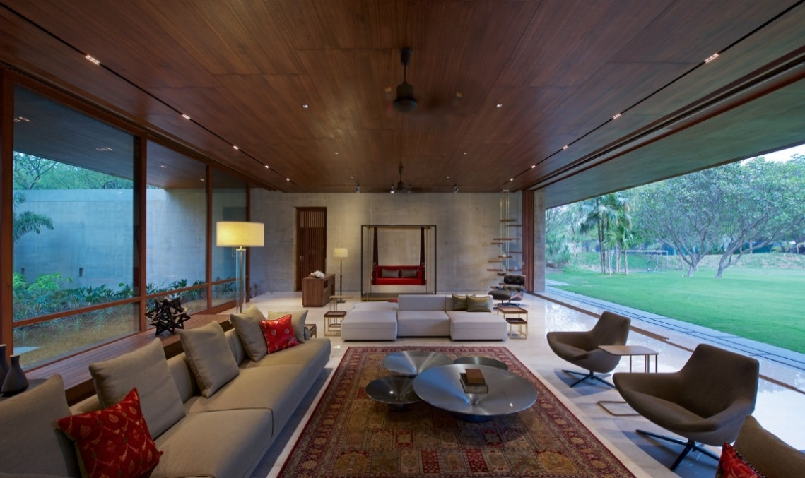
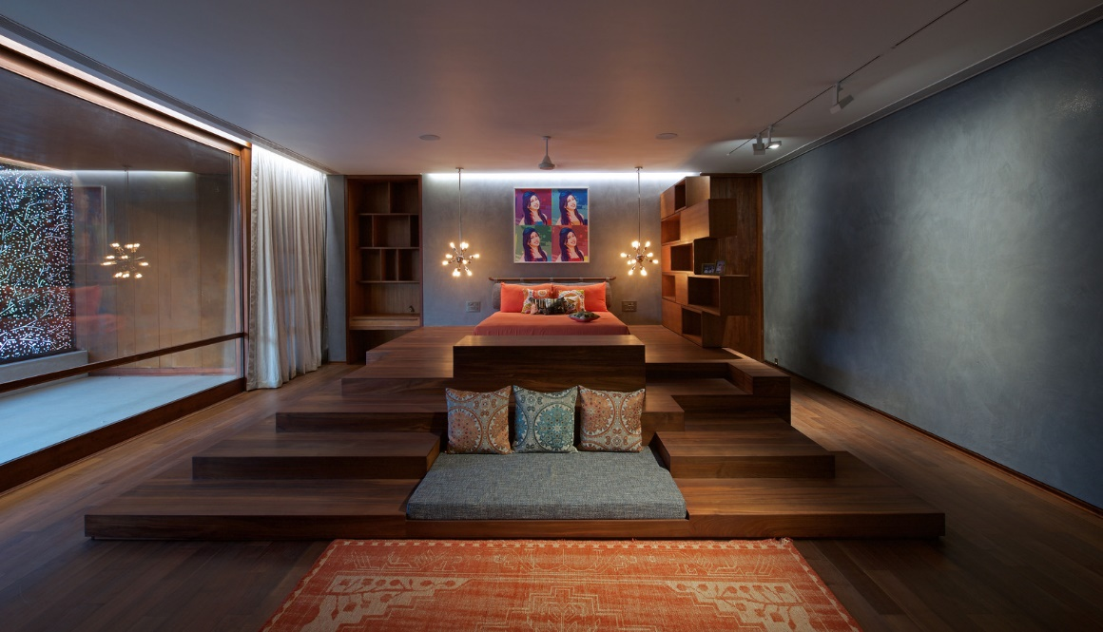
DIYA , Ahmedabad
| RESIDENCE OF MRS JYOTHI & MR. SHEKHAR REDDY | EXTERIOR REFERENCES |

Slide 25
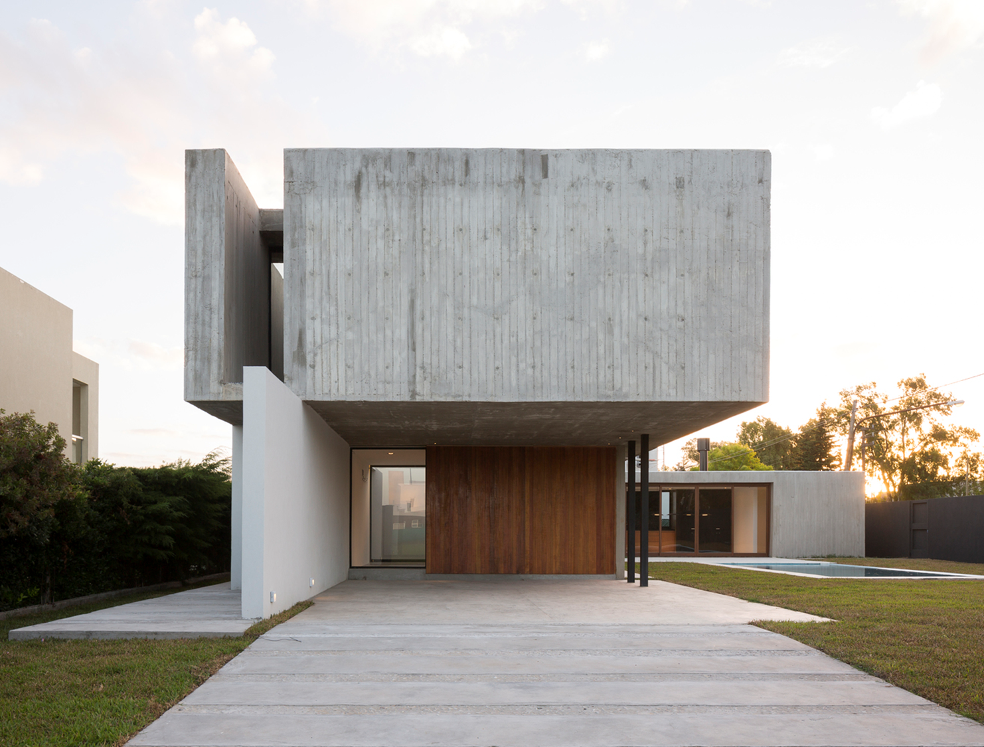
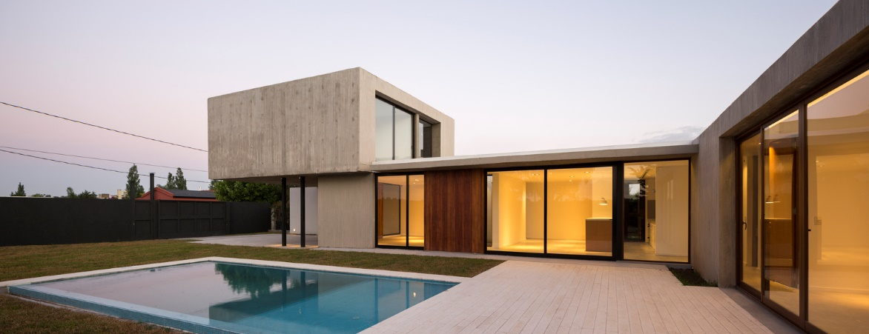
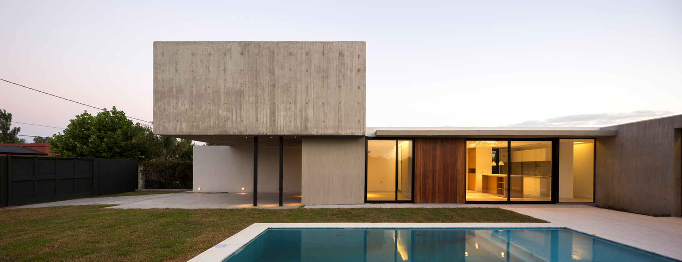
REX House , Argentina
| RESIDENCE OF MRS JYOTHI & MR. SHEKHAR REDDY | EXTERIOR REFERENCES |

Slide 26

AW Residence , Indonesia
| RESIDENCE OF MRS JYOTHI & MR. SHEKHAR REDDY | EXTERIOR REFERENCES |

Slide 27


Compact House in Malleshwaram Bengaluru
| RESIDENCE OF MRS JYOTHI & MR. SHEKHAR REDDY | EXTERIOR REFERENCES |

Slide 28

Hyderabad
| RESIDENCE OF MRS JYOTHI & MR. SHEKHAR REDDY | EXTERIOR REFERENCES |

Slide 29

Hyderabad
| RESIDENCE OF MRS JYOTHI & MR. SHEKHAR REDDY | EXTERIOR REFERNECES |

Slide 30

Double Bay House, Sydney
| RESIDENCE OF MRS JYOTHI & MR. SHEKHAR REDDY | EXTERIOR REFERNECES |

Slide 31


Double Bay House, Sydney
| RESIDENCE OF MRS JYOTHI & MR. SHEKHAR REDDY | EXTERIOR REFERENCES |

Slide 32

| RESIDENCE OF MRS JYOTHI & MR. SHEKHAR REDDY | EXTERIOR REFERNCES |

Slide 33


RJ House, Indonesia
| RESIDENCE OF MRS JYOTHI & MR. SHEKHAR REDDY | EXTERIOR REFERENCES |

Slide 34


RJ House, Indonesia
| RESIDENCE OF MRS JYOTHI & MR. SHEKHAR REDDY | EXTERIOR REFERENCES |

Slide 35


Cloaked, Bangalore
| RESIDENCE OF MRS JYOTHI & MR. SHEKHAR REDDY | EXTERIOR REFERENCES |

Slide 36



Cloaked, Bangalore
| RESIDENCE OF MRS JYOTHI & MR. SHEKHAR REDDY | EXTERIOR REFERENCES |

Slide 37


Cloaked, Bangalore
| RESIDENCE OF MRS JYOTHI & MR. SHEKHAR REDDY | EXTERIOR REFERENCES |

Slide 38




Cloaked, Bangalore
| RESIDENCE OF MRS JYOTHI & MR. SHEKHAR REDDY | EXTERIOR REFERENCES |

Slide 39

H-House, Surat
| RESIDENCE OF MRS JYOTHI & MR. SHEKHAR REDDY | EXTERIOR REFERENCES |

Slide 40

H-House, Surat
| RESIDENCE OF MRS JYOTHI & MR. SHEKHAR REDDY | EXTERIOR REFERENCES |

Slide 41

H-House, Surat
| RESIDENCE OF MRS JYOTHI & MR. SHEKHAR REDDY | EXTERIOR REFERENCES |

Slide 42

S-House, Chittoor
| RESIDENCE OF MRS JYOTHI & MR. SHEKHAR REDDY | EXTERIOR REFERENCES |

Slide 43

Residence 414, Panchkula
| RESIDENCE OF MRS JYOTHI & MR. SHEKHAR REDDY | EXTERIOR REFERENCES |

Slide 44

Elemental House, Ahmedabad
| RESIDENCE OF MRS JYOTHI & MR. SHEKHAR REDDY | EXTERIOR REFERENCES |

Slide 45

Elemental House, Ahmedabad
| RESIDENCE OF MRS JYOTHI & MR. SHEKHAR REDDY | EXTERIOR REFERENCES |

Slide 46

Open House, Ahmedabad
| RESIDENCE OF MRS JYOTHI & MR. SHEKHAR REDDY | EXTERIOR REFERENCES |

Slide 47

Open House, Ahmedabad
| RESIDENCE OF MRS JYOTHI & MR. SHEKHAR REDDY | EXTERIOR REFERENCES |

Slide 48

Open House, Ahmedabad
| RESIDENCE OF MRS JYOTHI & MR. SHEKHAR REDDY | EXTERIOR REFERENCES |

Slide 49

Open House, Ahmedabad
| RESIDENCE OF MRS JYOTHI & MR. SHEKHAR REDDY | EXTERIOR REFERENCES |

Slide 50

Open House, Ahmedabad
| RESIDENCE OF MRS JYOTHI & MR. SHEKHAR REDDY | EXTERIOR REFERENCES |

Slide 51

House in Mohali
| RESIDENCE OF MRS JYOTHI & MR. SHEKHAR REDDY | EXTERIOR REFERENCES |

Slide 52

Screen House, Ahmedabad
| RESIDENCE OF MRS JYOTHI & MR. SHEKHAR REDDY | EXTERIOR REFERENCES |

Slide 53

Screen House, Ahmedabad
| RESIDENCE OF MRS JYOTHI & MR. SHEKHAR REDDY | EXTERIOR REFERENCES |

Slide 54

Screen House, Ahmedabad
| RESIDENCE OF MRS JYOTHI & MR. SHEKHAR REDDY | EXTERIOR REFERENCES |

Slide 55

Screen House, Ahmedabad
| RESIDENCE OF MRS JYOTHI & MR. SHEKHAR REDDY | EXTERIOR REFERENCES |

Slide 56

Screen House, Ahmedabad
| RESIDENCE OF MRS JYOTHI & MR. SHEKHAR REDDY | EXTERIOR REFERENCES |

Slide 57

Screen House, Ahmedabad
| RESIDENCE OF MRS JYOTHI & MR. SHEKHAR REDDY | EXTERIOR REFERENCES |

Slide 58


Louvered House, Vadodara
| RESIDENCE OF MRS JYOTHI & MR. SHEKHAR REDDY | EXTERIOR REFERENCES |

Slide 59


Louvered House, Vadodara
| RESIDENCE OF MRS JYOTHI & MR. SHEKHAR REDDY | EXTERIOR REFERENCES |

Slide 60

TUT House, Thoothukudi
| RESIDENCE OF MRS JYOTHI & MR. SHEKHAR REDDY | EXTERIOR REFERENCES |

Slide 61


TUT House, Thoothukudi
| RESIDENCE OF MRS JYOTHI & MR. SHEKHAR REDDY | EXTERIOR REFERENCES |

Slide 62


TUT House, Thoothukudi
| RESIDENCE OF MRS JYOTHI & MR. SHEKHAR REDDY | EXTERIOR REFERENCES |

Slide 63


Escarpment House, Australia
| RESIDENCE OF MRS JYOTHI & MR. SHEKHAR REDDY | EXTERIOR REFERENCES |

