Slide 1
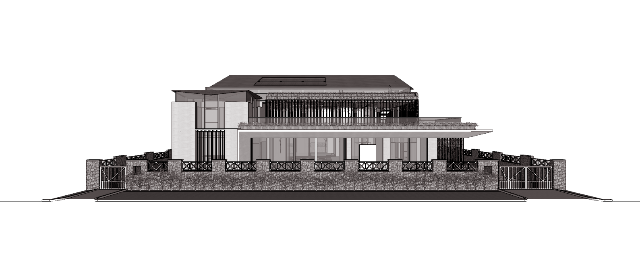
RESIDENCE OF MRS JYOTI & MR. SHEKHAR REDDY, HYDERABAD
SCHEMATIC DESIGN PROPOSAL - REVISED
January 2022

Slide 2
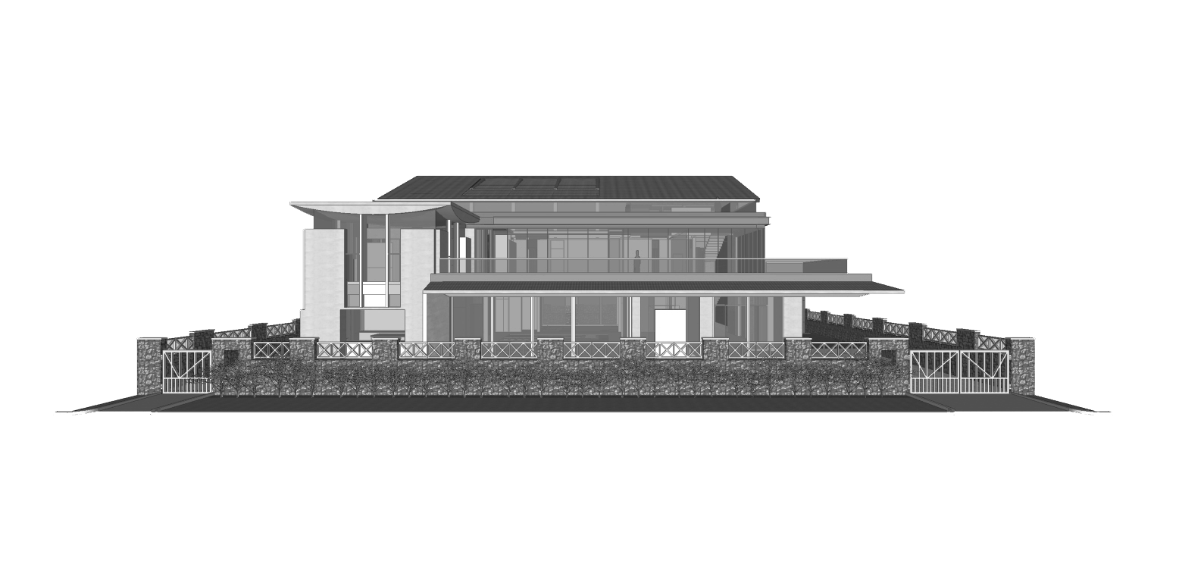
RESIDENCE OF MRS JYOTI & MR. SHEKHAR REDDY, HYDERABAD
SCHEMATIC DESIGN PROPOSAL - REVISED
January 2022

Slide 3
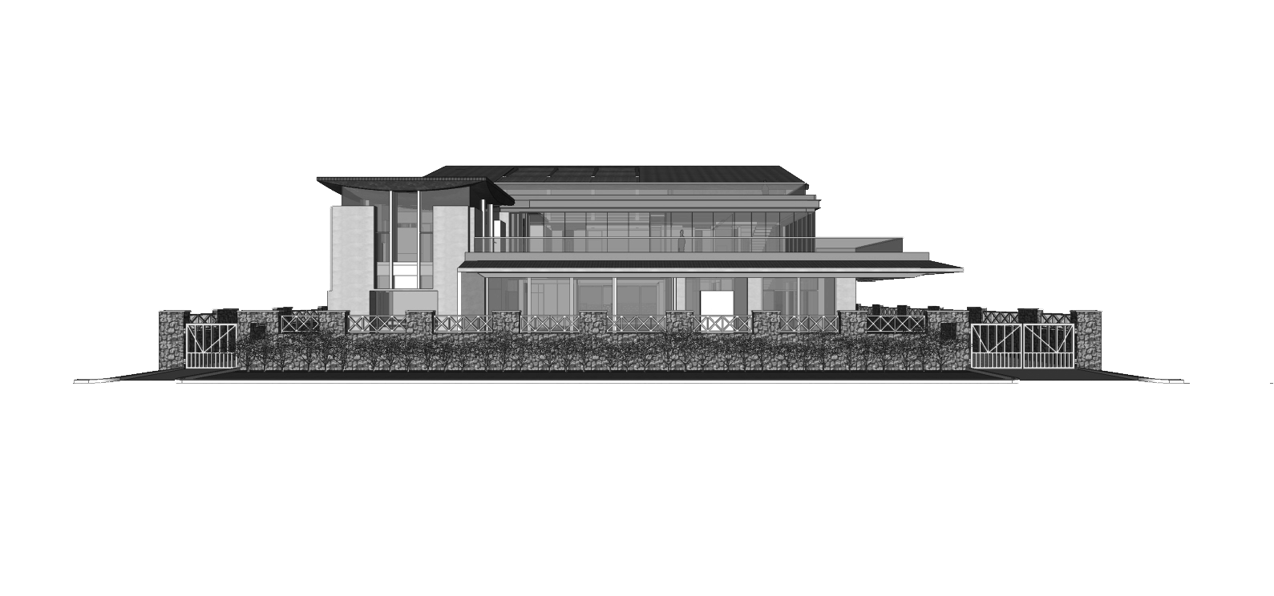
RESIDENCE OF MRS JYOTI & MR. SHEKHAR REDDY, HYDERABAD
SCHEMATIC DESIGN PROPOSAL - REVISED
January 2022

Slide 4
CONTENTS
Layouts
Elevation - opt 1
WVOA rules for rebuilding /modifying the villas
Elevations highlighting WVOA rules
3D Visualizations

Slide 5
LAYOUTS

Slide 6
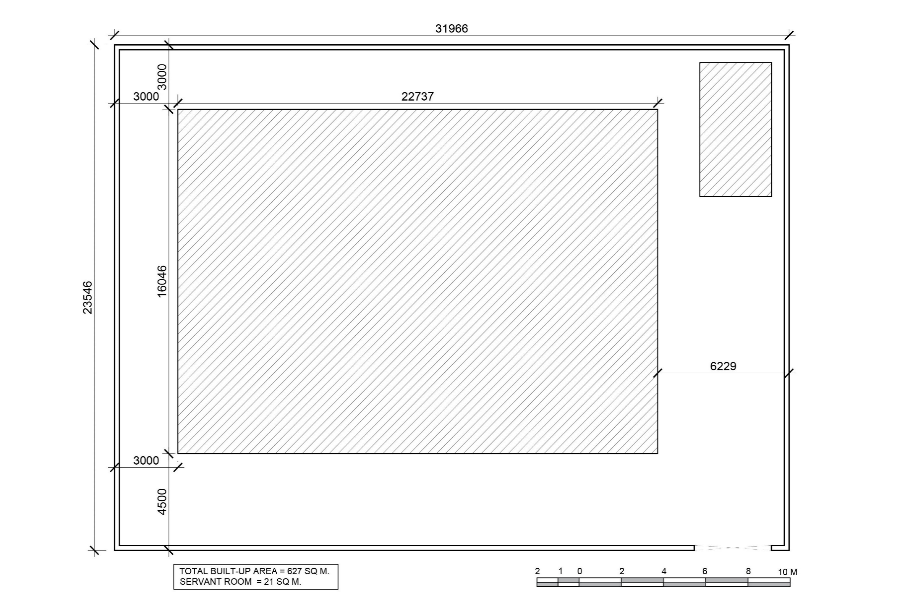
Set-backs maintained as per municipal by-laws
| RESIDENCE OF MRS JYOTI & MR. SHEKHAR REDDY | PROPOSED BUILDING FOOTPRINT AND SET-BACKS |

Slide 7
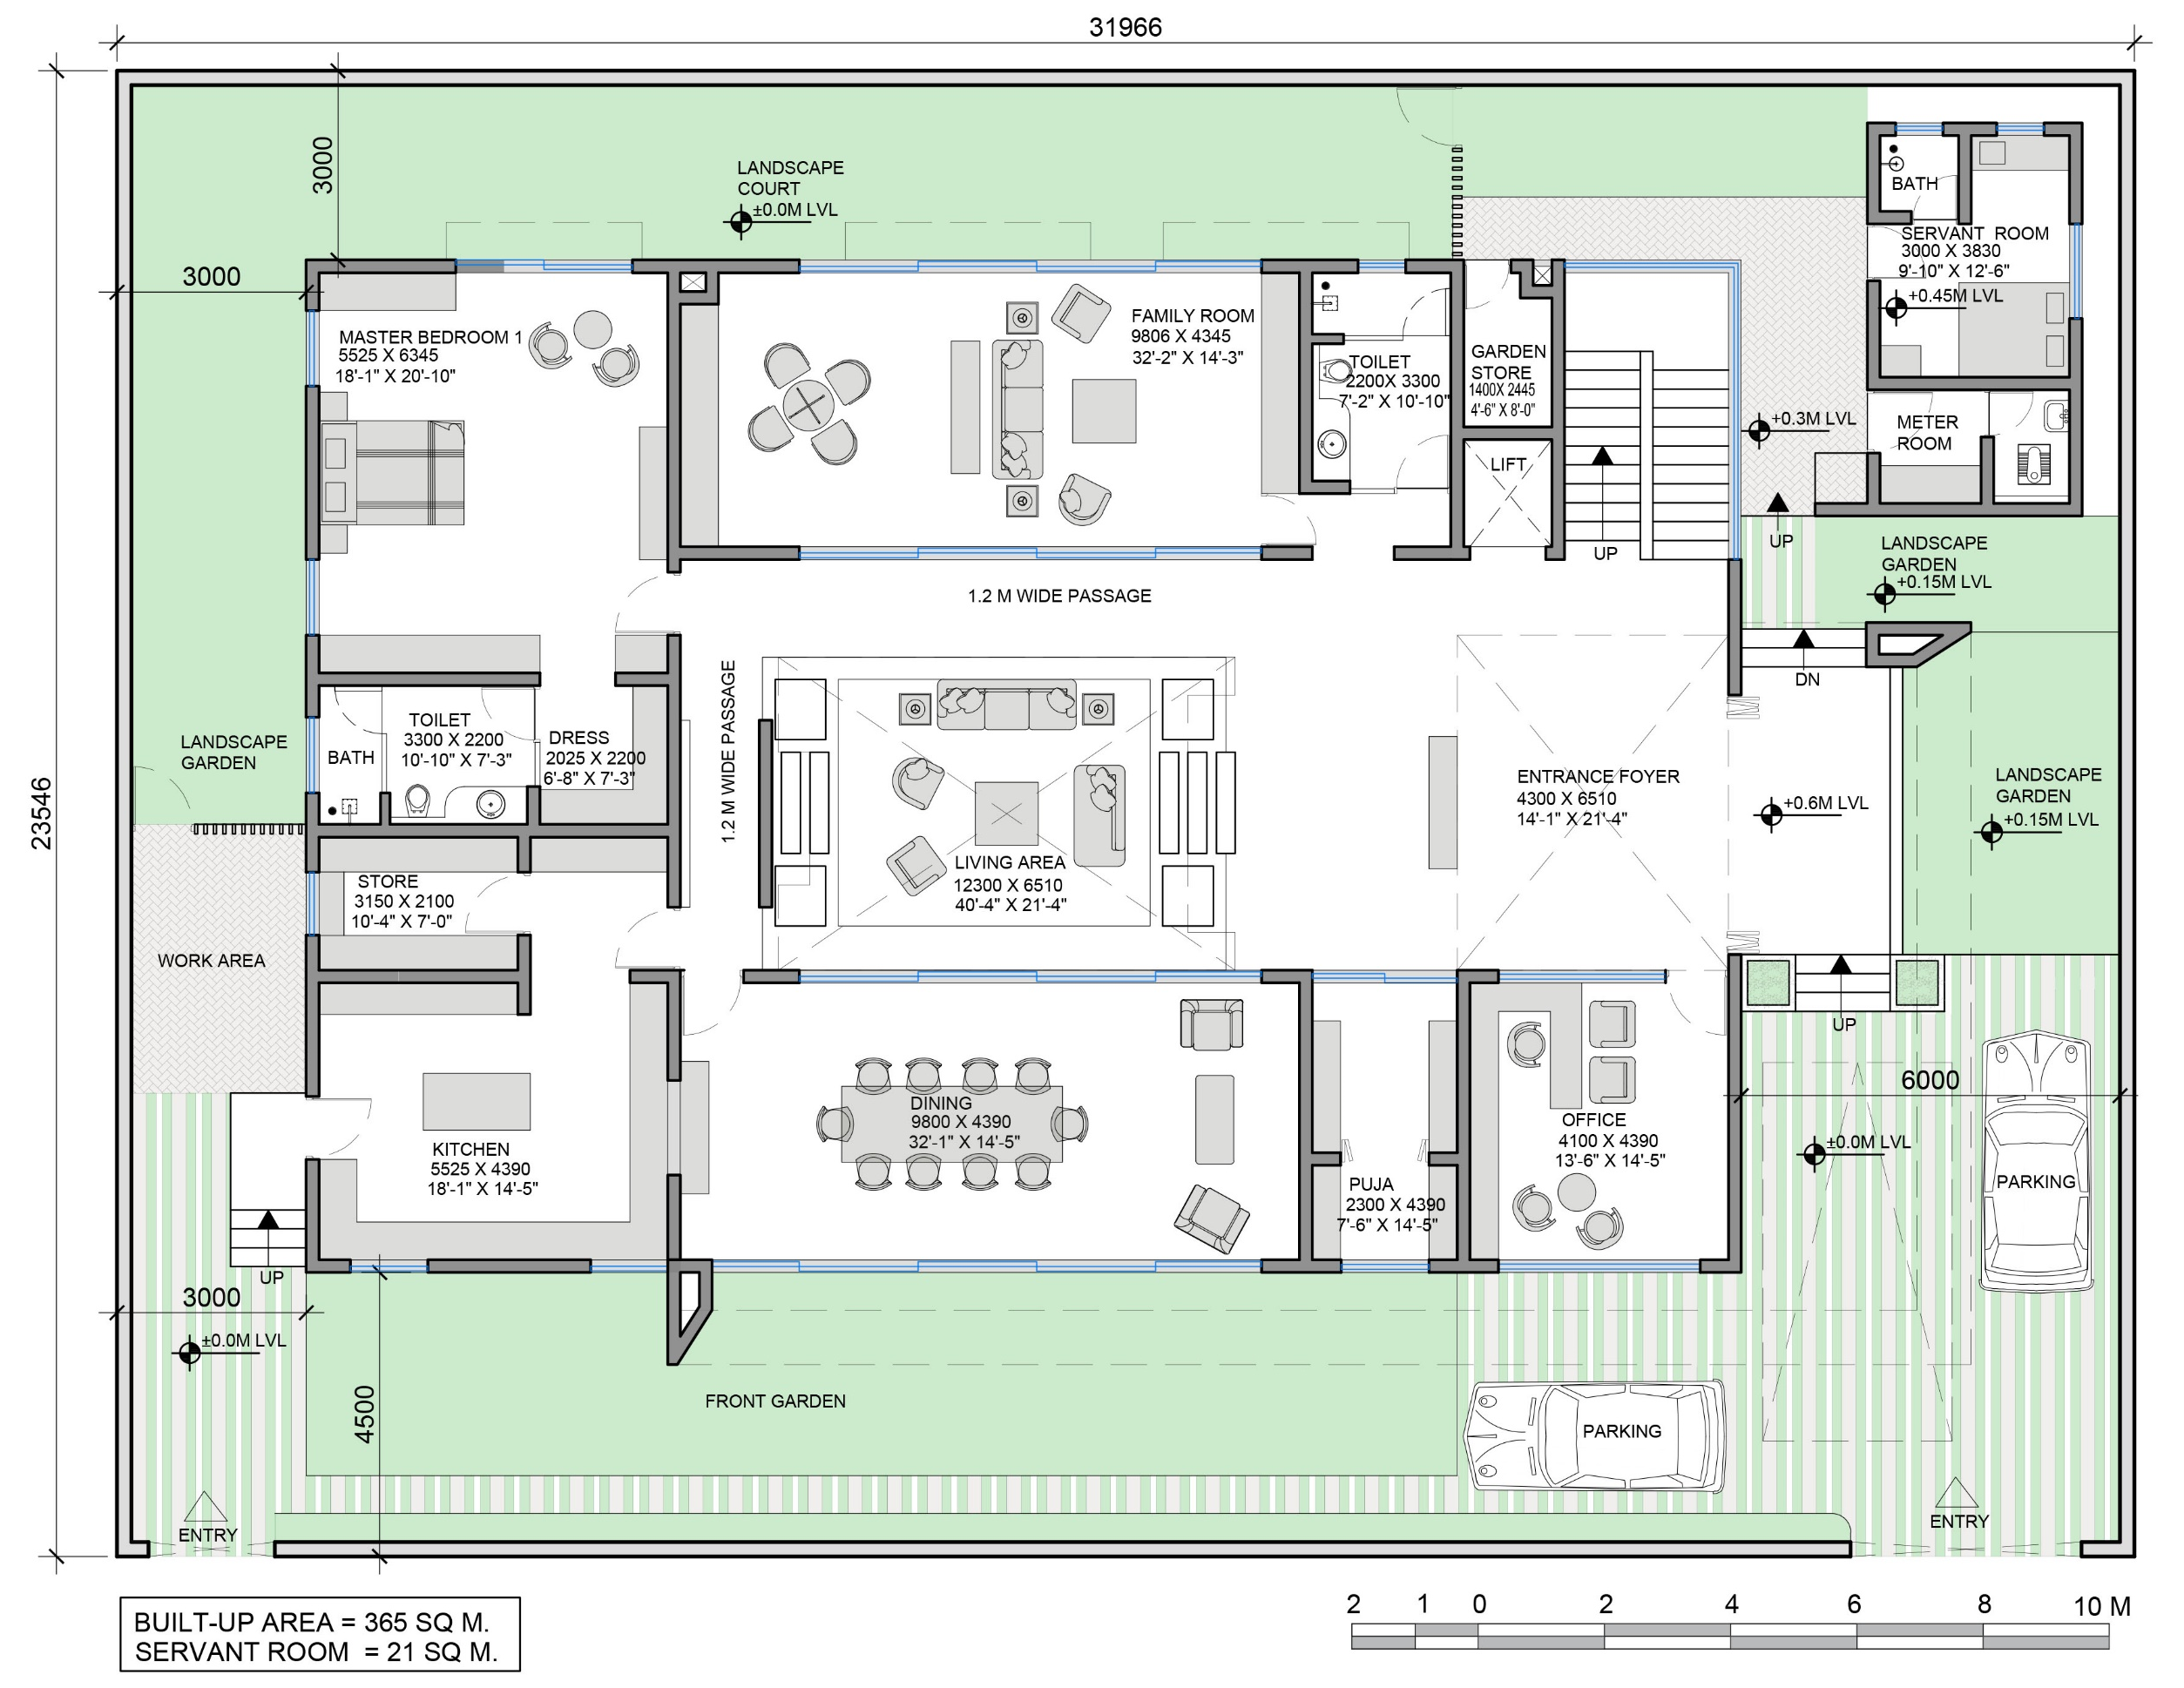

| RESIDENCE OF MRS JYOTI & MR. SHEKHAR REDDY | GROUND FLOOR LAYOUT |

Slide 8
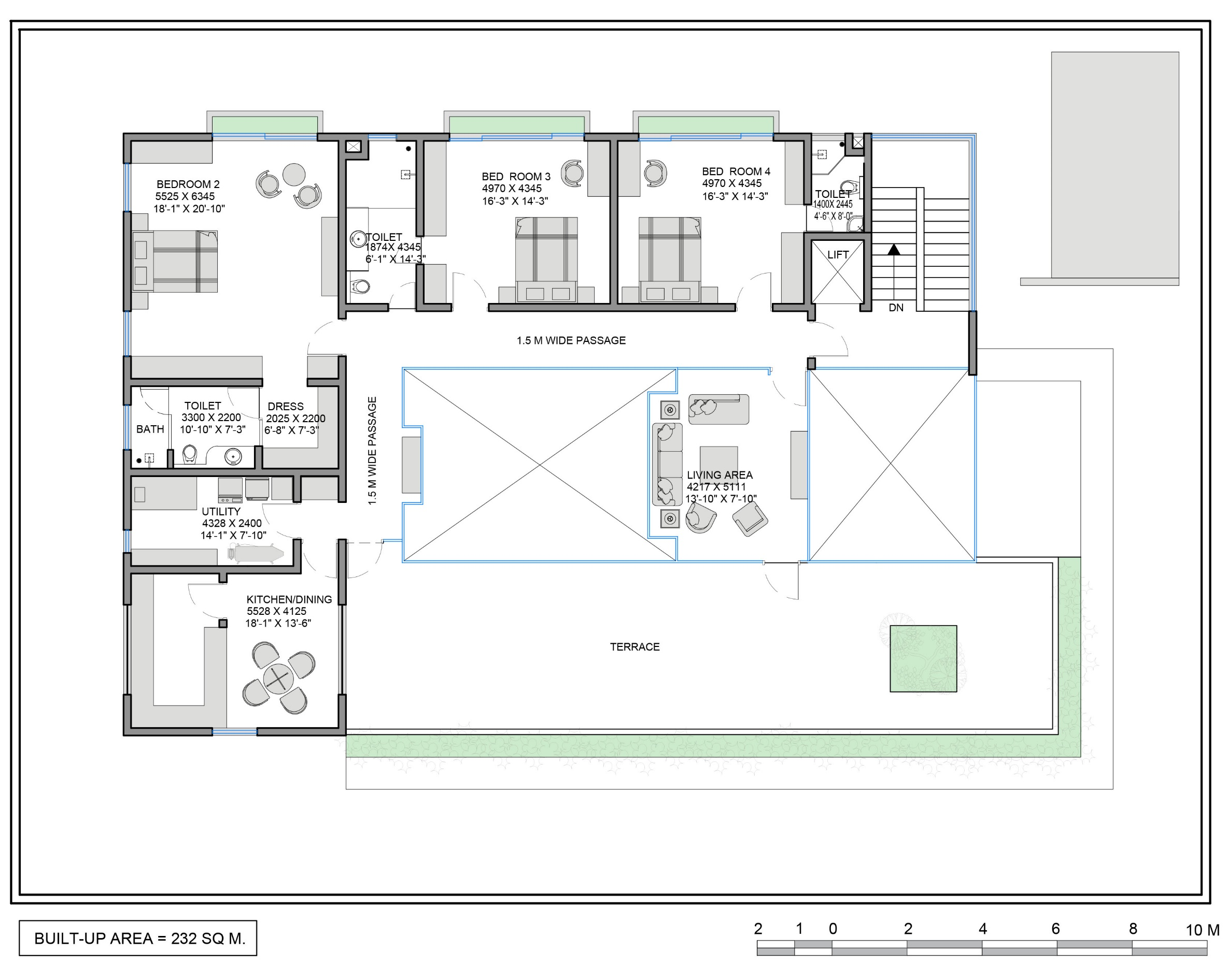
| RESIDENCE OF MRS JYOTI & MR. SHEKHAR REDDY | FIRST FLOOR LAYOUT |

Slide 9
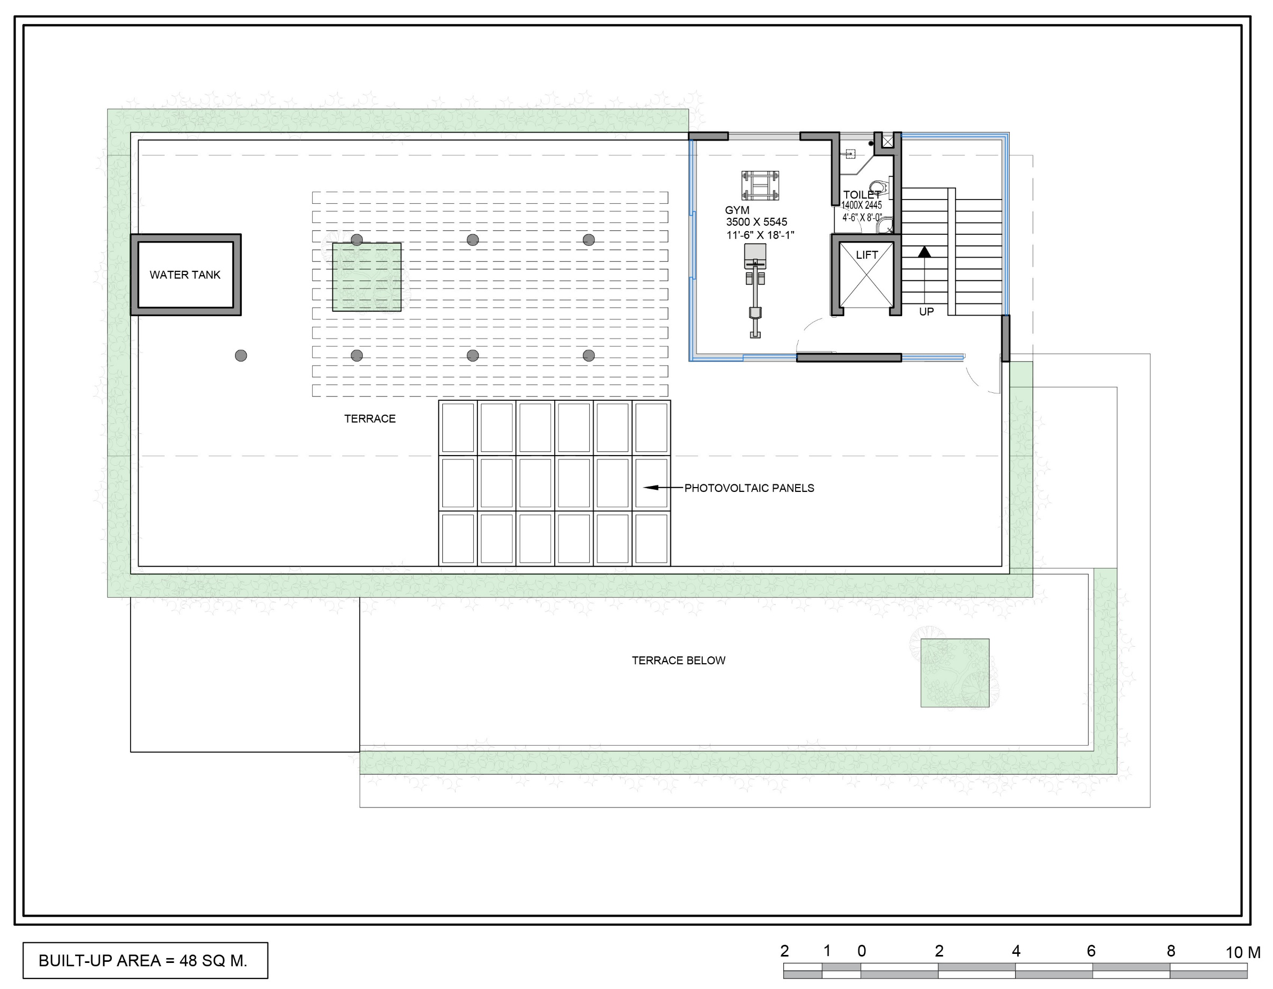
| RESIDENCE OF MRS JYOTI & MR. SHEKHAR REDDY | TERRACE FLOOR LAYOUT |

Slide 10
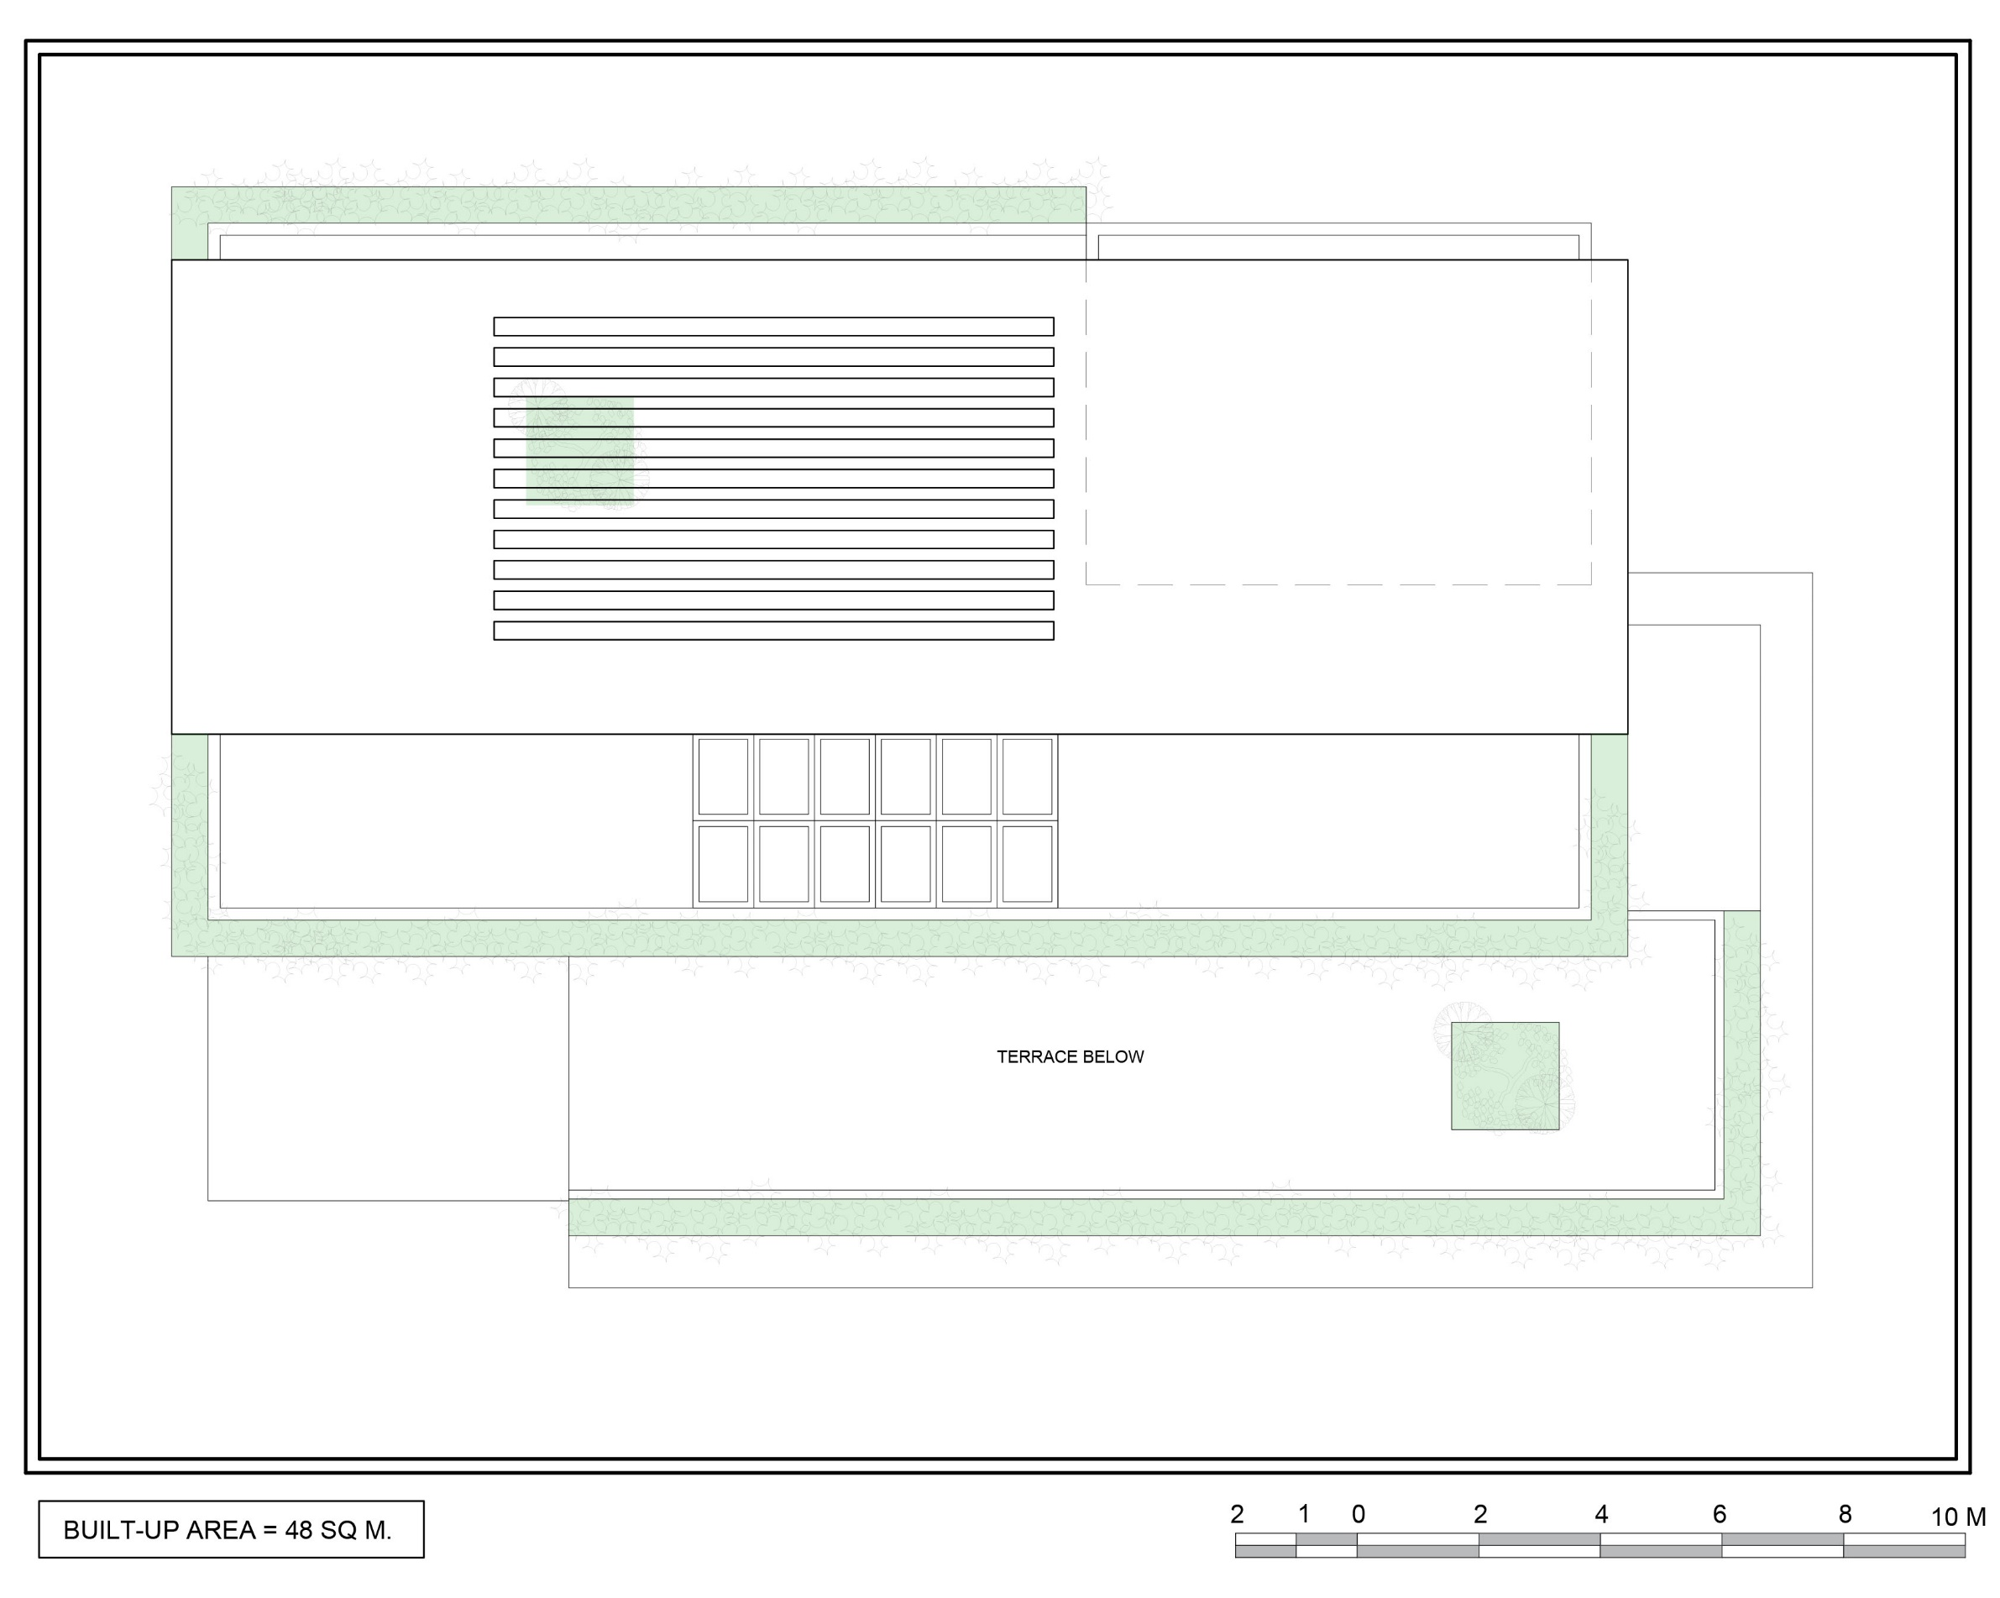
| RESIDENCE OF MRS JYOTI & MR. SHEKHAR REDDY | ROOF FLOOR LAYOUT |

Slide 11
ELEVATIONS – OPTION 1

Slide 12
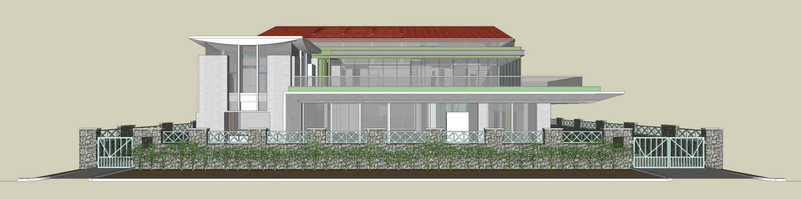
| RESIDENCE OF MRS JYOTI & MR. SHEKHAR REDDY | EAST-SIDE ELEVATION |

Slide 13
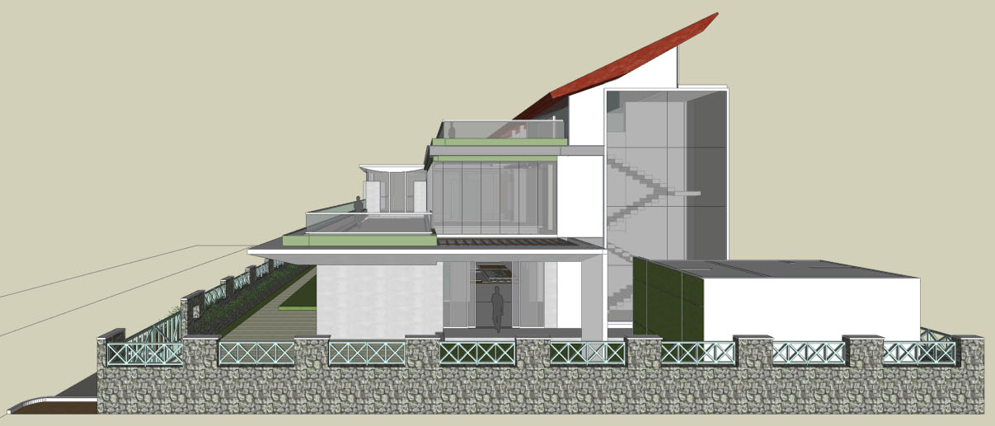
| RESIDENCE OF MRS JYOTI & MR. SHEKHAR REDDY | NORTH-SIDE ELEVATION |

Slide 14
ELEVATIONS – OPTION 1

Slide 15
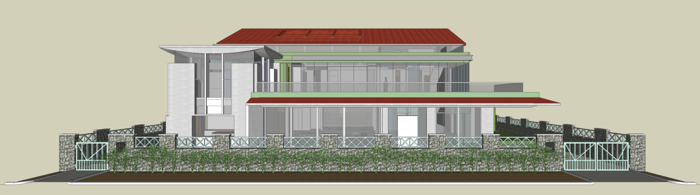
| RESIDENCE OF MRS JYOTI & MR. SHEKHAR REDDY | EAST-SIDE ELEVATION |

Slide 16
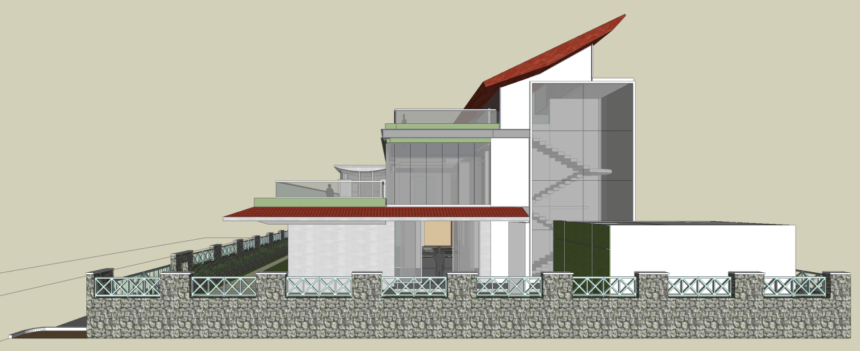
| RESIDENCE OF MRS JYOTI & MR. SHEKHAR REDDY | NORTH-SIDE ELEVATION |

Slide 17
ELEVATIONS – OPTION 2

Slide 18
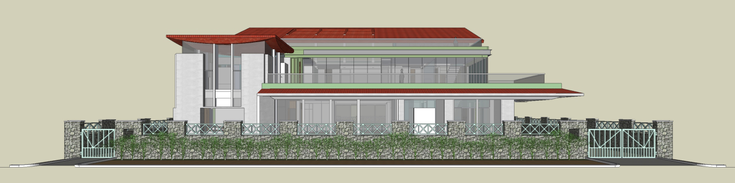
| RESIDENCE OF MRS JYOTI & MR. SHEKHAR REDDY | EAST-SIDE ELEVATION |

Slide 19
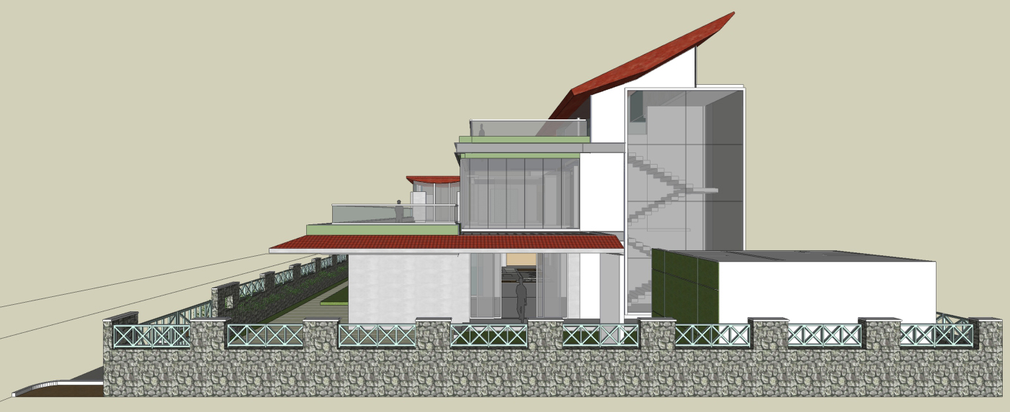
| RESIDENCE OF MRS JYOTI & MR. SHEKHAR REDDY | NORTH-SIDE ELEVATION |

Slide 20
ELEVATIONS – OPTION 2

Slide 21
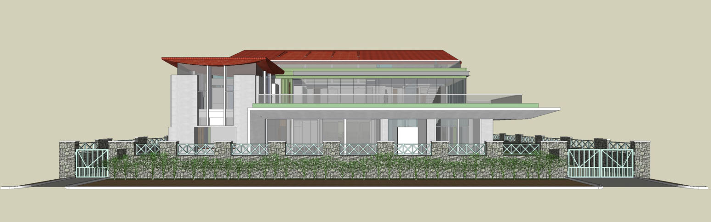
| RESIDENCE OF MRS JYOTI & MR. SHEKHAR REDDY | EAST-SIDE ELEVATION |

Slide 22
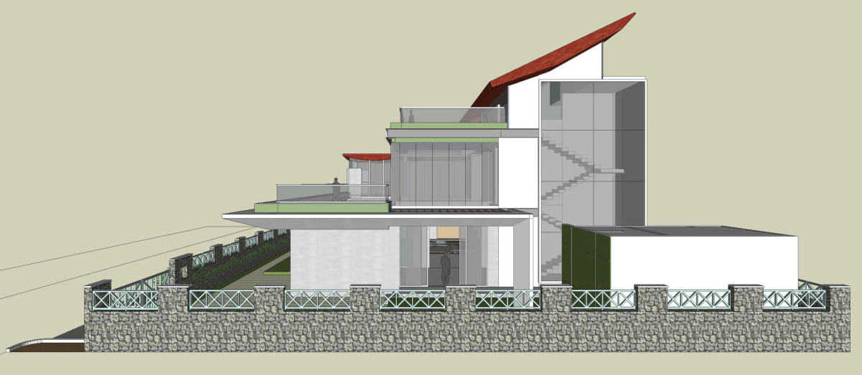
| RESIDENCE OF MRS JYOTI & MR. SHEKHAR REDDY | NORTH-SIDE ELEVATION |

Slide 23
WVOA CONTROL ON THE RE-BUILDING OR MODIFYING THE VILLAS.

Slide 24
The Original SET-BACKS of the building should be maintained for plot size below 440sq.yards
The Maximum permissible limit of the building height shall not exceed 11mtrs., from the Natural Ground level. (Ground + 2 Floors.)
The Front Elevation should be retained as per the Original Design with dropping roofs or as amended there upon; if any in AGM / EGM.
The Common Compound walls should be retained in original.
The original colour Scheme of the building shall be preserved or as decided by the AGM / EGM.
The Gate design and colour must remain original.
The Driveway should follow the original Symmetry to avoid Stormwater drain getting chocked.
Patio must be there, Design can vary, just to give uniformity
Out house (Servant quarter) can be increased with one more room of the same size excluding additional toilet facility. This should not disturb the neighbours ventilation and block natural lighting. The height must be retained as original / cannot be increased.
| RESIDENCE OF MRS JYOTI & MR. SHEKHAR REDDY | WVOA CONTROL ON RE-BUILDING VILLA |

Slide 25
ELEVATIONS HIGHLIGHTING WVOA RULES

Slide 26
Mangalore tile red coloured sloping roof as in existing scheme
White coloured / white conc. finish external walls retained as in the existing scheme
Planter boxes painted in identical green colour
Overhang canopy/patio
Compound wall retained
| RESIDENCE OF MRS JYOTI & MR. SHEKHAR REDDY | EAST-SIDE ELEVATION HIGHLIGHTING WVOA RULES |

Slide 27
Mangalore tile red coloured sloping roof as in existing scheme
Planter boxes painted in identical green colour
Overhang canopy/patio
White coloured / white conc. finish external walls retained as in the existing scheme
Servant quarter – low height (not obstructing neighbour’s view)
| RESIDENCE OF MRS JYOTI & MR. SHEKHAR REDDY | NORTH-SIDE ELEVATION HIGHLIGHTING WVOA RULES |

Slide 28
Mangalore tile red coloured sloping roof as in existing scheme
White coloured / white conc. finish external walls retained as in the existing scheme
Planter boxes painted in identical green colour
Overhang canopy/patio
Compound wall retained
| RESIDENCE OF MRS JYOTI & MR. SHEKHAR REDDY | EAST-SIDE ELEVATION HIGHLIGHTING WVOA RULES |

Slide 29
Mangalore tile red coloured sloping roof as in existing scheme
Planter boxes painted in identical green colour
Overhang canopy/patio
White coloured / white conc. finish external walls retained as in the existing scheme
Servant quarter – low height (not obstructing neighbour’s view)
| RESIDENCE OF MRS JYOTI & MR. SHEKHAR REDDY | NORTH-SIDE ELEVATION HIGHLIGHTING WVOA RULES |

Slide 30
Mangalore tile red coloured sloping roof as in existing scheme
White coloured / white conc. finish external walls retained as in the existing scheme
Planter boxes painted in identical green colour
11 M
Overhang canopy/patio
Compound wall retained
| RESIDENCE OF MRS JYOTI & MR. SHEKHAR REDDY | EAST-SIDE ELEVATION HIGHLIGHTING WVOA RULES |

Slide 31
Mangalore tile red coloured sloping roof as in existing scheme
Planter boxes painted in identical green colour
Overhang canopy/patio
White coloured / white conc. finish external walls retained as in the existing scheme
11 M
Servant quarter – low height (not obstructing neighbour’s view)
| RESIDENCE OF MRS JYOTI & MR. SHEKHAR REDDY | NORTH-SIDE ELEVATION HIGHLIGHTING WVOA RULES |

Slide 32
Mangalore tile red coloured sloping roof as in existing scheme
White coloured / white conc. finish external walls retained as in the existing scheme
Planter boxes painted in identical green colour
Overhang canopy/patio
Compound wall retained
| RESIDENCE OF MRS JYOTI & MR. SHEKHAR REDDY | EAST-SIDE ELEVATION HIGHLIGHTING WVOA RULES |

Slide 33
Mangalore tile red coloured sloping roof as in existing scheme
Planter boxes painted in identical green colour
Overhang canopy/patio
White coloured / white conc. finish external walls retained as in the existing scheme
11 M
Servant quarter – low height (not obstructing neighbour’s view)
| RESIDENCE OF MRS JYOTI & MR. SHEKHAR REDDY | NORTH-SIDE ELEVATION HIGHLIGHTING WVOA RULES |

Slide 34
3D VISUALIZATION

Slide 35
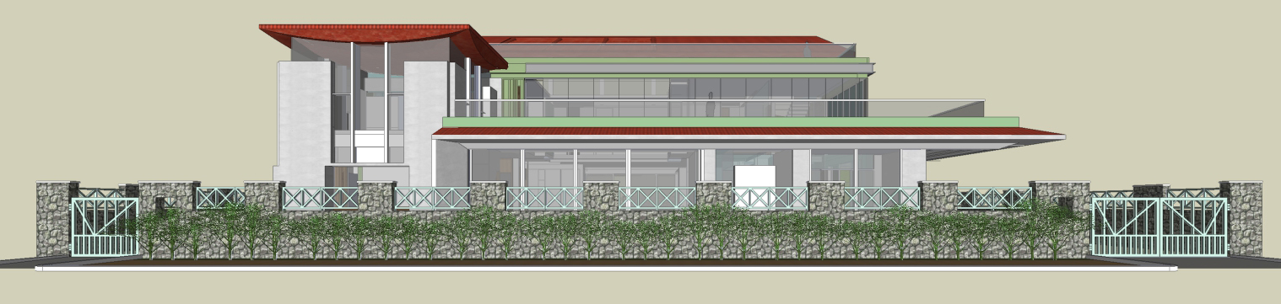
| RESIDENCE OF MRS JYOTI & MR. SHEKHAR REDDY | EAST VIEW AT 1.5M EYE LEVEL |

Slide 36
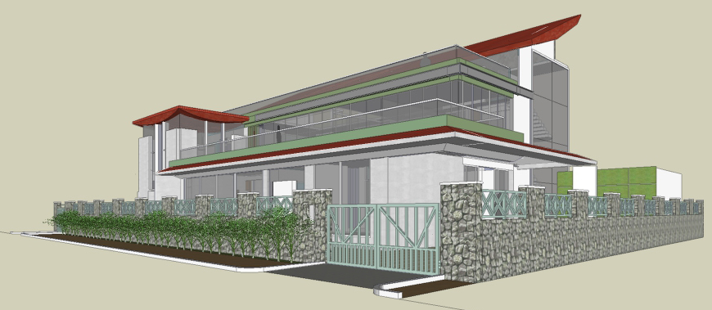
| RESIDENCE OF MRS JYOTI & MR. SHEKHAR REDDY | N-E VIEW AT 1.5M EYE LEVEL |

Slide 37
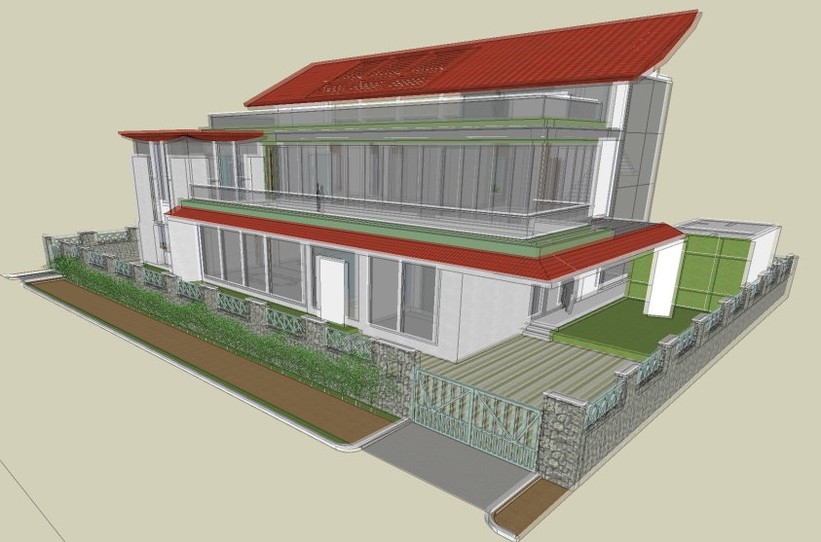
| RESIDENCE OF MRS JYOTI & MR. SHEKHAR REDDY | N-E VIEW |

Slide 38
3D VISUALIZATION

Slide 39
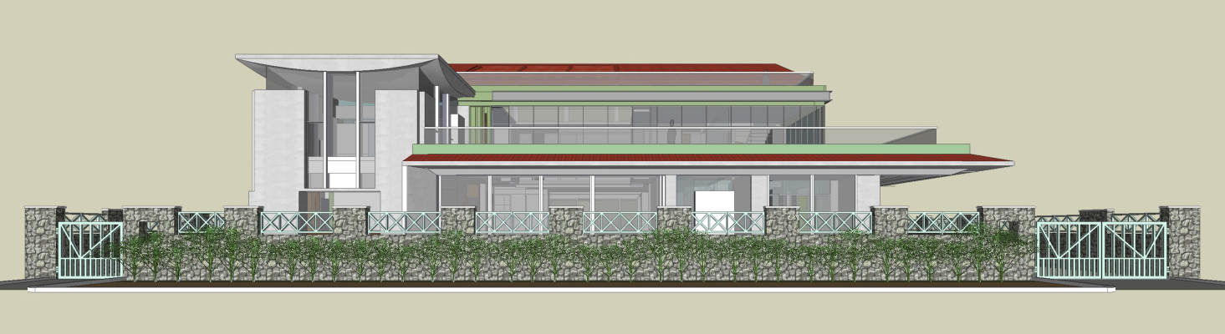
| RESIDENCE OF MRS JYOTI & MR. SHEKHAR REDDY | EAST VIEW AT 1.5M EYE LEVEL |

Slide 40
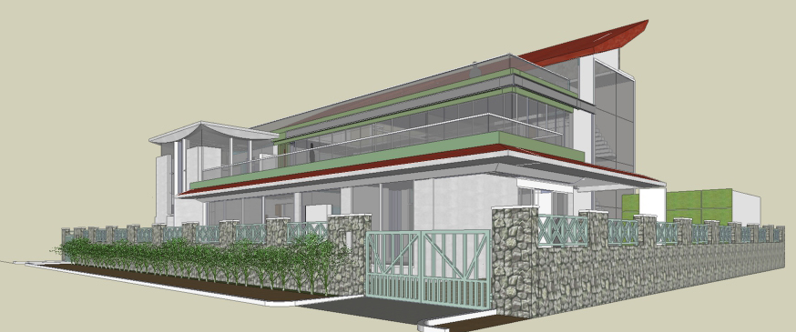
| RESIDENCE OF MRS JYOTI & MR. SHEKHAR REDDY | N-E VIEW AT 1.5M EYE LEVEL |

Slide 41
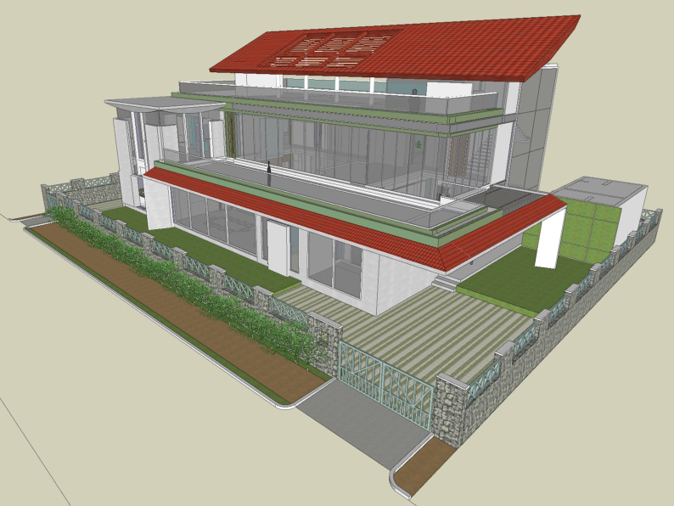
| RESIDENCE OF MRS JYOTI & MR. SHEKHAR REDDY | N-E VIEW |

Slide 42
3D VISUALIZATION

Slide 43
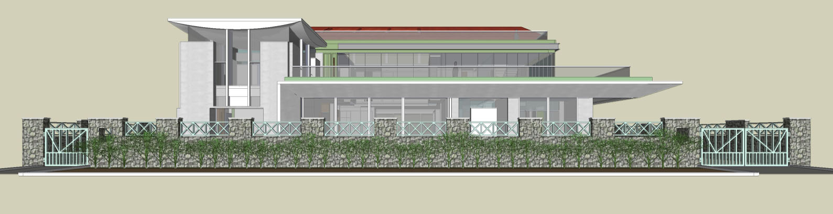
| RESIDENCE OF MRS JYOTI & MR. SHEKHAR REDDY | EAST VIEW AT 1.5M EYE LEVEL |

Slide 44
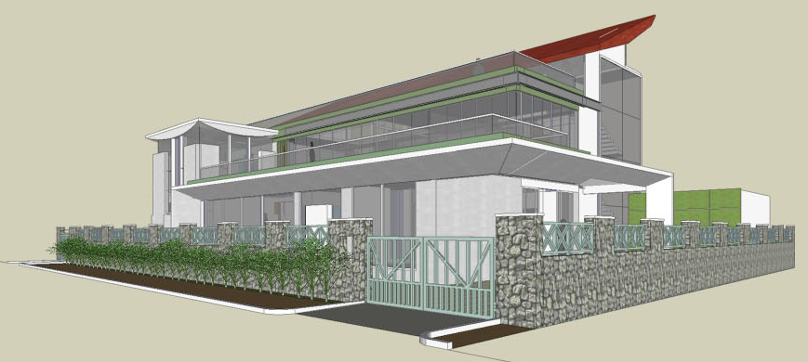
| RESIDENCE OF MRS JYOTI & MR. SHEKHAR REDDY | N-E VIEW AT 1.5M EYE LEVEL |

Slide 45
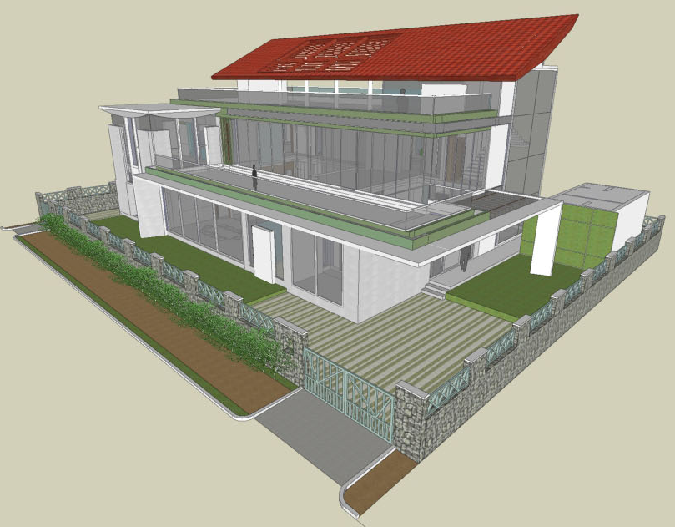
| RESIDENCE OF MRS JYOTI & MR. SHEKHAR REDDY | N-E VIEW |

Slide 46
3D VISUALIZATION

Slide 47
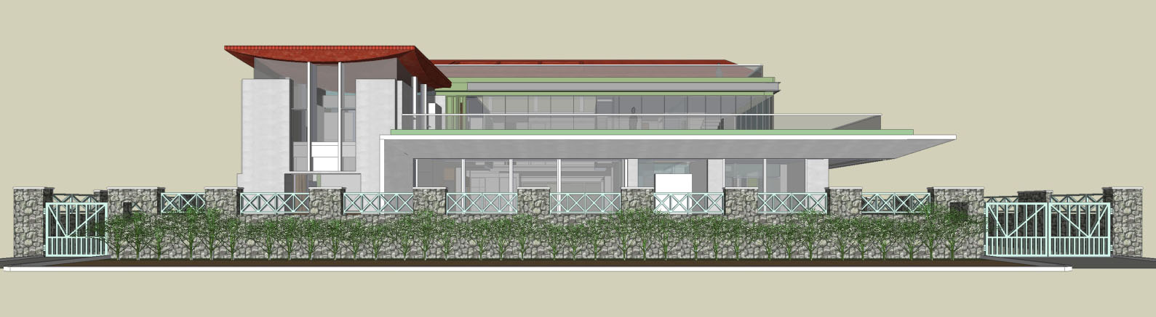
| RESIDENCE OF MRS JYOTI & MR. SHEKHAR REDDY | EAST VIEW AT 1.5M EYE LEVEL |

Slide 48
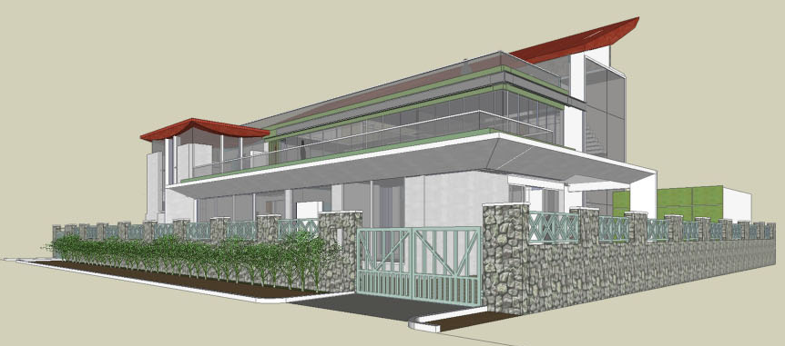
| RESIDENCE OF MRS JYOTI & MR. SHEKHAR REDDY | N-E VIEW AT 1.5M EYE LEVEL |

Slide 49
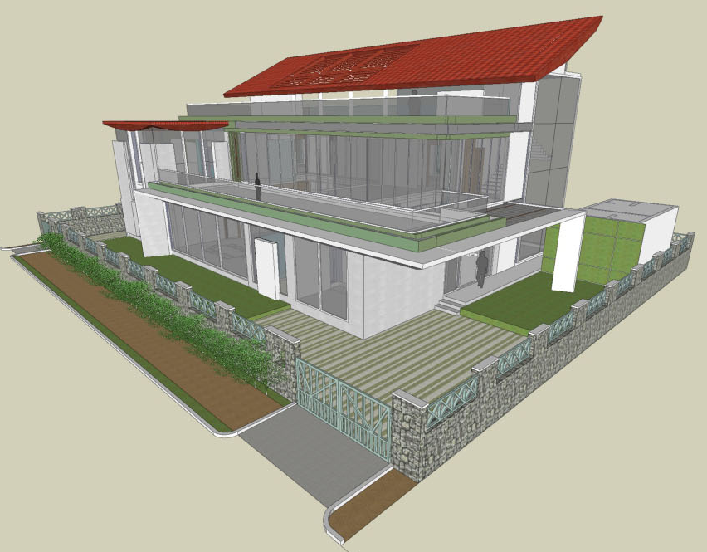
| RESIDENCE OF MRS JYOTI & MR. SHEKHAR REDDY | N-E VIEW |

Slide 50
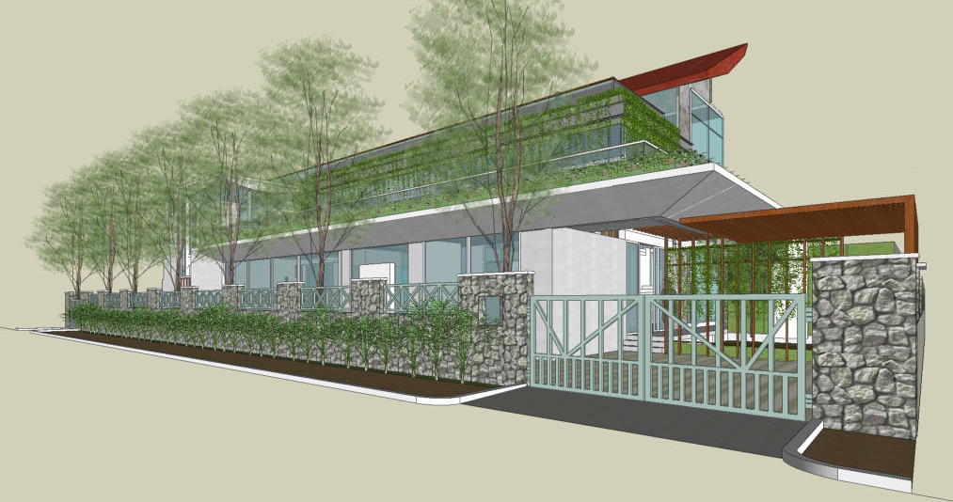
| RESIDENCE OF MRS JYOTI & MR. SHEKHAR REDDY | N-E VIEW AT 1.5M EYE LEVEL |

Slide 51
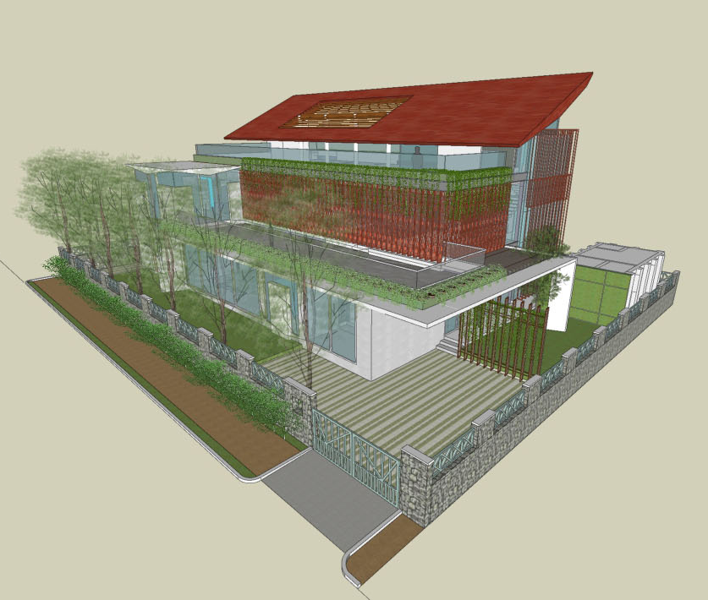
| RESIDENCE OF MRS JYOTI & MR. SHEKHAR REDDY | N-E VIEW |

Slide 52
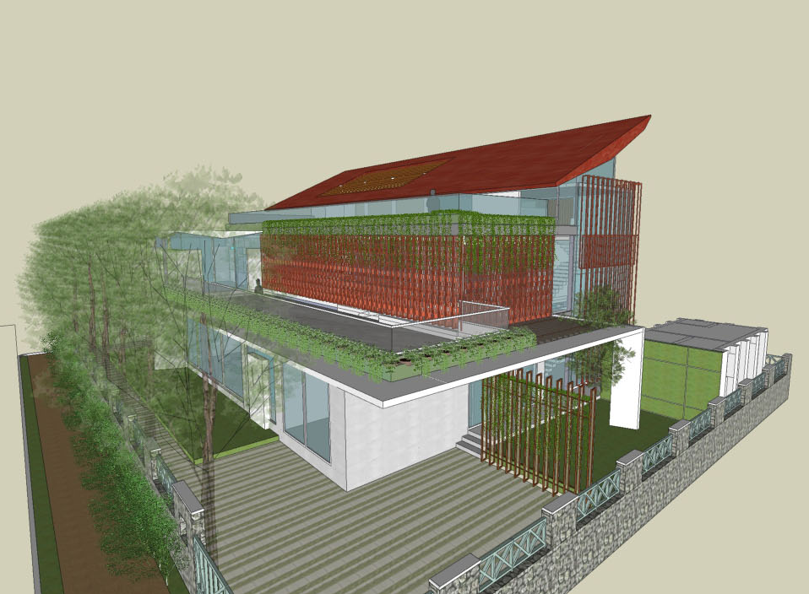
| RESIDENCE OF MRS JYOTI & MR. SHEKHAR REDDY | N-E VIEW |

Slide 53
THANK YOU

