Slide 1
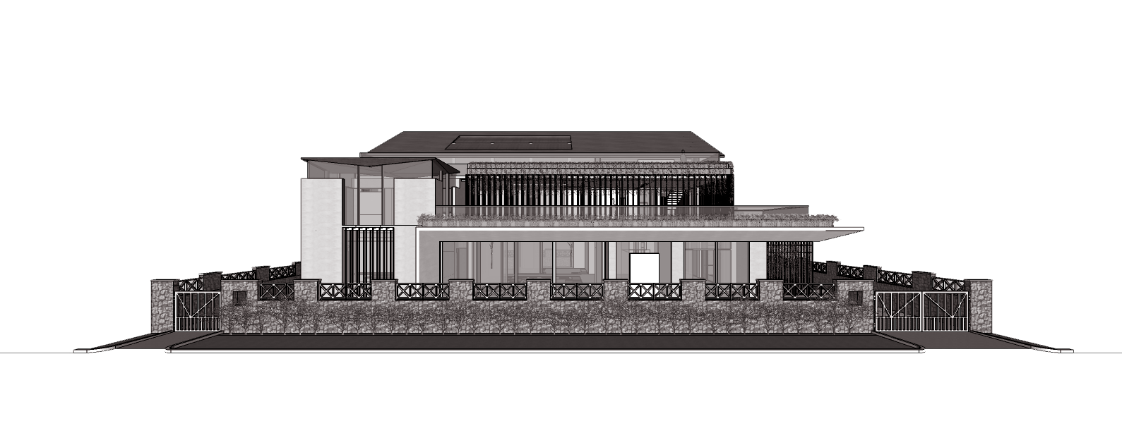
RESIDENCE OF MRS JYOTI & MR. SHEKHAR REDDY, HYDERABAD
SCHEMATIC DESIGN PROPOSAL – ELEVATION OPTIONS
January 2022

Slide 2
OPTION - 1

Slide 3
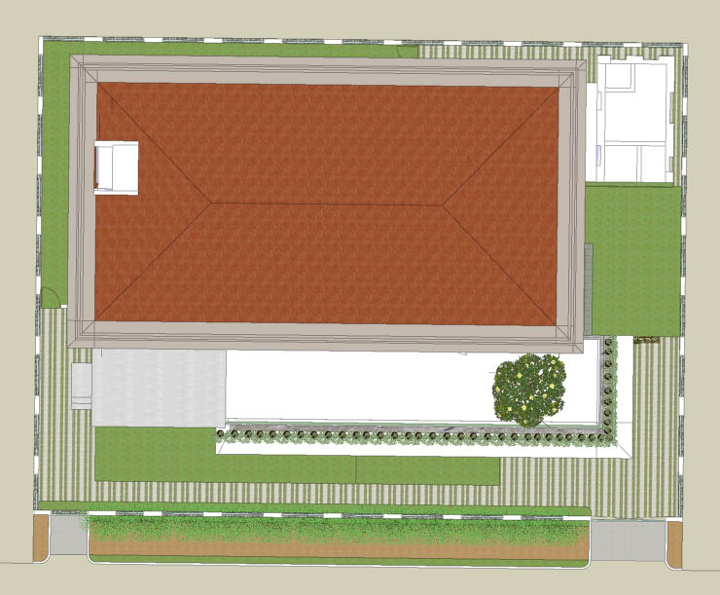
Landscape Garden
Servant’s quarter
Mangalore tile red coloured sloping roof
Landscape Garden
Terrace at 1st floor
Landscape Garden
Entry/Exit
Entry/Exit
| RESIDENCE OF MRS JYOTI & MR. SHEKHAR REDDY | ROOF TOP VIEW|

Slide 4
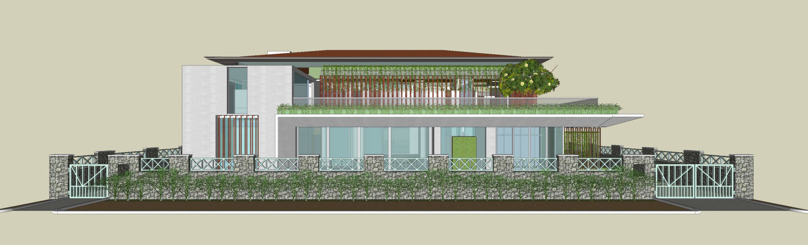
Mangalore tile red coloured sloping roof as in existing scheme
White coloured / white conc. finish external walls retained as in the existing scheme
Planter boxes painted in identical green colour
Overhang canopy/patio
Compound wall retained
| RESIDENCE OF MRS JYOTI & MR. SHEKHAR REDDY | EAST-SIDE ELEVATION |

Slide 5
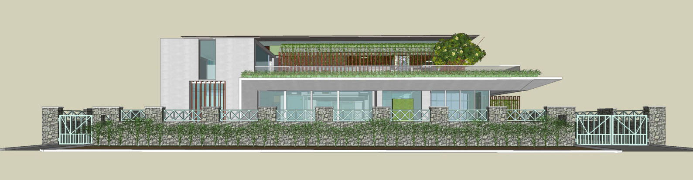
| RESIDENCE OF MRS JYOTI & MR. SHEKHAR REDDY | EAST-SIDE ELEVATION AT 1.5M EYE-LVL. |

Slide 6
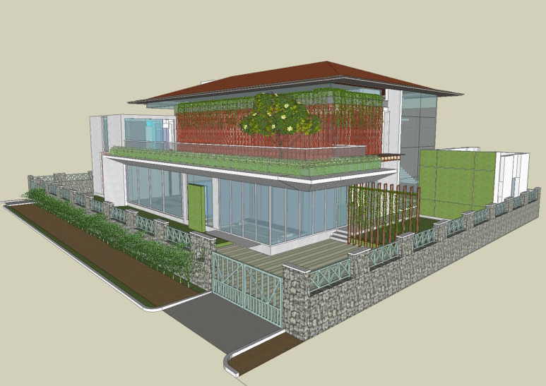
Mangalore tile red coloured sloping roof as in existing scheme
White coloured / white conc. finish external walls retained as in the existing scheme
Planter boxes painted in identical green colour
Overhang canopy/patio
Compound wall + Entrance gate retained
| RESIDENCE OF MRS JYOTI & MR. SHEKHAR REDDY | N-E VIEW |

Slide 7
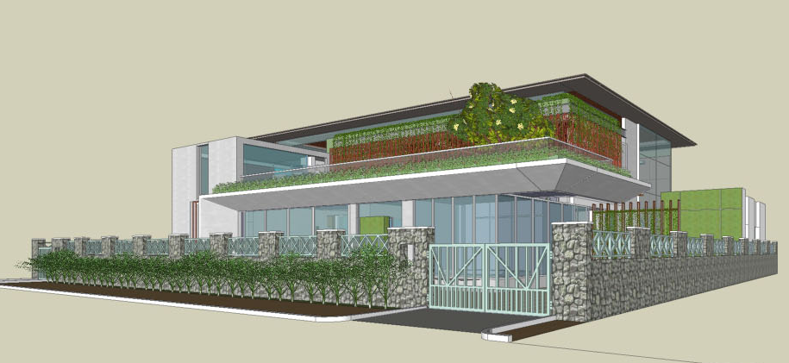
| RESIDENCE OF MRS JYOTI & MR. SHEKHAR REDDY | N-E VIEW AT 1.5M EYE-LVL. |

Slide 8
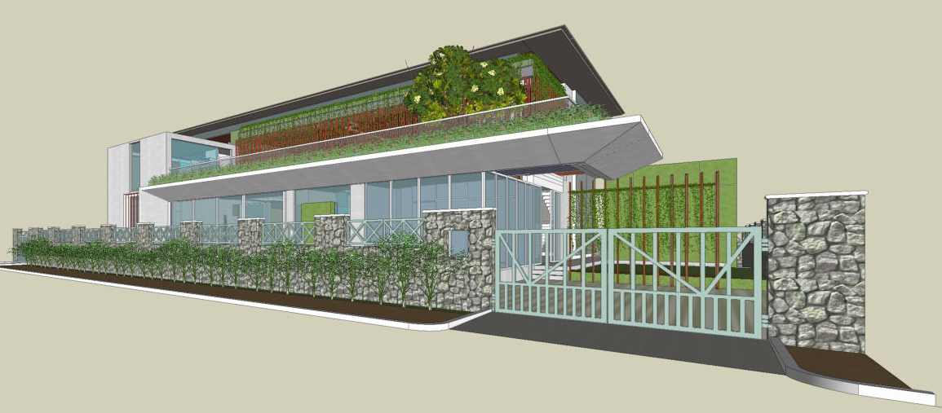
| RESIDENCE OF MRS JYOTI & MR. SHEKHAR REDDY | N-E VIEW AT 1.5M EYE-LVL. |

Slide 9
OPTION - 2

Slide 10
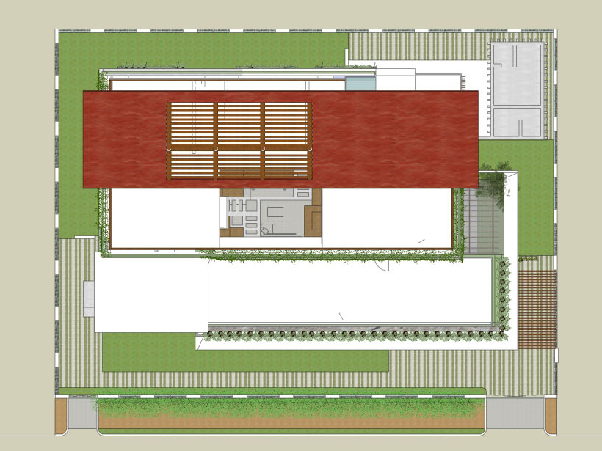
Landscape Garden
Servant’s quarter
Mangalore tile red coloured sloping roof
Landscape Garden
Skylight/ solar farm
Terrace at 2nd floor
Terrace at 1st floor
Landscape Garden
Car Park
Entry/Exit
Entry/Exit
| RESIDENCE OF MRS JYOTI & MR. SHEKHAR REDDY | ROOF TOP VIEW|

Slide 11
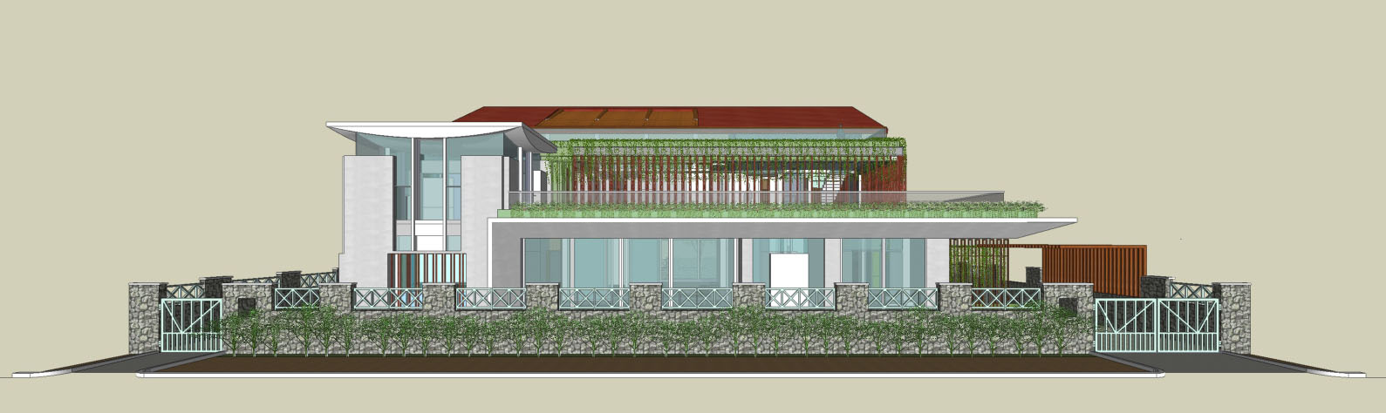
Mangalore tile red coloured sloping roof modified from the existing scheme
White coloured / white conc. finish external walls retained as in the existing scheme
Planter boxes painted in identical green colour
Overhang canopy/patio
Compound wall retained
| RESIDENCE OF MRS JYOTI & MR. SHEKHAR REDDY | EAST-SIDE ELEVATION |

Slide 12
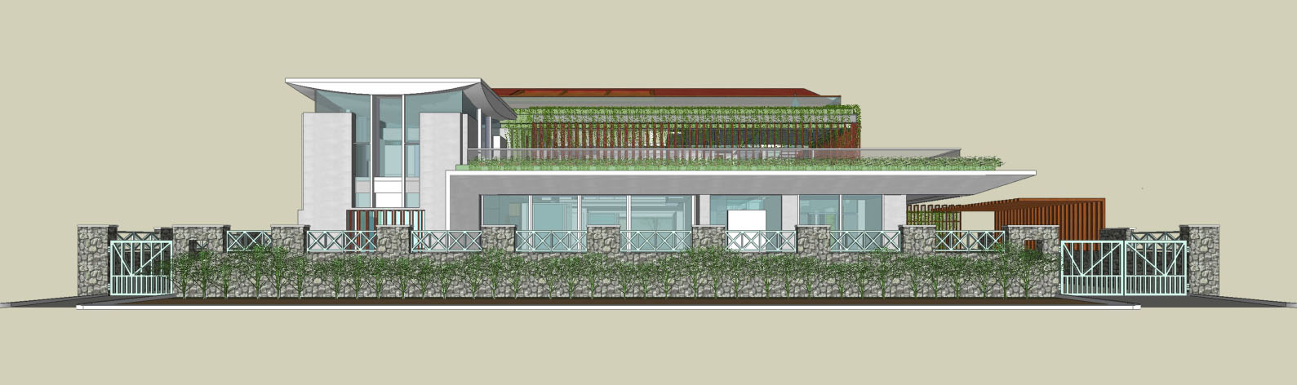
| RESIDENCE OF MRS JYOTI & MR. SHEKHAR REDDY | EAST-SIDE ELEVATION AT 1.5M EYE-LVL. |

Slide 13
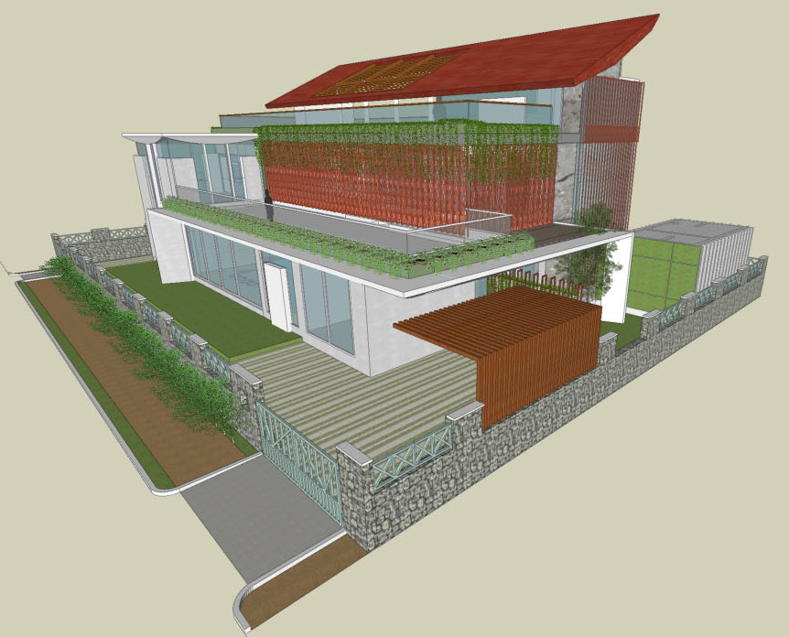
Mangalore tile red coloured sloping roof modified from existing scheme
White coloured / white conc. finish external walls retained as in the existing scheme
Planter boxes painted in identical green colour
Overhang canopy/patio
Compound wall retained
| RESIDENCE OF MRS JYOTI & MR. SHEKHAR REDDY | N-E VIEW |

Slide 14
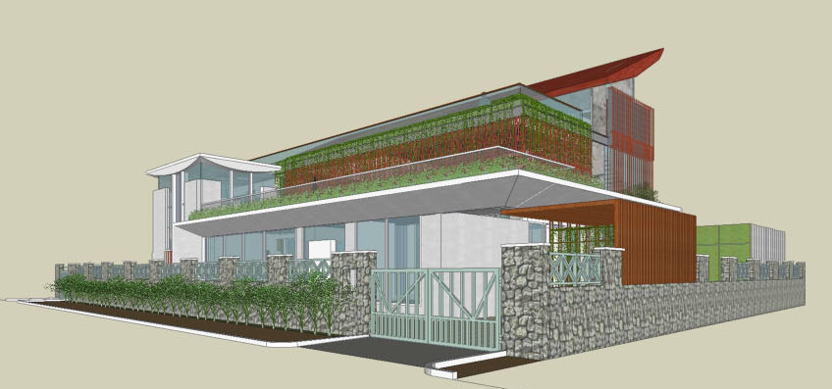
| RESIDENCE OF MRS JYOTI & MR. SHEKHAR REDDY | N-E VIEW AT 1.5M EYE-LVL. |

Slide 15
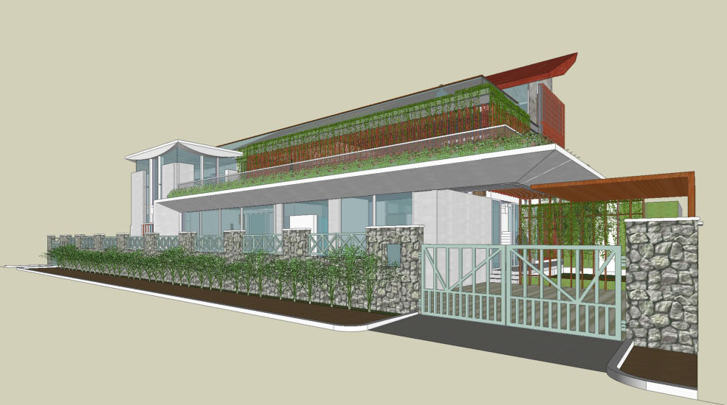
| RESIDENCE OF MRS JYOTI & MR. SHEKHAR REDDY | N-E VIEW AT 1.5M EYE-LVL. |

Slide 16
OPTION - 3

Slide 17
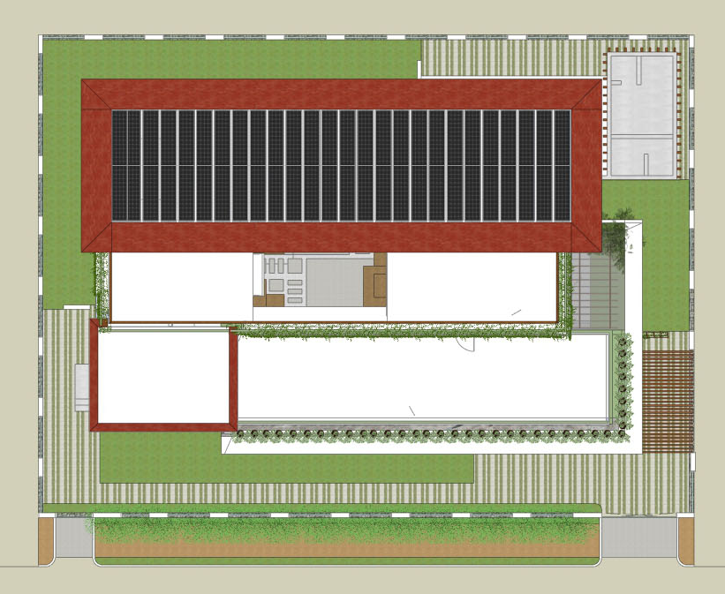
Landscape Garden
Mangalore tile red coloured sloping roof
Servant’s quarter
Solar farm
Landscape Garden
Skylight
Terrace at 2nd floor
Terrace at 1st floor
Landscape Garden
Car Park
Entry/Exit
Entry/Exit
| RESIDENCE OF MRS JYOTI & MR. SHEKHAR REDDY | ROOF TOP VIEW|

Slide 18
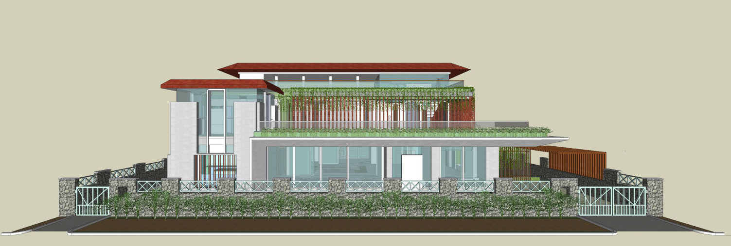
Mangalore tile red coloured sloping roof as in existing scheme
White coloured / white conc. finish external walls retained as in the existing scheme
Planter boxes painted in identical green colour
Overhang canopy/patio
Compound wall retained
| RESIDENCE OF MRS JYOTI & MR. SHEKHAR REDDY | EAST-SIDE ELEVATION |

Slide 19
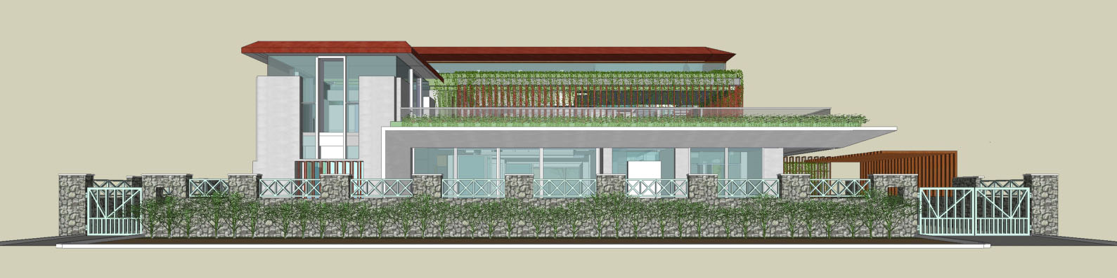
| RESIDENCE OF MRS JYOTI & MR. SHEKHAR REDDY | EAST-SIDE ELEVATION AT 1.5M EYE-LVL. |

Slide 20
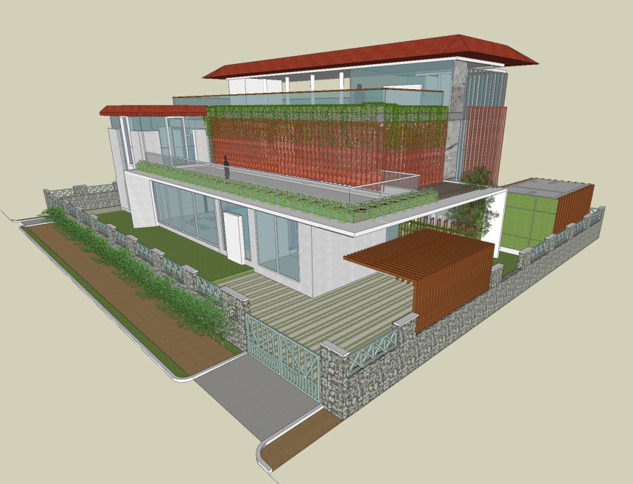
Mangalore tile red coloured sloping roof as in the existing scheme
White coloured / white conc. finish external walls retained as in the existing scheme
Planter boxes painted in identical green colour
Overhang canopy/patio
Compound wall retained
| RESIDENCE OF MRS JYOTI & MR. SHEKHAR REDDY | N-E VIEW |

Slide 21
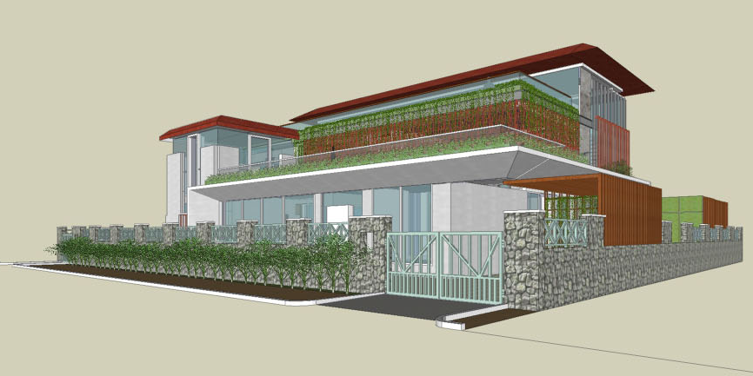
| RESIDENCE OF MRS JYOTI & MR. SHEKHAR REDDY | N-E VIEW AT 1.5M EYE-LVL. |

Slide 22
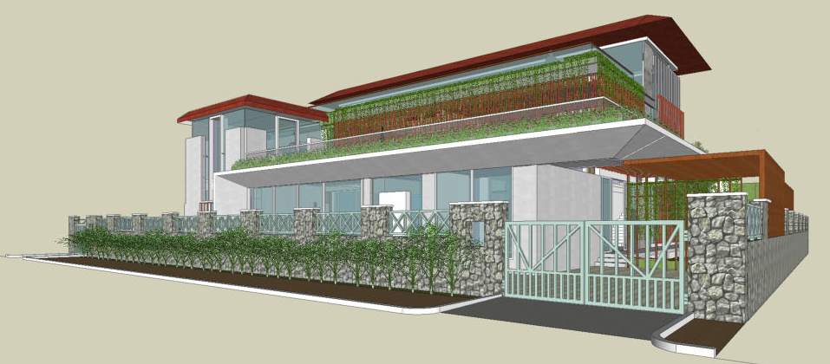
| RESIDENCE OF MRS JYOTI & MR. SHEKHAR REDDY | N-E VIEW AT 1.5M EYE-LVL. |

Slide 23
OPTION - 4

Slide 24
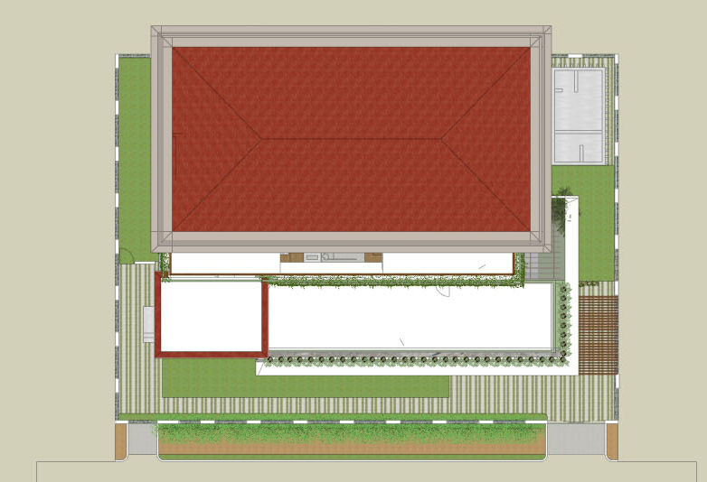
Mangalore tile red coloured sloping roof
Servant’s quarter
Landscape Garden
Skylight
Terrace at 2nd floor
Terrace at 1st floor
Landscape Garden
Car Park
Entry/Exit
Entry/Exit
| RESIDENCE OF MRS JYOTI & MR. SHEKHAR REDDY | ROOF TOP VIEW|

Slide 25
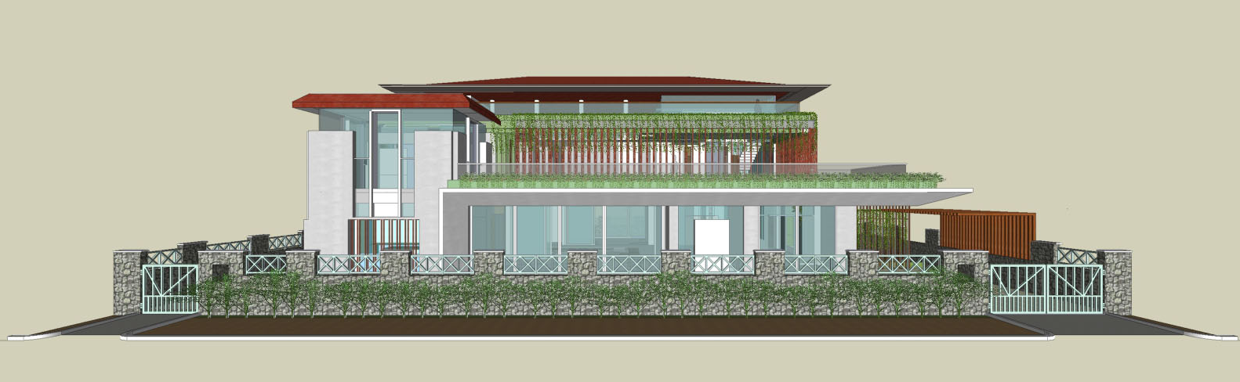
Mangalore tile red coloured sloping roof as in existing scheme
White coloured / white conc. finish external walls retained as in the existing scheme
Planter boxes painted in identical green colour
Overhang canopy/patio
Compound wall retained
| RESIDENCE OF MRS JYOTI & MR. SHEKHAR REDDY | EAST-SIDE ELEVATION |

Slide 26
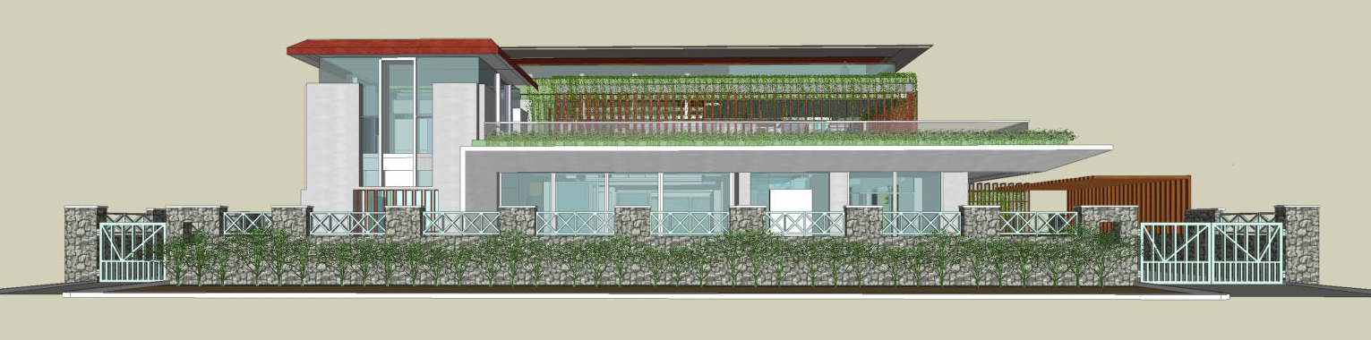
| RESIDENCE OF MRS JYOTI & MR. SHEKHAR REDDY | EAST-SIDE ELEVATION AT 1.5M EYE-LVL. |

Slide 27
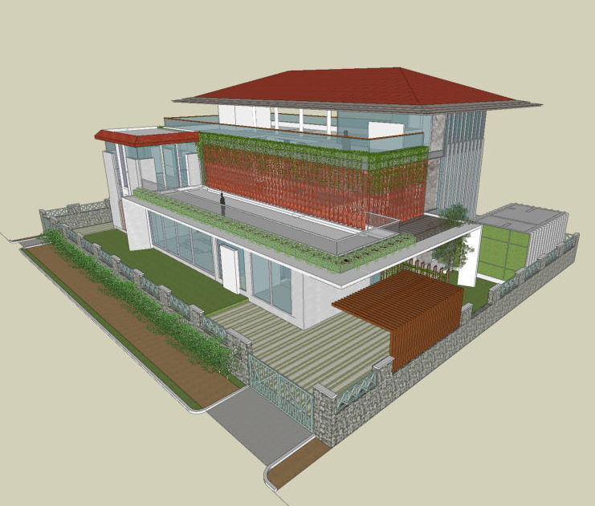
Mangalore tile red coloured sloping roof as in the existing scheme
White coloured / white conc. finish external walls retained as in the existing scheme
Planter boxes painted in identical green colour
Overhang canopy/patio
Compound wall retained
| RESIDENCE OF MRS JYOTI & MR. SHEKHAR REDDY | N-E VIEW |

Slide 28
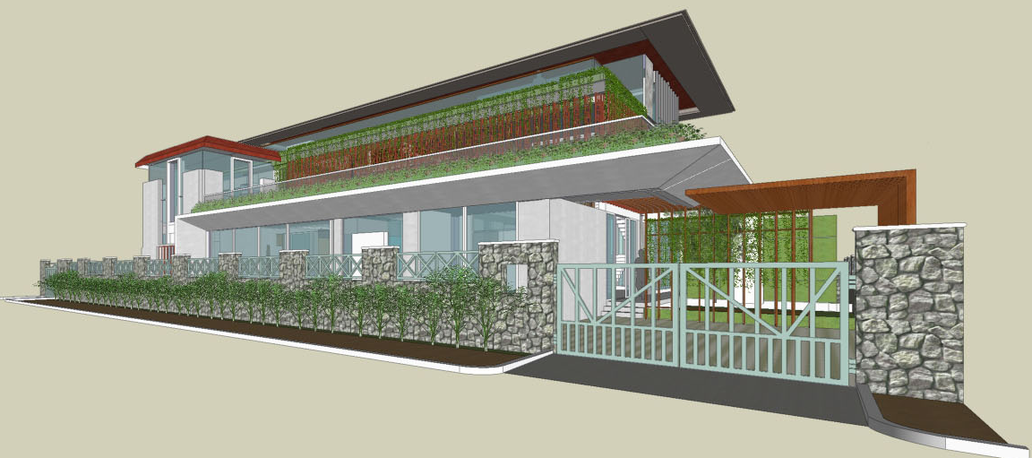
| RESIDENCE OF MRS JYOTI & MR. SHEKHAR REDDY | N-E VIEW AT 1.5M EYE-LVL. |

Slide 29
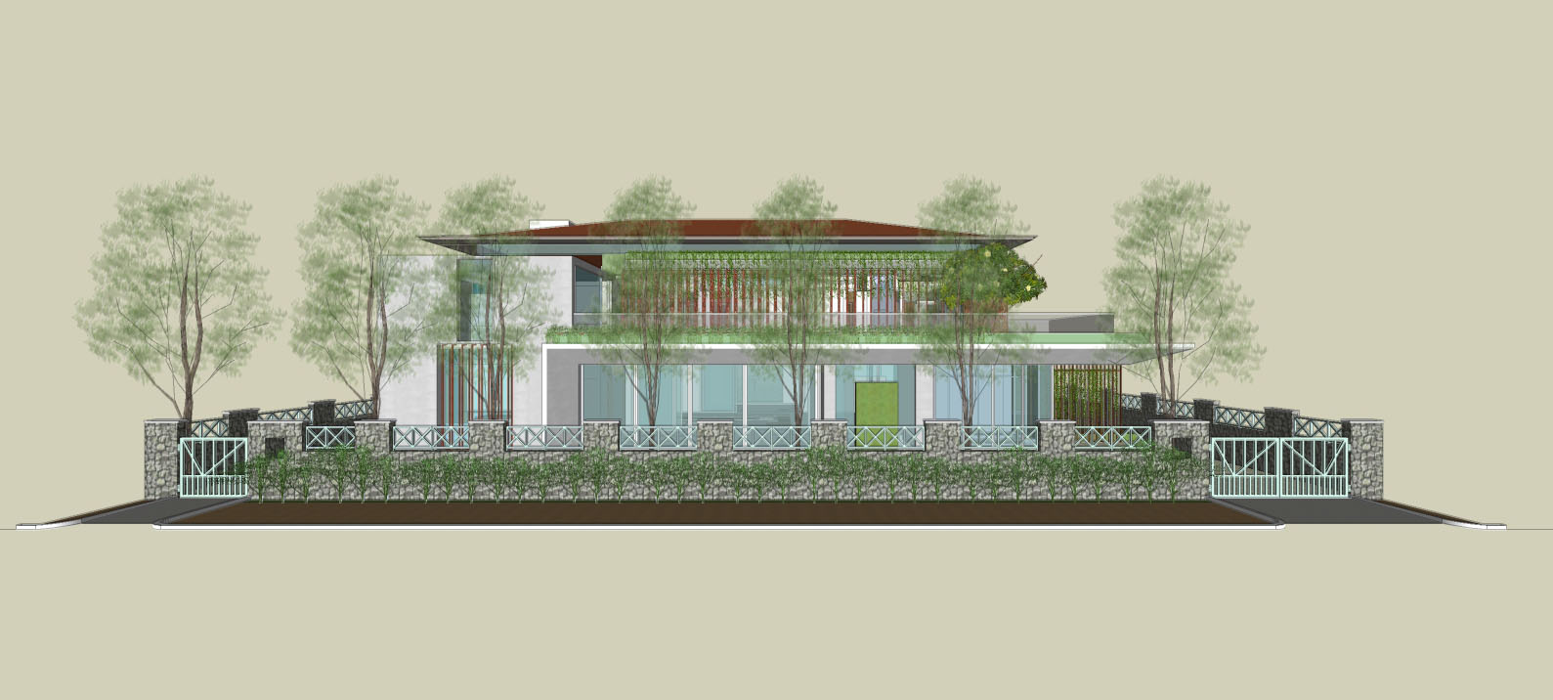
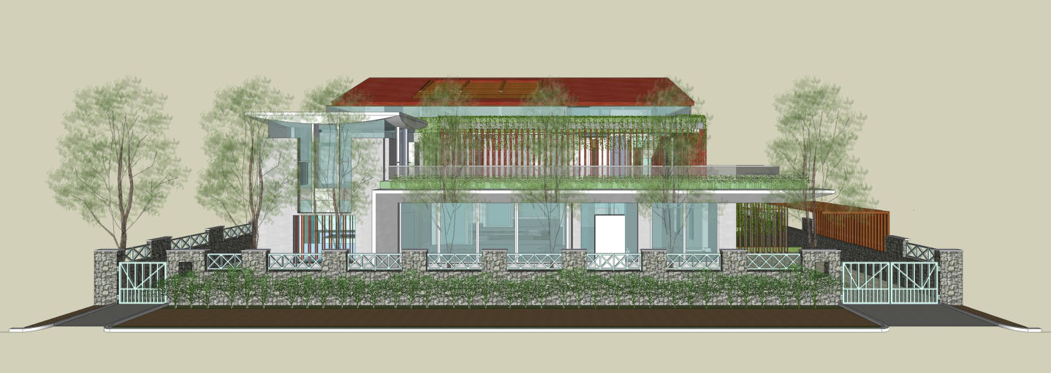
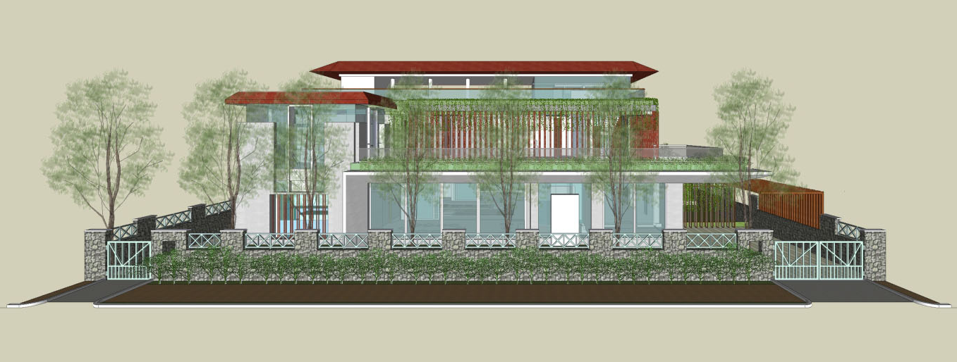
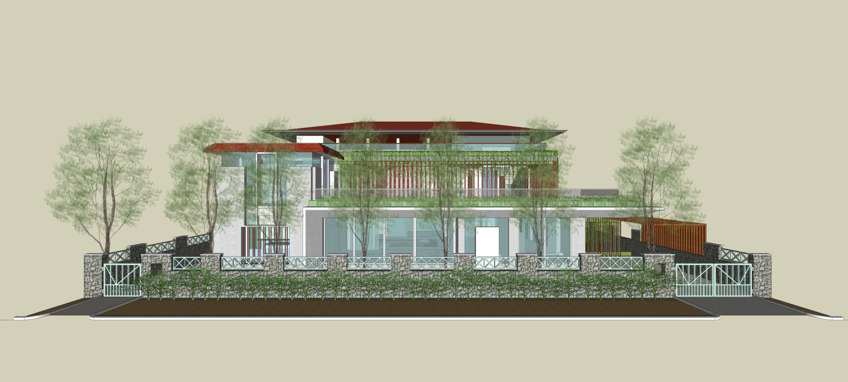
With Lines of existing trees
OPTION -1
OPTION - 2
OPTION - 3
OPTION - 4
| RESIDENCE OF MRS JYOTI & MR. SHEKHAR REDDY | COMPARATIVE - 4 OPTIONS – EAST ELEVATIONS |

Slide 30
Without Lines of existing trees
OPTION -1
OPTION - 2
OPTION - 3
OPTION - 4
| RESIDENCE OF MRS JYOTI & MR. SHEKHAR REDDY | COMPARATIVE - 4 OPTIONS – EAST ELEVATIONS |

Slide 31
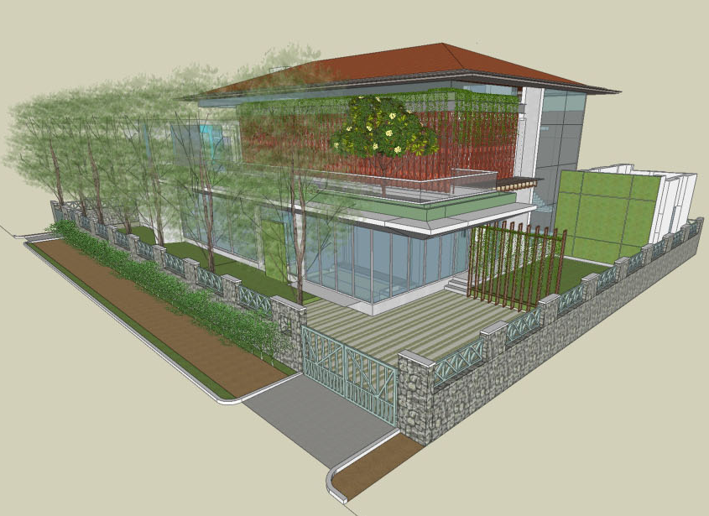
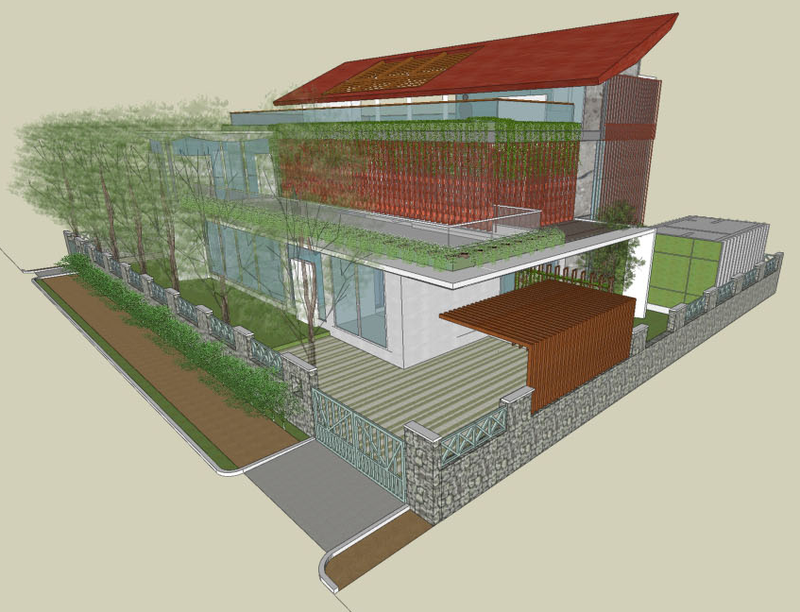
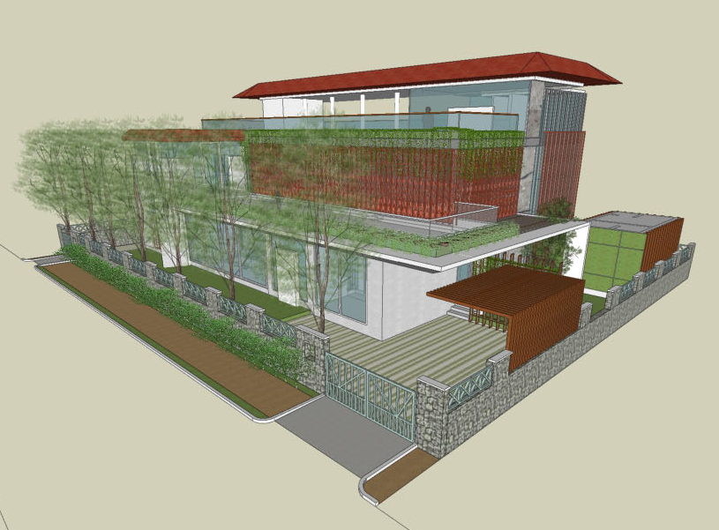
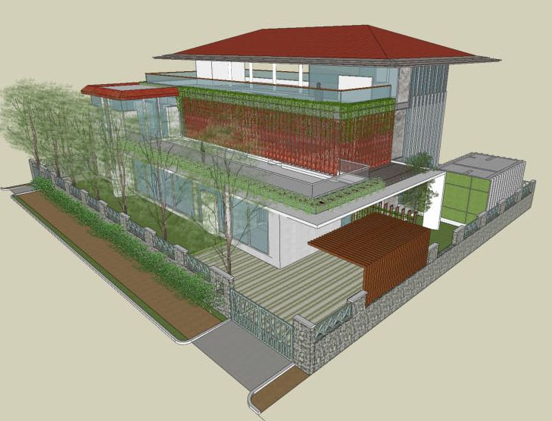
OPTION -1
OPTION - 2
OPTION - 3
OPTION - 4
| RESIDENCE OF MRS JYOTI & MR. SHEKHAR REDDY | COMPARATIVE - 4 OPTIONS – N-E VIEW |

Slide 32
OPTION -1
OPTION - 2
OPTION - 3
OPTION - 4
| RESIDENCE OF MRS JYOTI & MR. SHEKHAR REDDY | COMPARATIVE - 4 OPTIONS – N-E VIEW |

Slide 33
THANK YOU

