Slide 1
RESIDENCE OF MRS JYOTHI & MR. SHEKHAR REDDY, HYDERABAD
September 2021

Slide 2
LAYOUTS

Slide 3
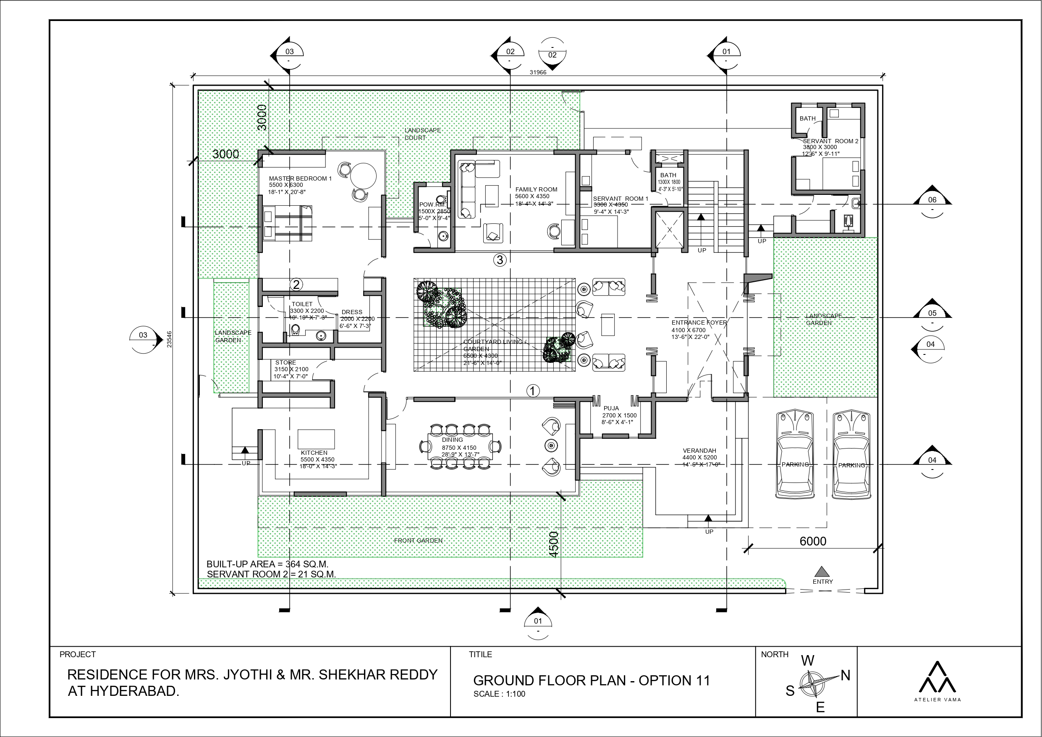
| RESIDENCE OF MRS JYOTHI & MR. SHEKHAR REDDY | FURNITURE LAYOUT- GROUND FLOOR|

Slide 4
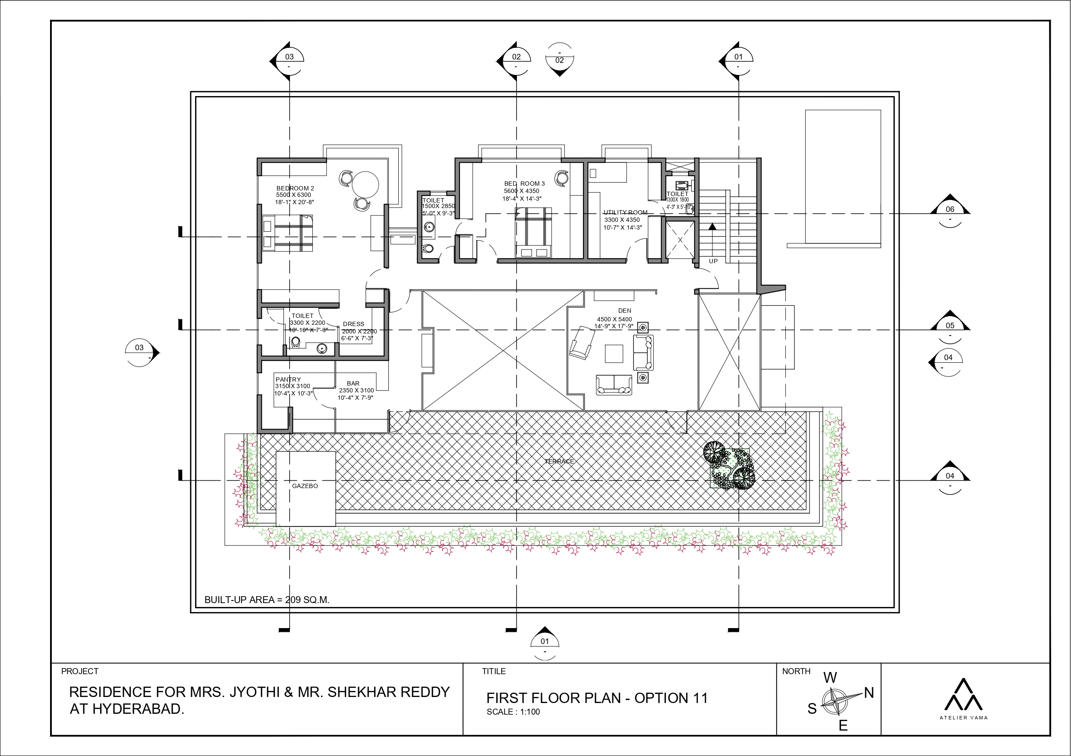
| RESIDENCE OF MRS JYOTHI & MR. SHEKHAR REDDY | FURNITURE LAYOUT- FIRST FLOOR|

Slide 5
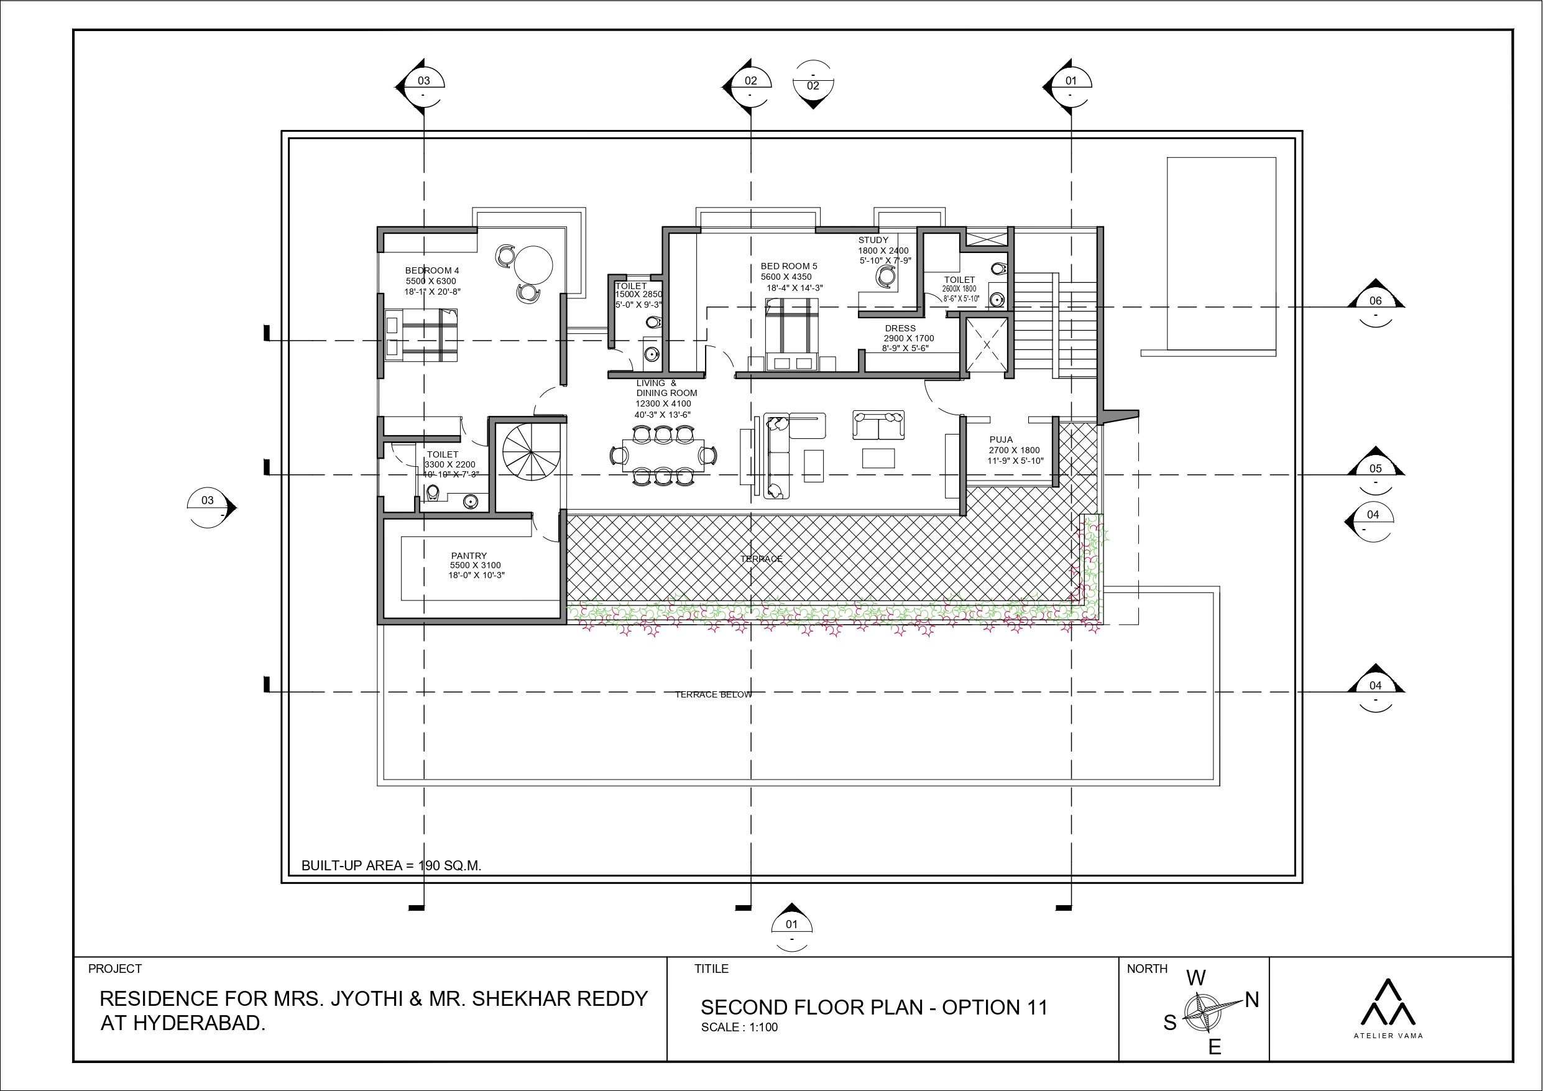
| RESIDENCE OF MRS JYOTHI & MR. SHEKHAR REDDY | FURNITURE LAYOUT- SECOND FLOOR|

Slide 6
FLOOR PLATES WITH FURNITURE

Slide 7
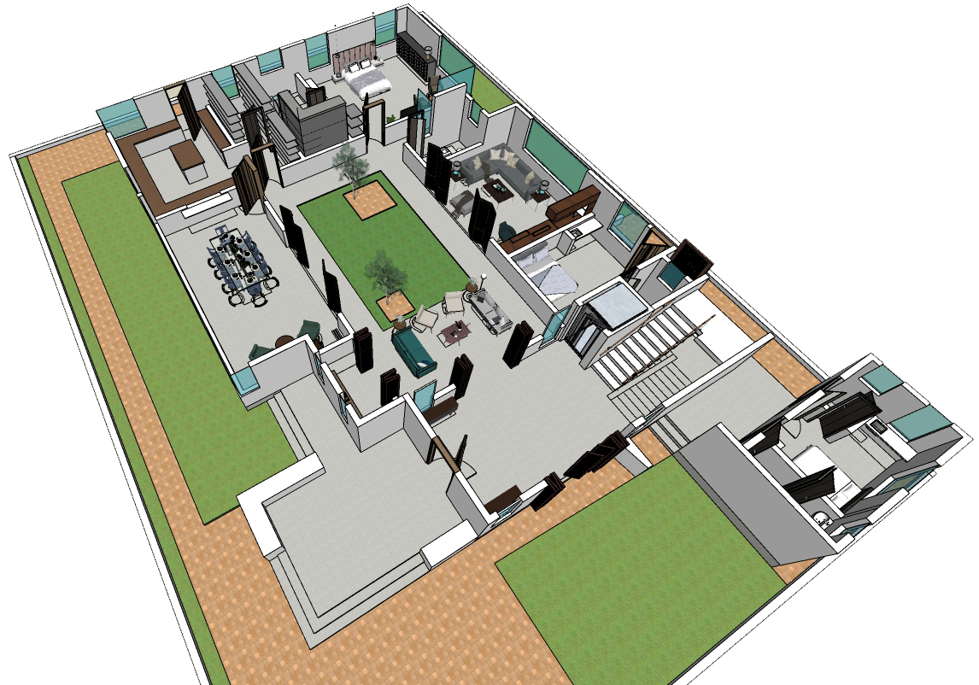
9
8
7
10
6
5
11
13
4
1.Veranda
3
2. Entrance Foyer
5
3. Staircase
12
4.Lift
5.Living + Courtyard
2
6. Family room
14
7. Powder room
8. Master Bedroom
1
9. Store
10. Kitchen
11. Dining
12. Puja
13. Servant room 1
14. Servant room 2
| RESIDENCE OF MRS JYOTHI & MR. SHEKHAR REDDY | FLOOR PLATE - GROUND FLOOR|

Slide 8
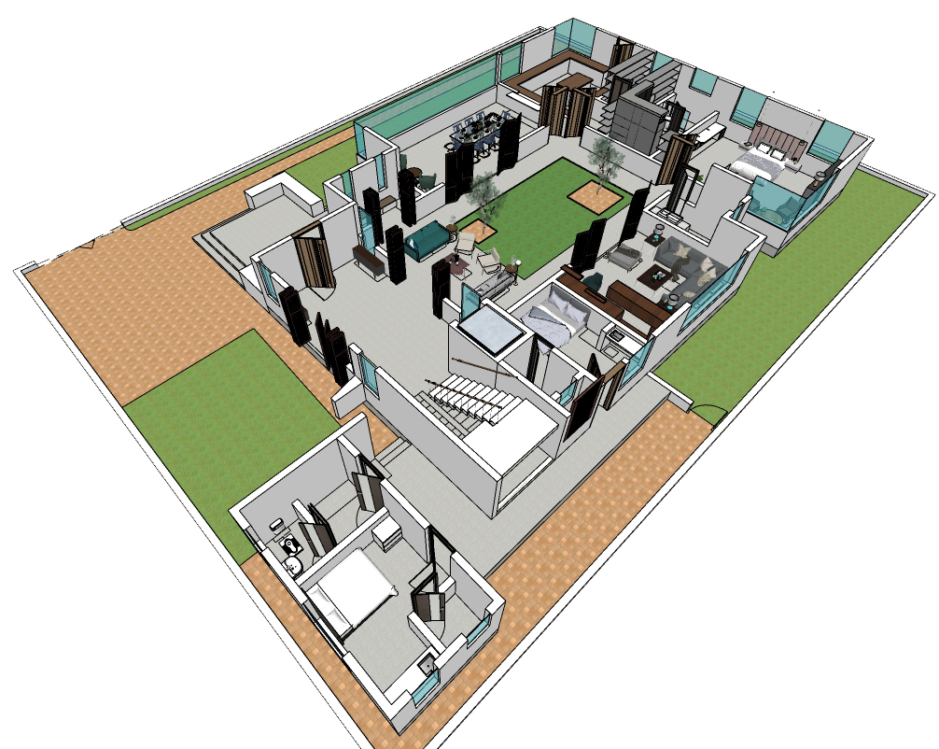
10
9
8
11
12
7
5
1
6
5
2
1.Veranda
4
13
2. Entrance Foyer
3. Staircase
4.Lift
3
5.Living + Courtyard
6. Family room
7. Powder room
8. Master Bedroom
9. Store
10. Kitchen
14
11. Dining
12. Puja
13. Servant room 1
14. Servant room 2
| RESIDENCE OF MRS JYOTHI & MR. SHEKHAR REDDY | FLOOR PLATE - GROUND FLOOR|

Slide 9
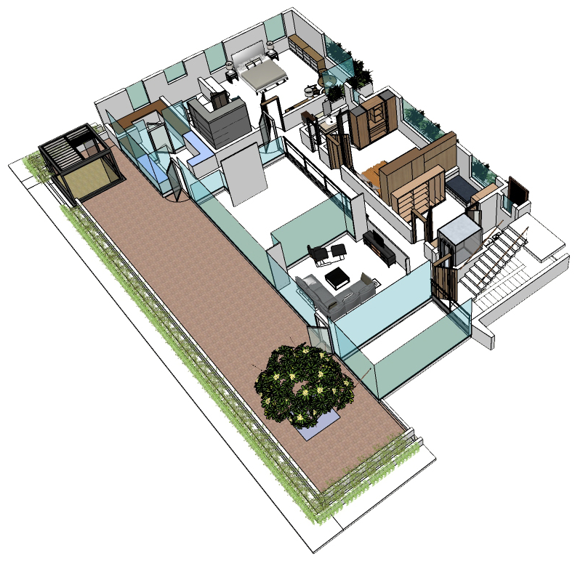
5
9
6
8
7
10
2
4
3
1
11
1.Den
2. Utility room
3. Staircase
4.Lift
5.Bedroom 3
6. Toilet
7. Bedroom 2
8. Bar
9. Pantry
10. Gazebo
11. Terrace
| RESIDENCE OF MRS JYOTHI & MR. SHEKHAR REDDY | FLOOR PLATE – FIRST FLOOR|

Slide 10
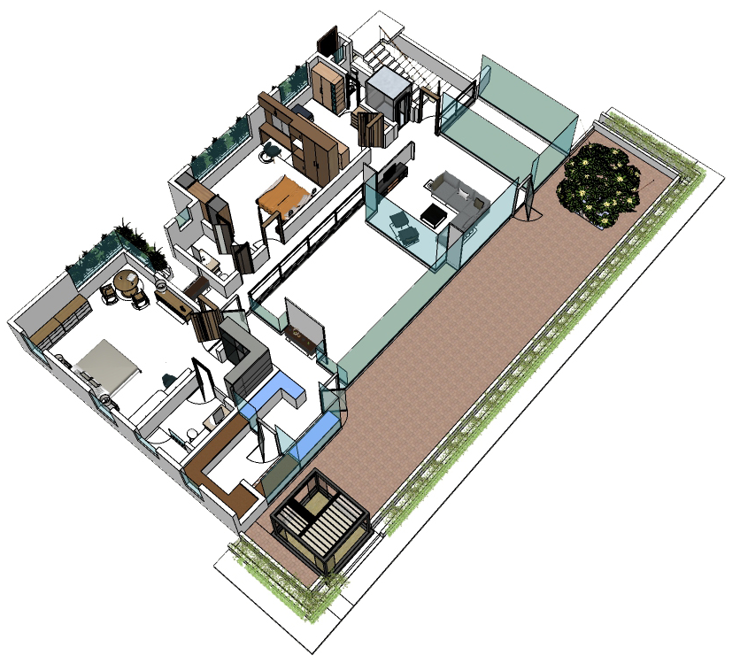
3
4
2
1
7
6
5
11
1.Den
2. Utility room
8
3. Staircase
4.Lift
9
10
5.Bedroom 3
6. Toilet
7. Bedroom 2
8. Bar
9. Pantry
10. Gazebo
11. Terrace
| RESIDENCE OF MRS JYOTHI & MR. SHEKHAR REDDY | FLOOR PLATE – FIRST FLOOR|

Slide 11
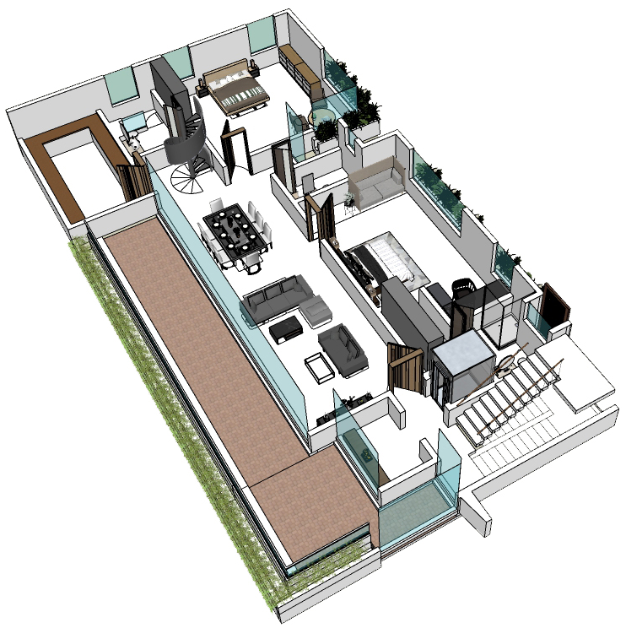
7
9
6
8
5
2
10
4
3
1. Puja
2. Living + Dining
3. Staircase
1
4.Lift
5.Bedroom 5
6. Toilet
7. Bedroom 4
8. Spiral staircase
9. Pantry
10. Terrace
| RESIDENCE OF MRS JYOTHI & MR. SHEKHAR REDDY | FLOOR PLATE – SECOND FLOOR|

Slide 12
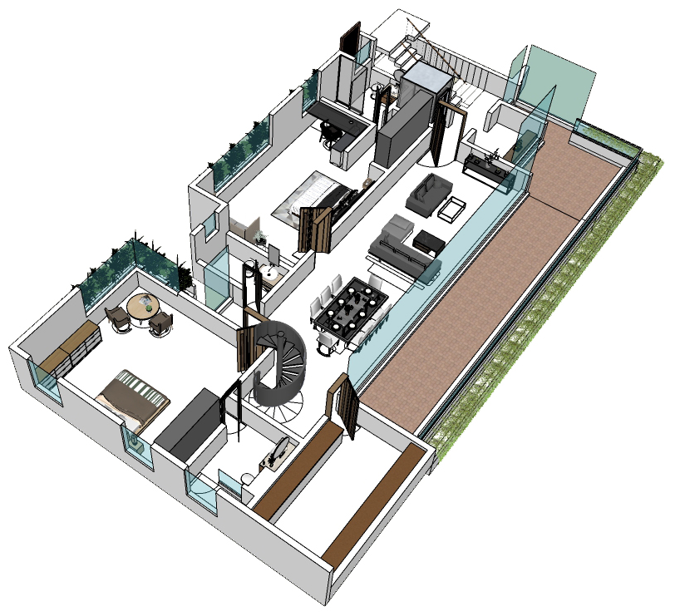
3
4
1
5
6
2
10
7
1. Puja
8
2. Living + Dining
3. Staircase
4.Lift
5.Bedroom 5
9
6. Toilet
7. Bedroom 4
8. Spiral staircase
9. Pantry
10. Terrace
| RESIDENCE OF MRS JYOTHI & MR. SHEKHAR REDDY | FLOOR PLATE – SECOND FLOOR|

Slide 13
SECTIONS

Slide 14
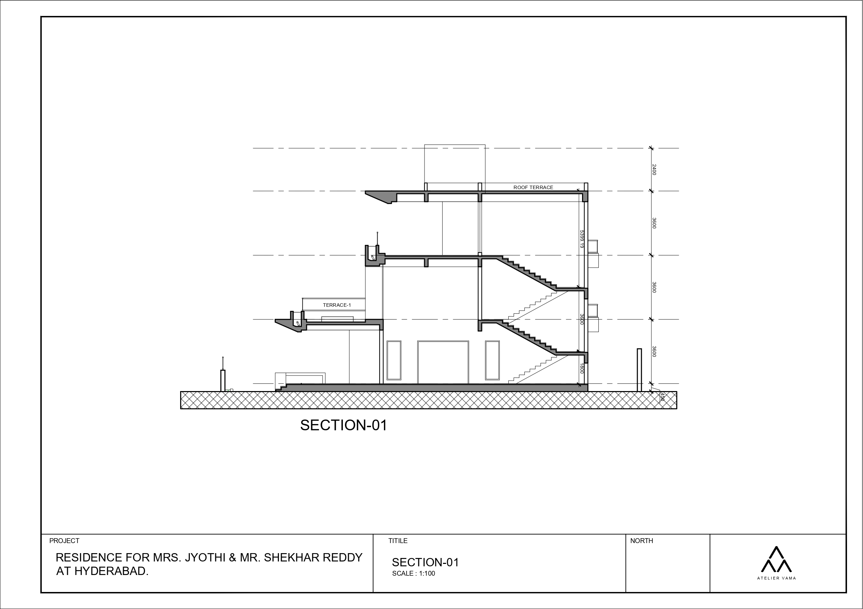
| RESIDENCE OF MRS JYOTHI & MR. SHEKHAR REDDY | SECTION - 01|

Slide 15
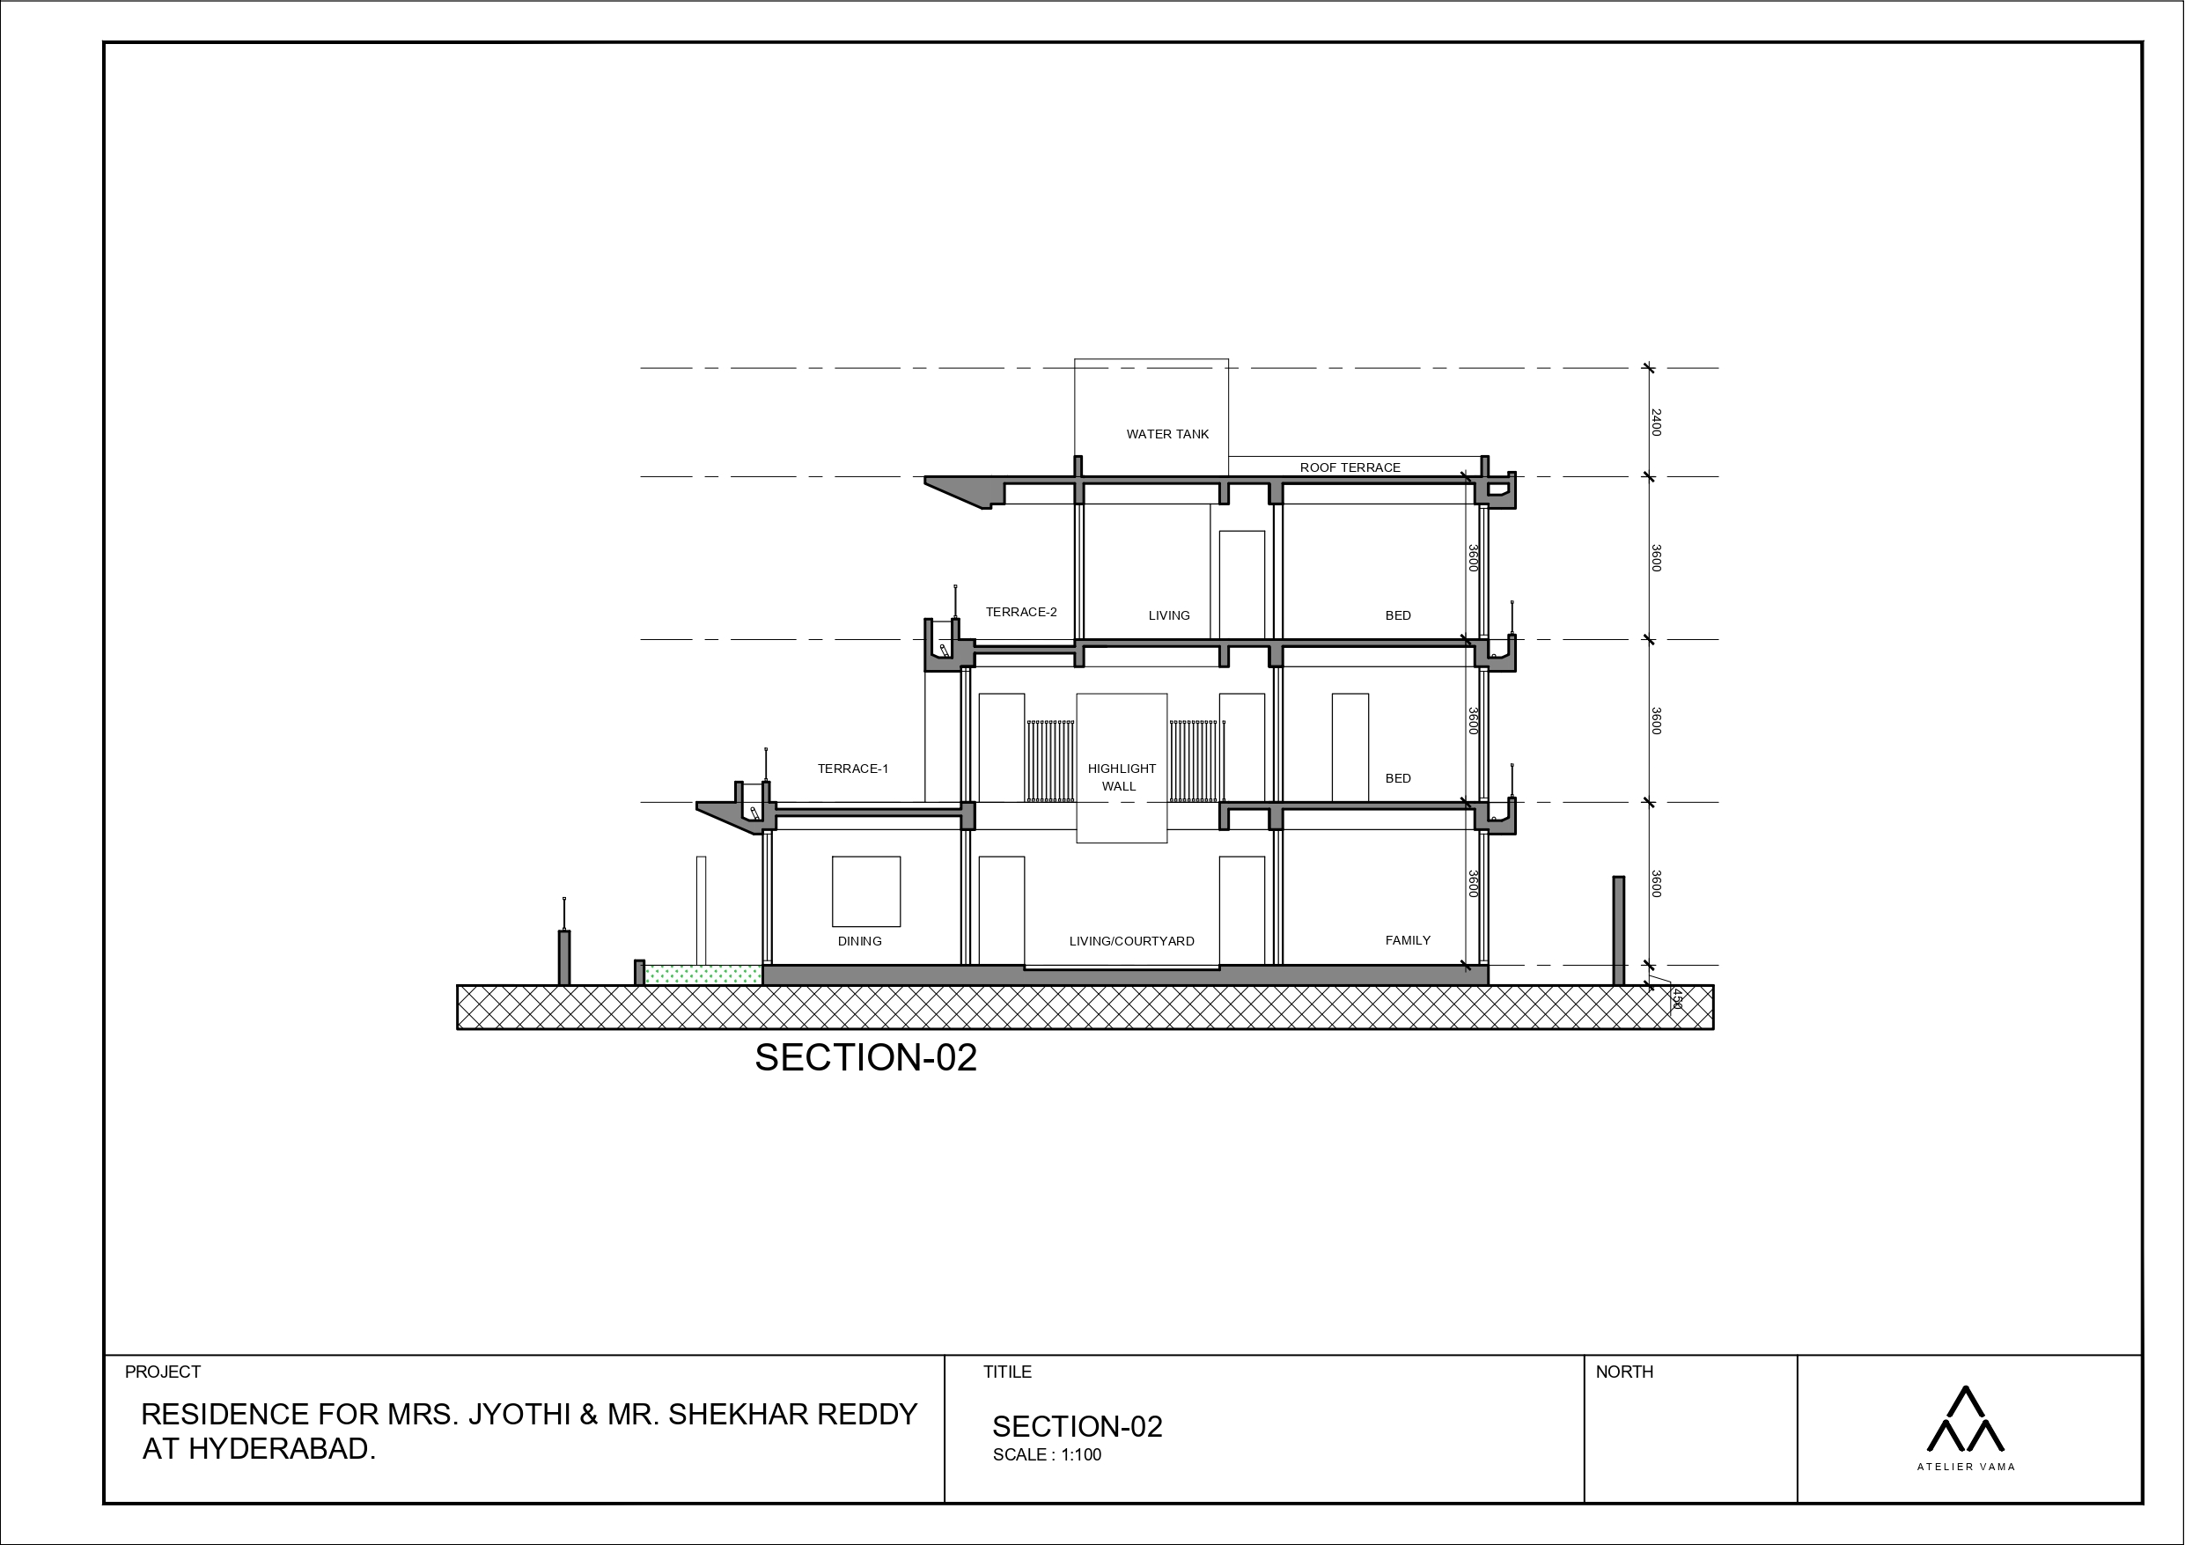
| RESIDENCE OF MRS JYOTHI & MR. SHEKHAR REDDY | SECTION - 02|

Slide 16
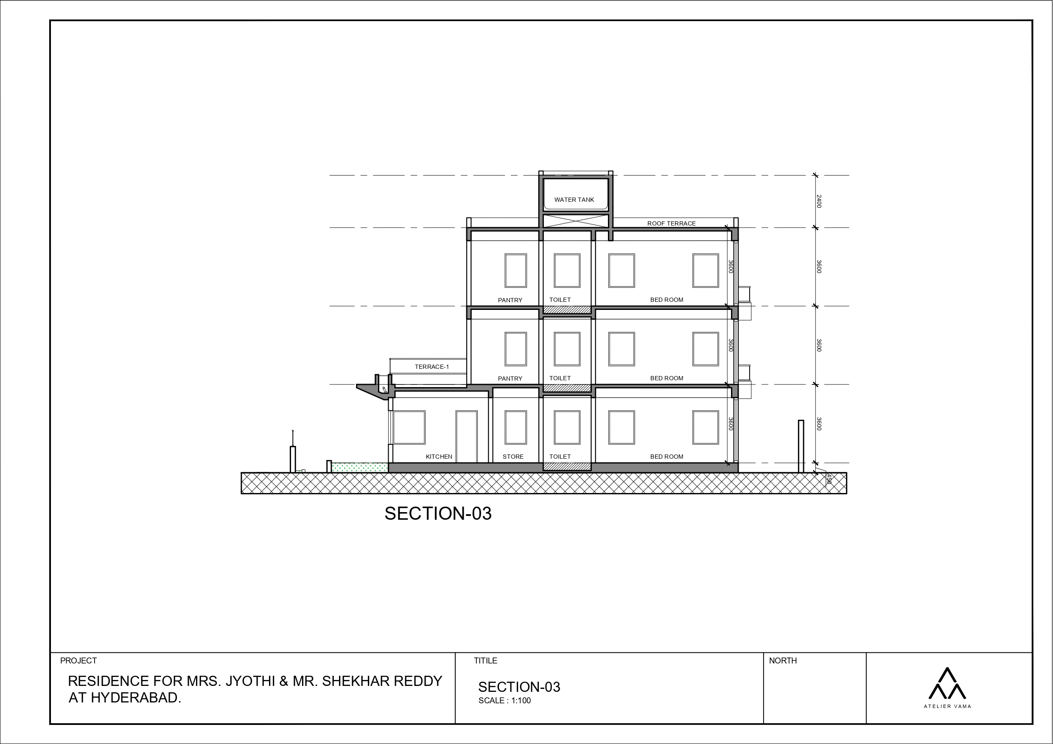
| RESIDENCE OF MRS JYOTHI & MR. SHEKHAR REDDY | SECTION - 03|

Slide 17
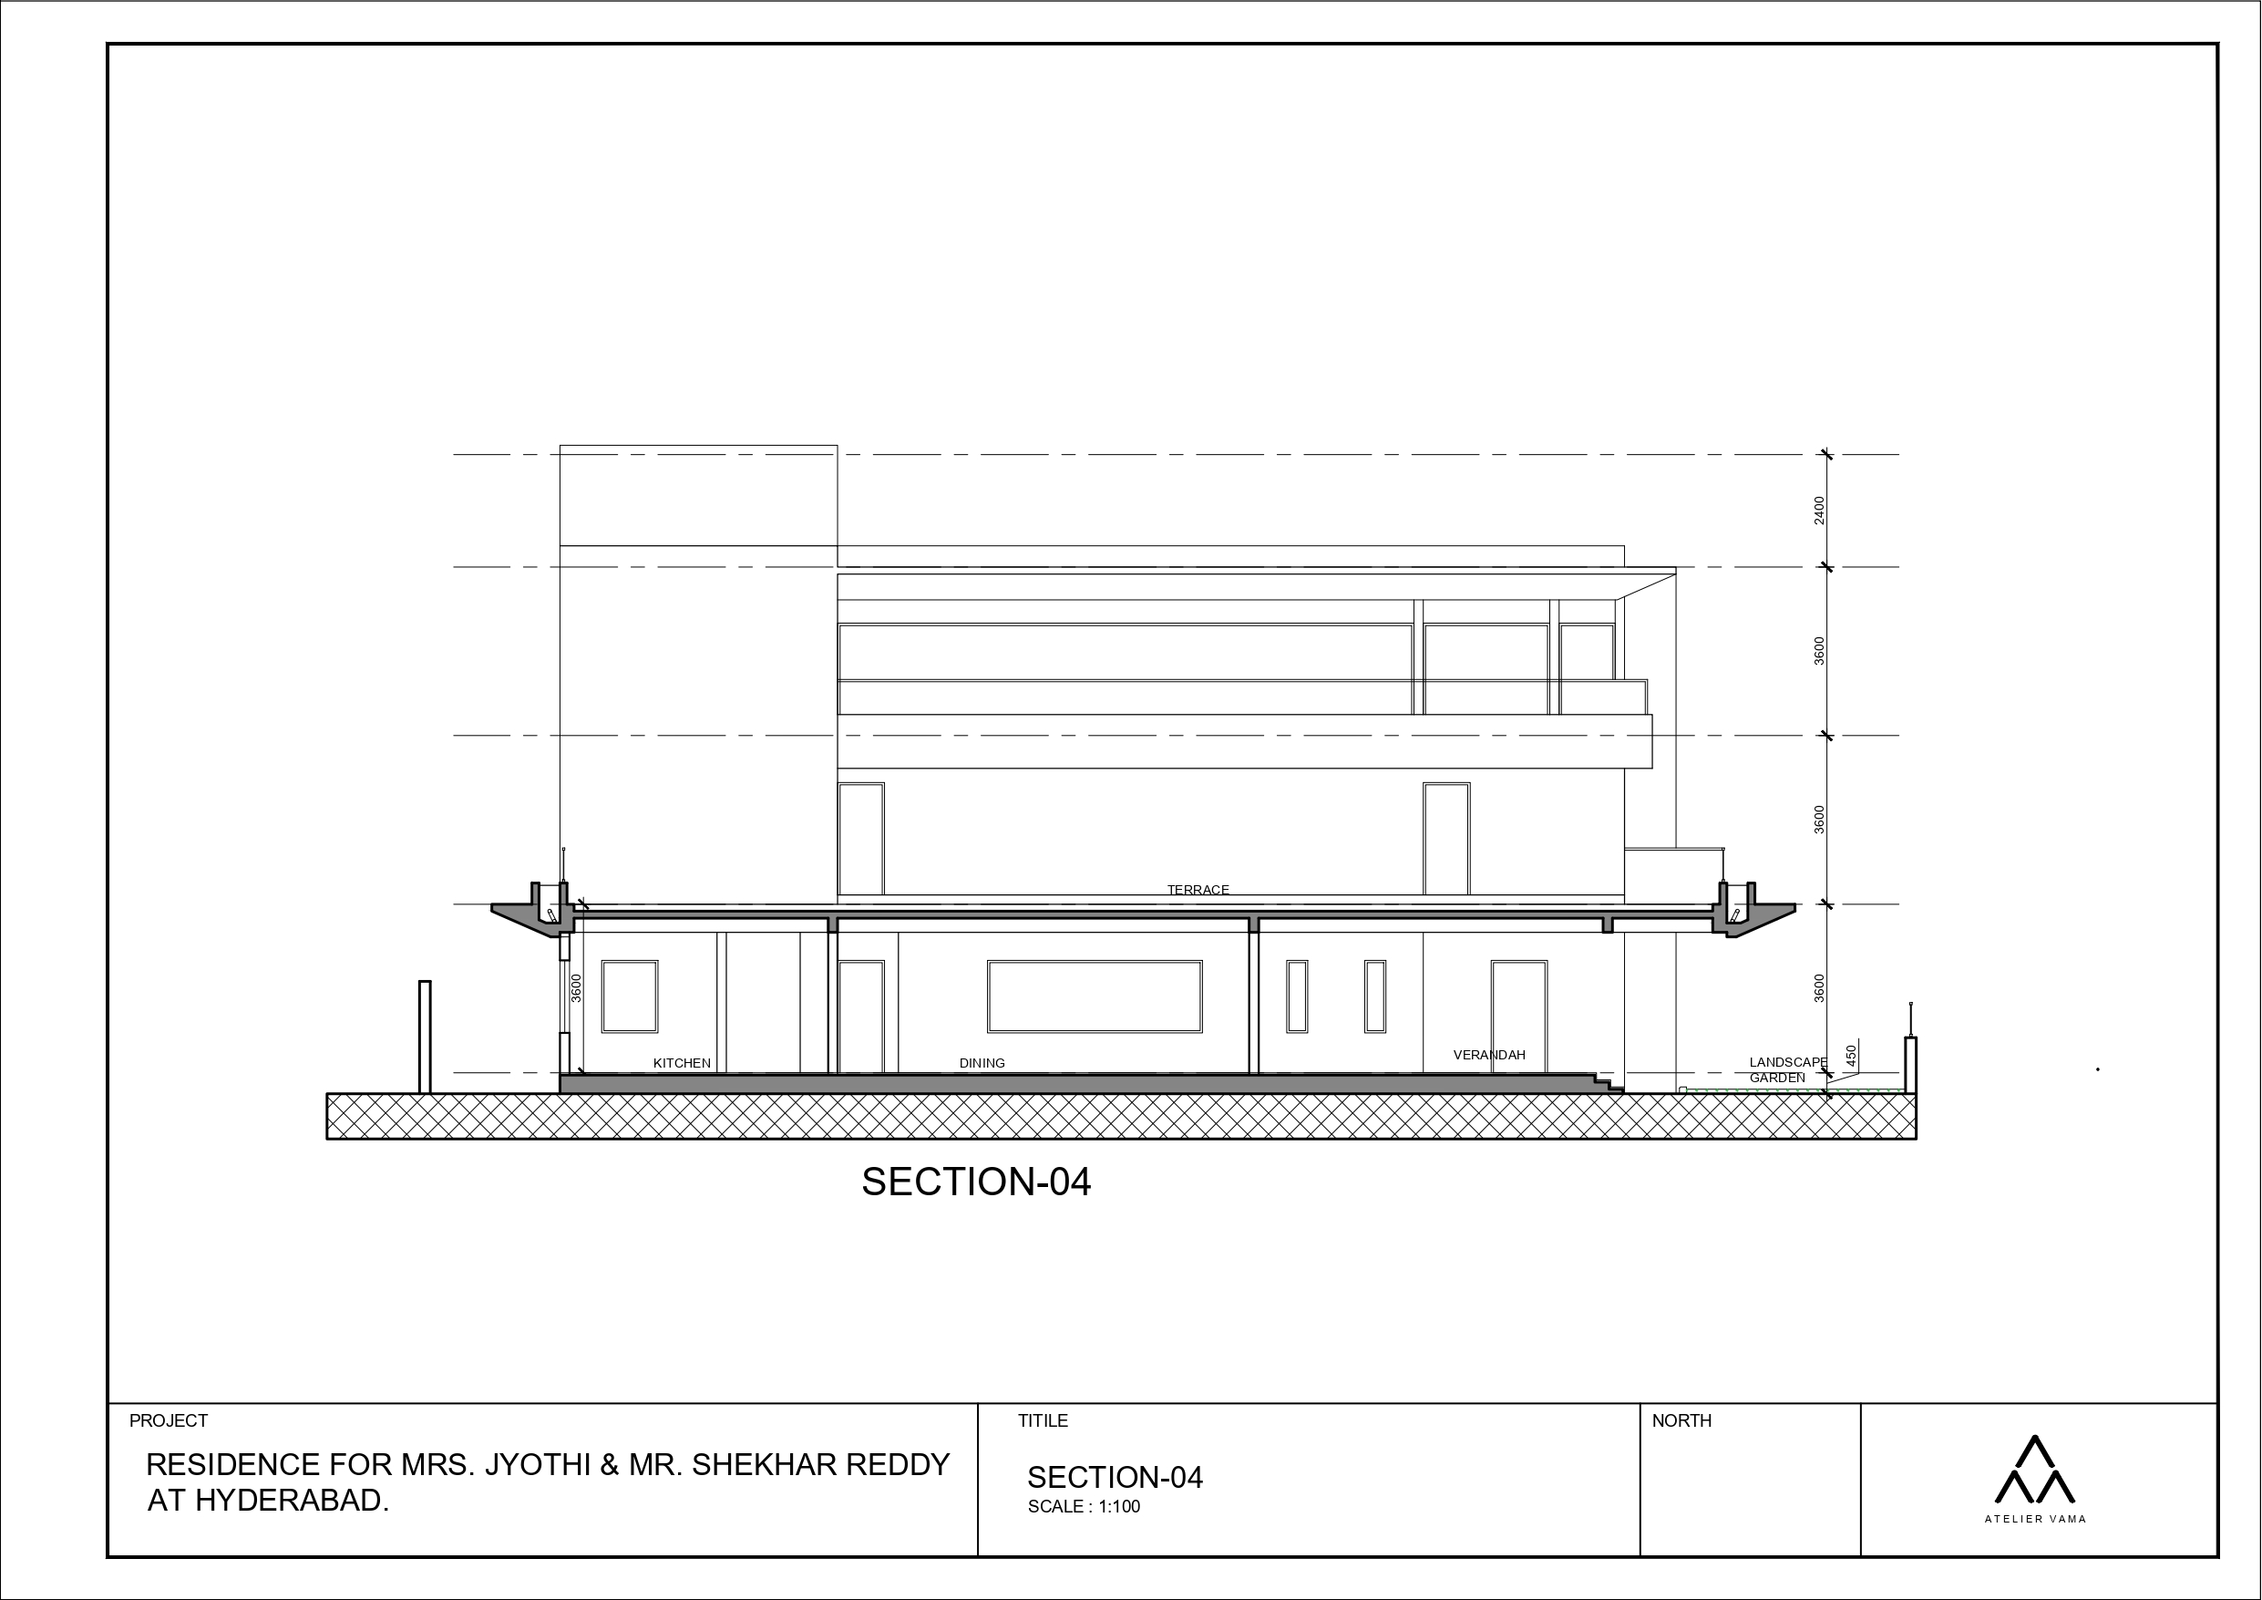
| RESIDENCE OF MRS JYOTHI & MR. SHEKHAR REDDY | SECTION - 04|

Slide 18
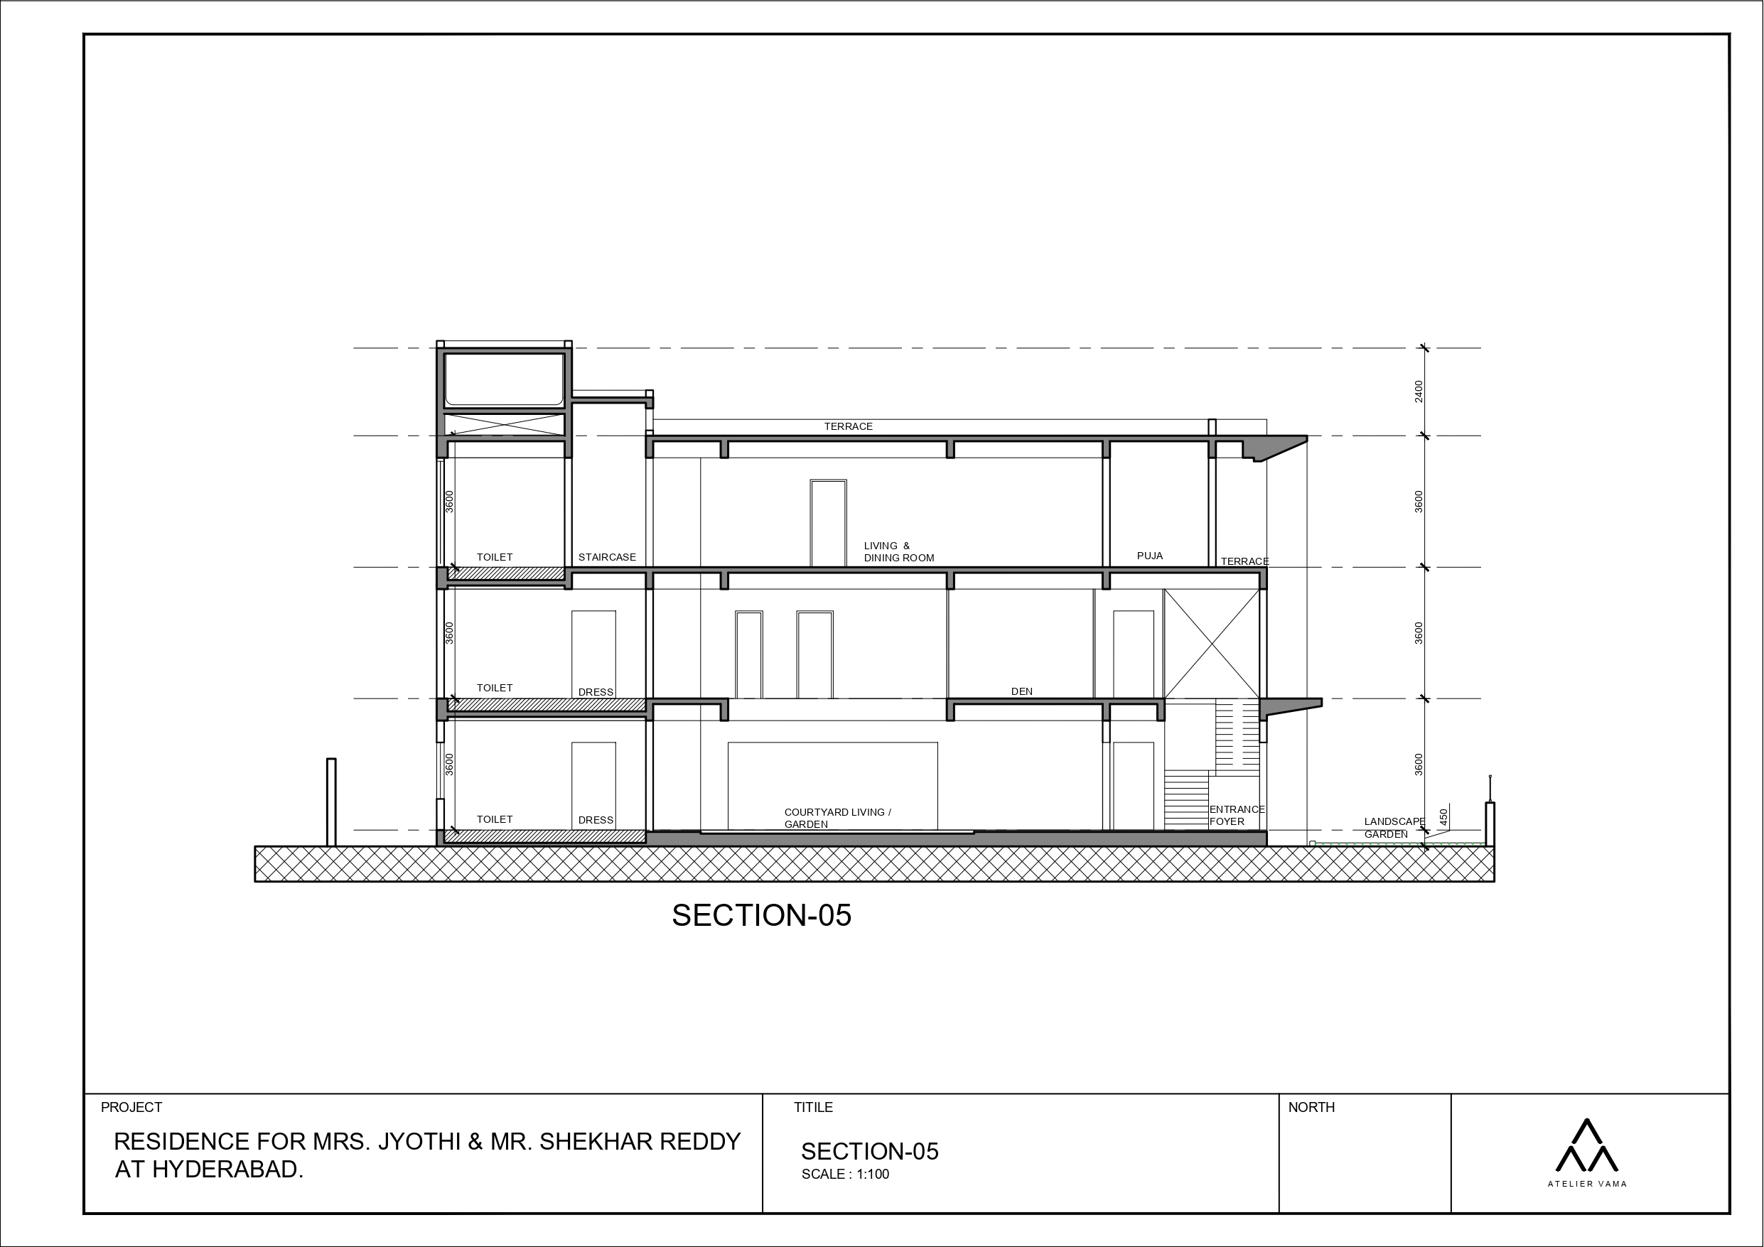
| RESIDENCE OF MRS JYOTHI & MR. SHEKHAR REDDY | SECTION - 05|

Slide 19
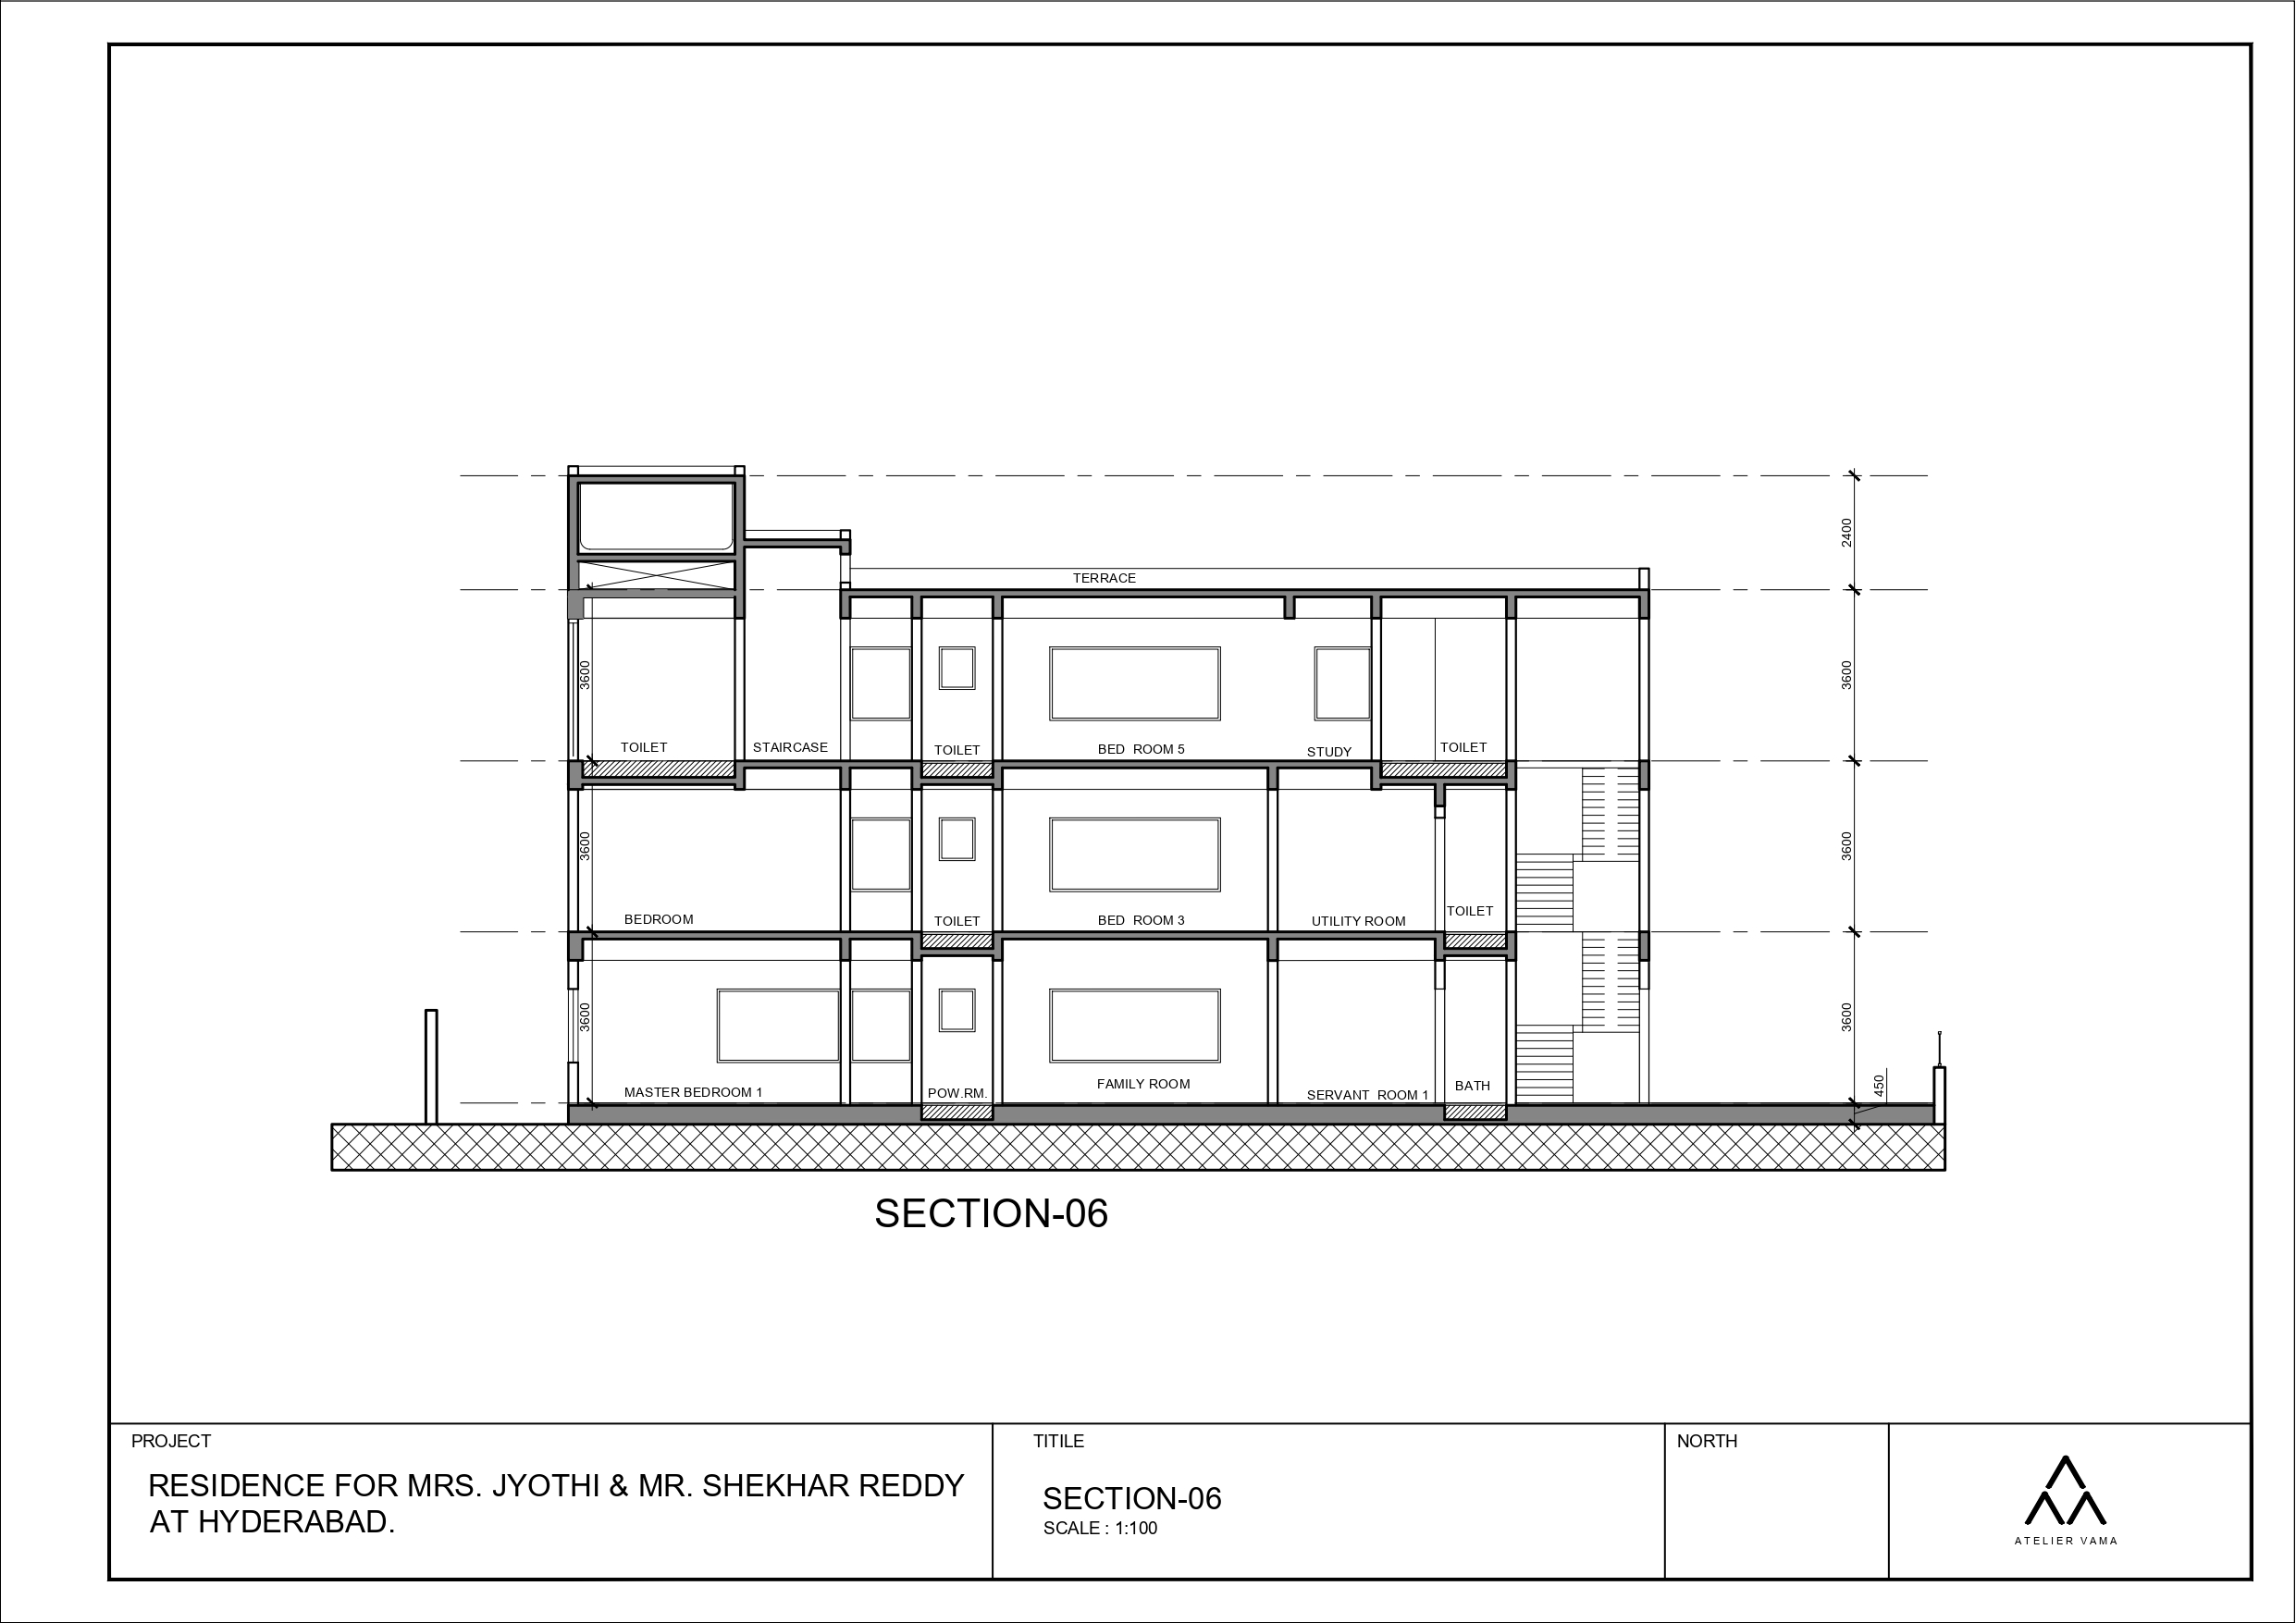
| RESIDENCE OF MRS JYOTHI & MR. SHEKHAR REDDY | SECTION - 06|

Slide 20
ELEVATIONS

Slide 21
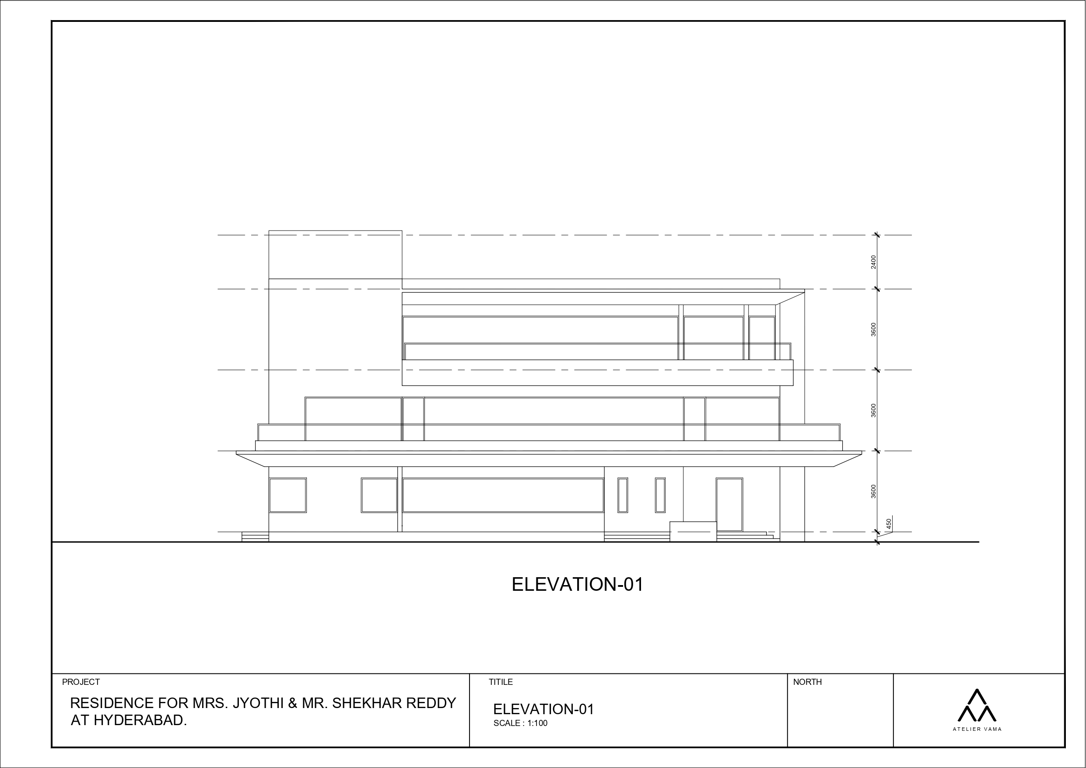
| RESIDENCE OF MRS JYOTHI & MR. SHEKHAR REDDY | EAST- SIDE ELEVATION |

Slide 22
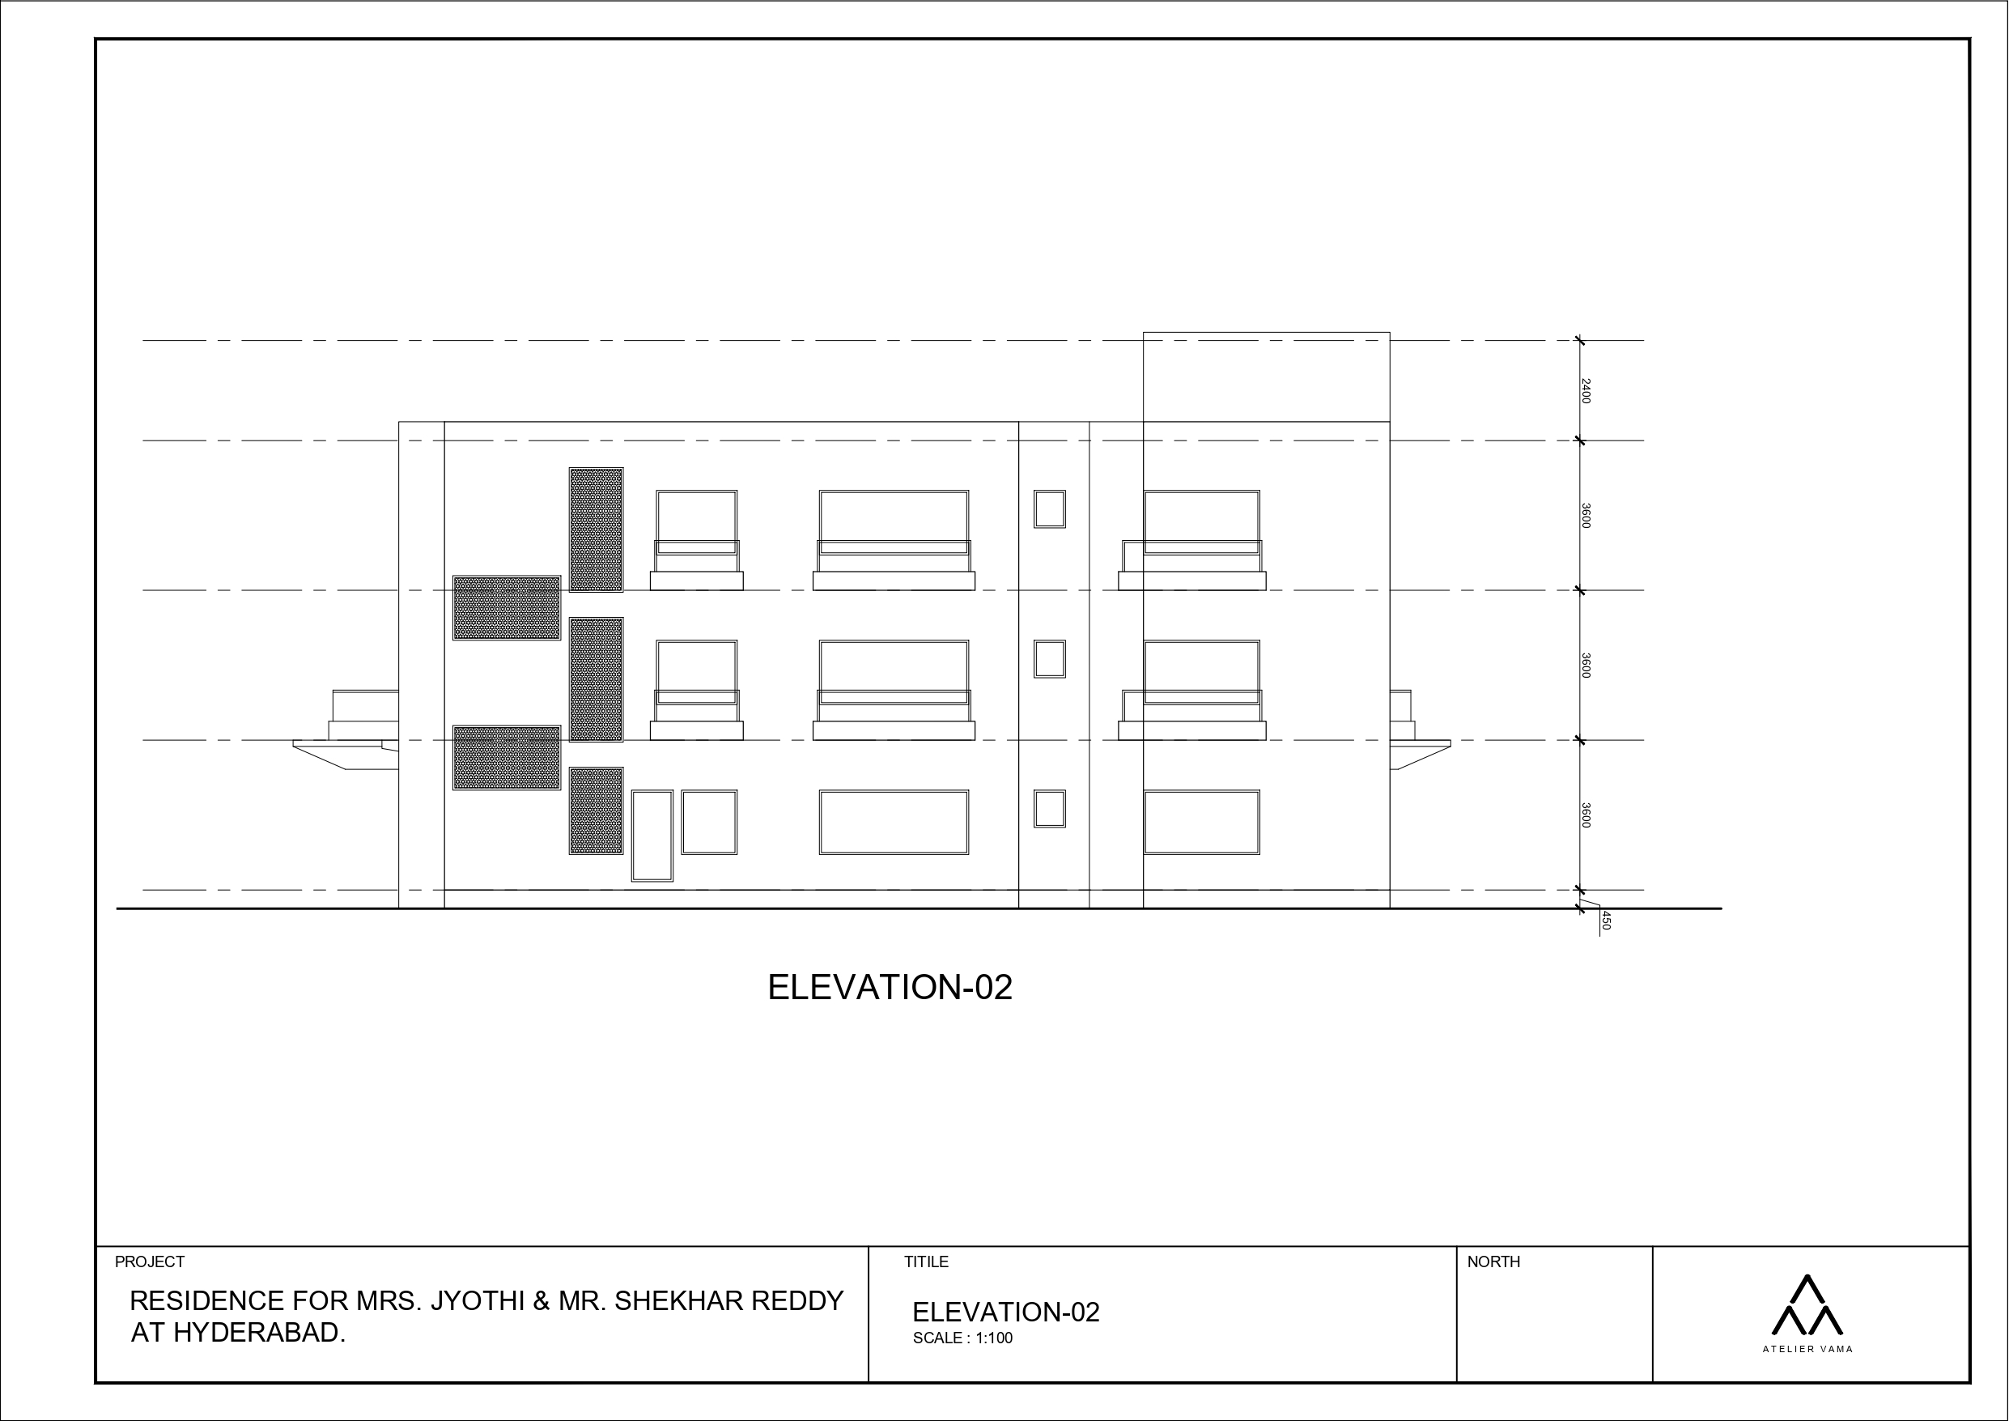
| RESIDENCE OF MRS JYOTHI & MR. SHEKHAR REDDY | WEST- SIDE ELEVATION |

Slide 23
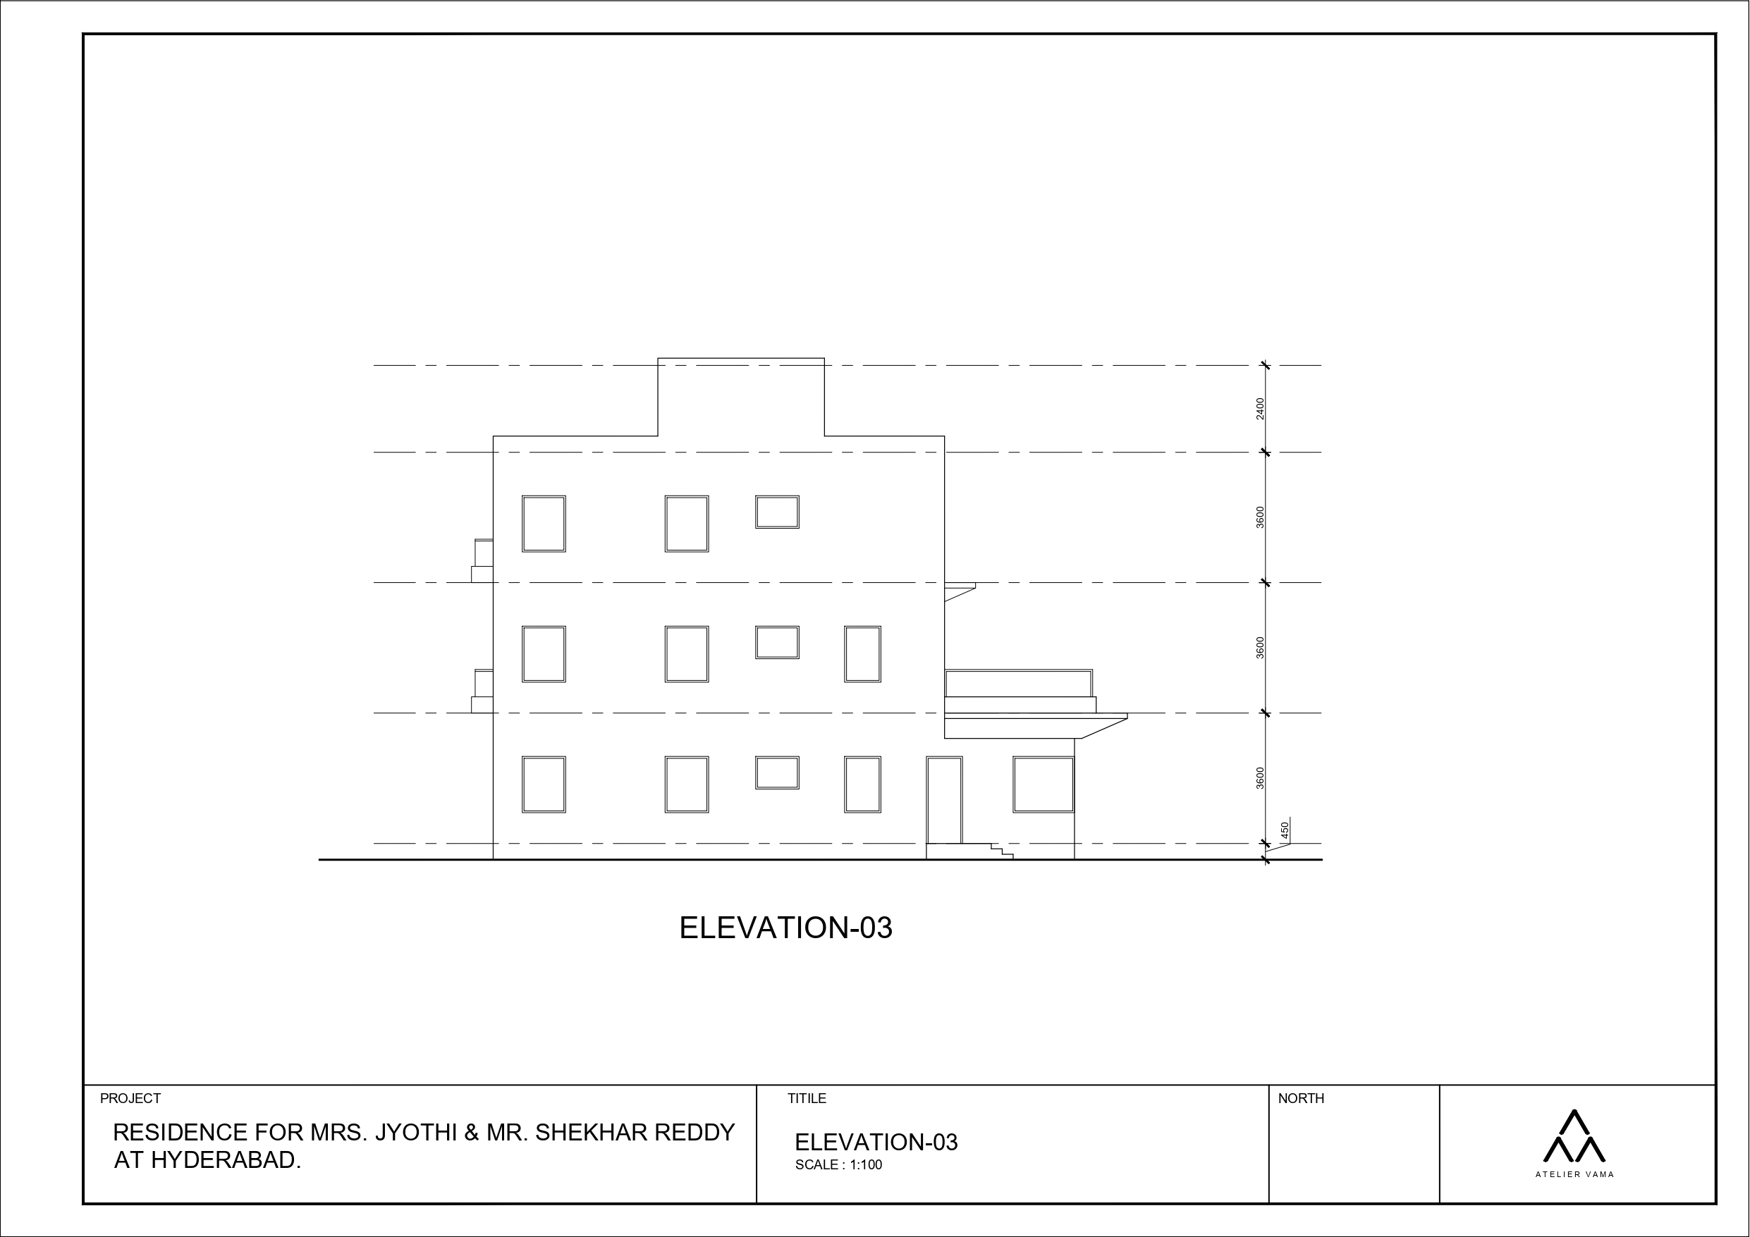
| RESIDENCE OF MRS JYOTHI & MR. SHEKHAR REDDY | SOUTH-SIDE ELEVATION |

Slide 24
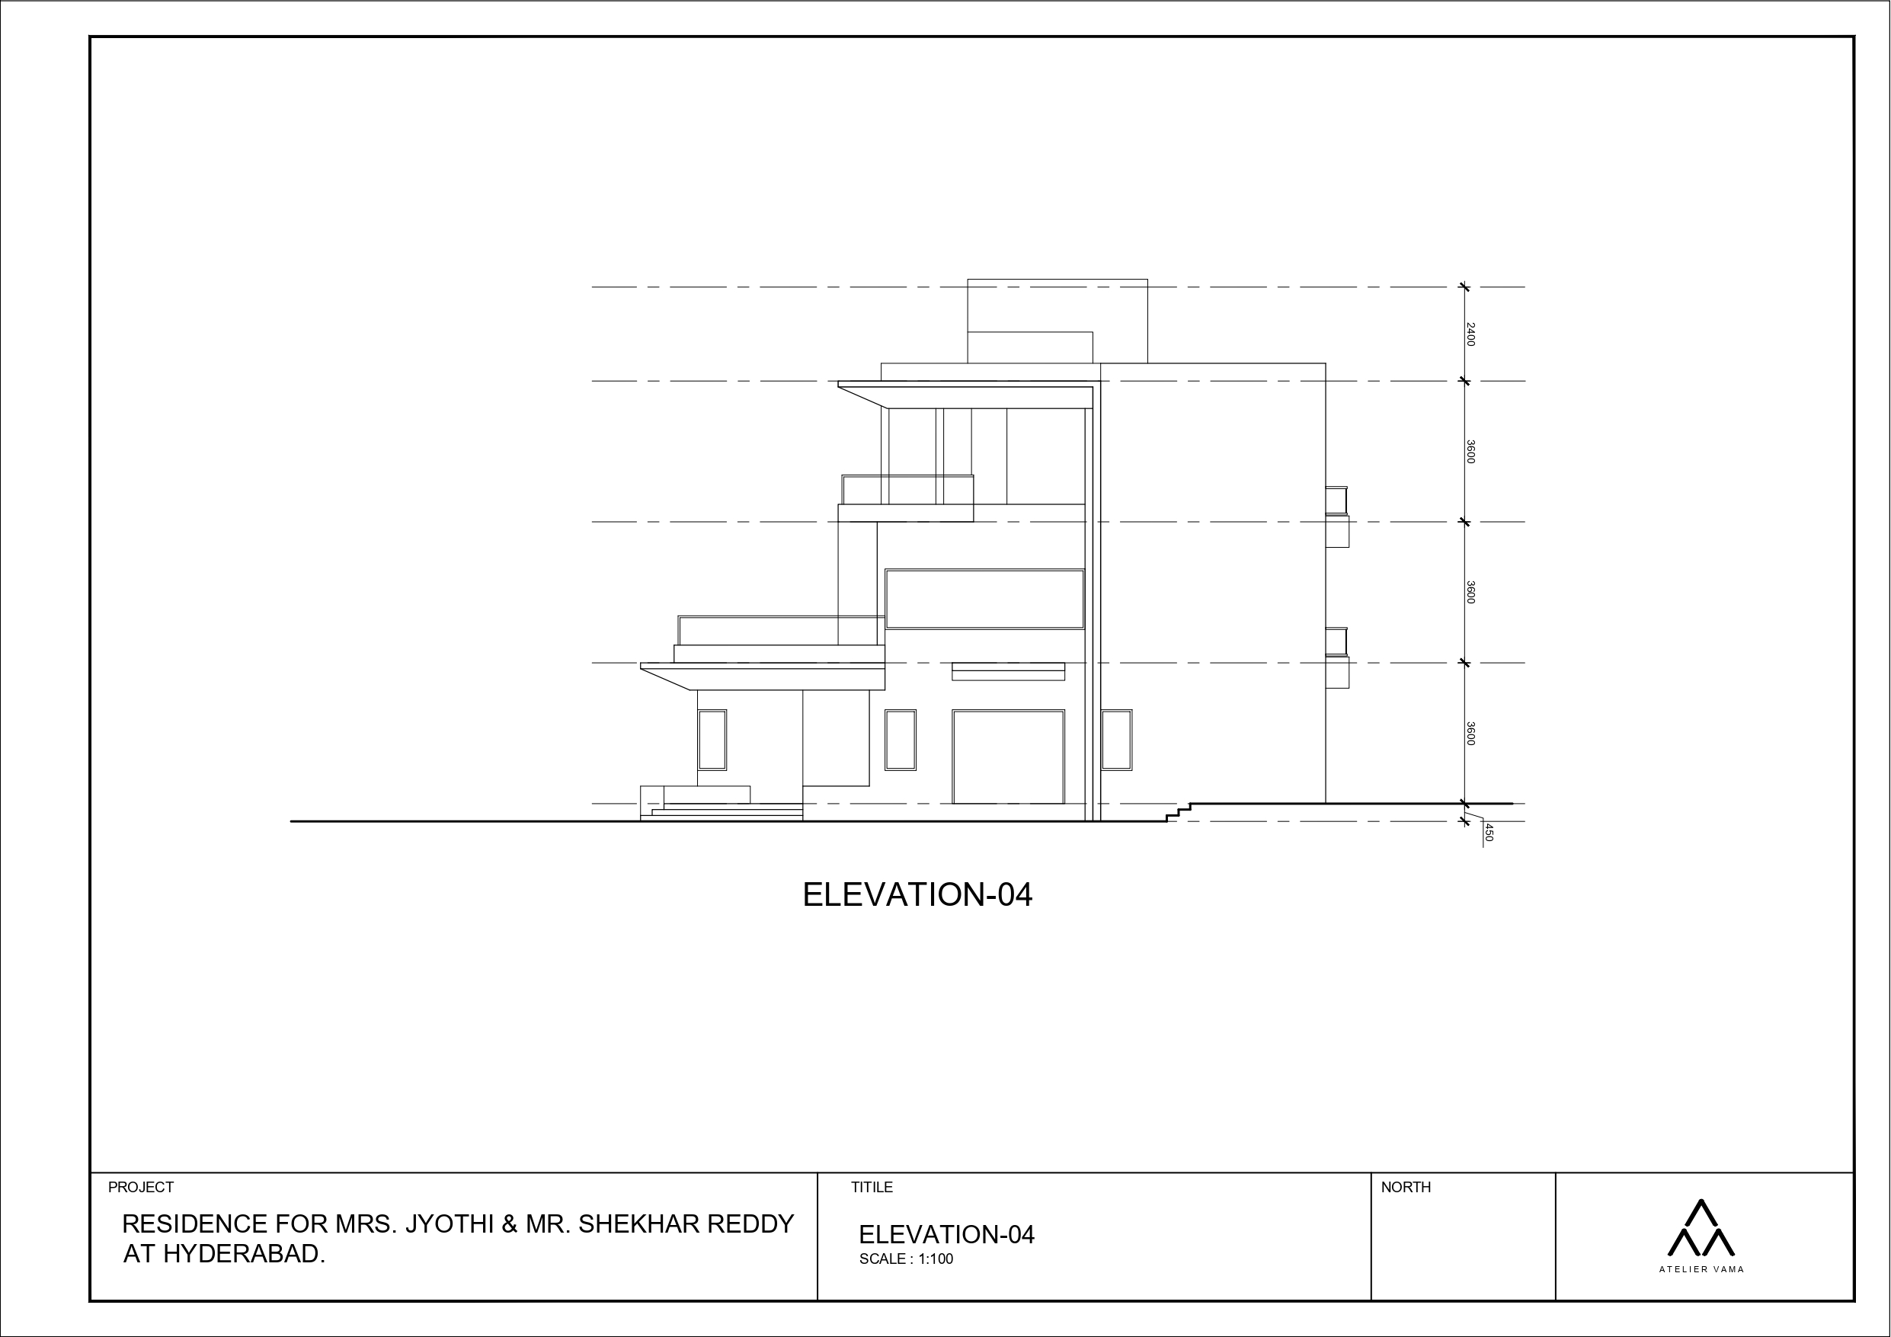
| RESIDENCE OF MRS JYOTHI & MR. SHEKHAR REDDY | NORTH-SIDE ELEVATION |

Slide 25
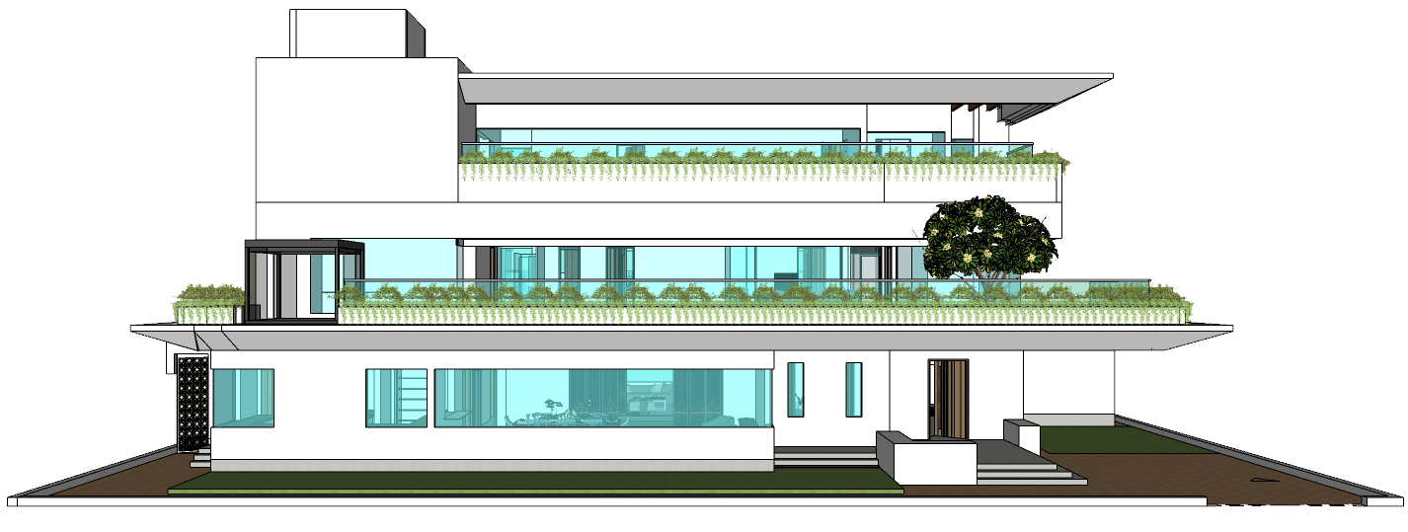
| RESIDENCE OF MRS JYOTHI & MR. SHEKHAR REDDY | EAST ELEVATION |

Slide 26
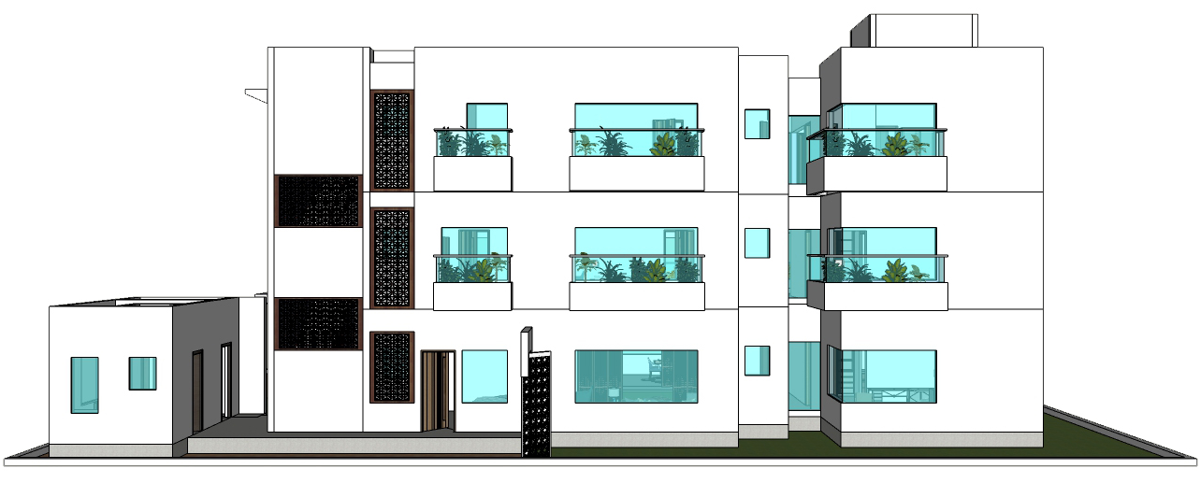
| RESIDENCE OF MRS JYOTHI & MR. SHEKHAR REDDY | WEST ELEVATION |

Slide 27
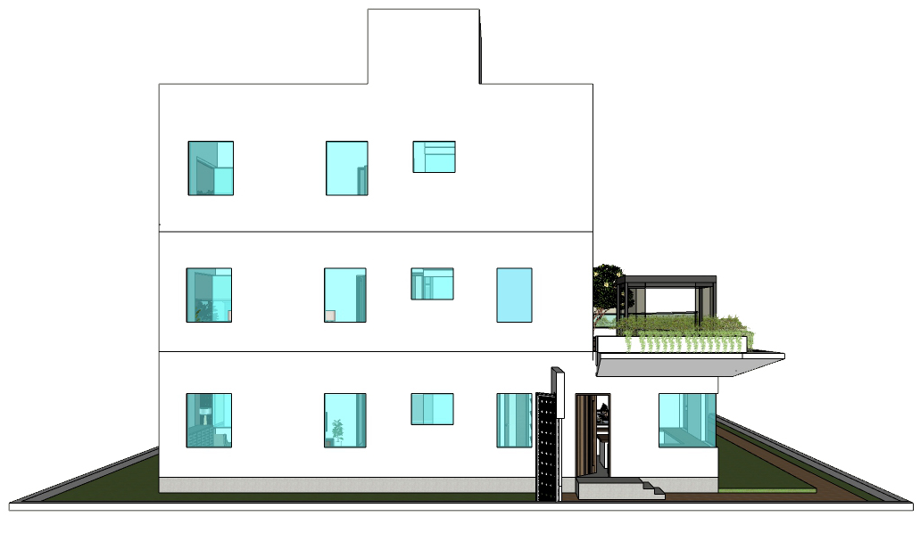
| RESIDENCE OF MRS JYOTHI & MR. SHEKHAR REDDY | SOUTH ELEVATION |

Slide 28
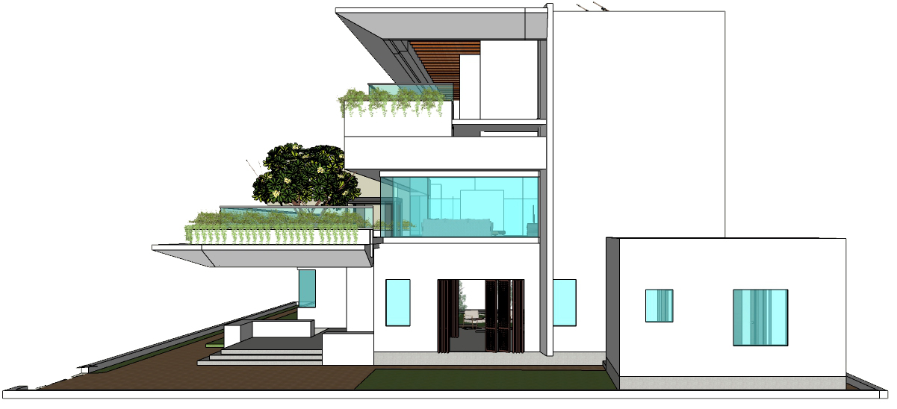
| RESIDENCE OF MRS JYOTHI & MR. SHEKHAR REDDY | NORTH ELEVATION |

Slide 29
VIEWS

Slide 30
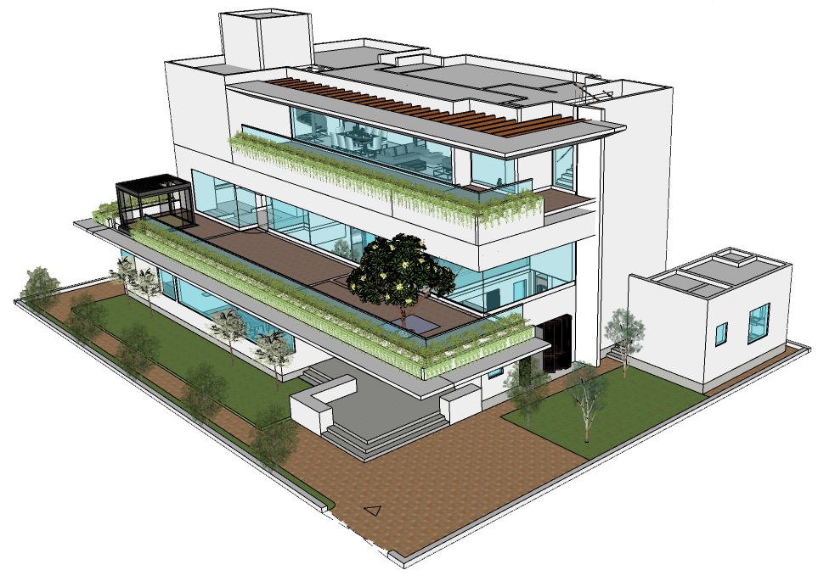
| RESIDENCE OF MRS JYOTHI & MR. SHEKHAR REDDY | ISOMETRIC VIEW |

Slide 31
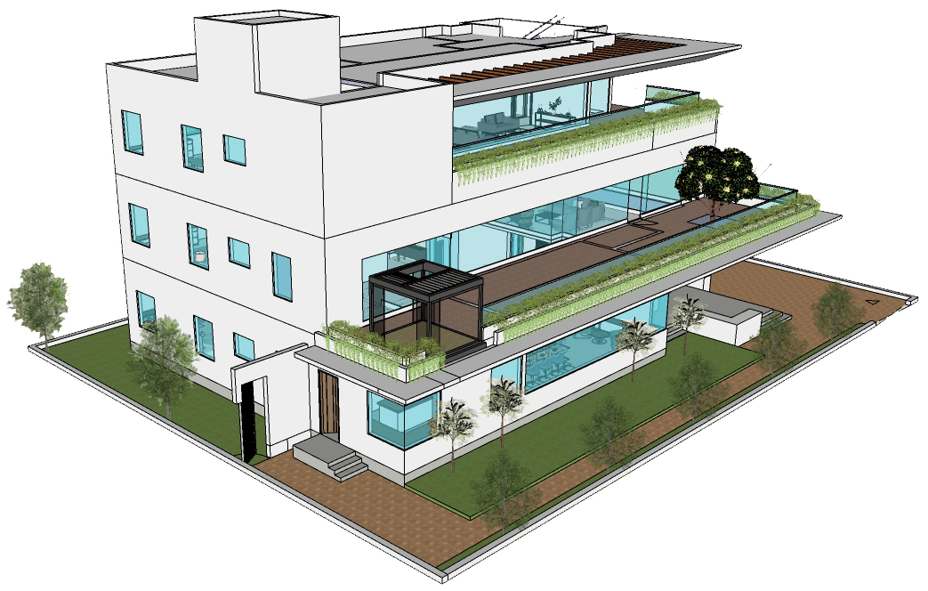
| RESIDENCE OF MRS JYOTHI & MR. SHEKHAR REDDY | ISOMETRIC VIEW |

Slide 32
INTERIOR VIEWS

Slide 33
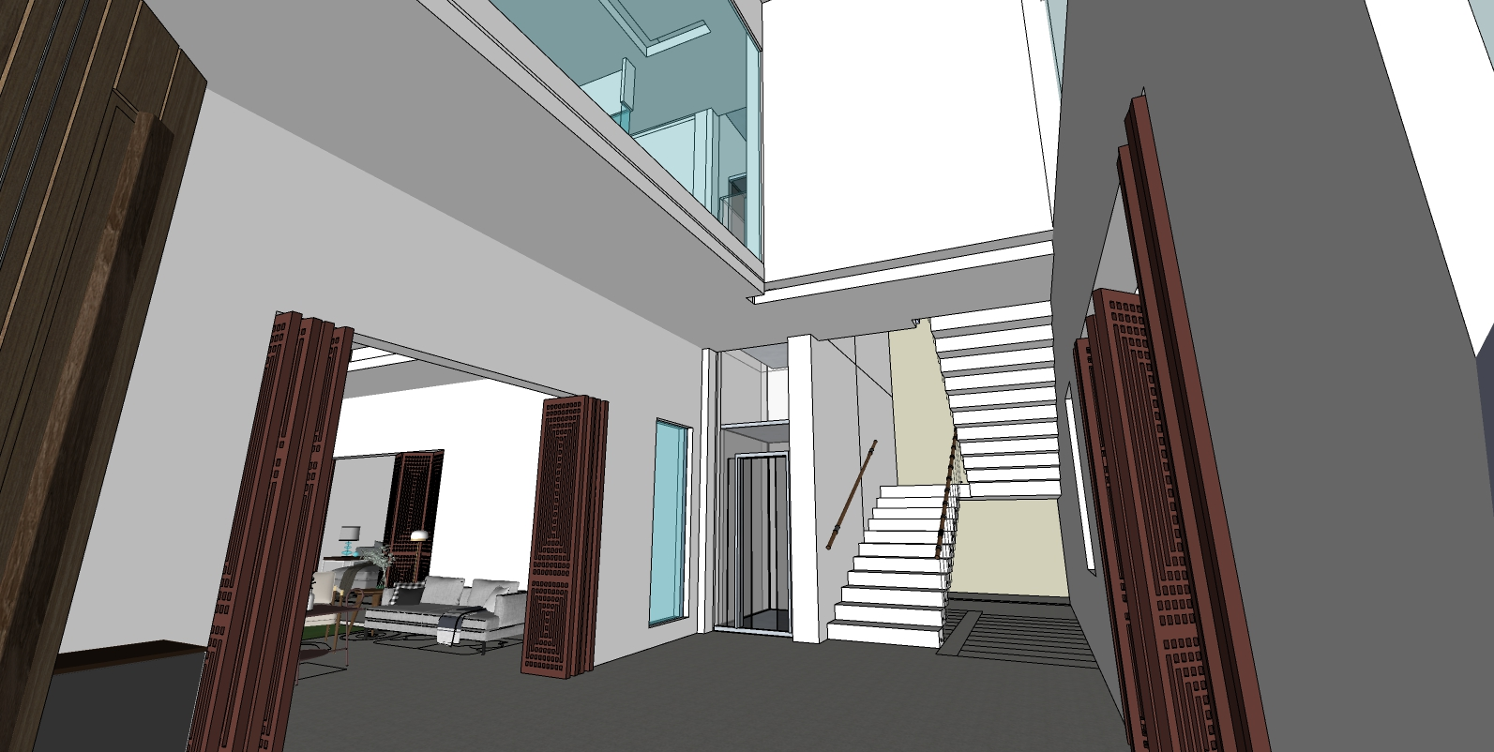
| RESIDENCE OF MRS JYOTHI & MR. SHEKHAR REDDY | ENTRANCE FOYER |

Slide 34
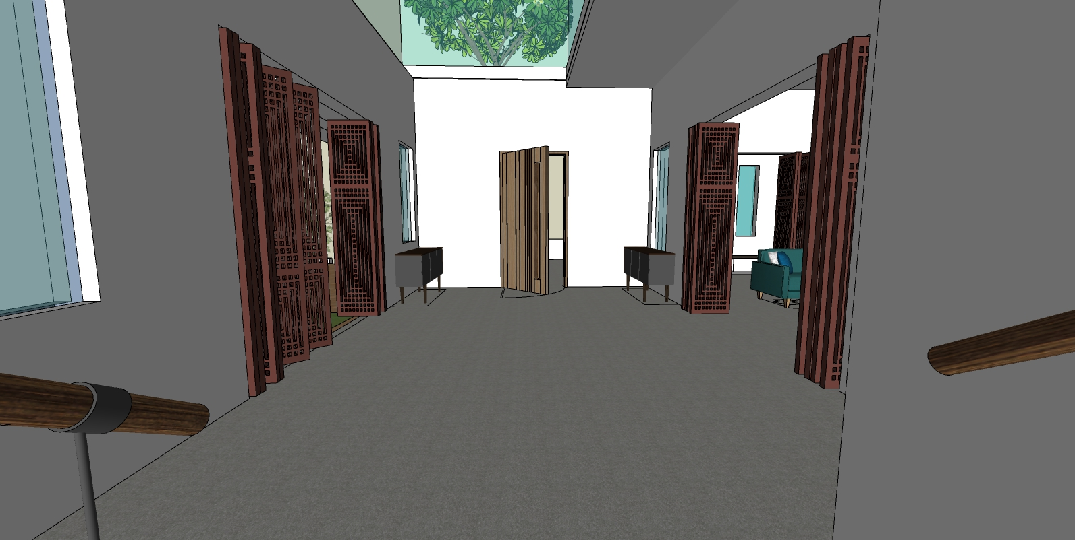
| RESIDENCE OF MRS JYOTHI & MR. SHEKHAR REDDY | ENTRANCE FOYER |

Slide 35
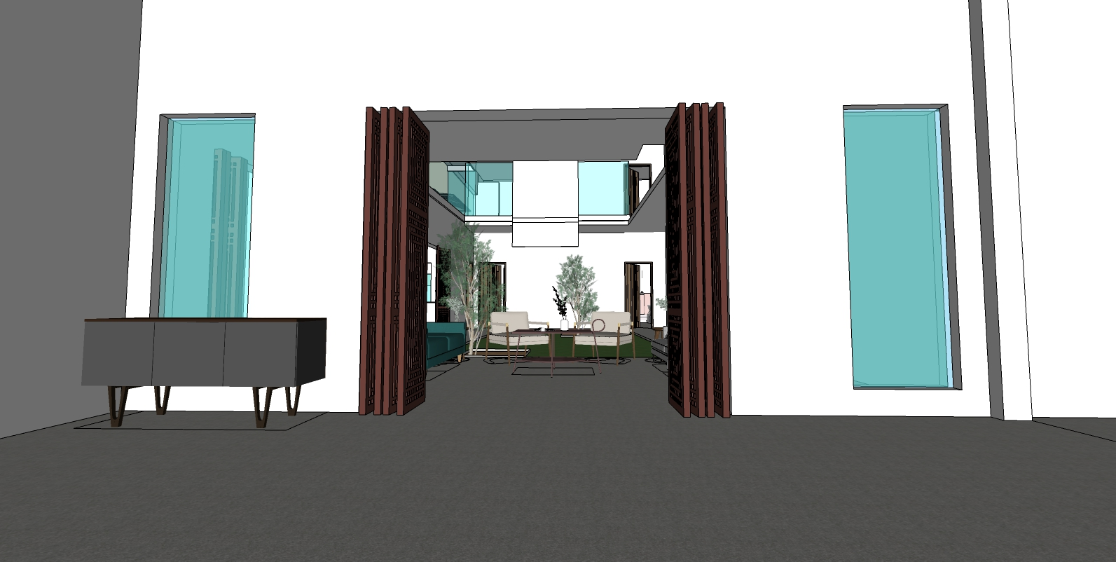
| RESIDENCE OF MRS JYOTHI & MR. SHEKHAR REDDY | TOWARDS LIVING AREA|

Slide 36
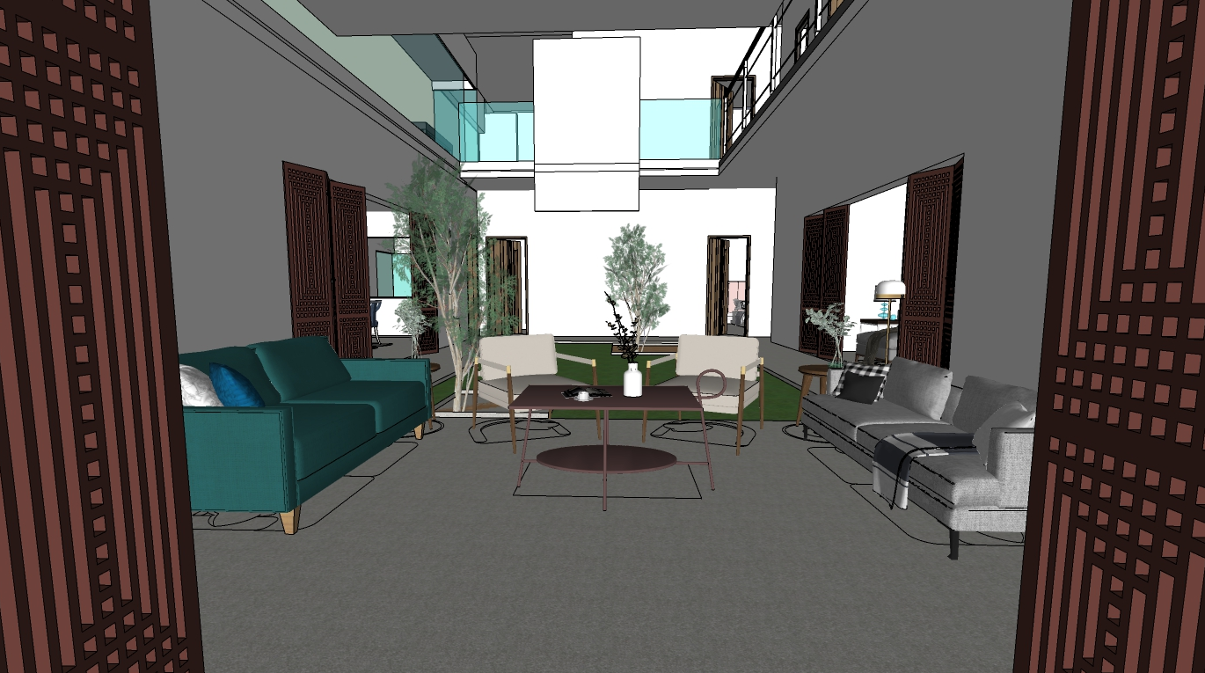
| RESIDENCE OF MRS JYOTHI & MR. SHEKHAR REDDY | LIVING AREA |

Slide 37
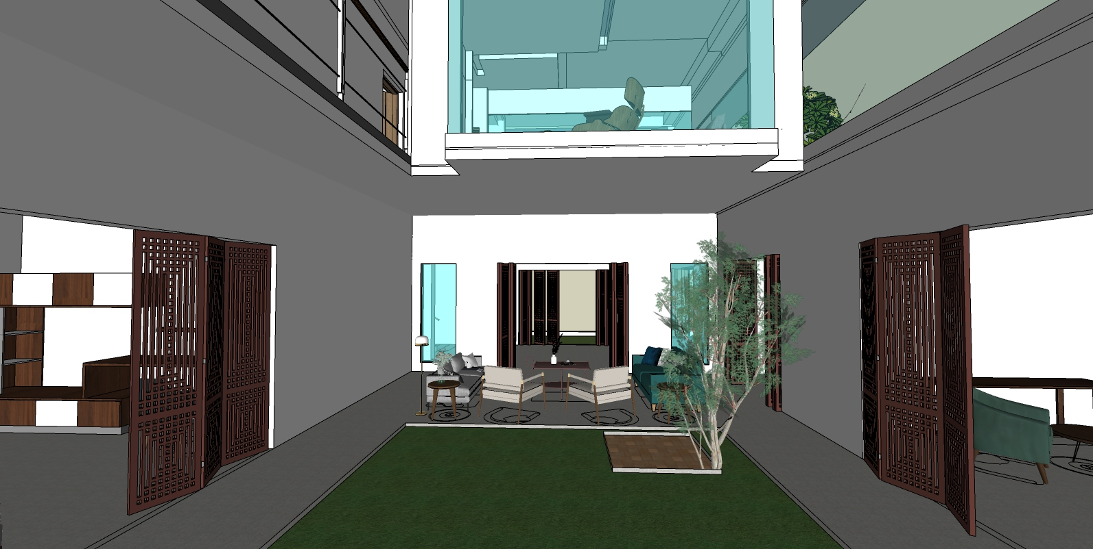
| RESIDENCE OF MRS JYOTHI & MR. SHEKHAR REDDY | COURTYARD |

Slide 38
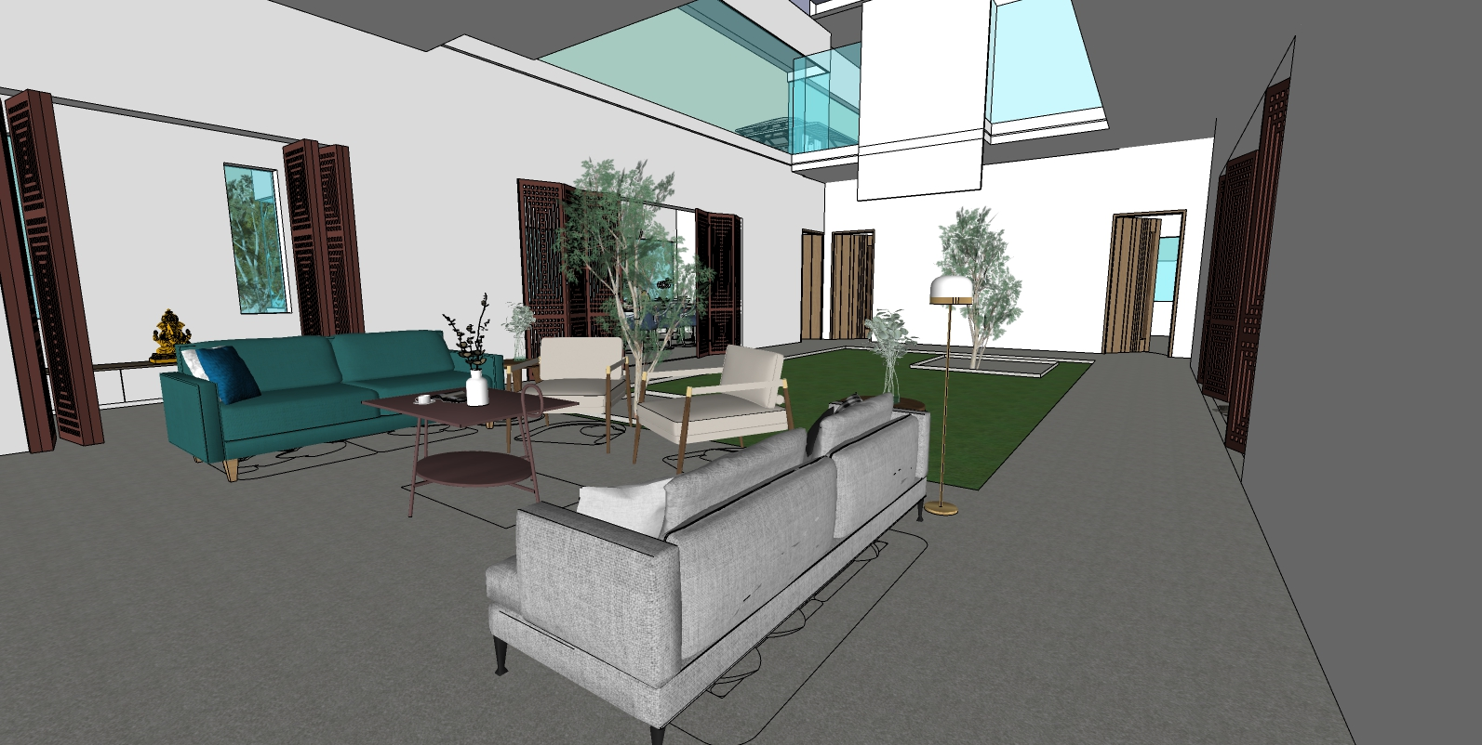
| RESIDENCE OF MRS JYOTHI & MR. SHEKHAR REDDY | LIVING + COURTYARD |

Slide 39
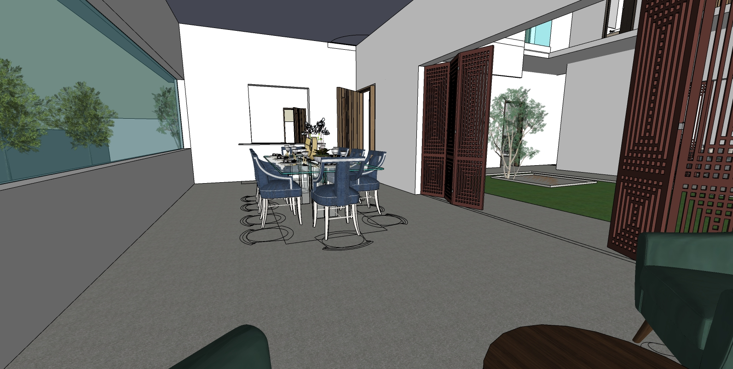
| RESIDENCE OF MRS JYOTHI & MR. SHEKHAR REDDY | DINING ROOM|

Slide 40
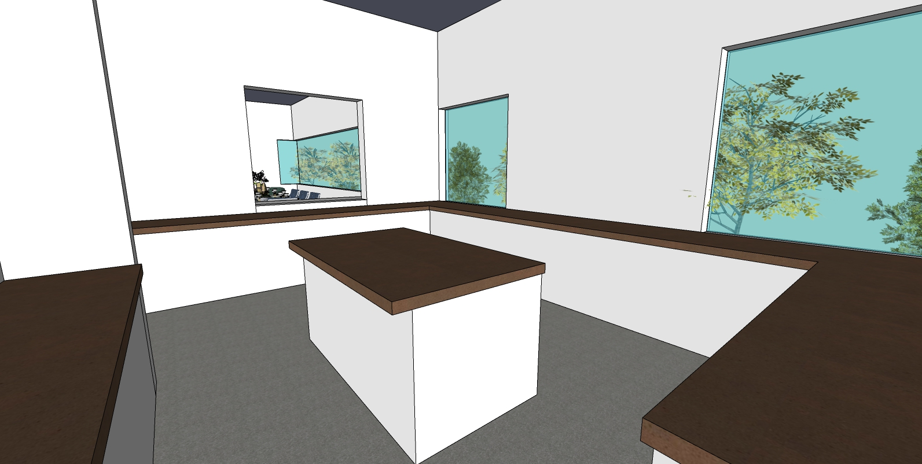
| RESIDENCE OF MRS JYOTHI & MR. SHEKHAR REDDY | KITCHEN |

Slide 41
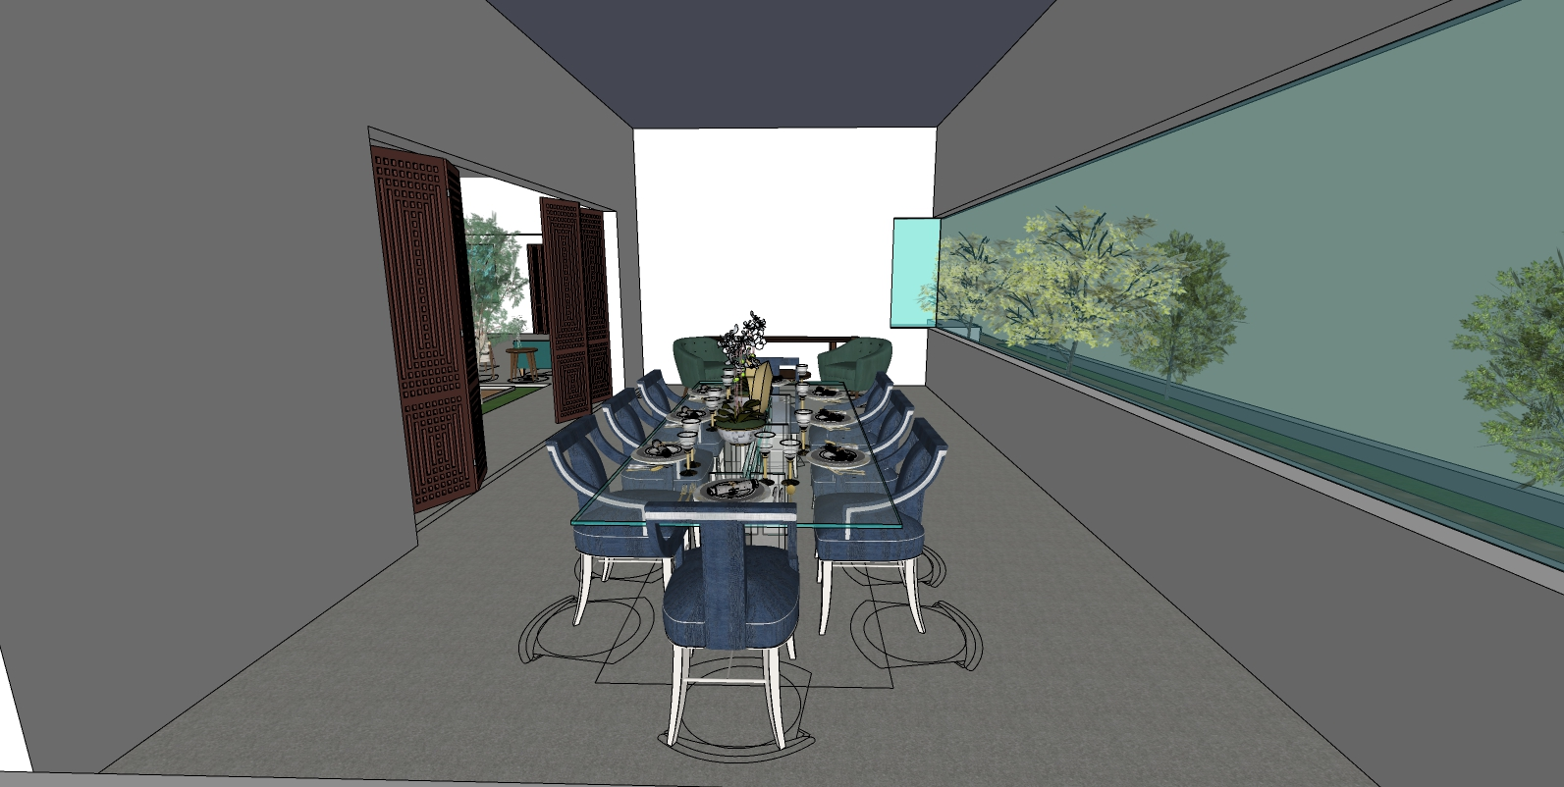
| RESIDENCE OF MRS JYOTHI & MR. SHEKHAR REDDY | DINING |

Slide 42
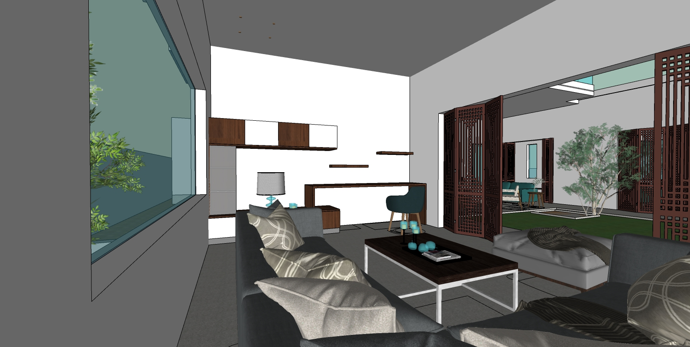
| RESIDENCE OF MRS JYOTHI & MR. SHEKHAR REDDY | FAMILY ROOM |

Slide 43
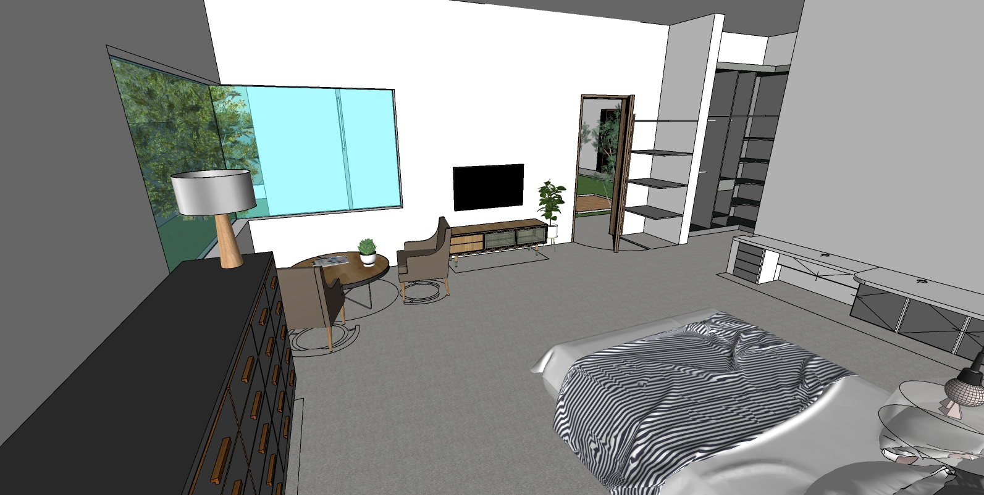
| RESIDENCE OF MRS JYOTHI & MR. SHEKHAR REDDY | MASTERBED -1|

Slide 44
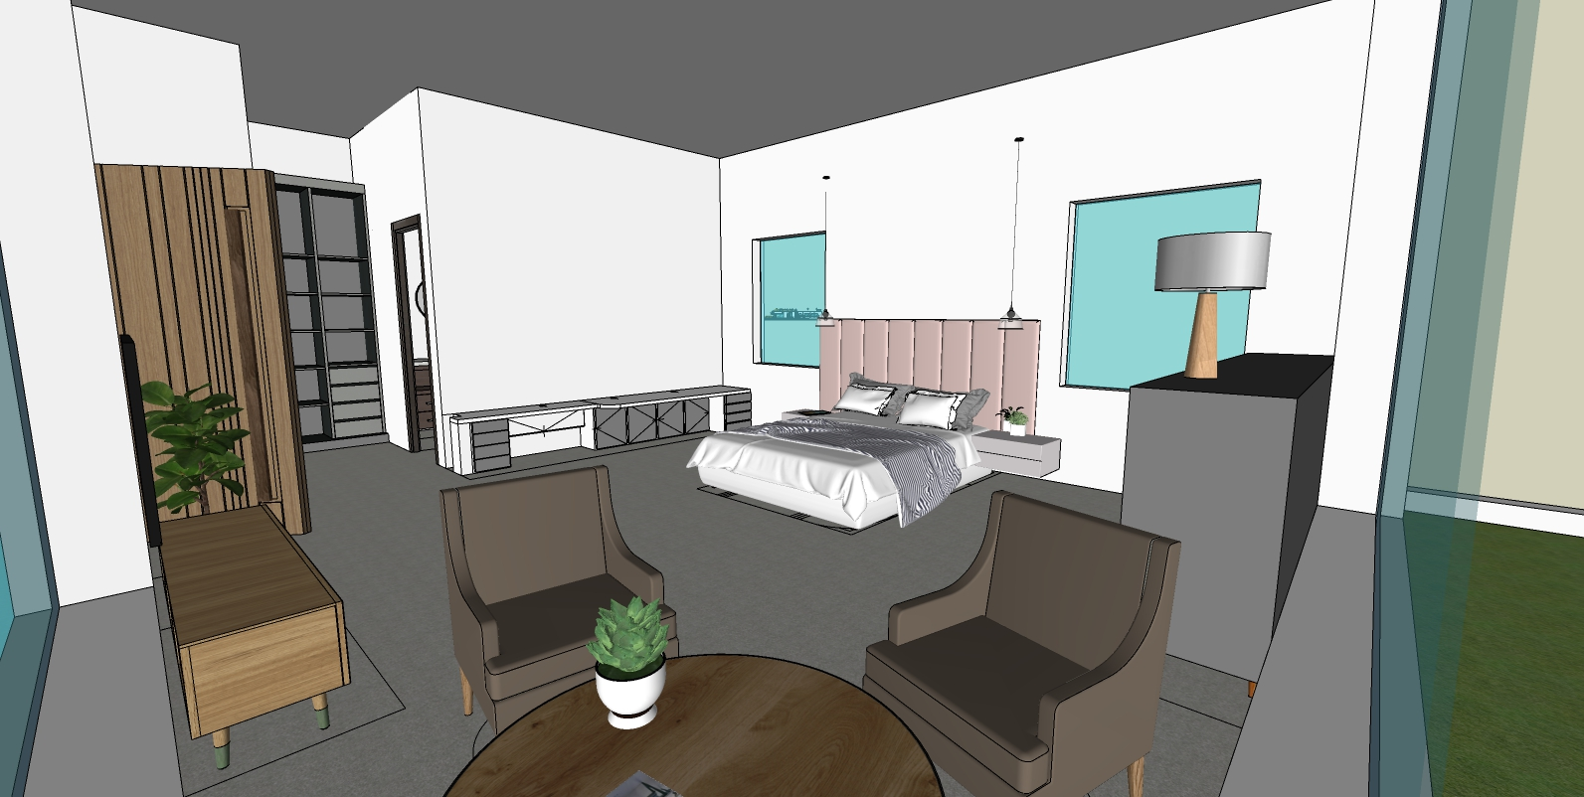
| RESIDENCE OF MRS JYOTHI & MR. SHEKHAR REDDY | MASTERBED -1|

Slide 45
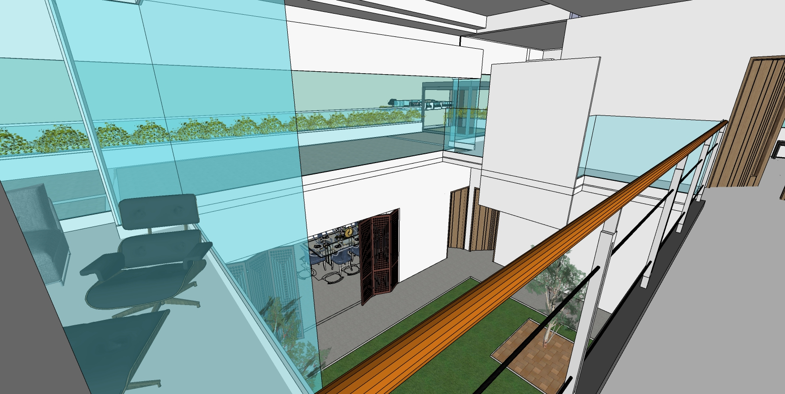
| RESIDENCE OF MRS JYOTHI & MR. SHEKHAR REDDY | OVER-LOOKING THE COURTYARD |

Slide 46
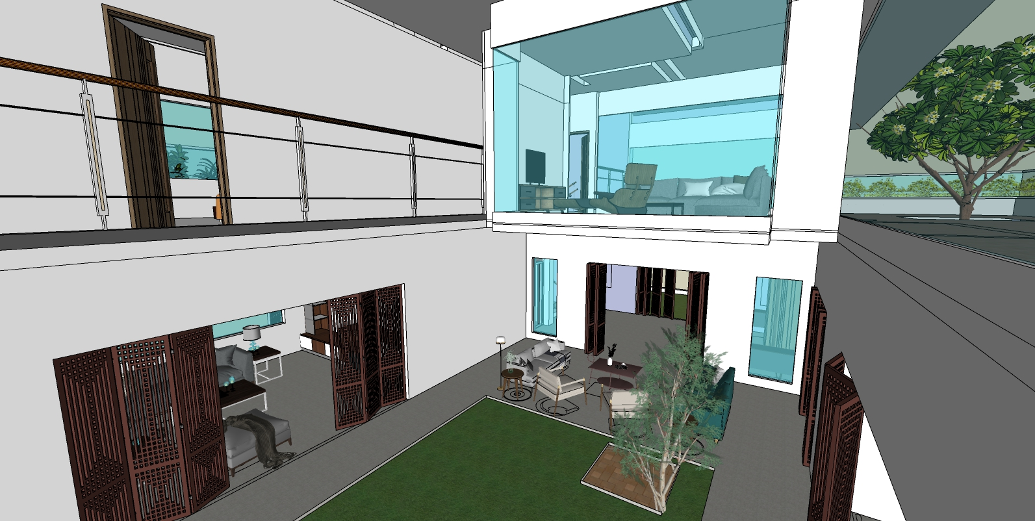
| RESIDENCE OF MRS JYOTHI & MR. SHEKHAR REDDY | OVER-LOOKING THE COURTYARD |

Slide 47
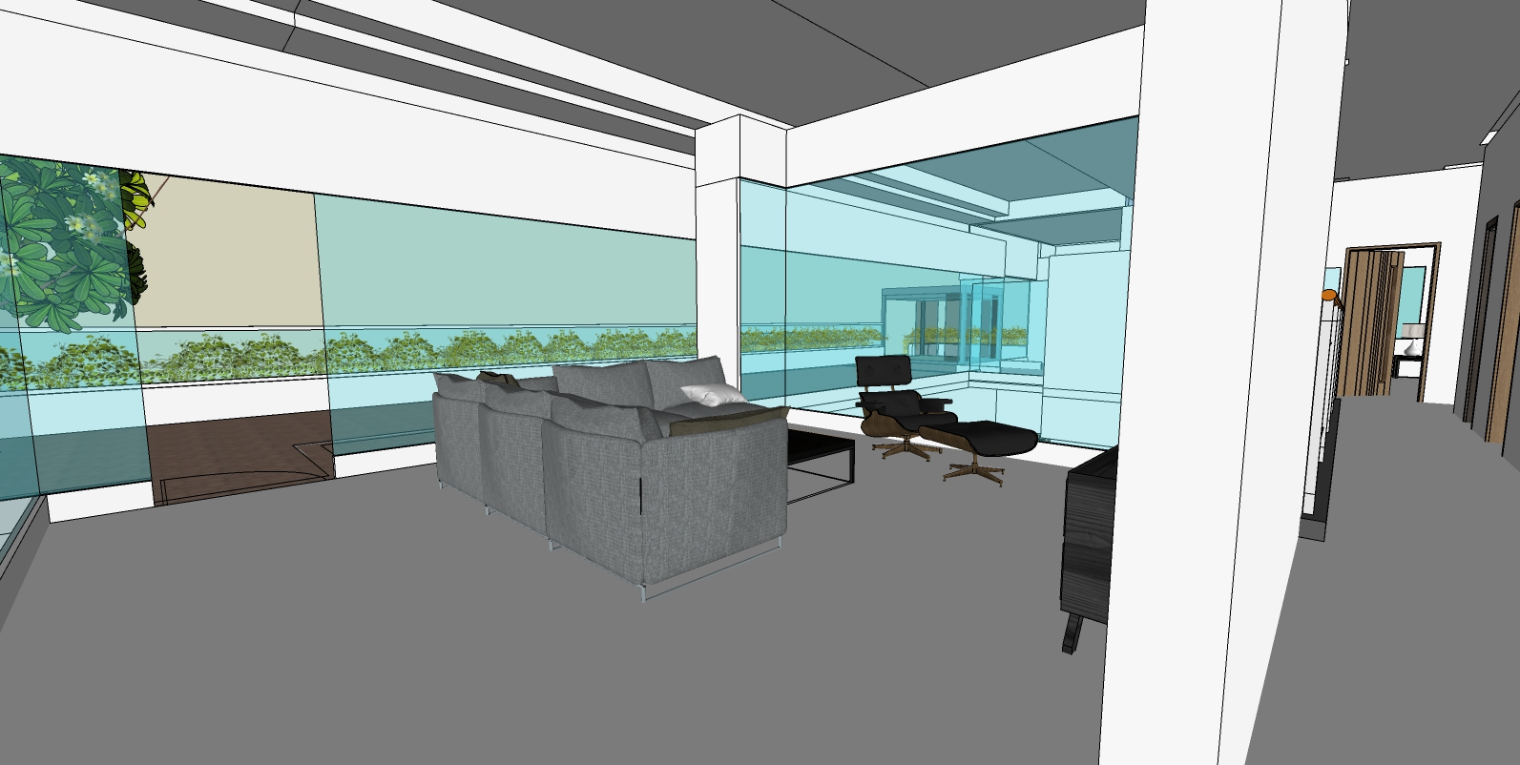
| RESIDENCE OF MRS JYOTHI & MR. SHEKHAR REDDY |THE DEN |

Slide 48
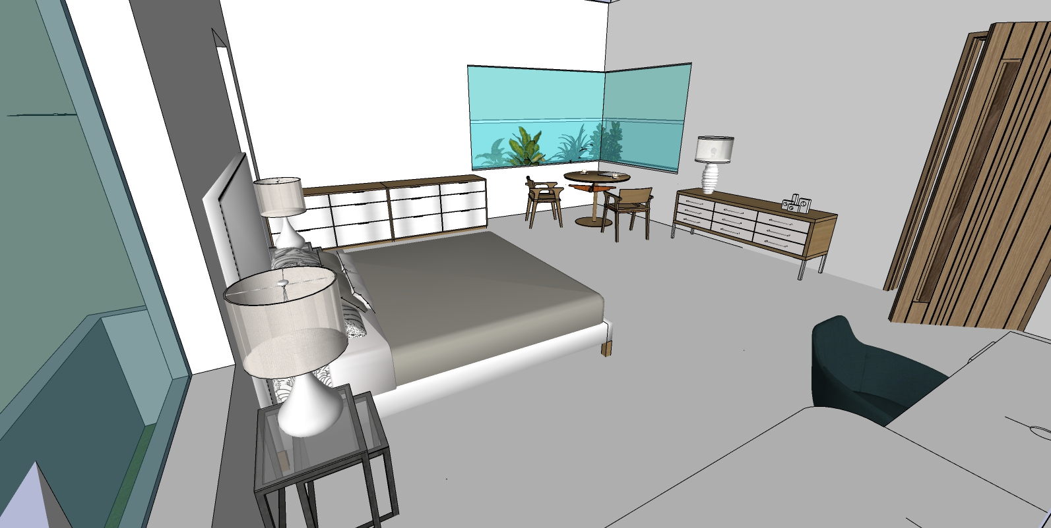
| RESIDENCE OF MRS JYOTHI & MR. SHEKHAR REDDY |MASTER BEDROOM 2 |

Slide 49
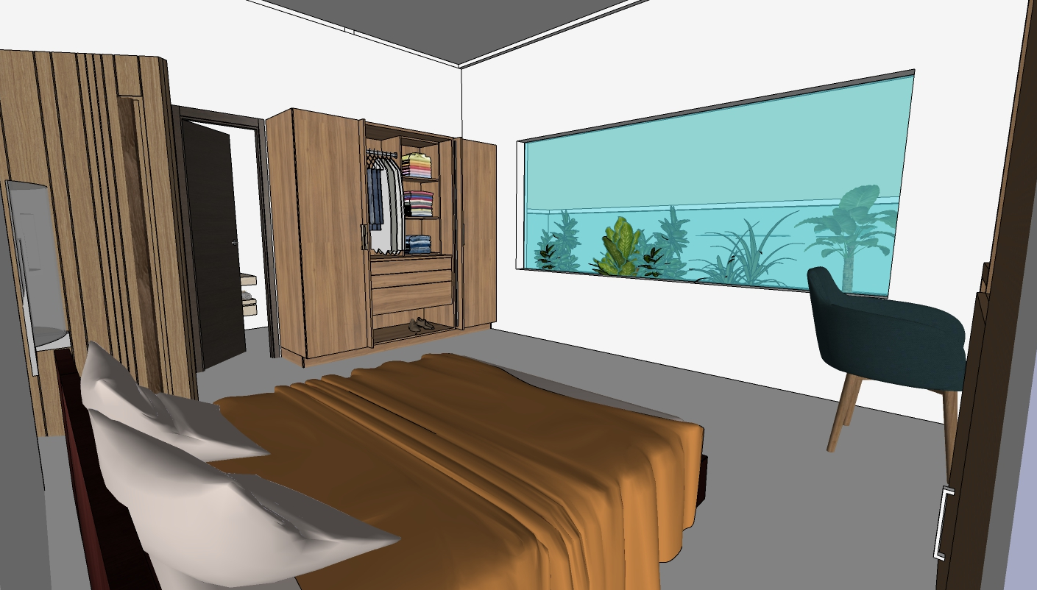
| RESIDENCE OF MRS JYOTHI & MR. SHEKHAR REDDY |MASTERBED ROOM 3 |

Slide 50
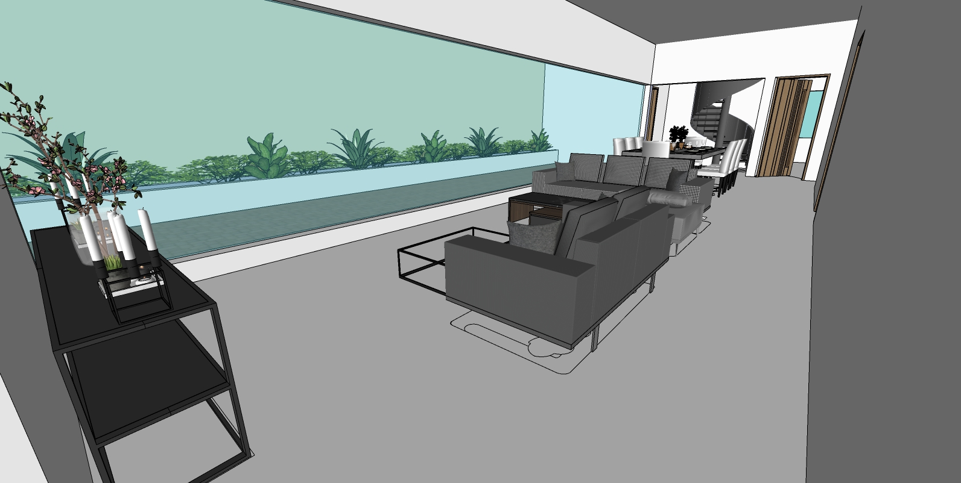
| RESIDENCE OF MRS JYOTHI & MR. SHEKHAR REDDY | LIVING + DINING ON SECOND FLOOR|

Slide 51
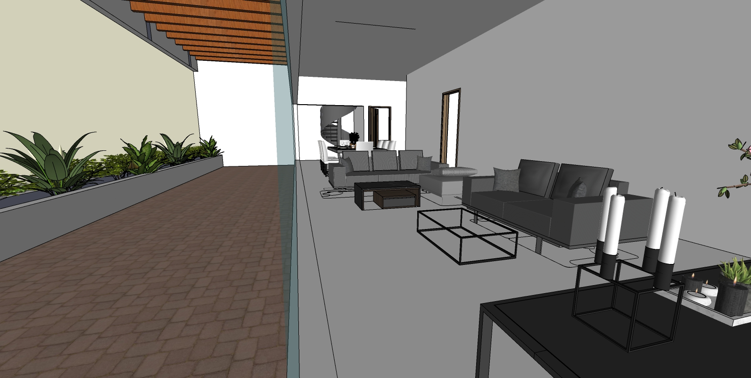
| RESIDENCE OF MRS JYOTHI & MR. SHEKHAR REDDY | LIVING + DINING + TERRACE ON SECOND FLOOR |

Slide 52
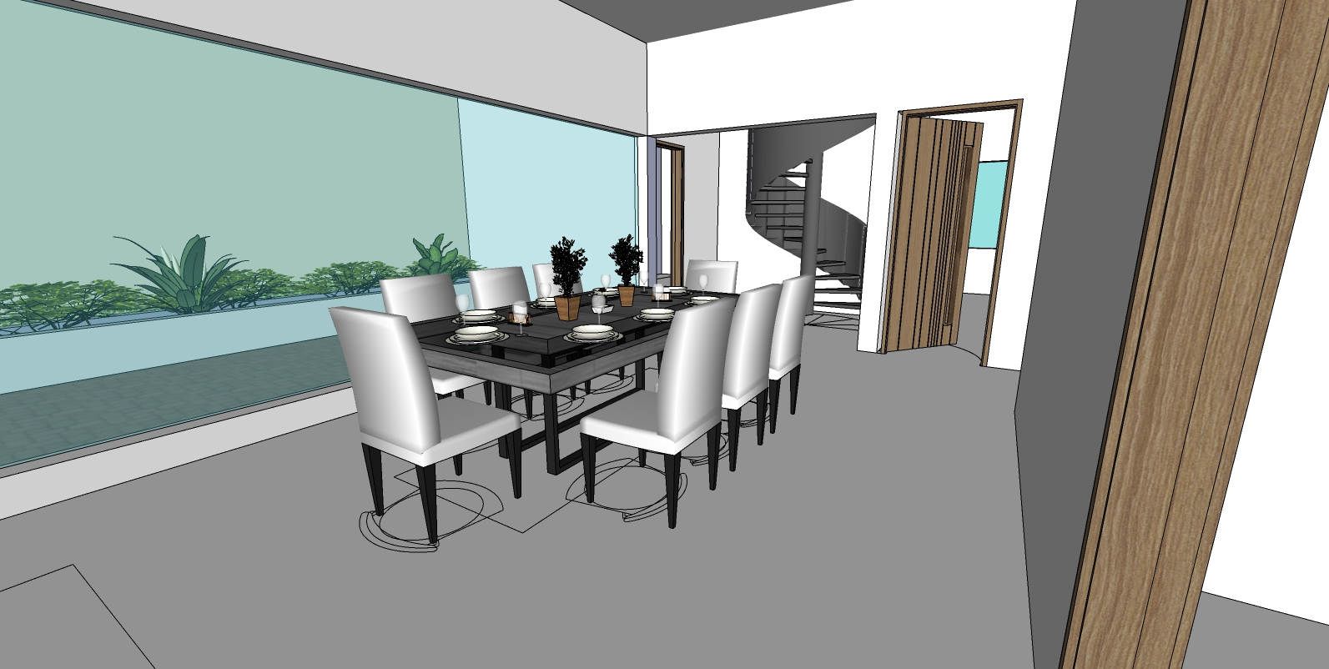
| RESIDENCE OF MRS JYOTHI & MR. SHEKHAR REDDY | DINING ON SECOND FLOOR |

Slide 53
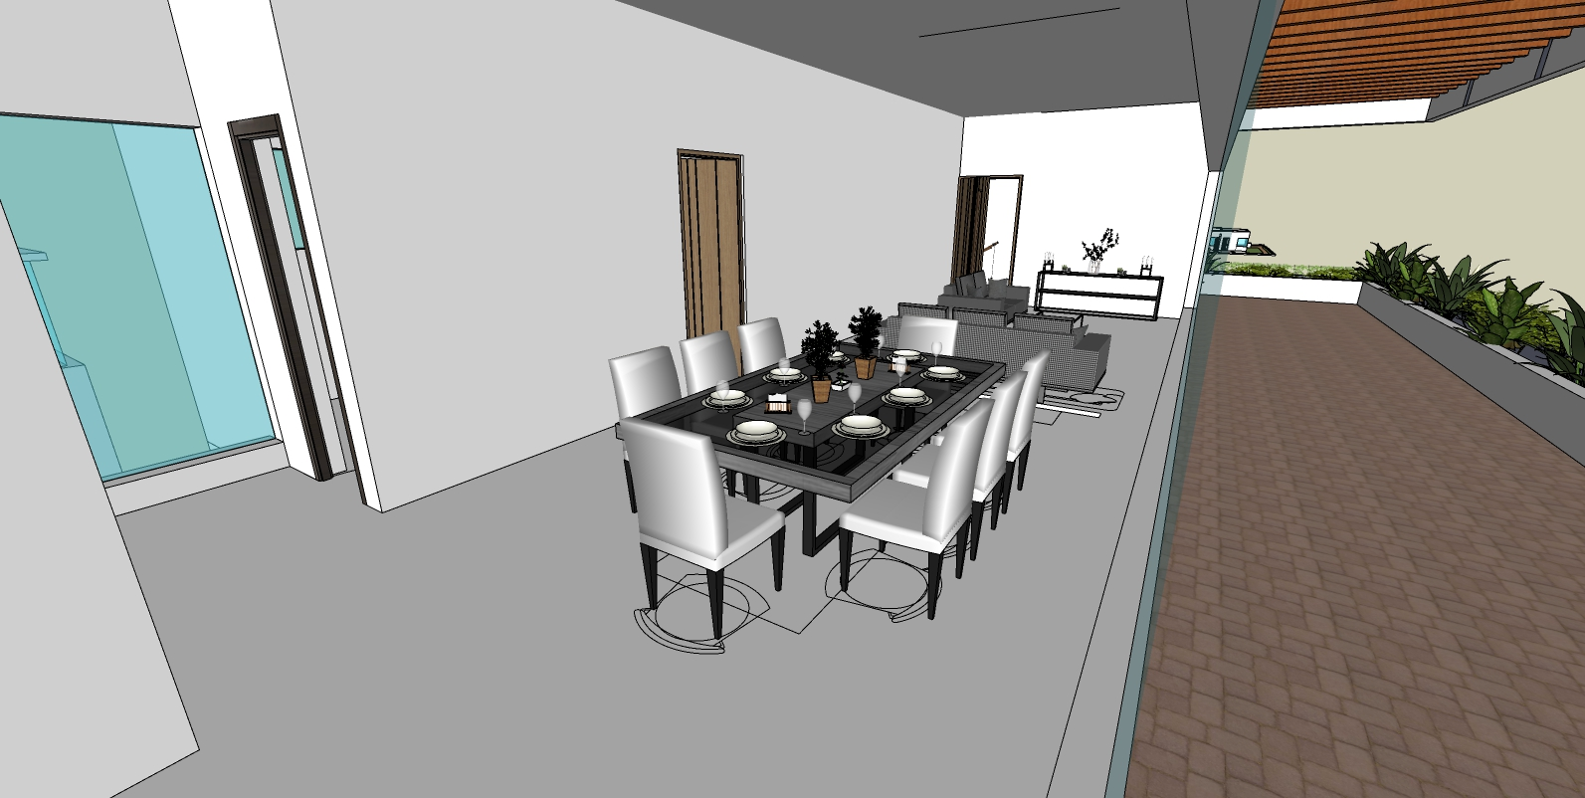
| RESIDENCE OF MRS JYOTHI & MR. SHEKHAR REDDY | DINING ON SECOND FLOOR |

Slide 54
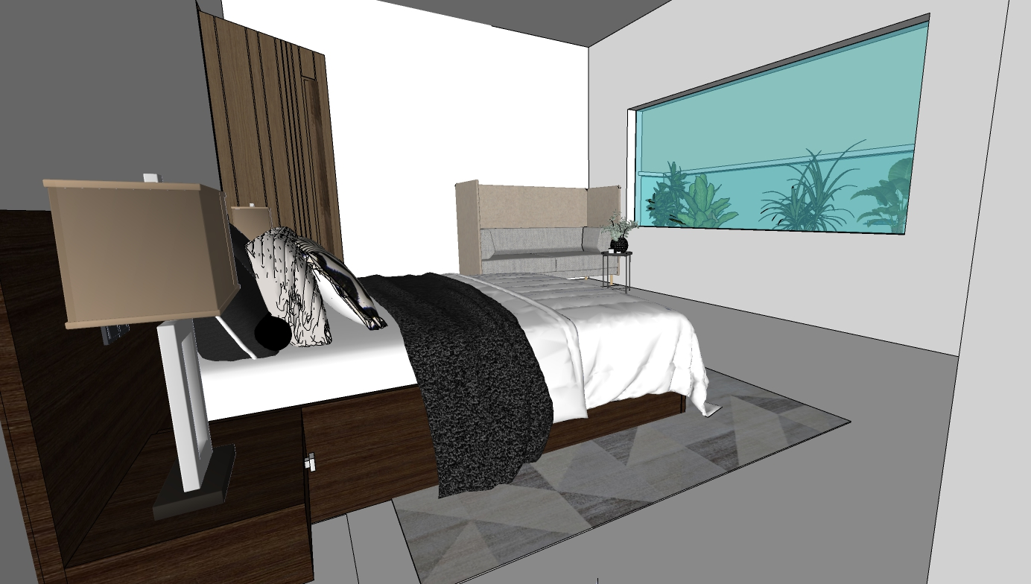
| RESIDENCE OF MRS JYOTHI & MR. SHEKHAR REDDY |BEDROOM 5 |

Slide 55
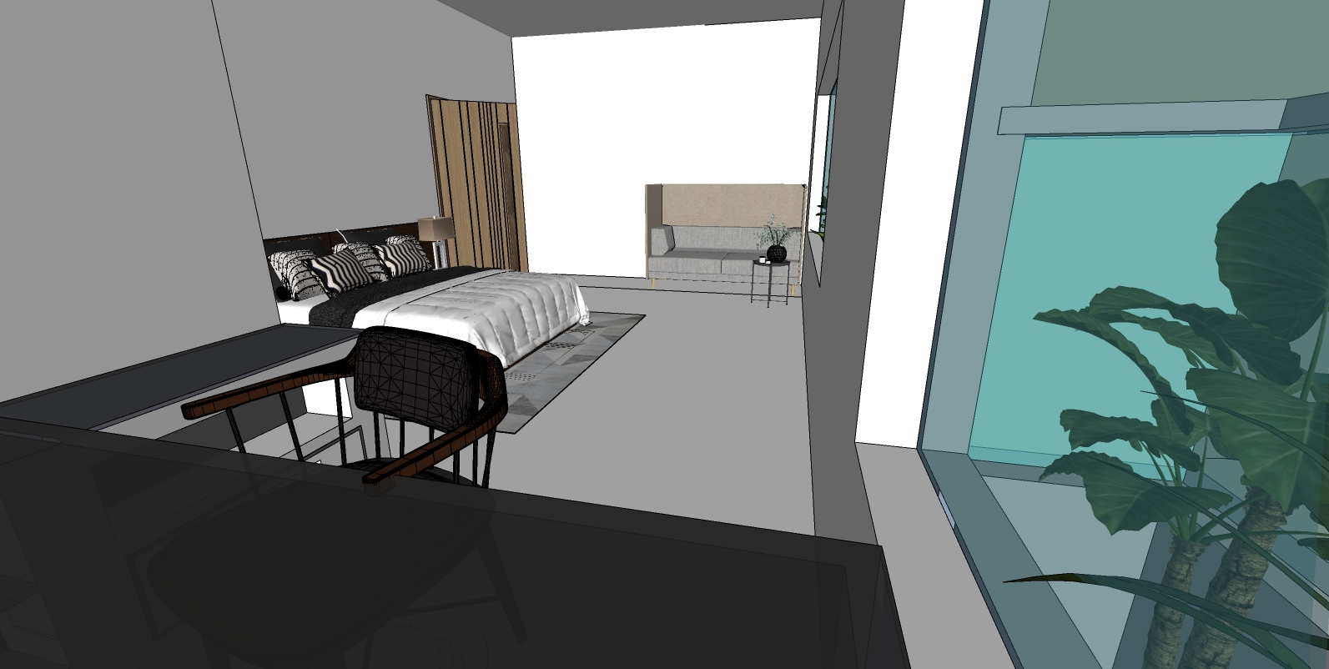
| RESIDENCE OF MRS JYOTHI & MR. SHEKHAR REDDY |BEDDROOM 5 |

Slide 56
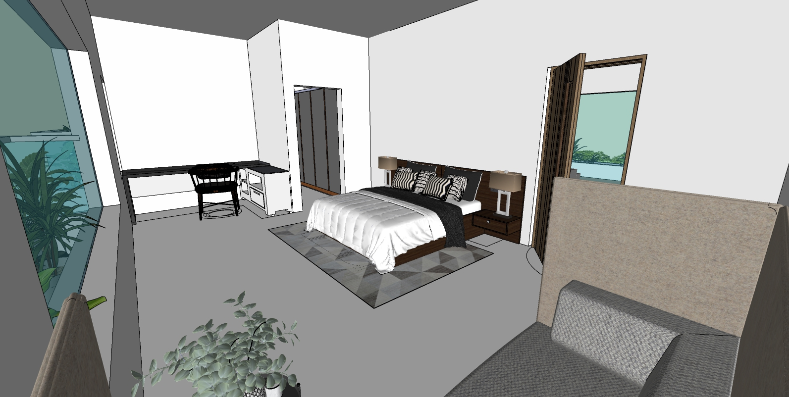
| RESIDENCE OF MRS JYOTHI & MR. SHEKHAR REDDY |BEDDROOM 5 |

Slide 57
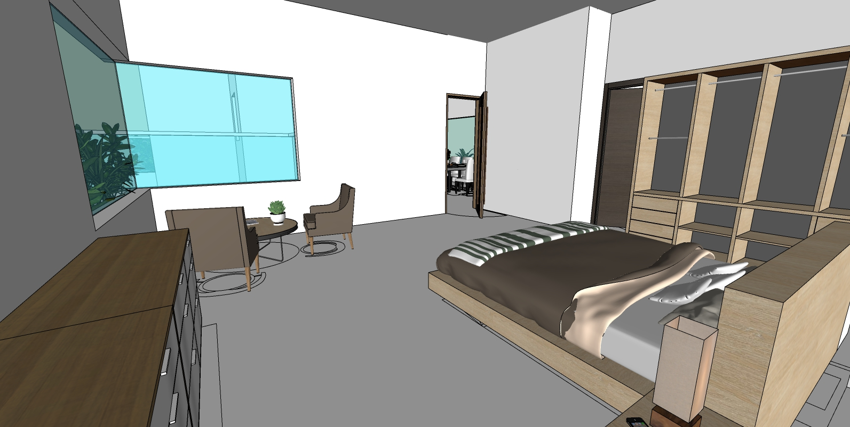
| RESIDENCE OF MRS JYOTHI & MR. SHEKHAR REDDY |BEDDROOM 4 |

Slide 58

| RESIDENCE OF MRS JYOTHI & MR. SHEKHAR REDDY |BEDROOM 4 |

