Slide 1
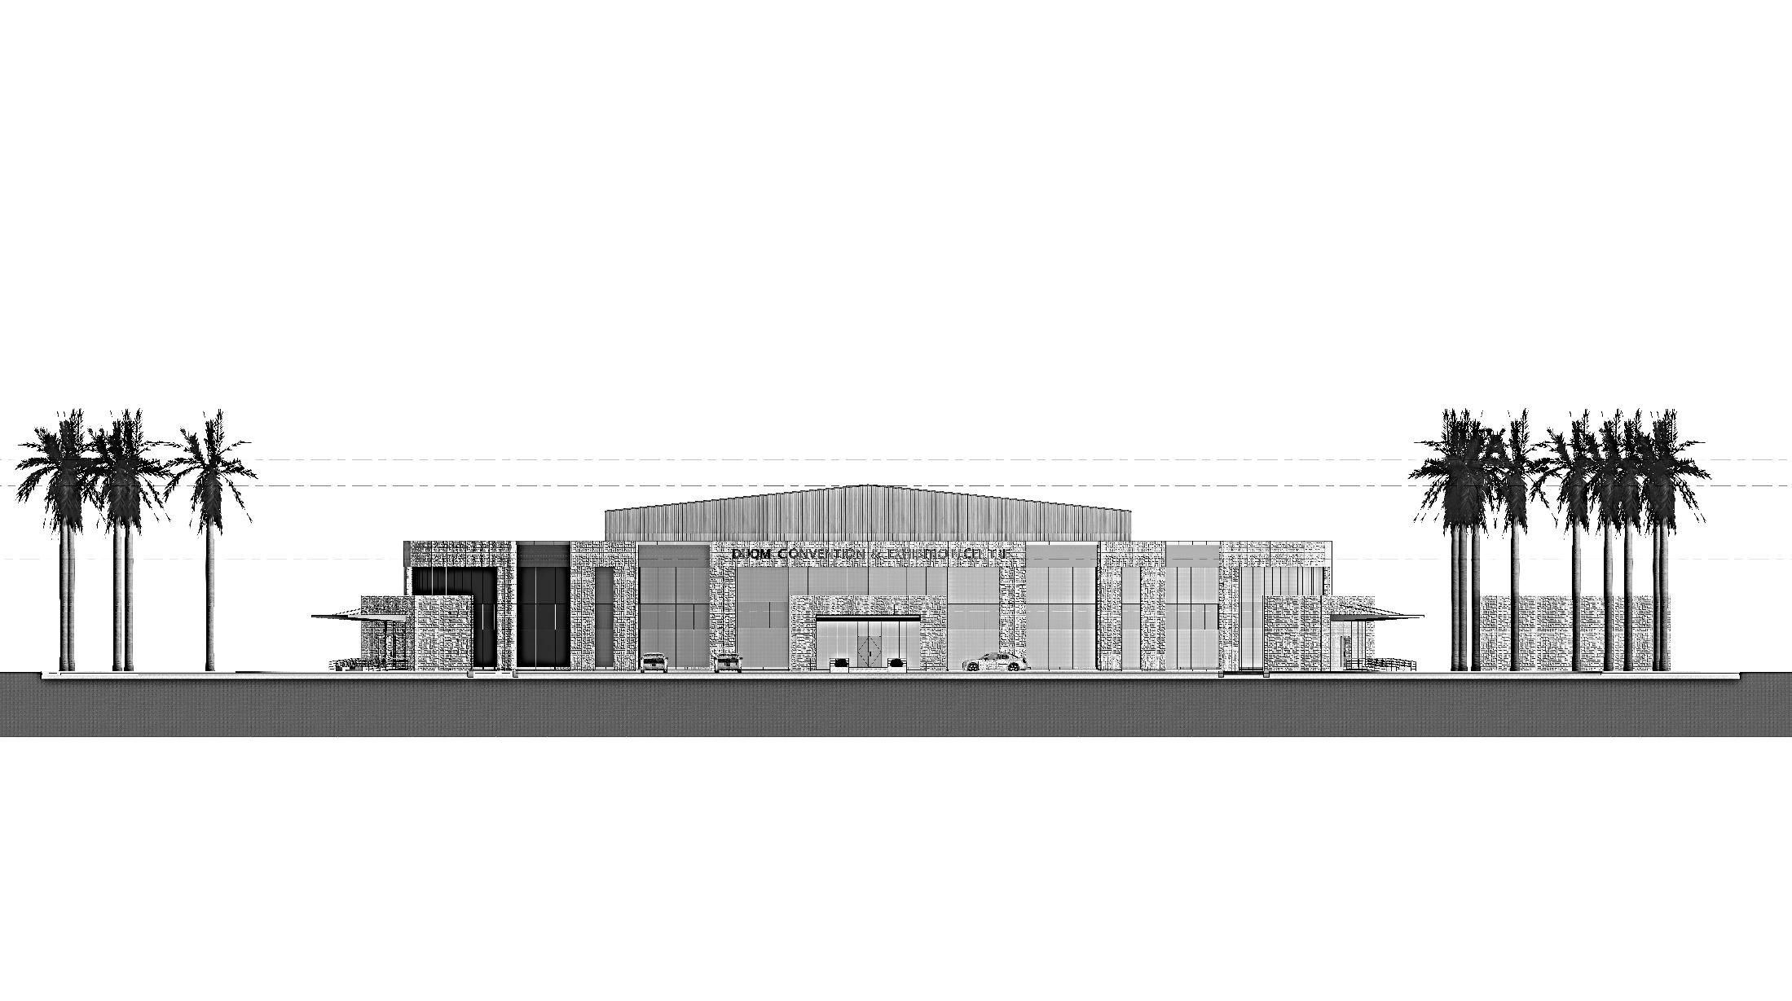
CONVENTION AND EXHIBITION CENTRE, DUQM –
CONCEPTUAL SCHEME
June 2022

Slide 2
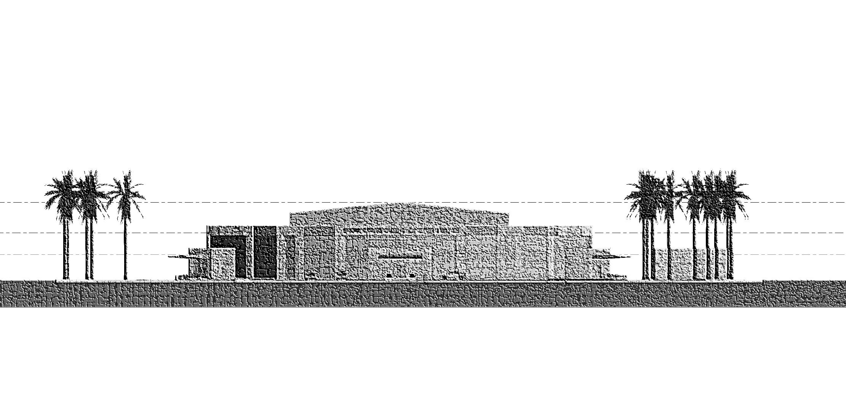
Contents
Introduction
Site Context
Masterplan
Access Plan
Circulation layout
References for circular Convention Centre
Layouts
Elevations
Sections
Seat staging
Parking/toilet/fire exits Calculation
Area Calculation
3D Visualization
References

Slide 3
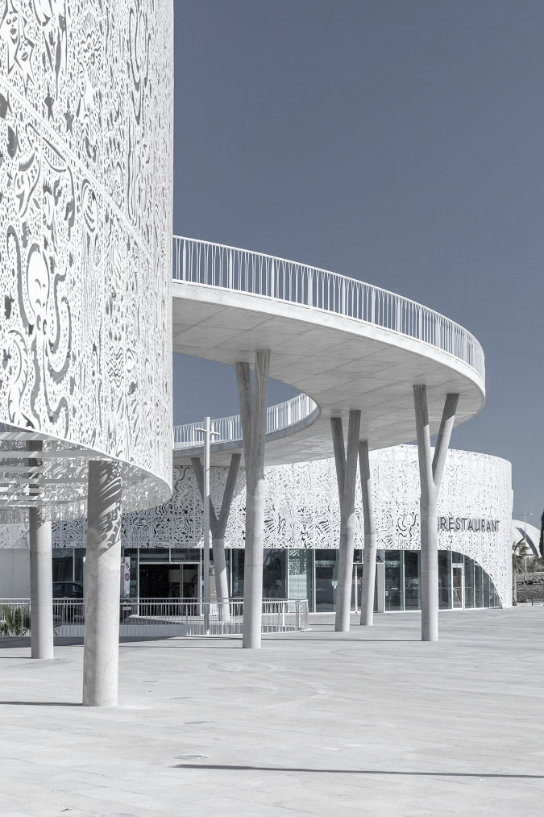
Introduction
Public Authority for Special Economic Zones and Free Zones (OPAZ) has proposed 1000seater Convention and Exhibition centre at Duqm. This Project is located in the Governorate of Duqm of the Al Wusta Region, near Crown plaza hotel Duqm
The proposed facility has been designed as a spacious, modern and eco-friendly facility spread over a built-up area of 6000sqm. The facility has a capacity to host 1000 guests together and is equipped with state-of-the-art features and facilities like Multipurpose Hall of 1000seating capacity, Cafeteria of 75-100persons capacity, Multi-function lobby for exhibition and gathering spaces, a business centre with Conference and meeting rooms facilities (100capacity in total), Office for Administration staff, prayer rooms and other support facilities required for the smooth function of the proposed centre. Other facilities include Utility Buildings, Guard Room, and 100+ parking spaces with external development and Landscaping spreading over a developable area of around 19,000sqm.
The Convention building has been designed for two floors. The ground floor houses a state of the art, 1000seater multipurpose hall with roof height of 14m. This large spacious hall can be used for conventions, exhibition, auditorium like events, banquets etc; supported by spacious double height lobbies, cafeteria, prayers room, restrooms, a well-equipped stage and backstage facilities.
The mezzanine floor comprises of the office for administrative staff, and a well-equipped business centre, with 2 conference halls, meeting room, breakout space, reception and relevant support facilities.
The proposed Building has been designed keeping in mind a fast paced construction and a stringent time-line of 4months to completion and handing over. The building carcass has been designed for modular and prefabricated construction in steel, to be fit out and assembly based. The building is wrapped with modular panels of glass, GRC and concrete, with a Standing seam roof over the Hall and RCC slab over the mezzanine. The roof can also accommodate solar panels as an alternate source of energy.
The proposed 1000seater Convention and Exhibition centre at Duqm shall be a landmark for Al Wusta Region and a symbol of collaborative efforts between client and the contractor..

Slide 4
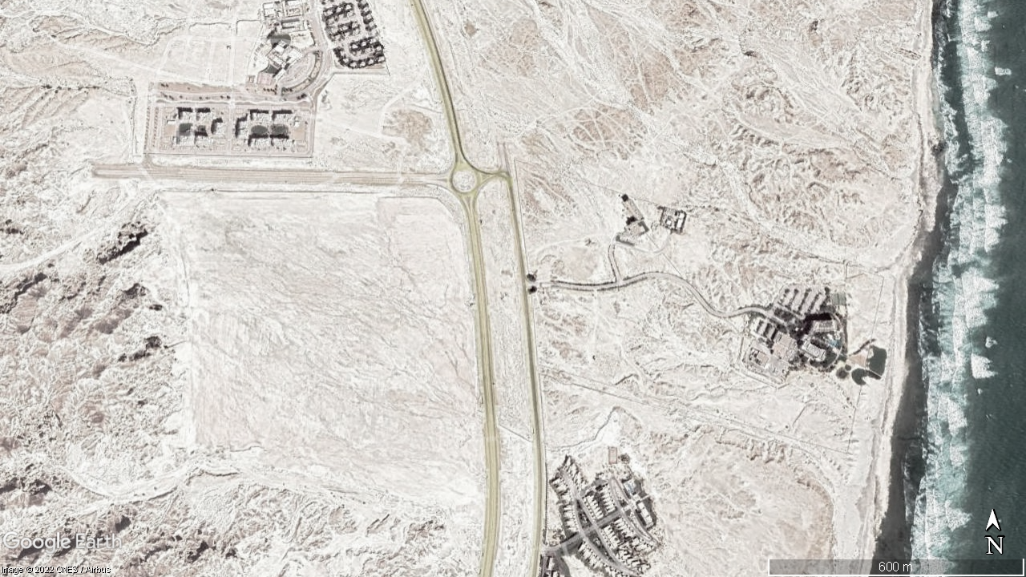
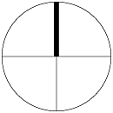
Site Context
Duqm Frontier Town
650 M
600 M
Land parcel (under consideration)
700 M
Crowne Plaza, Duqm
650 M
N
Park Inn by Radisson Hotel

Slide 5
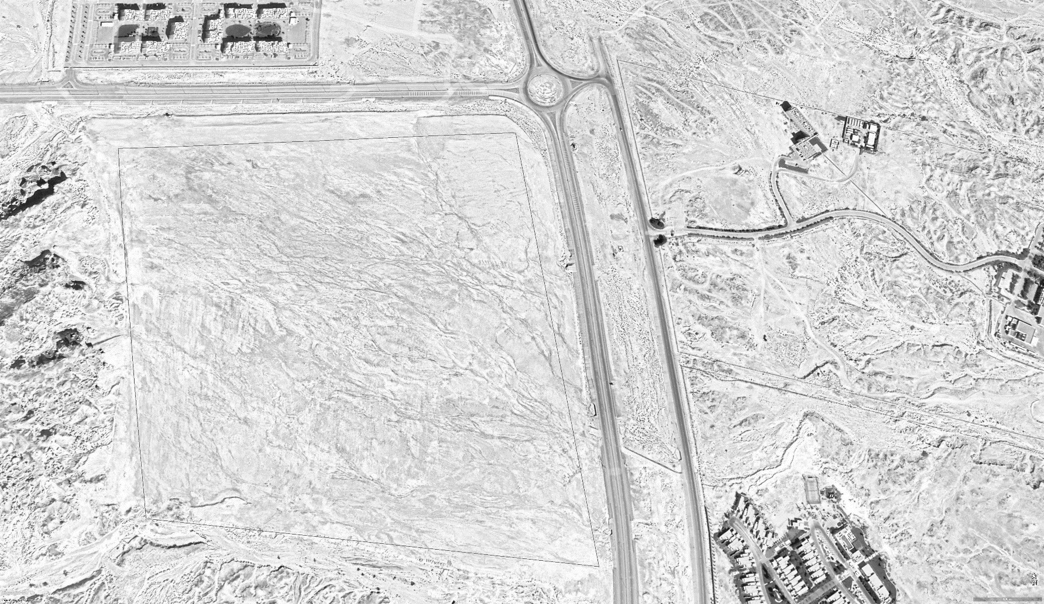
Proposed Site
Approach road
Proposed development Area = 19300 sq.m.
Land parcel for Convention Centre
N

Slide 6
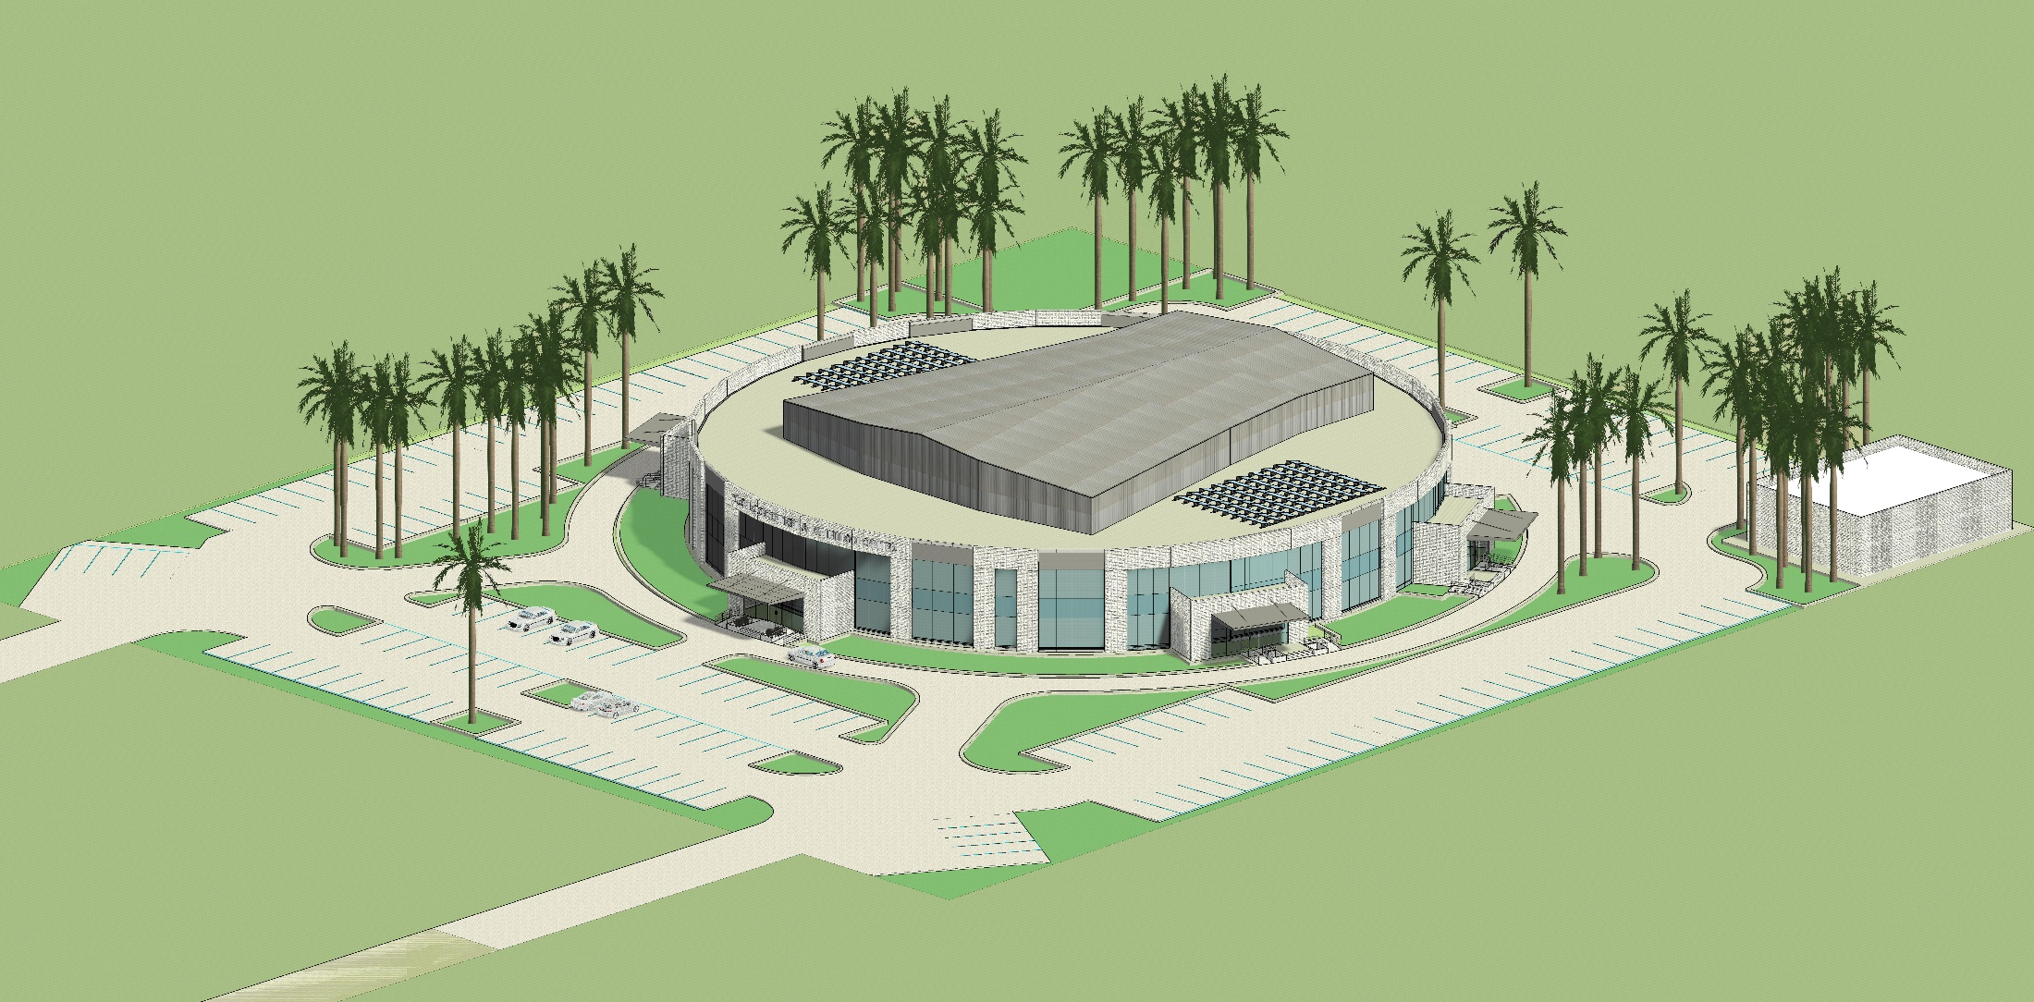
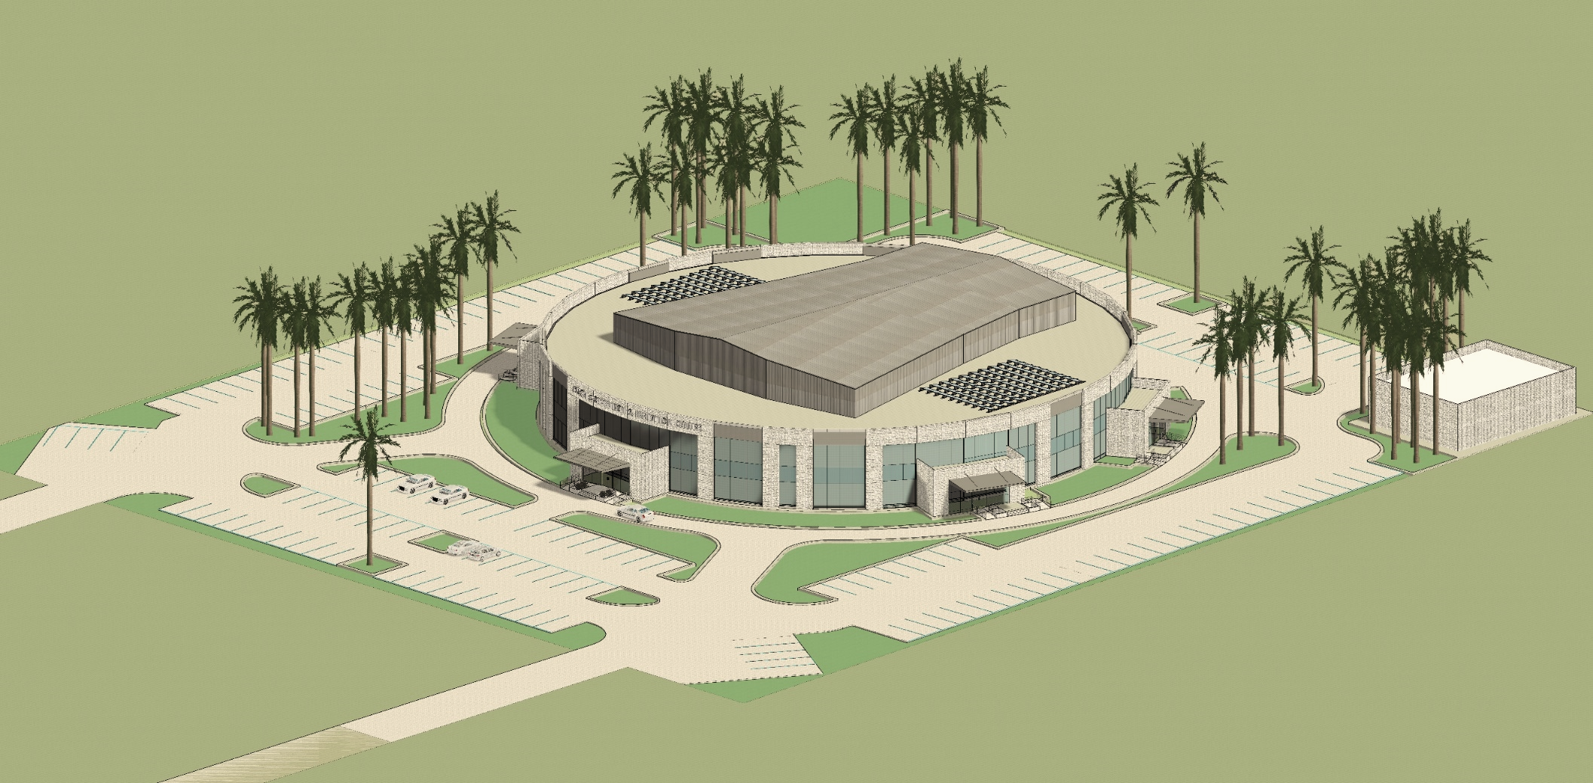
Views

Slide 7
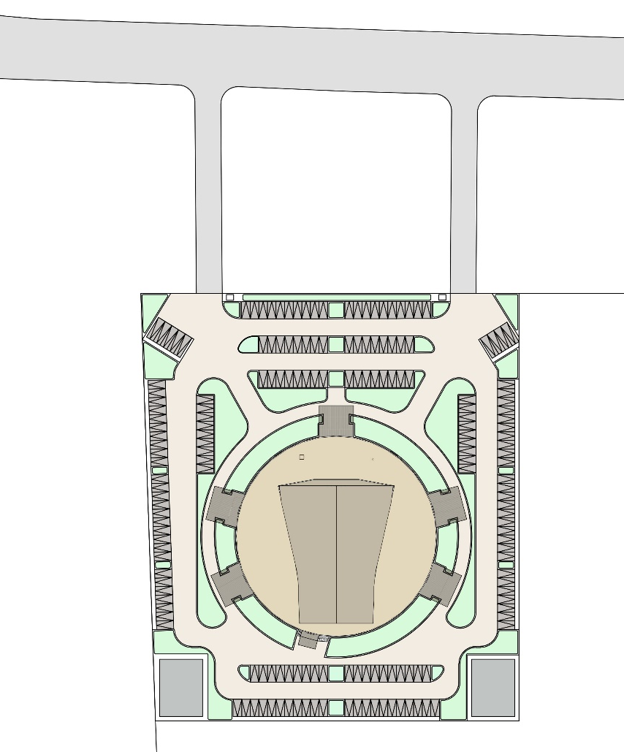
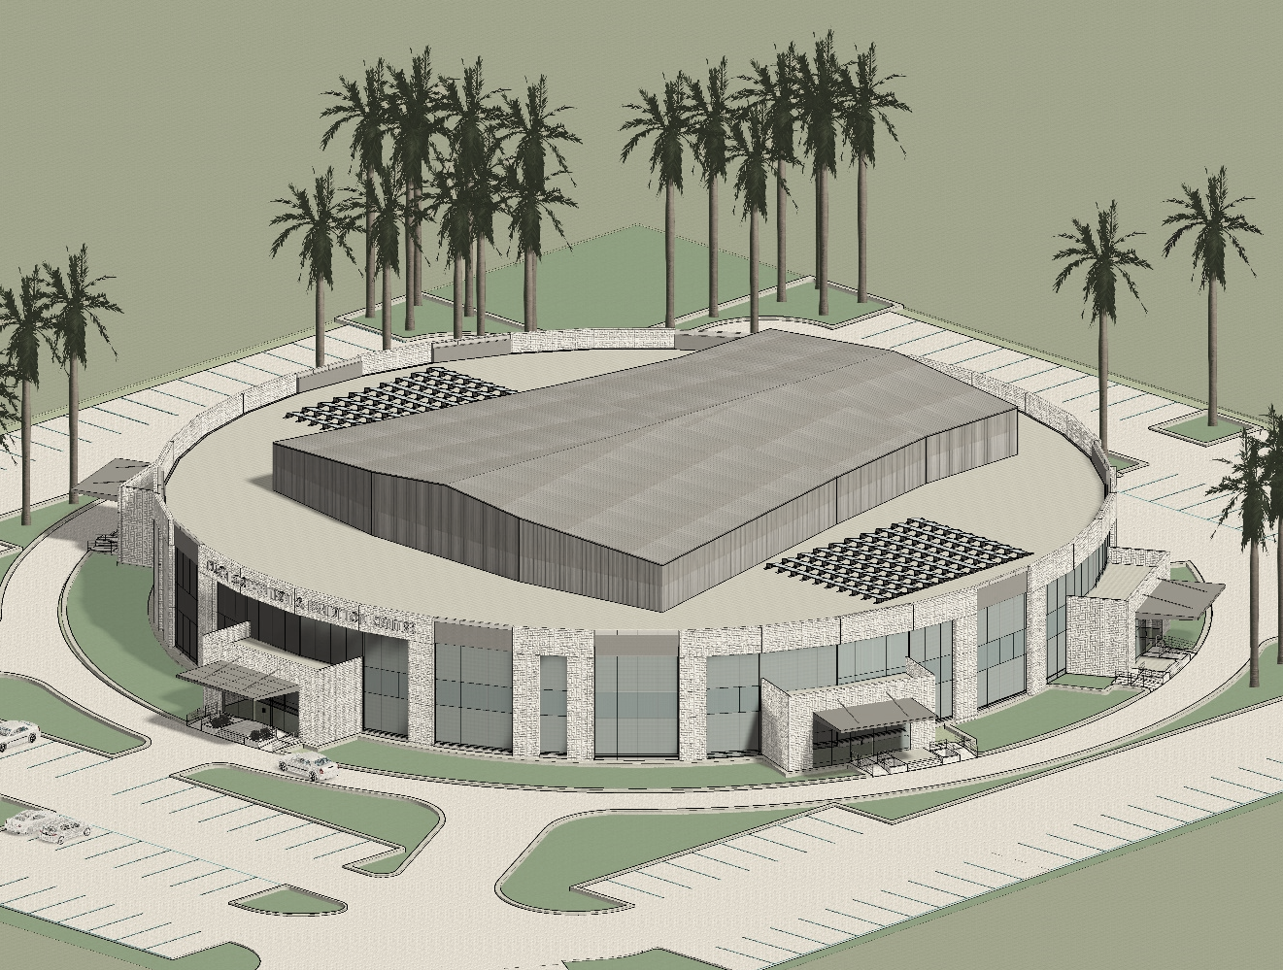

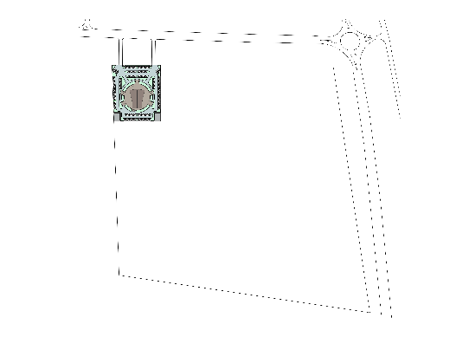
Master Plan
Access Road
Entry
Exit
4
3
4
3
3
3
4
3
3
4
3
3
1
3
3
1
Convention Centre
3
3
2
Utilities
Land parcel for Convention Centre
N
Landscape area
2
4
2
3
4
Parking area
Key Plan

Slide 8
Access Plan
Access Road
Entry
Exit
Main Entrance for Convention Centre
VIP Entry
Staff Entry
Cafeteria Entry
Backstage Entry
Service Entry
Land parcel for Convention Centre
N
Key Plan

Slide 9

Access Plan
Entry
Exit
`
6.0m wide Driveway
6.0m wide Driveway
Main Entrance for Convention Centre
7.5m wide Driveway
7.5m wide Driveway
VIP Entry
Cafeteria Entry
Backstage Entry
Staff Entry
Service Entry
N
6.0m wide Driveway

Slide 10
Circulation Layout
Fire tender movement
Entry
Exit
Vehicular access towards parking
Vehicular Drop-off(for public vehicles)
`
Service entry
N

Slide 11
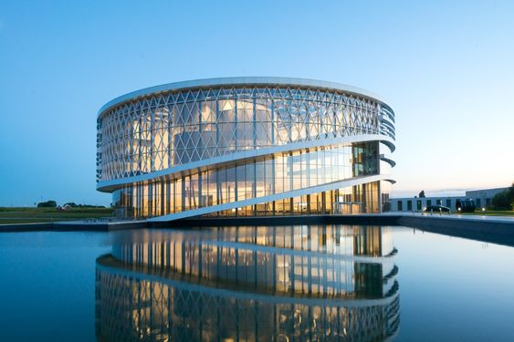
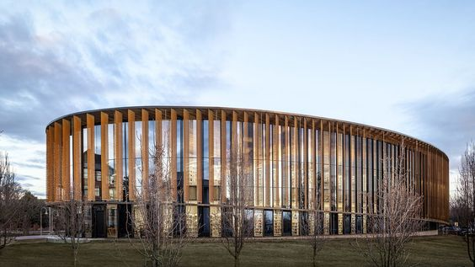
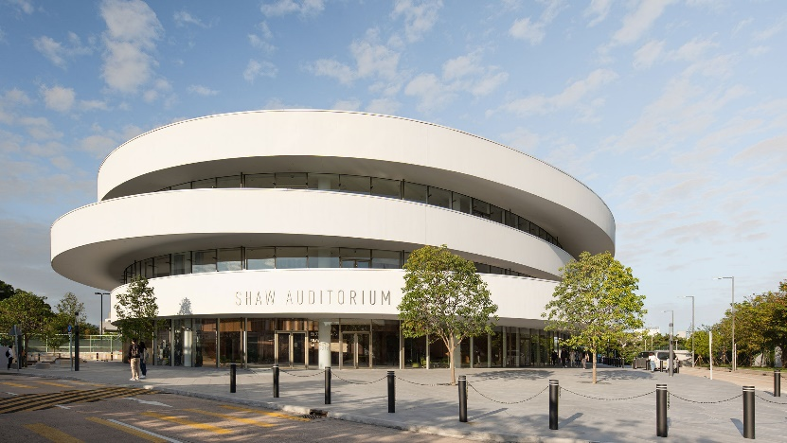
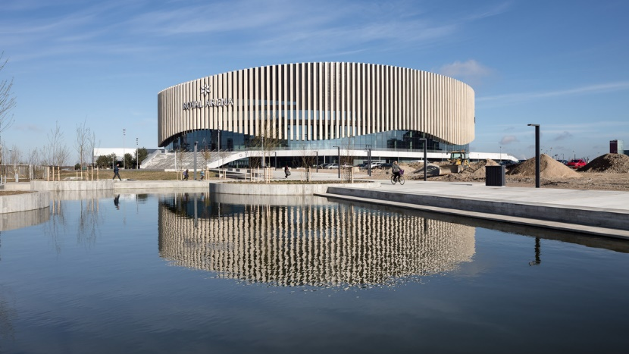
References for circular Convention Centre

Slide 12
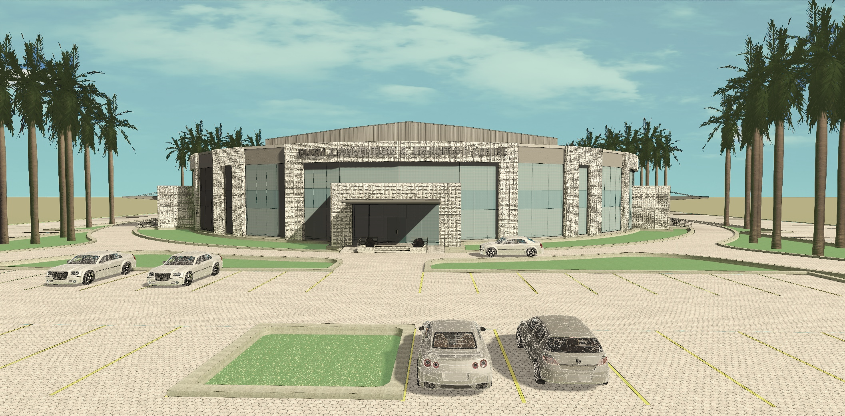
Views

Slide 13
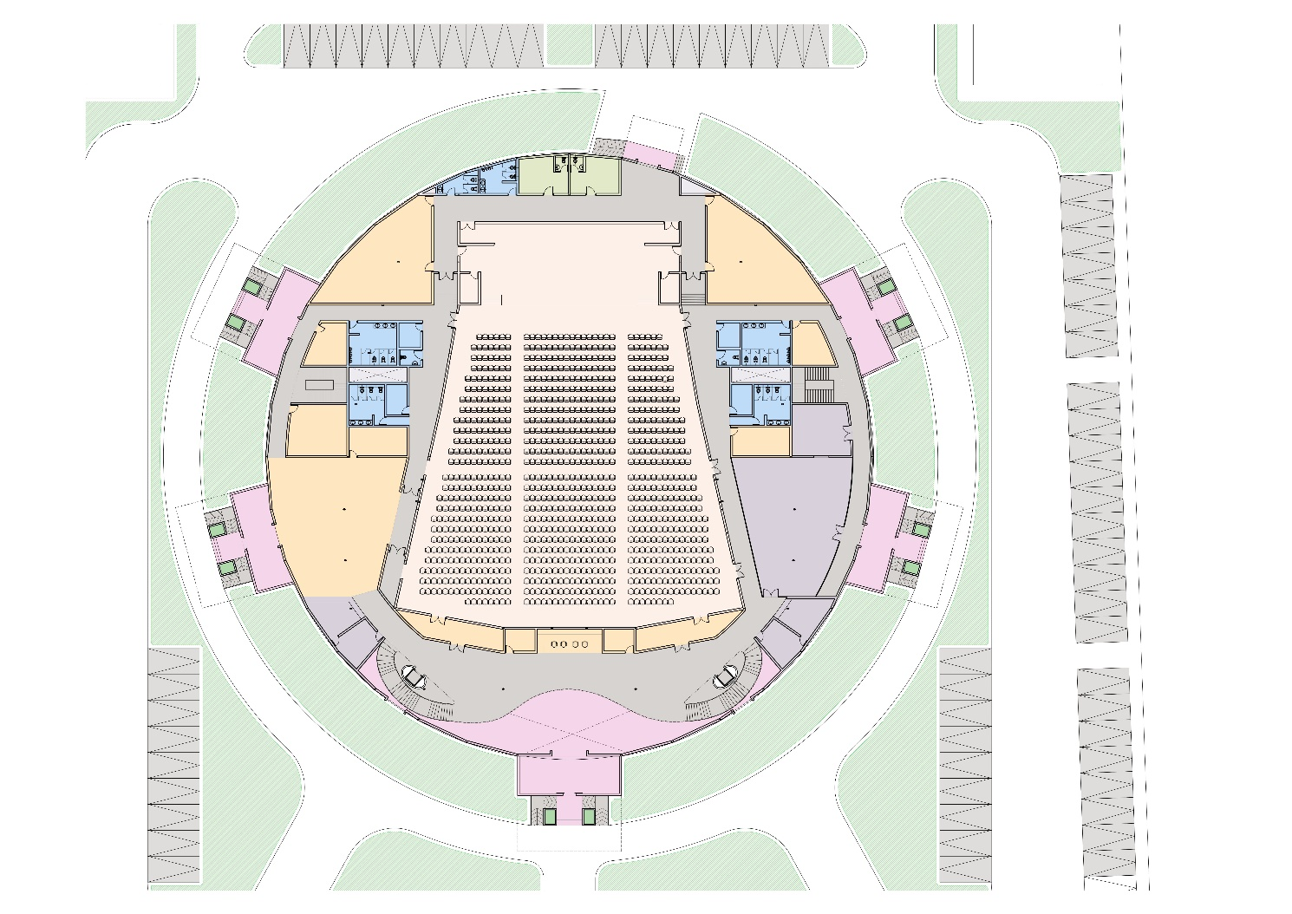
Ground Floor Plan
Activity areas
Entrances / porch airlock lobby
1
Lobby area
Service entry
Landscaping
2
Lounge
Circulation area, staircase, lifts
3
Prayer room
Cafeteria & kitchen
4
Air lock passage
Staff entry
6
5
Backstage entry
Utility/Services
Furniture store
Stage
5
Auditorium Hall
6
Backstage rehearsal
2
3
Green Rooms
7
Registration
2
Entry/Exits to the Auditorium Hall
3
3
1
Cafeteria entry
VIP entry
4
7
4
Hall foyer
Main entry
N

Slide 14
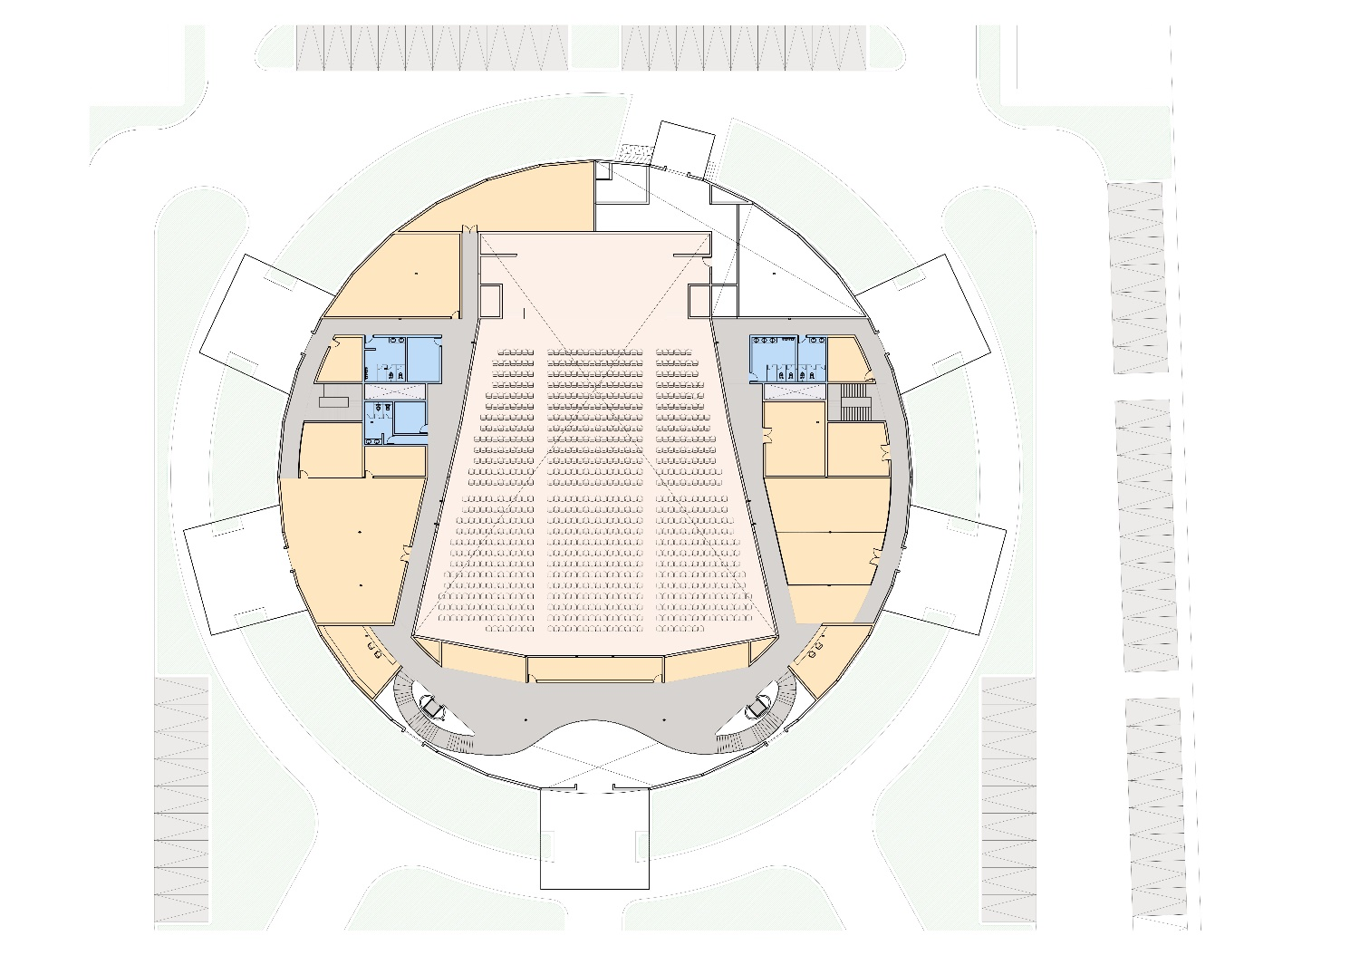
Mezzanine Floor Plan
Activity areas
Landscaping
1
Projection room
Circulation area
2
Reception
Utility/Services
3
Conference room
8
Auditorium
4
Meeting room
8
5
Pantry
6
Manager room
6
8
7
Office
8
Rooms
4
5
4
5
3
7
3
2
1
2
Lobby
N

Slide 15
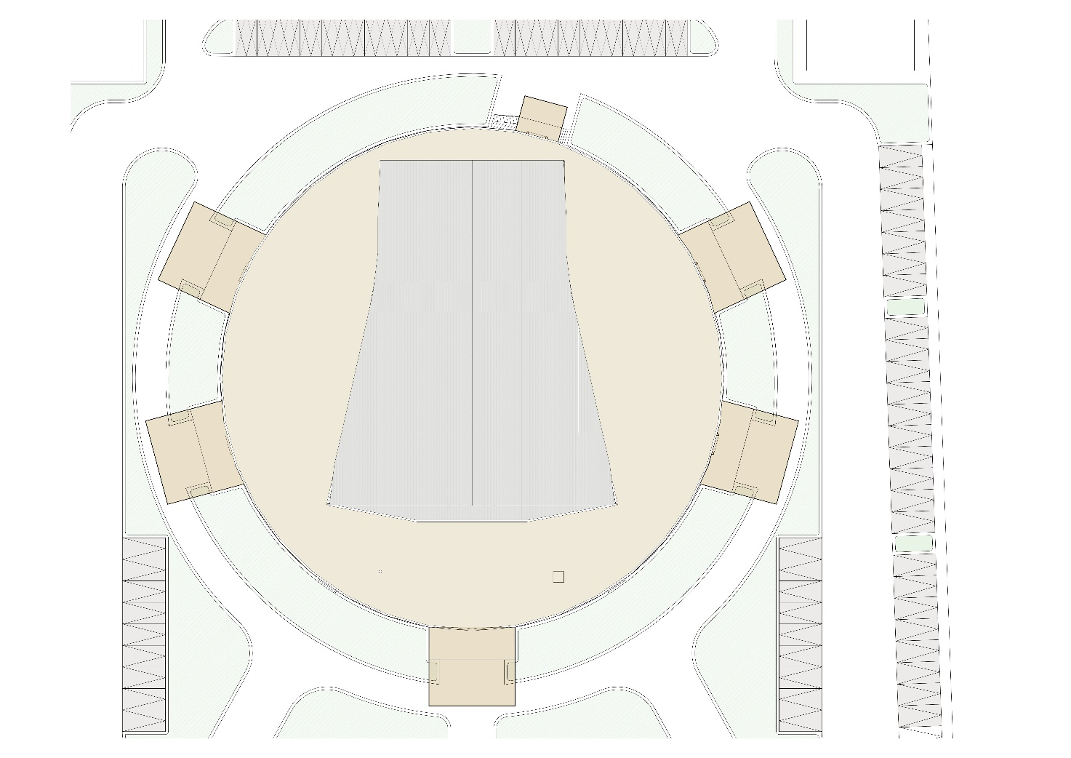
Roof Plan
RCC slab with solar farm
Aluminium standing seam roof
Canopy
N

Slide 16
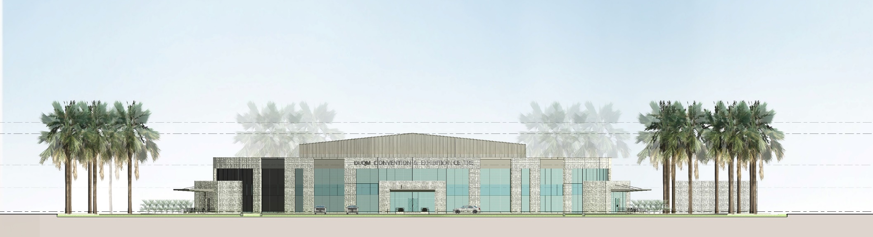
Front Elevation
ROOF LVL.
TERRACE LVL.
FIRST FLOOR LVL.
GROUND FLOOR LVL.

Slide 17
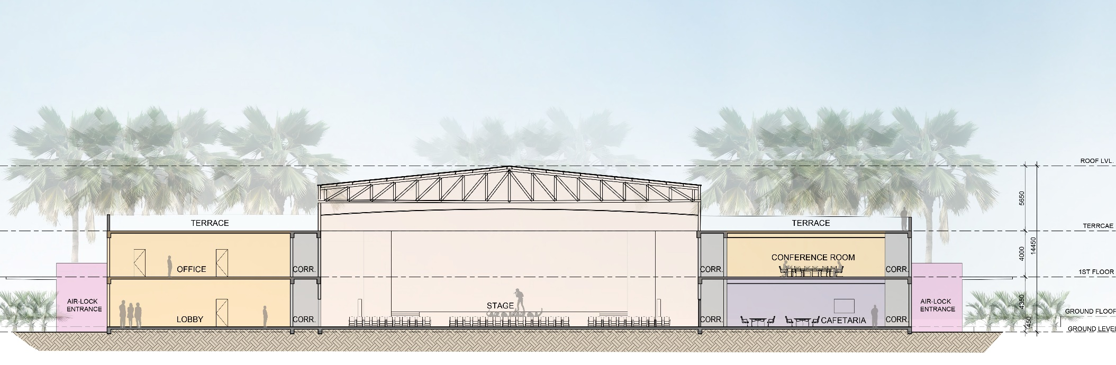
Section A
TERRACE LVL.

Slide 18
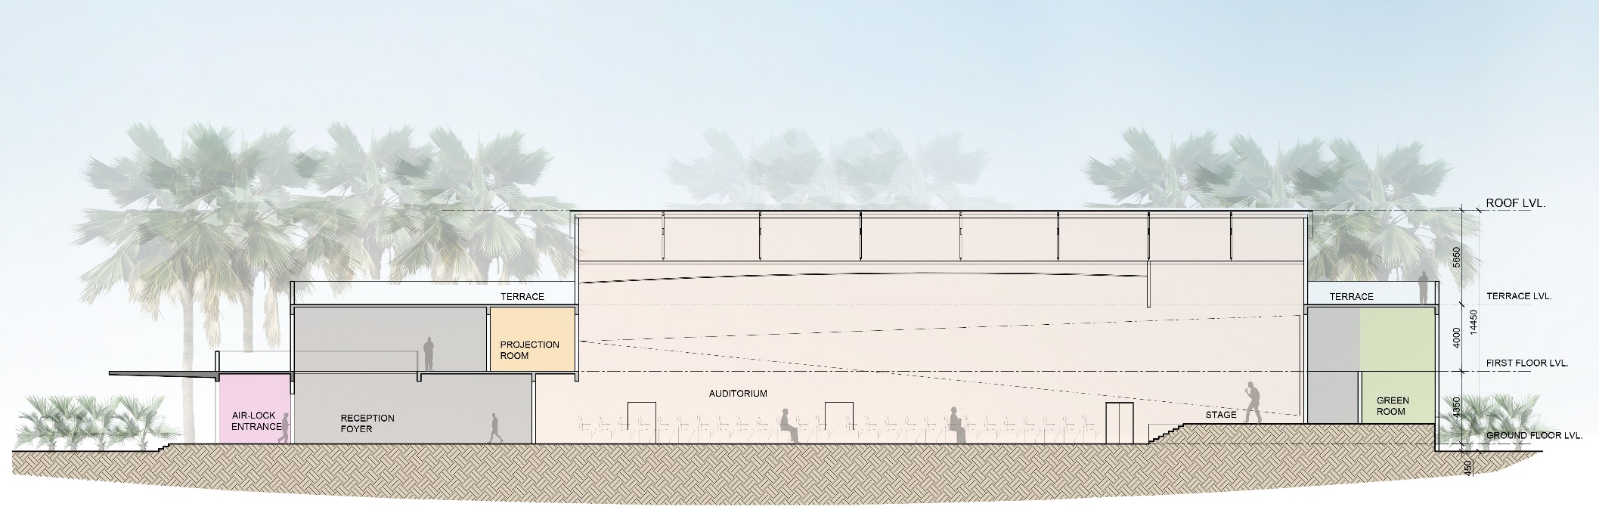
Section B

Slide 19
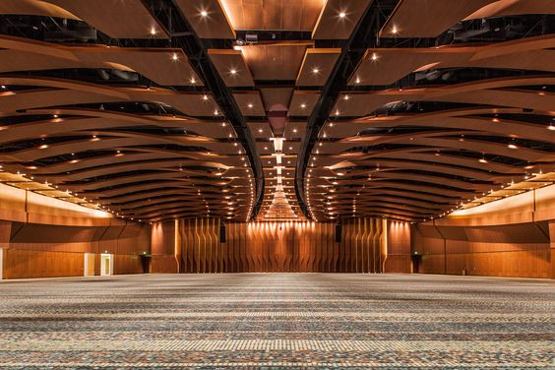
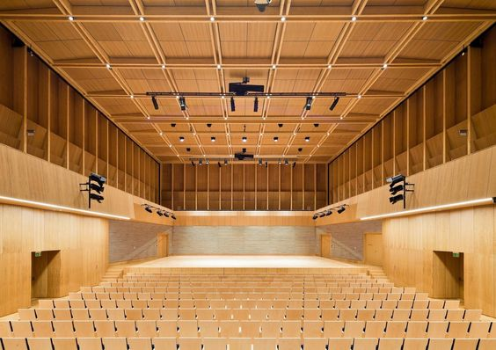
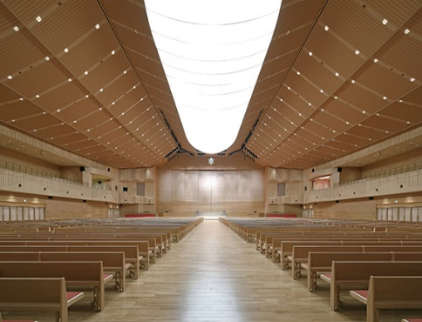
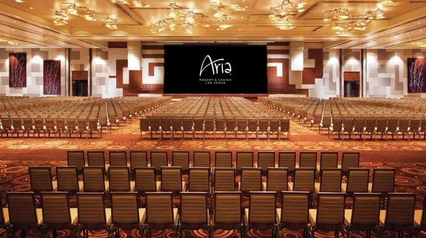
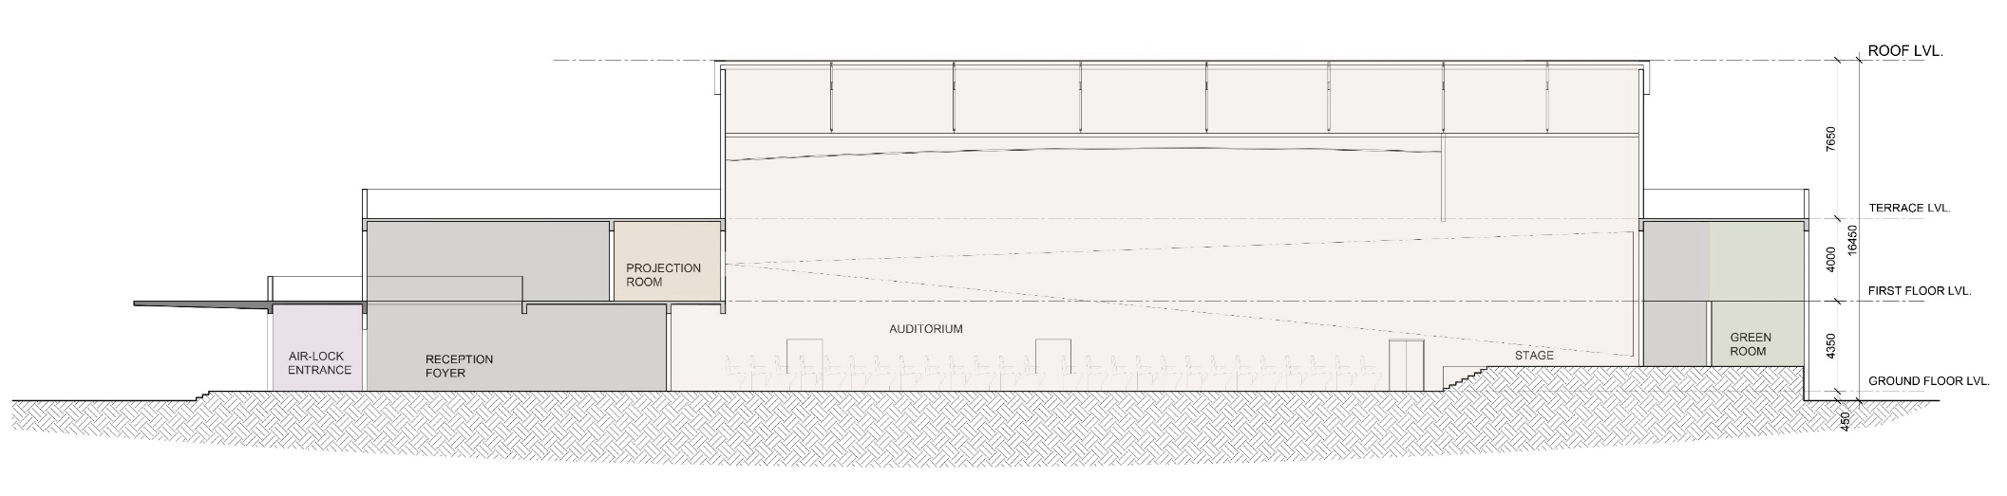
Seat staging
Option – 1 Flat seating

Slide 20
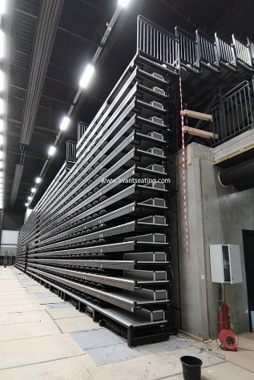

Seat staging
Option – 2 Tier seating with Retractable Seating System
Flat floor of the Hall could also have a retractable seating system, a seating solution that converts the flat floor into a seating space, thus allowing flexibility. Retractable seating has fold down chairs that can be closed and opened (fully or partially) and stacked aside. Fold away auditorium seating is an efficient, space-saving way to provide seating on demand.

Slide 21
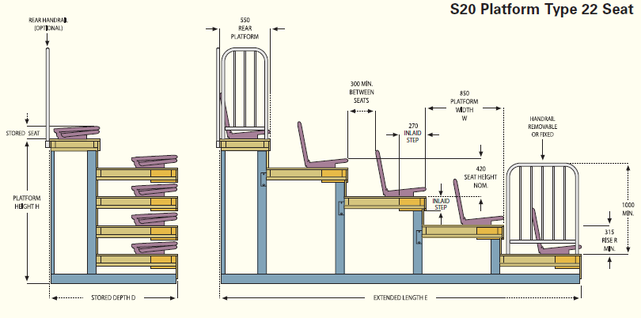
Seat staging – Retractable Seating System (Optional)

Slide 22
Toilet, Parking, Fire Exits Calculation for 1000 seater Convention Centre

Slide 23
Area Statement

Slide 24
Area Statement without airlock & reduced mezzanine

Slide 25
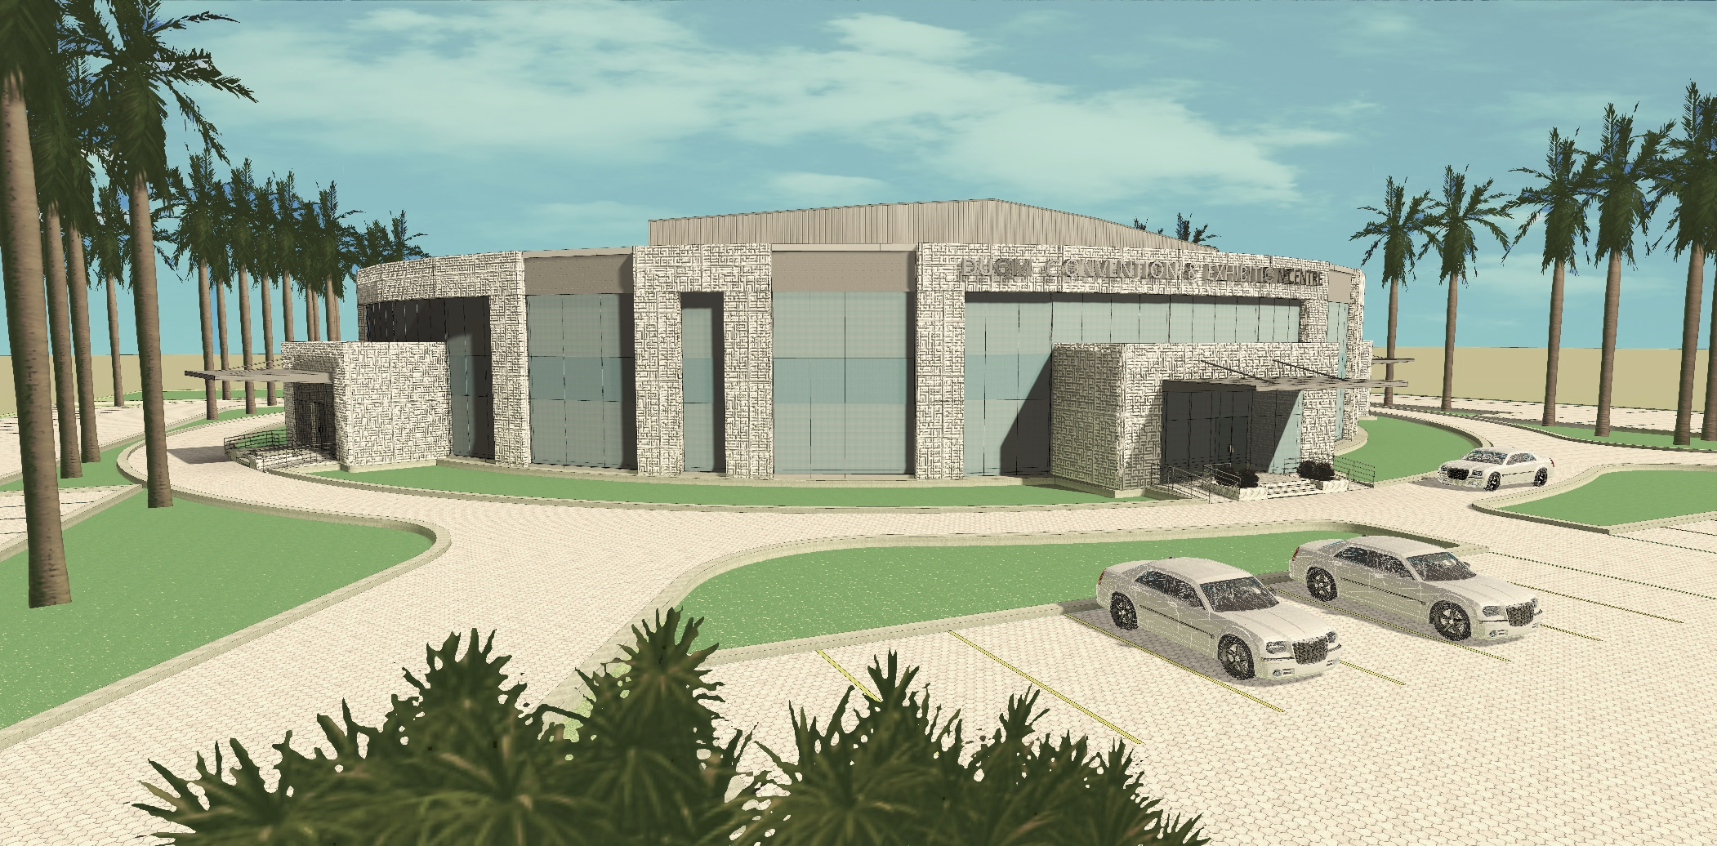
Views

Slide 26
Views

Slide 27
Views

Slide 28
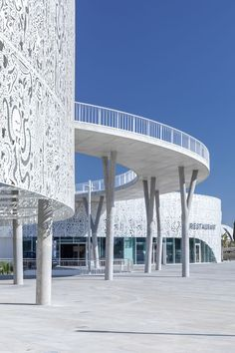
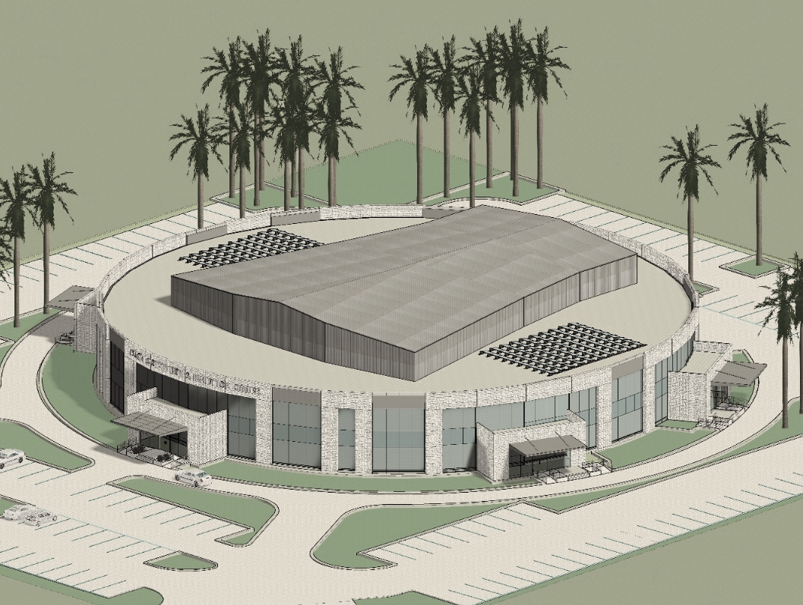
References – façade treatment options
1. GRC Arabic pattern panel

Slide 29
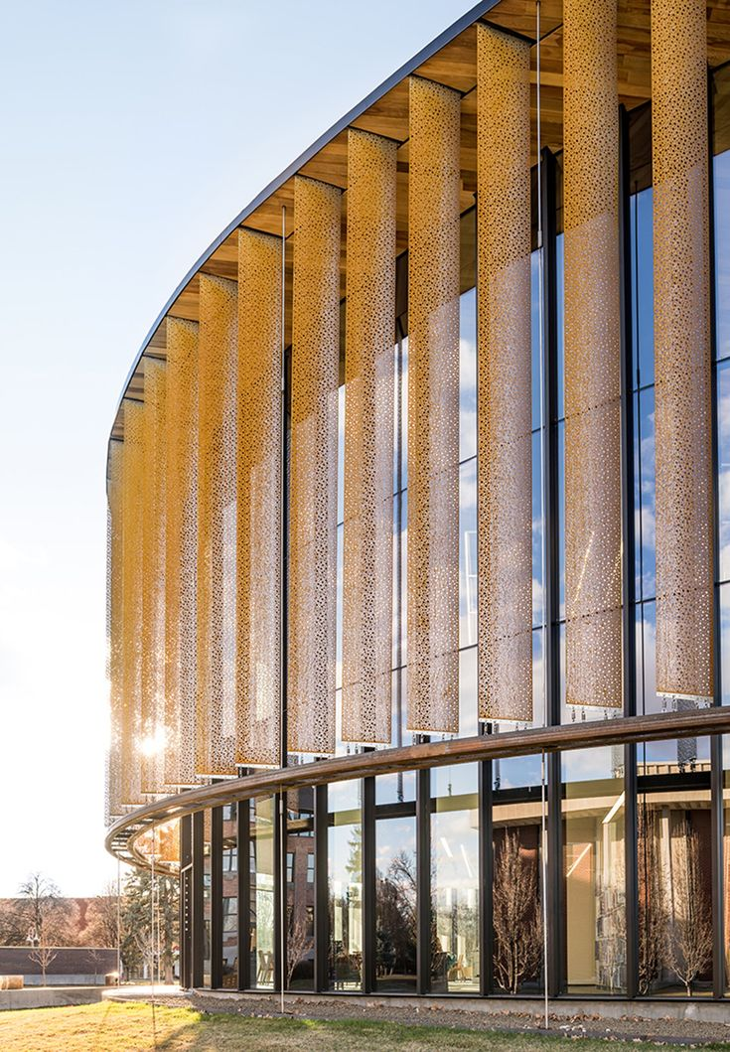
References – façade treatment options
Glass, Concrete panels and Screens

Slide 30
References – façade treatment options
Glass reinforced Concrete (GRC) Cladding

Slide 31
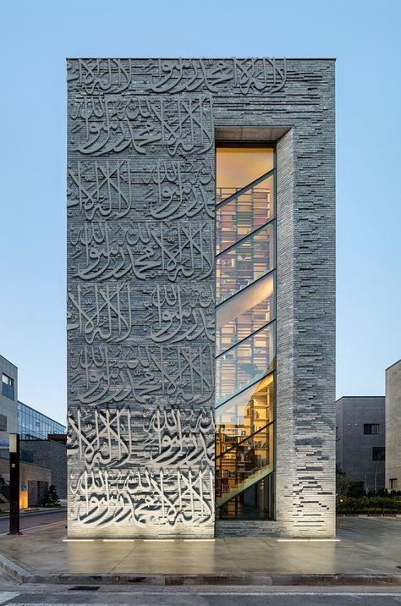
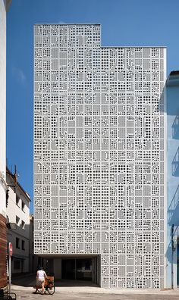
References – façade treatment options
Glass reinforced Concrete (GRC) Cladding

Slide 32
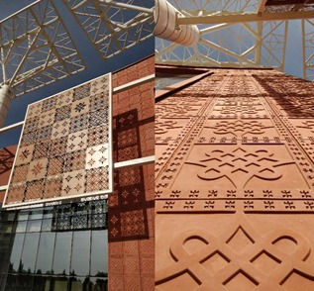
References – façade treatment options
Glass reinforced Concrete (GRC) Cladding

Slide 33
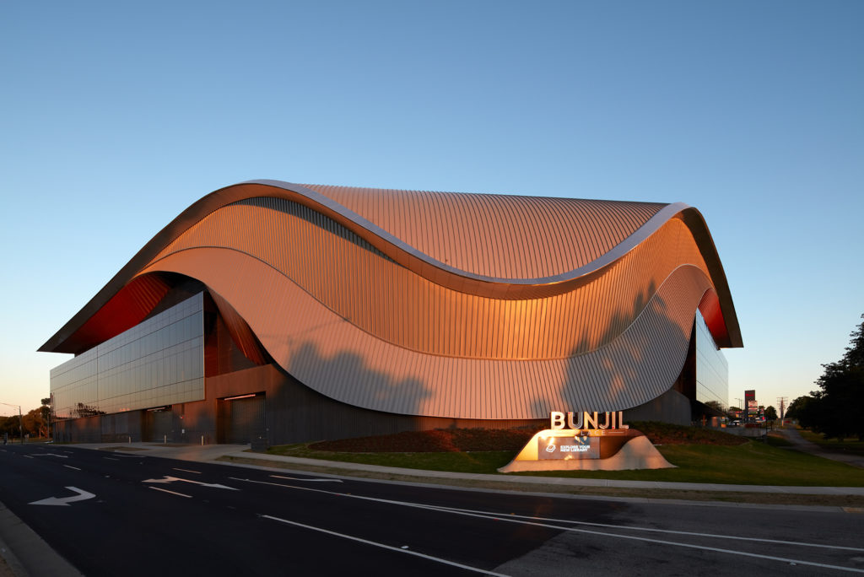
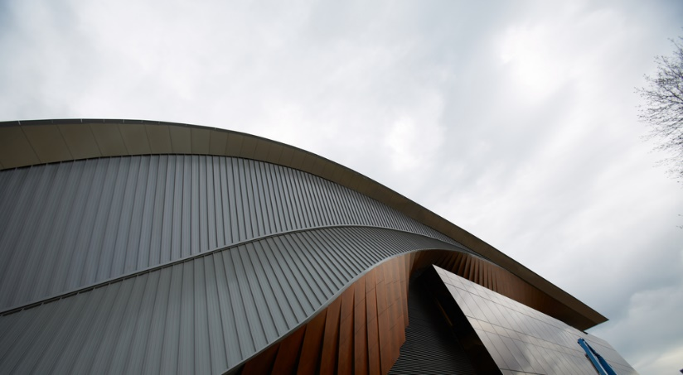
References – façade treatment options
Aluminium/ Galvalume Standing Seam roof and cladding

Slide 34
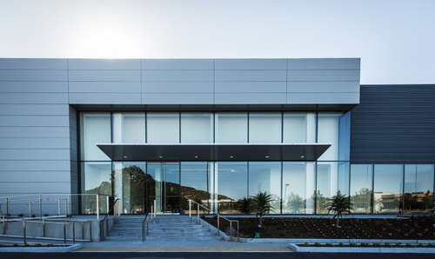
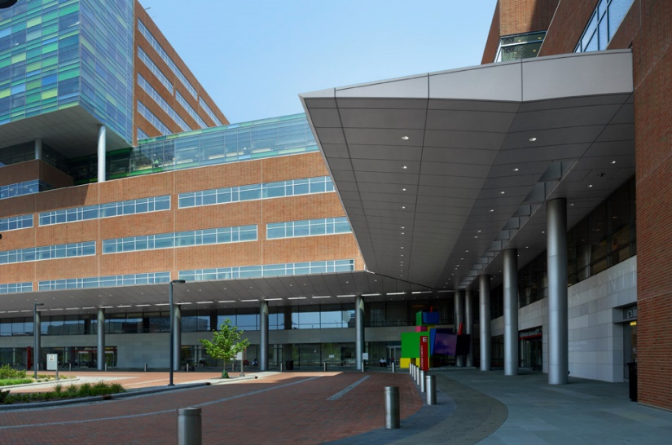
References – façade treatment options
Metal. - Aluminium clad canopy

Slide 35
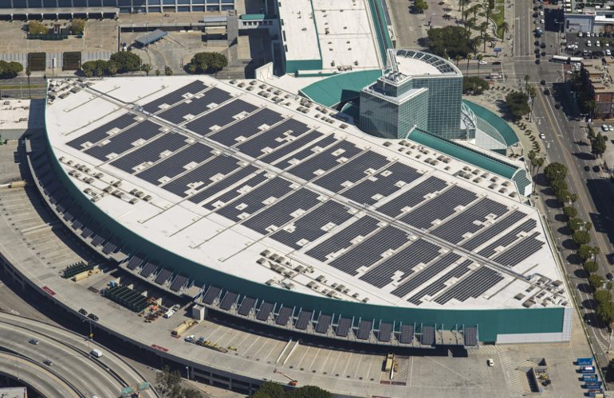
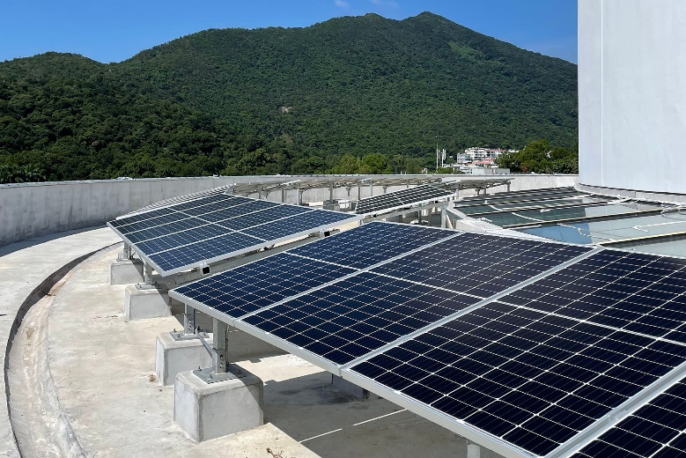
References – façade treatment options
Solar Panels on the Roof

Slide 36
Thank You

