Slide 1
RESIDENCE AT ALIBAUG
SCHEMATIC DESIGN PROPOSAL
October 2022

Slide 2
CONTENTS
Layouts
Sections
Site photographs

Slide 3
LAYOUTS

Slide 4
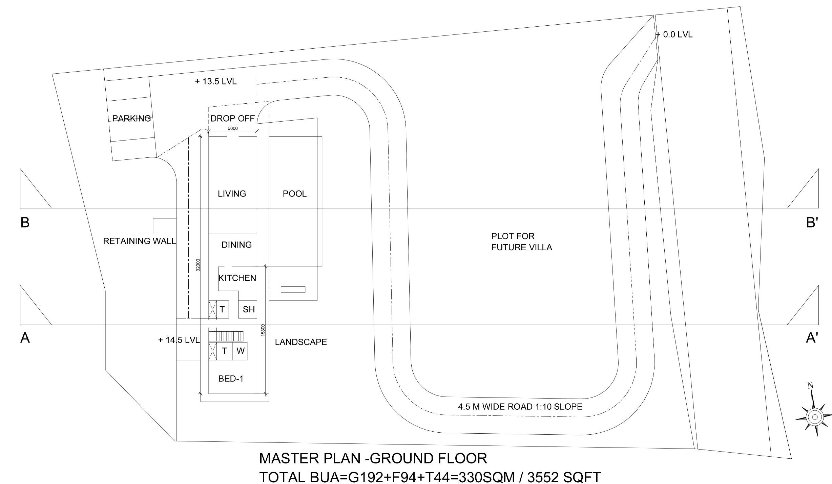
| RESIDENCE AT ALIBAUG | MASTERPLAN - GROUND FLOOR |

Slide 5
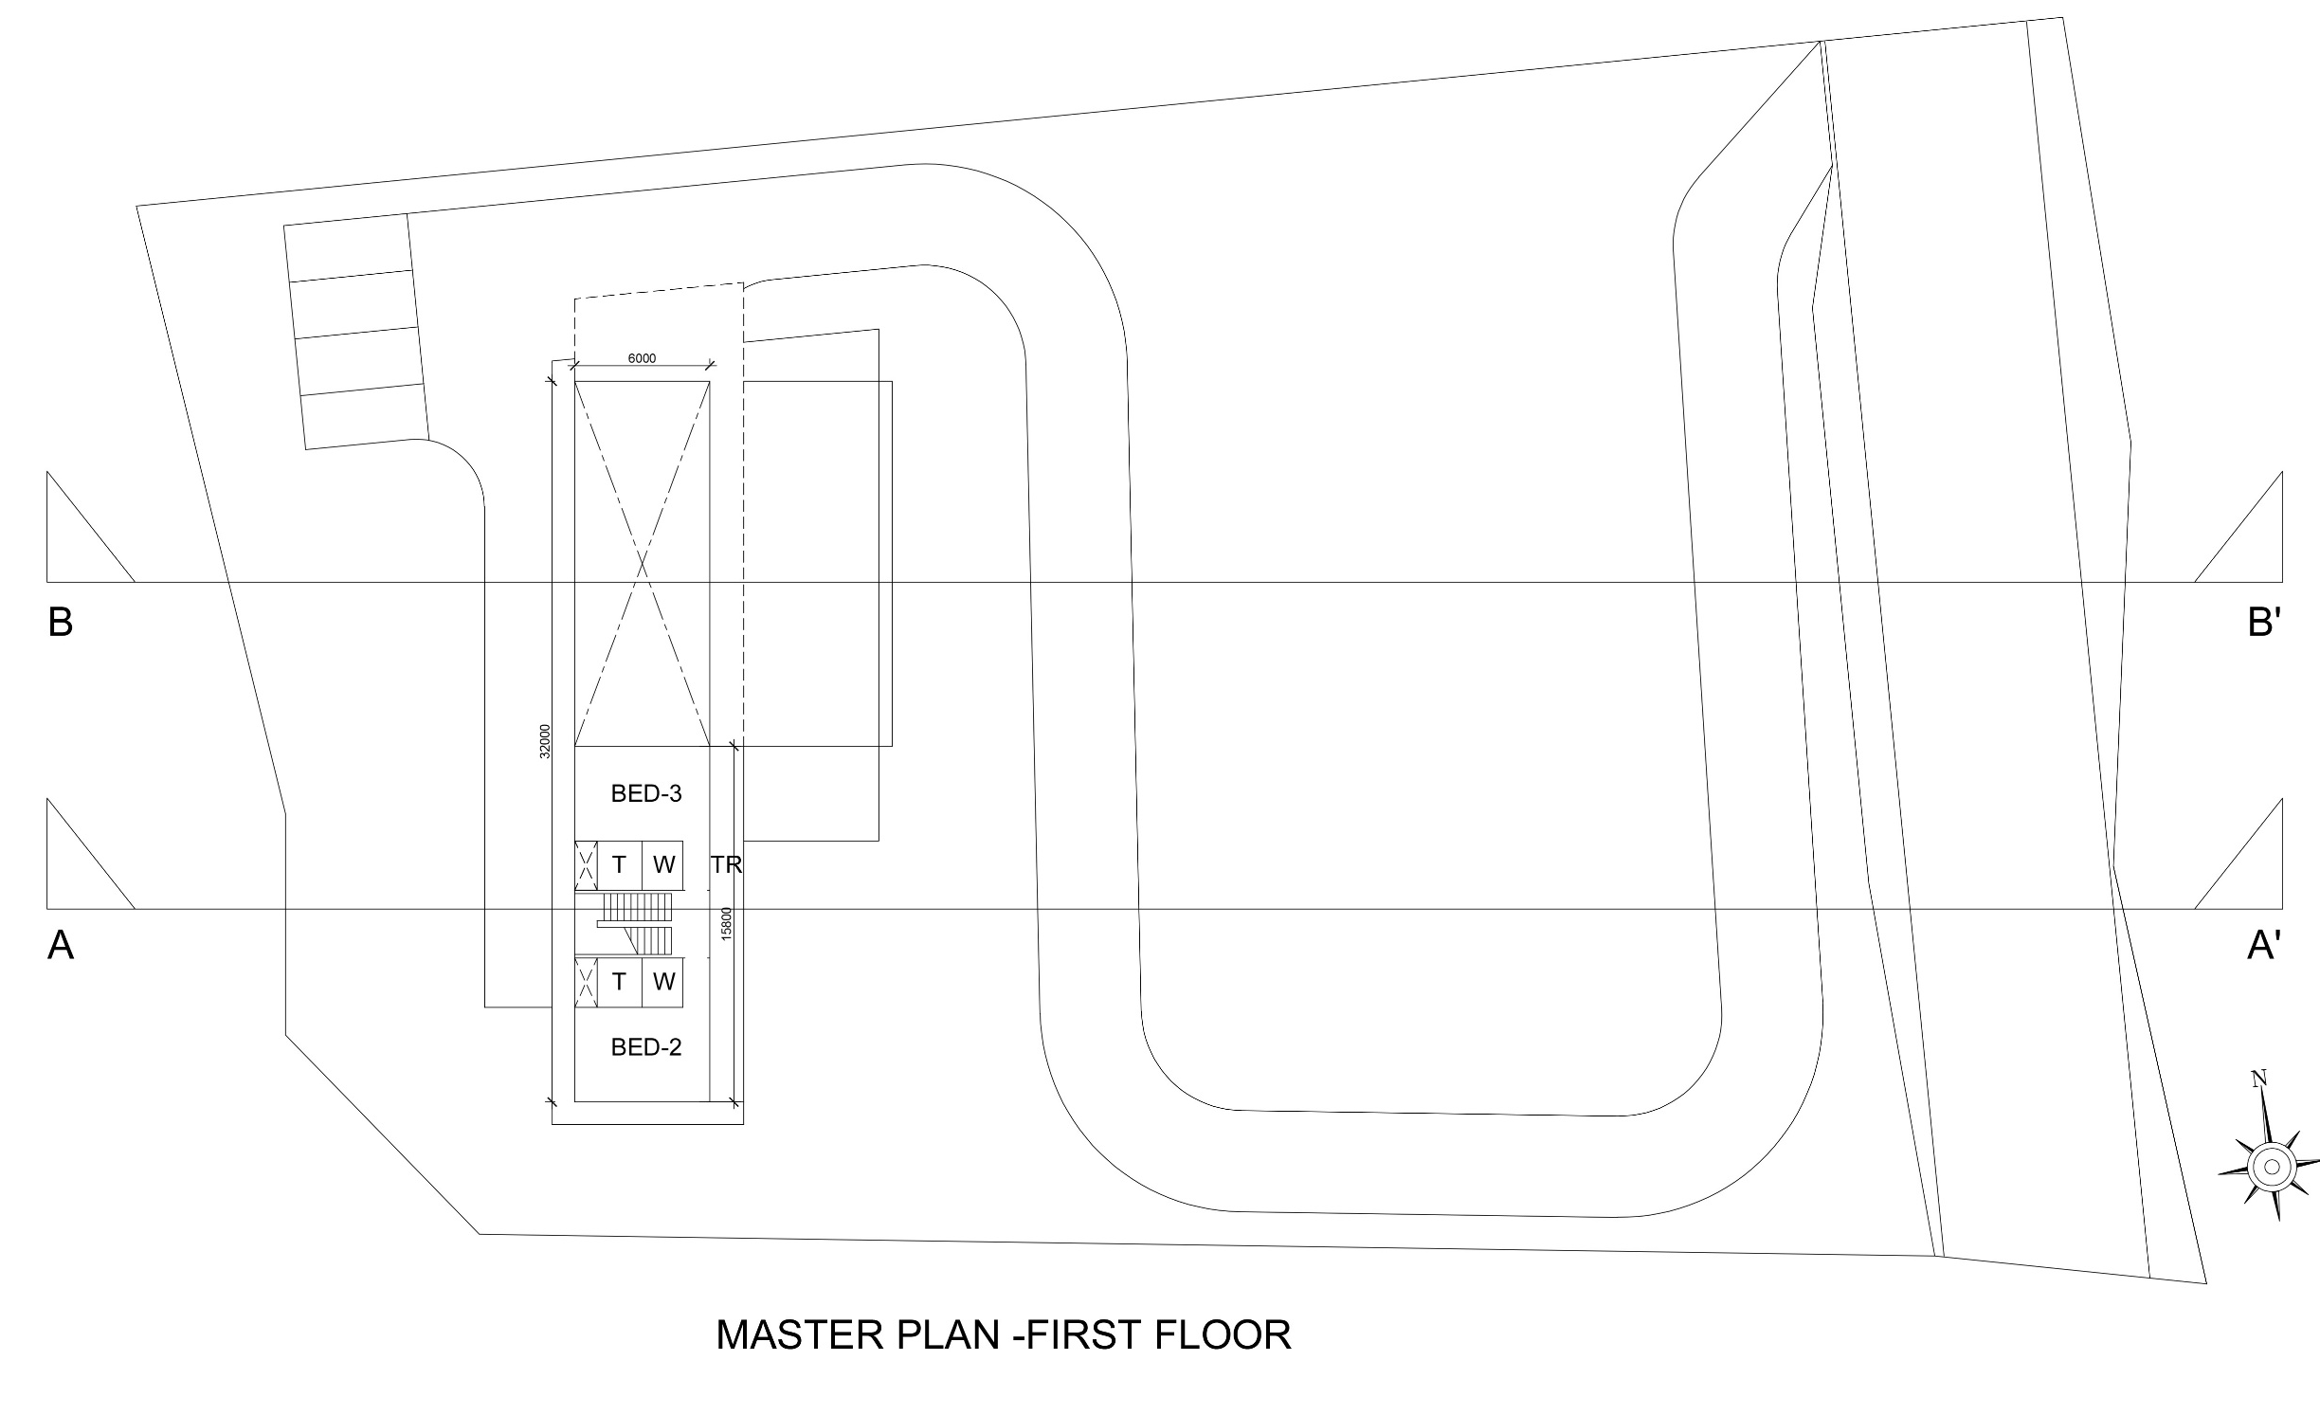
| RESIDENCE AT ALIBAUG | MASTERPLAN - FIRST FLOOR |

Slide 6
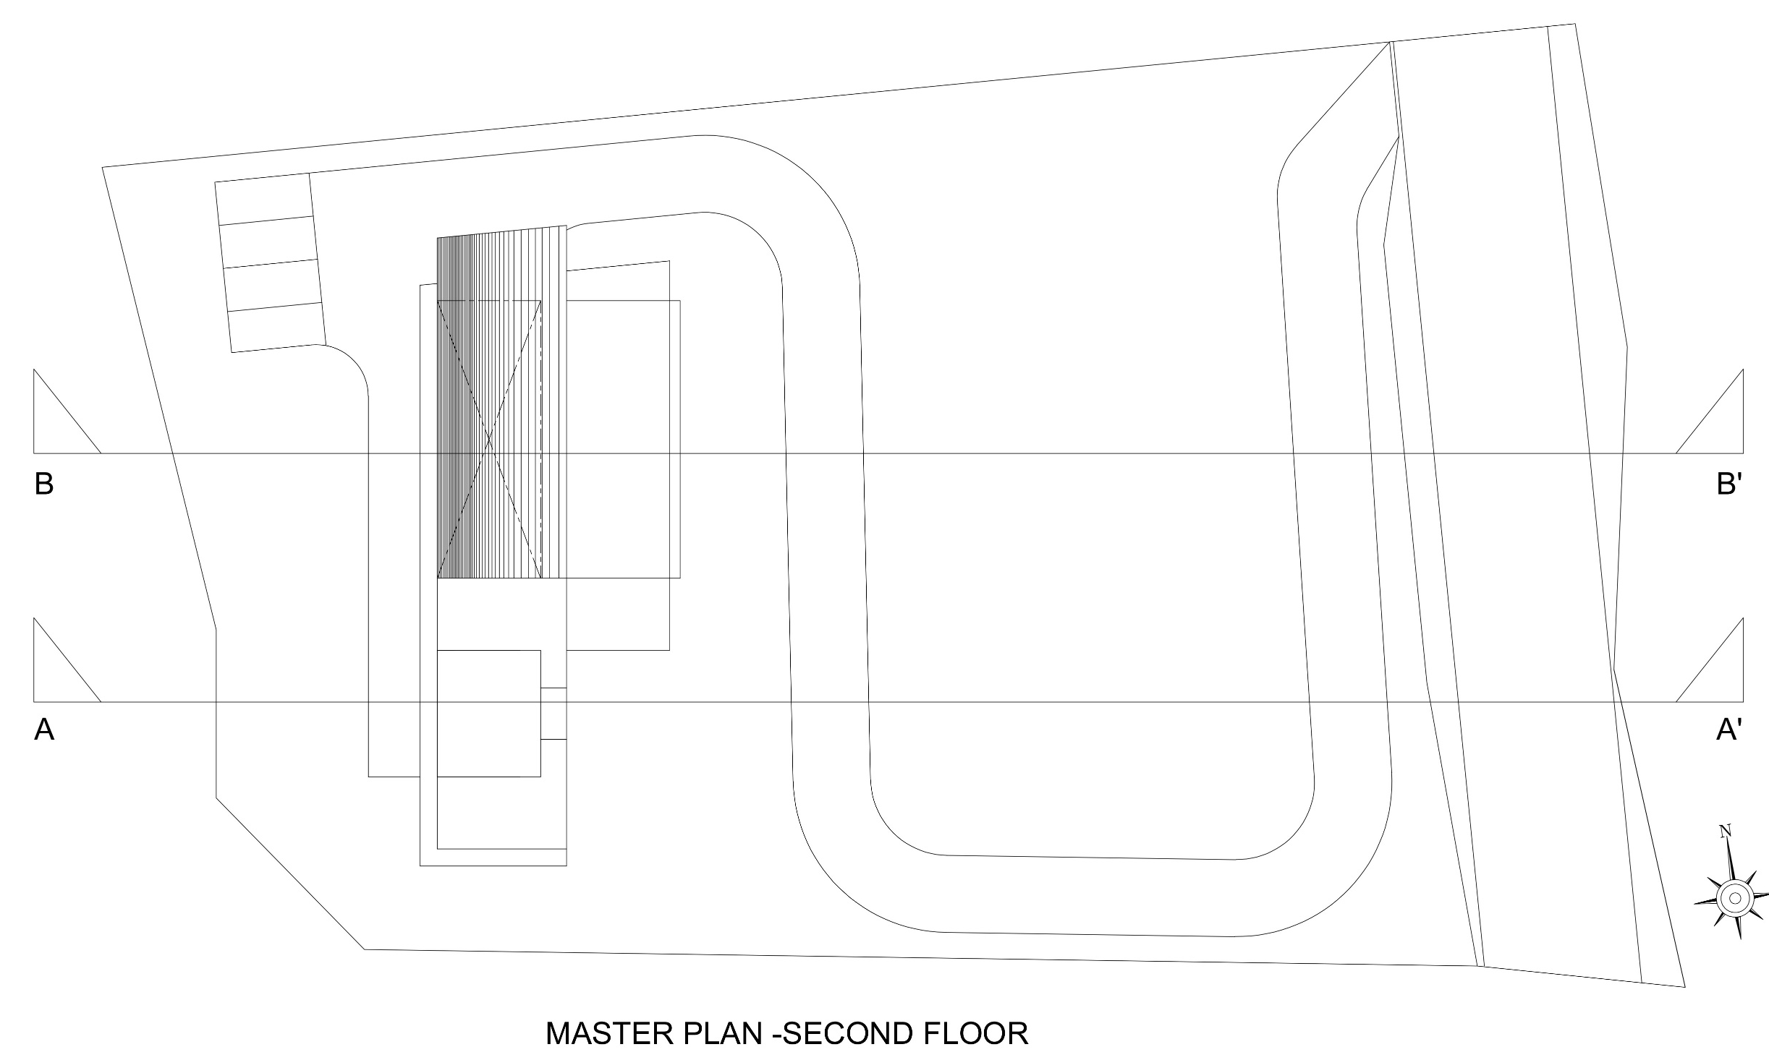
| RESIDENCE AT ALIBAUG | MASTER PLAN – SECOND FLOOR LAYOUT |

Slide 7
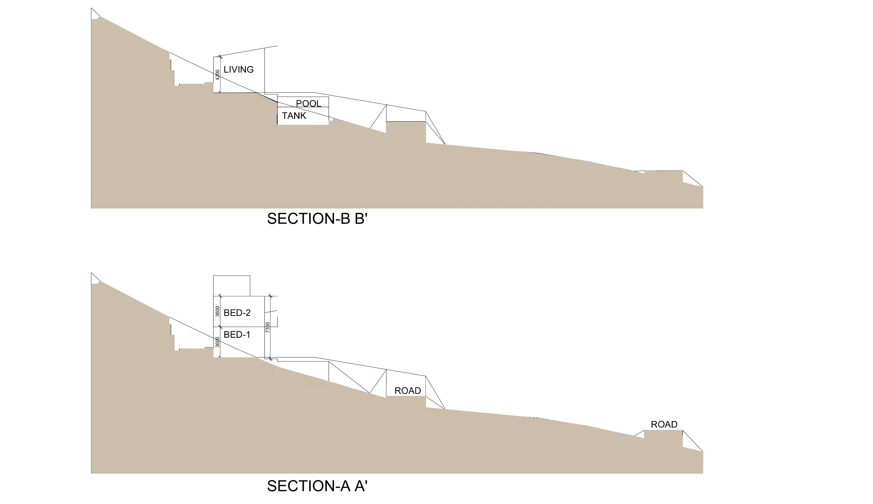

A
A’
B
B’
| RESIDENCE AT ALIBAUG | SITE SECTIONS WITH BLDG. & ROAD |

Slide 8
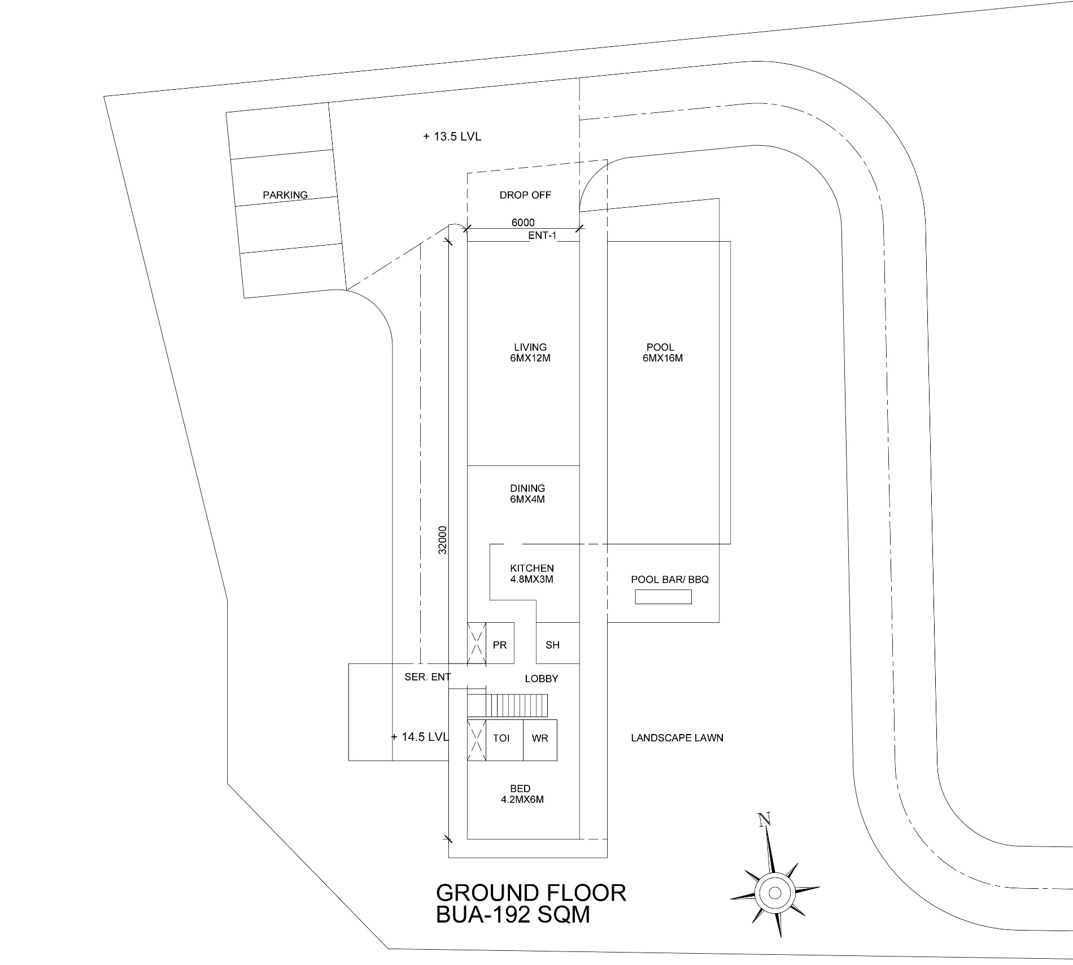
| RESIDENCE AT ALIBAUG | GROUND FLOOR LAYOUT |

Slide 9
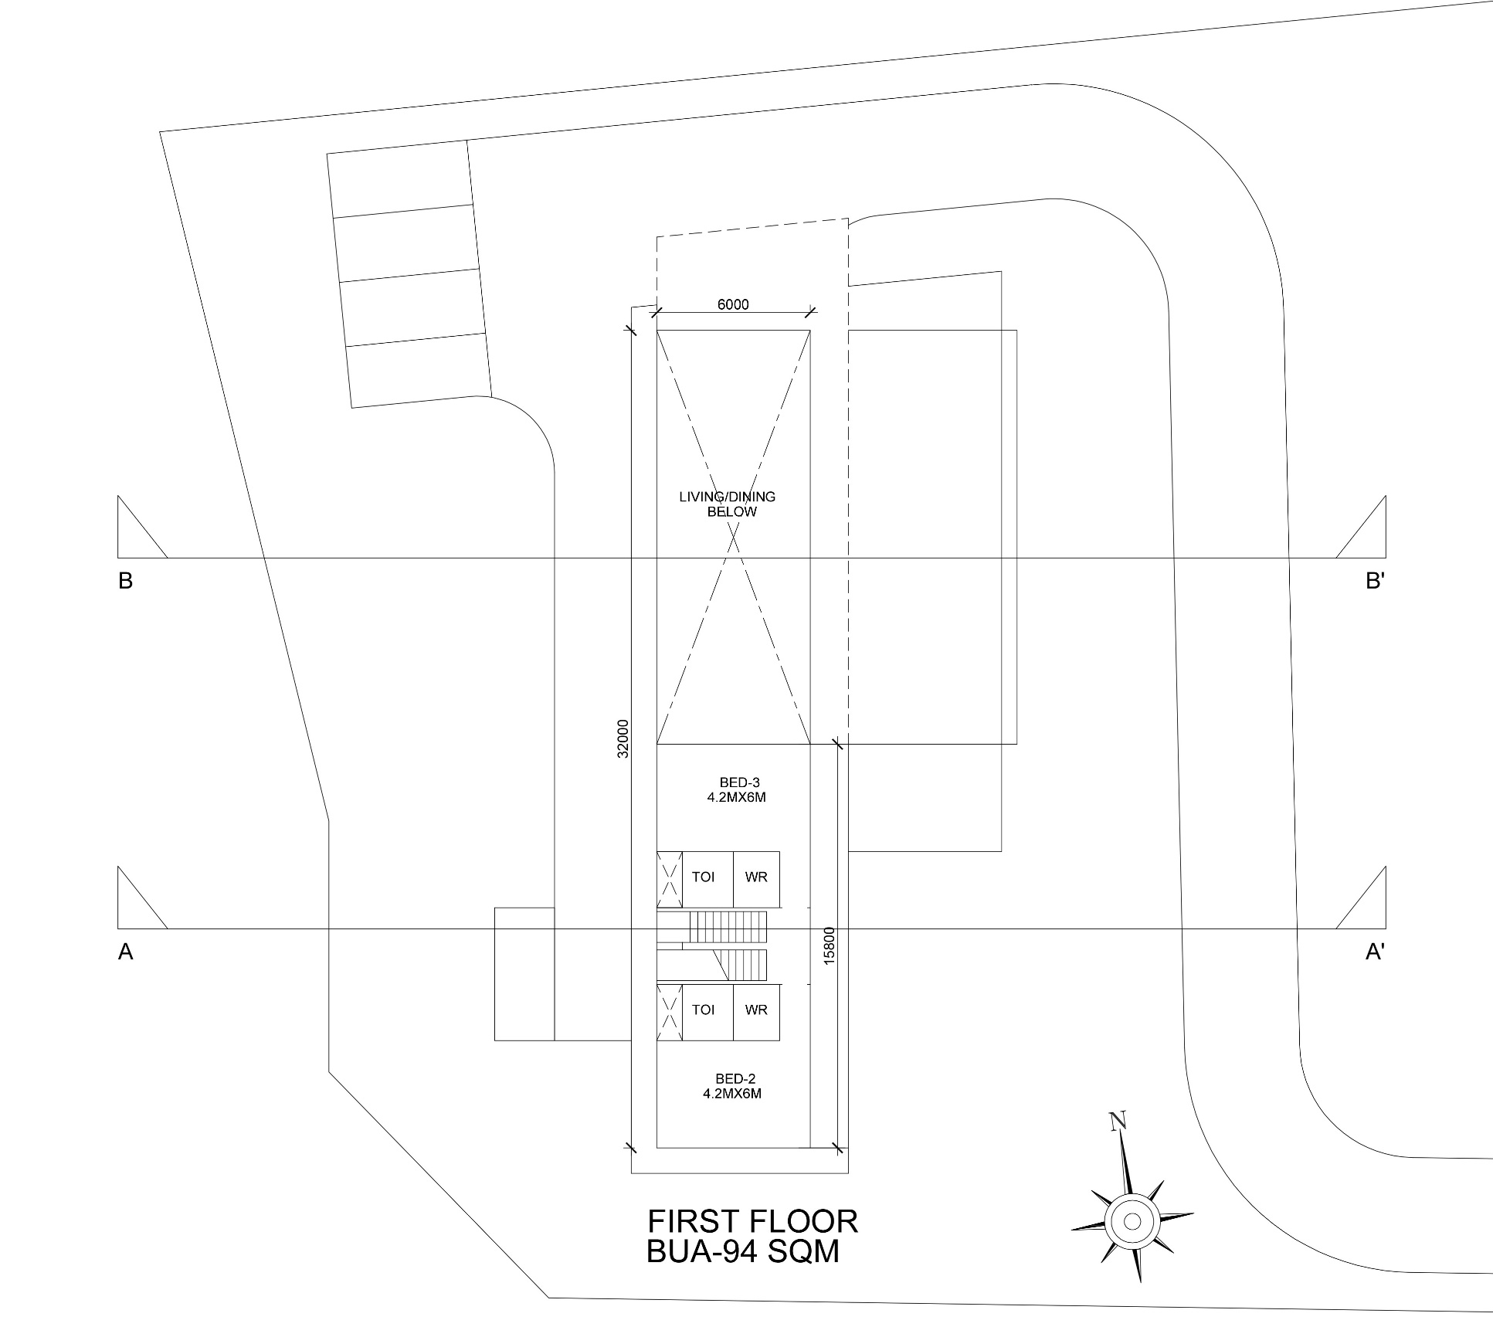

| RESIDENCE AT ALIBAUG | FIRST FLOOR LAYOUT |

Slide 10
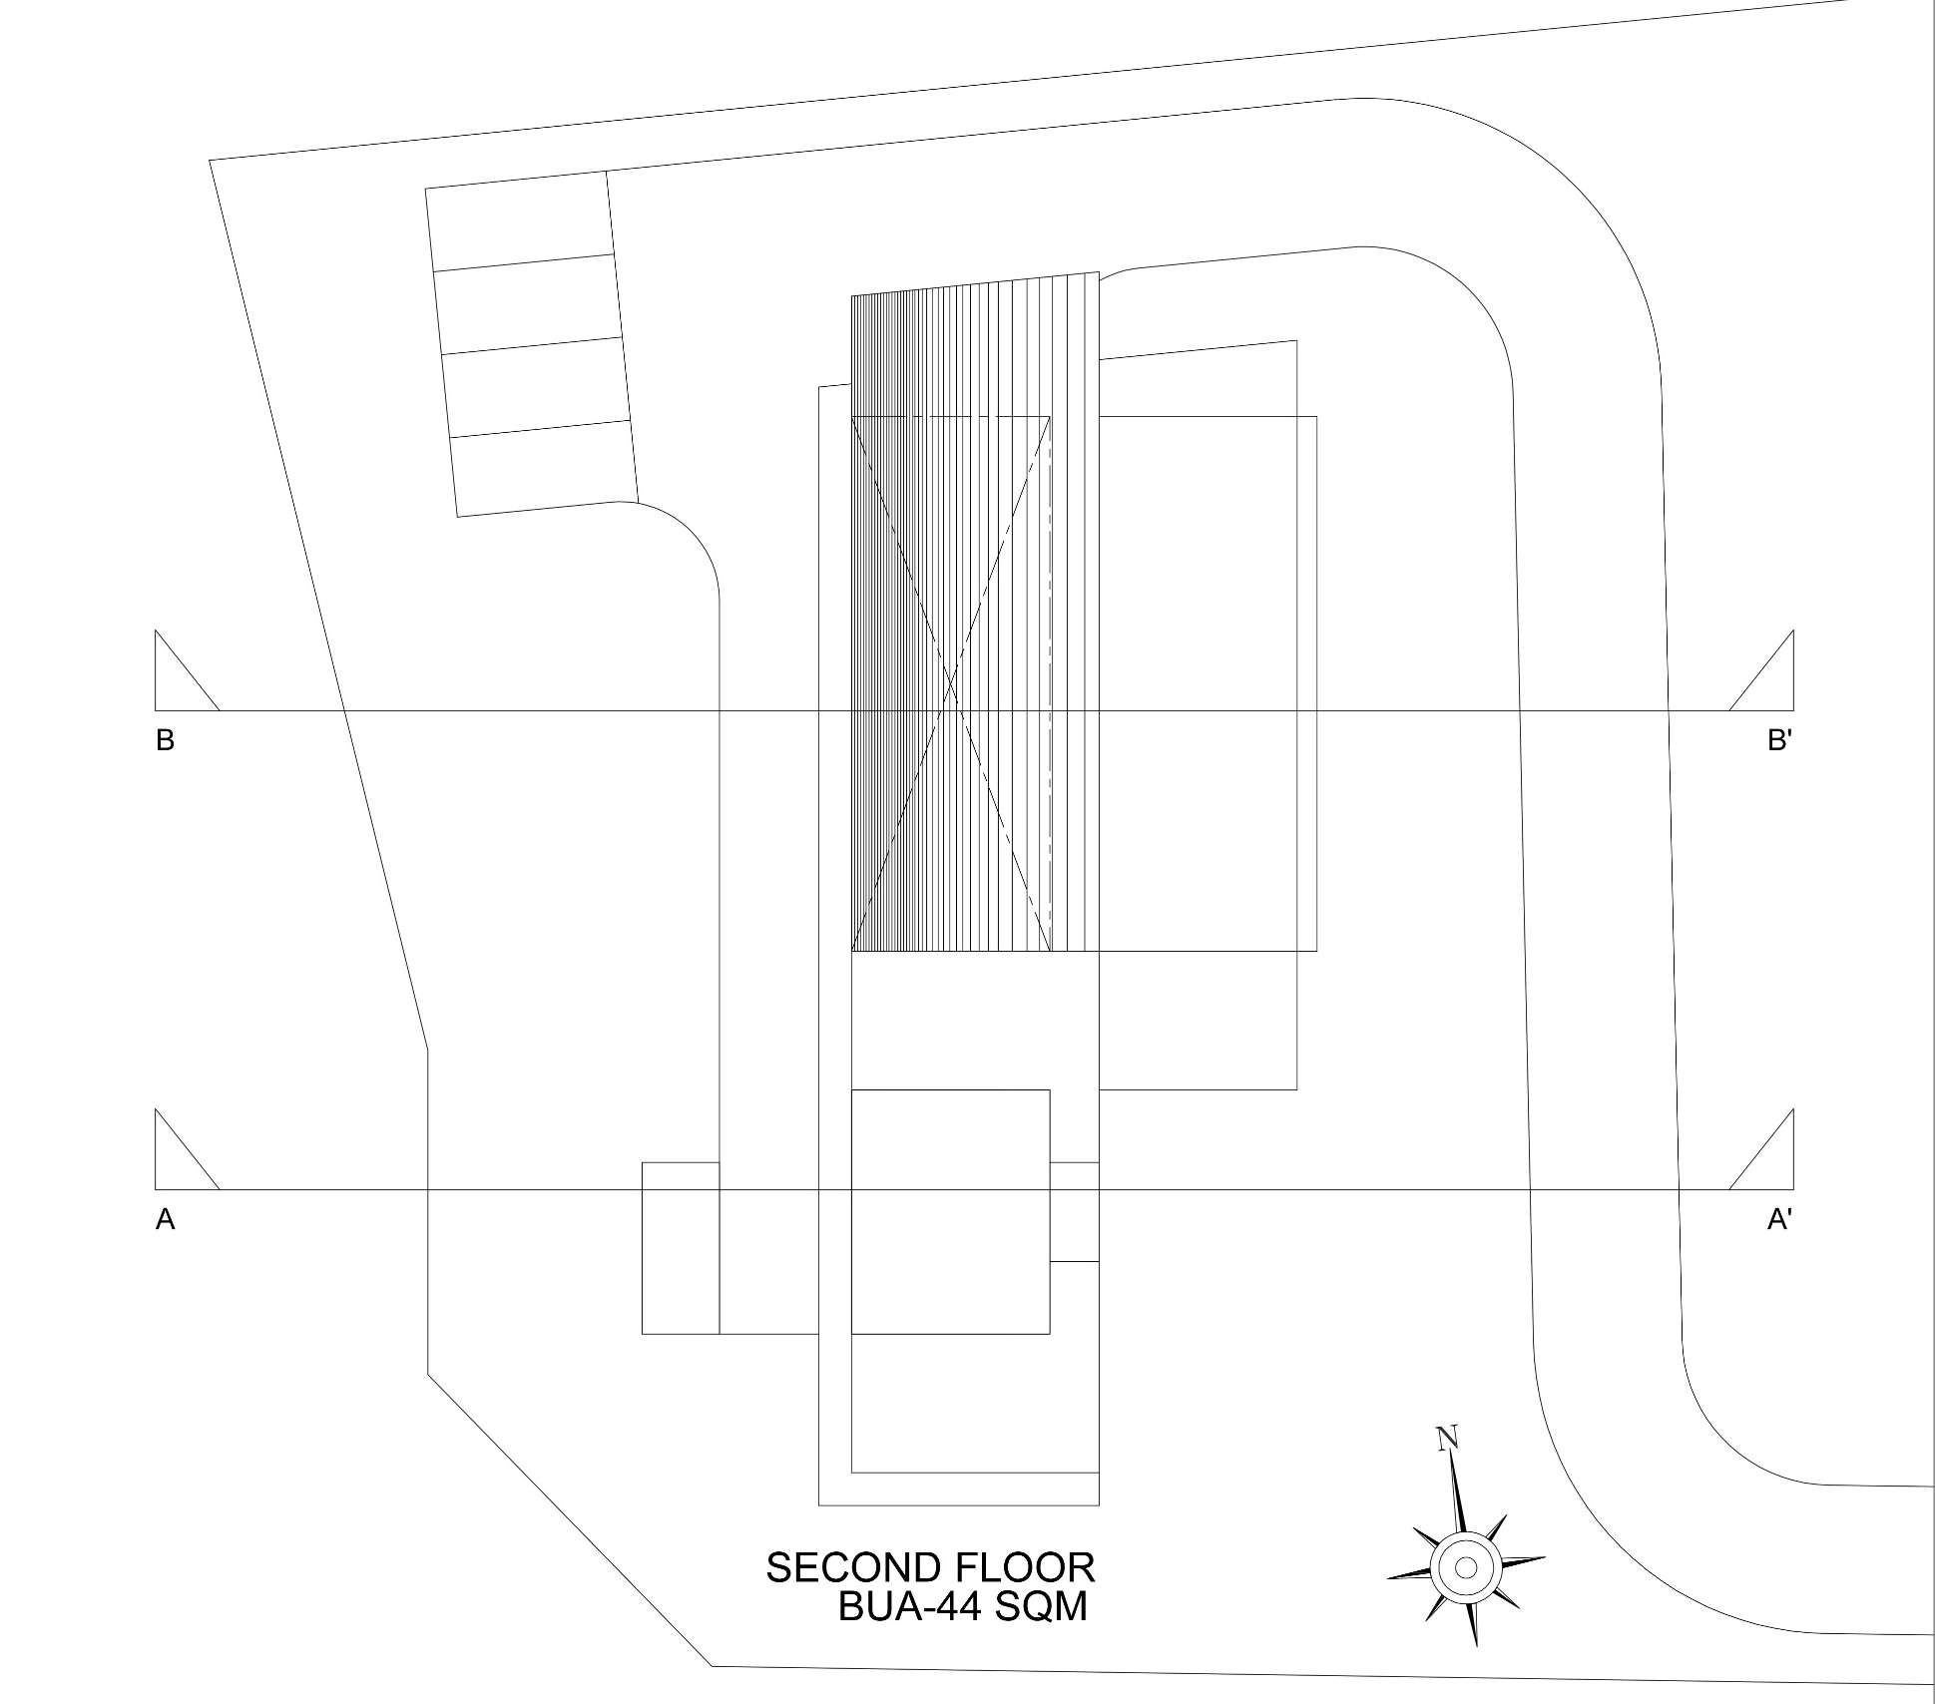
| RESIDENCE AT ALIBAUG | SECOND FLOOR LAYOUT |

Slide 11
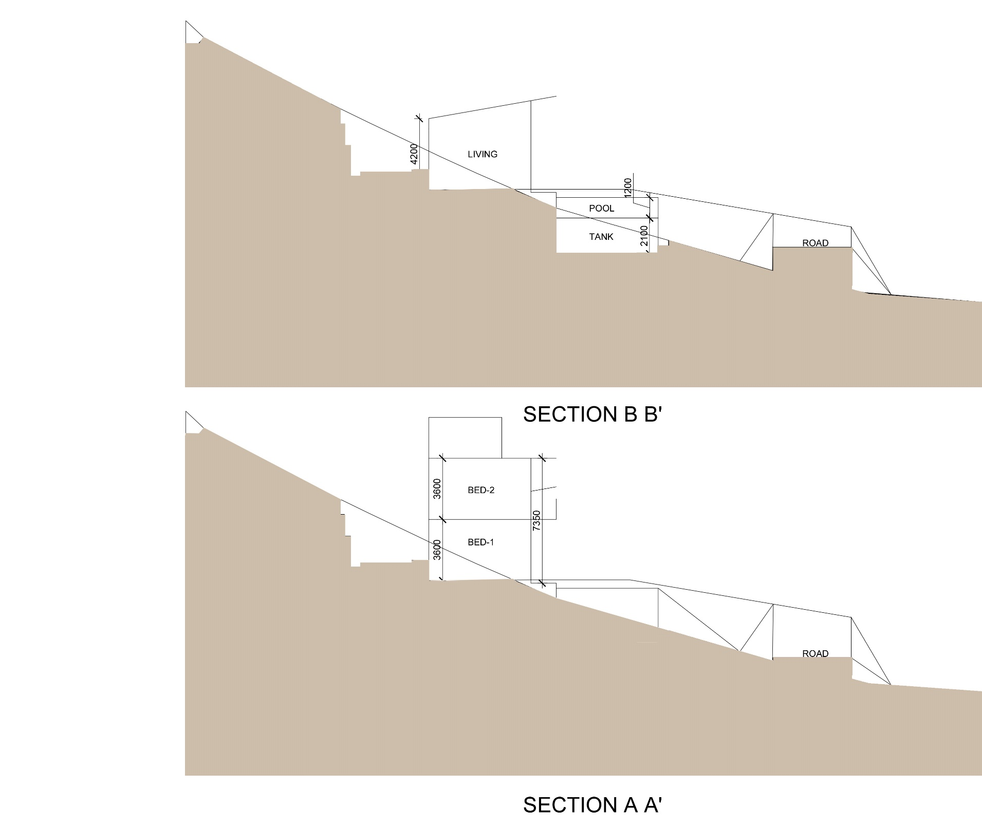

A
A’
B
B’
| RESIDENCE AT ALIBAUG | SECTION AT A-A’ |

Slide 12
SITE PHOTOGRAPHS – VIEW TOWARDS THE SITE

Slide 13
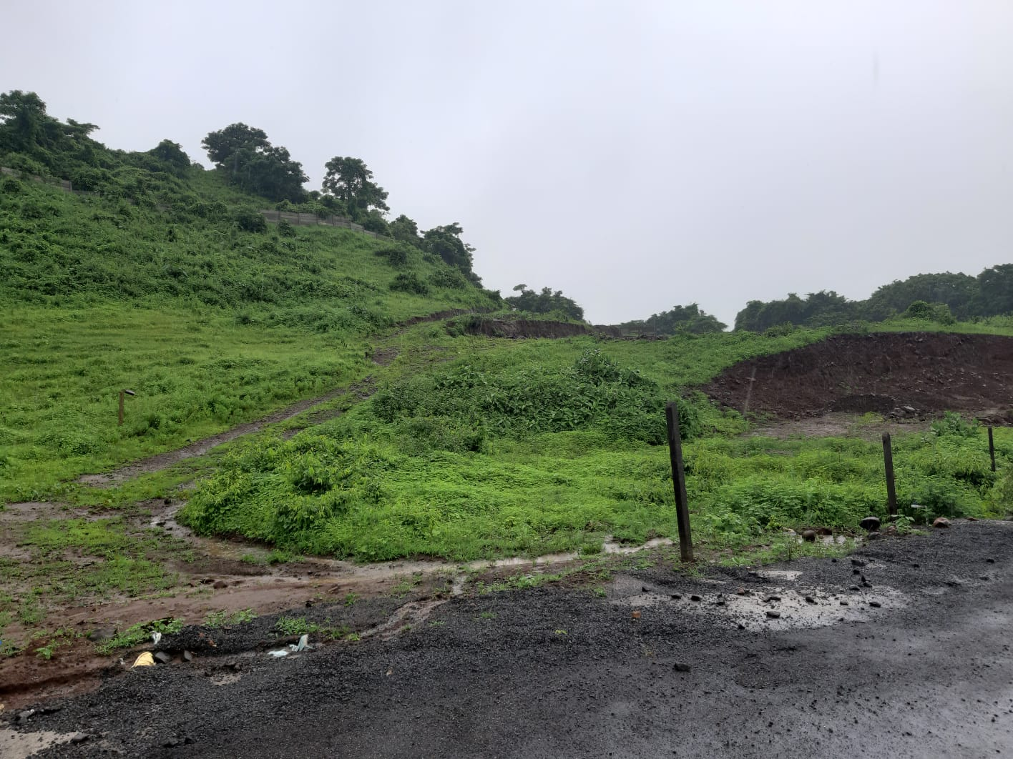
| RESIDENCE AT ALIBAUG | SITE PHOTOGRAPHS – VIEW TOWARDS THE SITE |

Slide 14
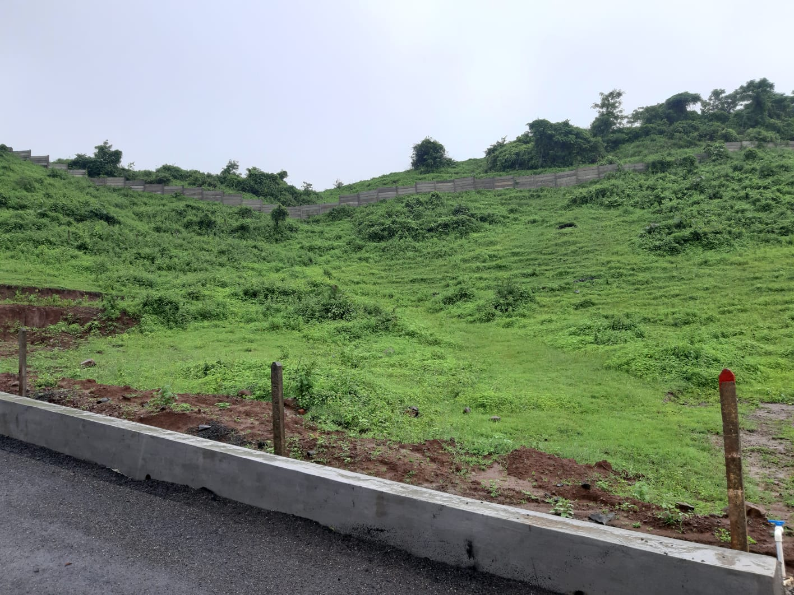
| RESIDENCE AT ALIBAUG | SITE PHOTOGRAPHS - VIEW TOWARDS THE SITE |

Slide 15
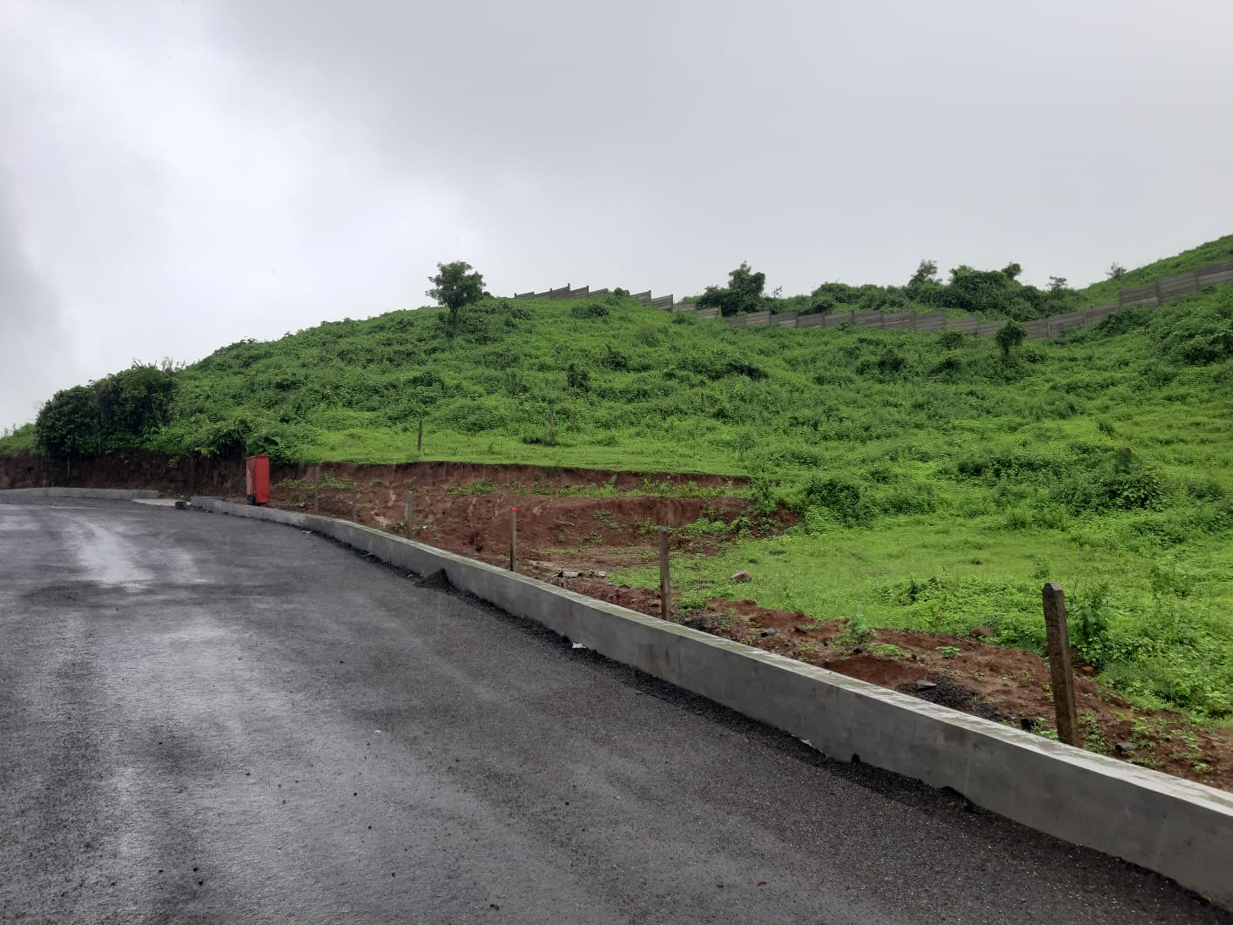
| RESIDENCE AT ALIBAUG | SITE PHOTOGRAPHS - VIEW TOWARDS THE SITE |

Slide 16
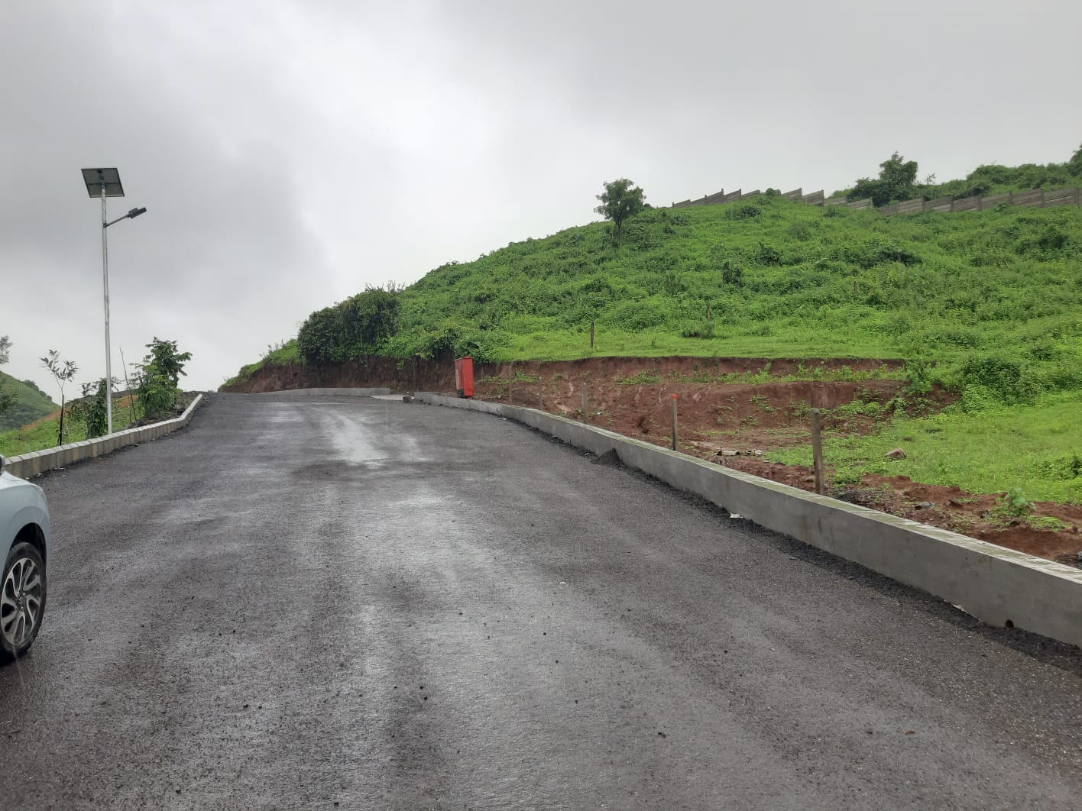
| RESIDENCE AT ALIBAUG | SITE PHOTOGRAPHS - VIEW TOWARDS THE SITE |

Slide 17
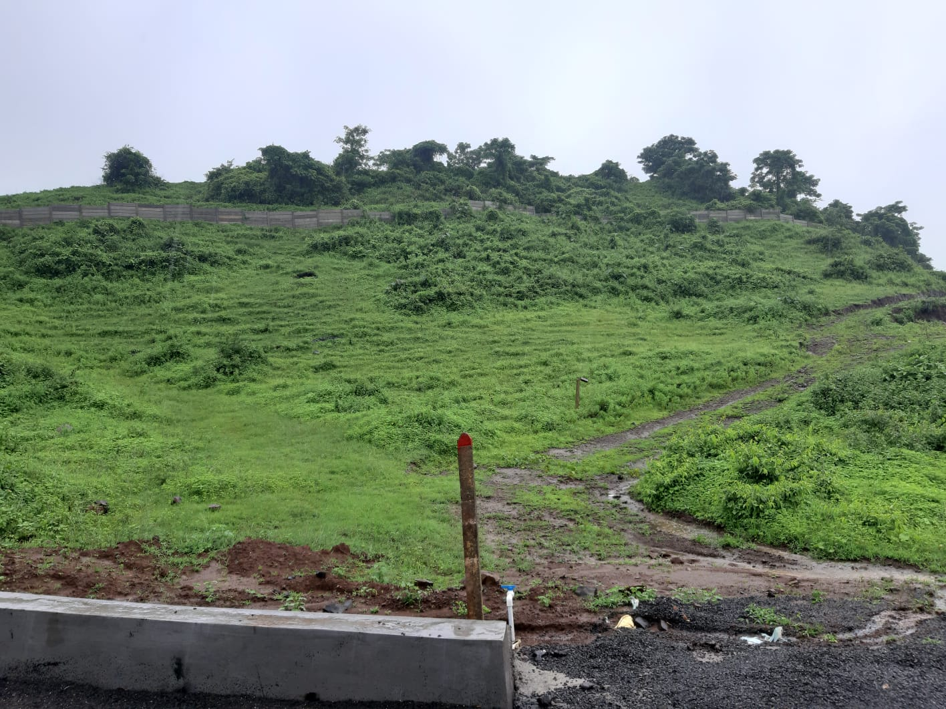
| RESIDENCE AT ALIBAUG | SITE PHOTOGRAPHS - VIEW TOWARDS THE SITE |

Slide 18
SITE PHOTOGRAPHS – VIEW FROM THE SITE

Slide 19
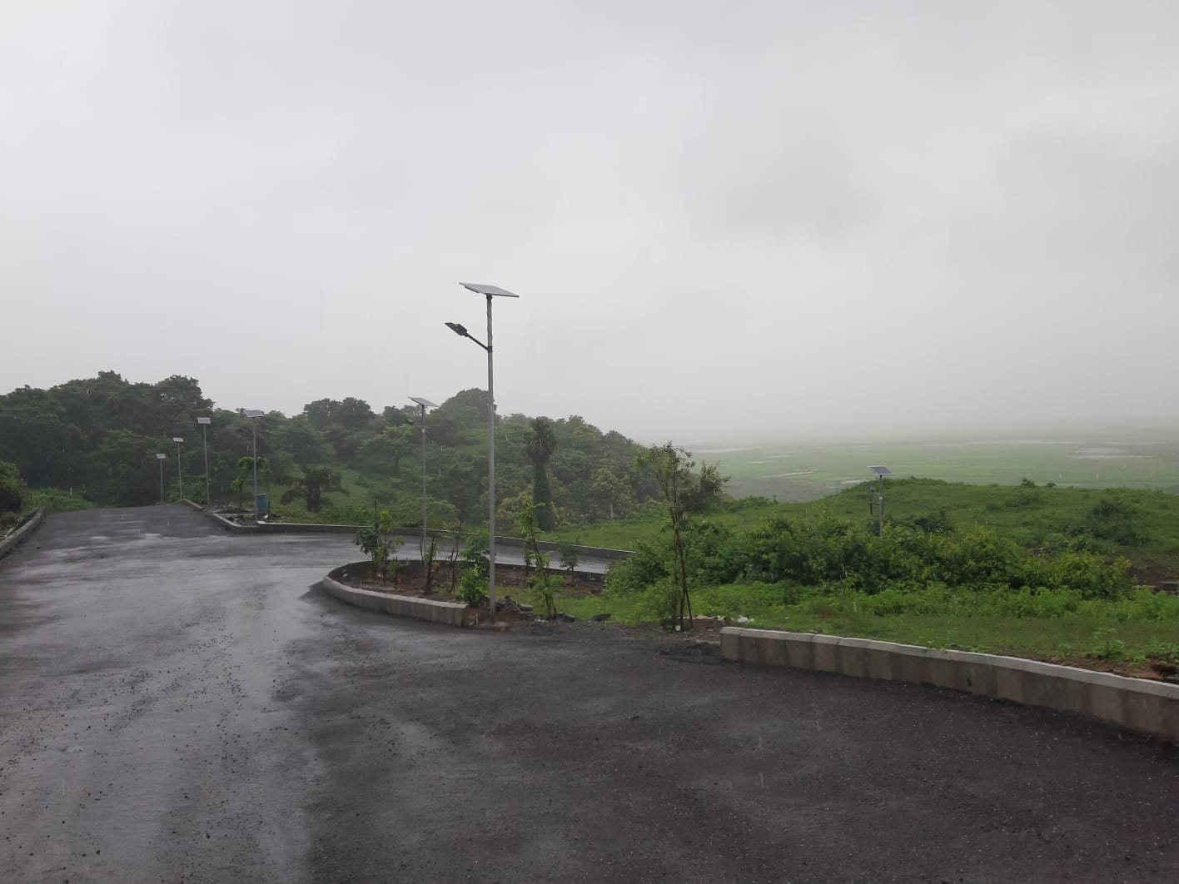
| RESIDENCE AT ALIBAUG | SITE PHOTOGRAPHS – VIEW FROM THE SITE |

Slide 20
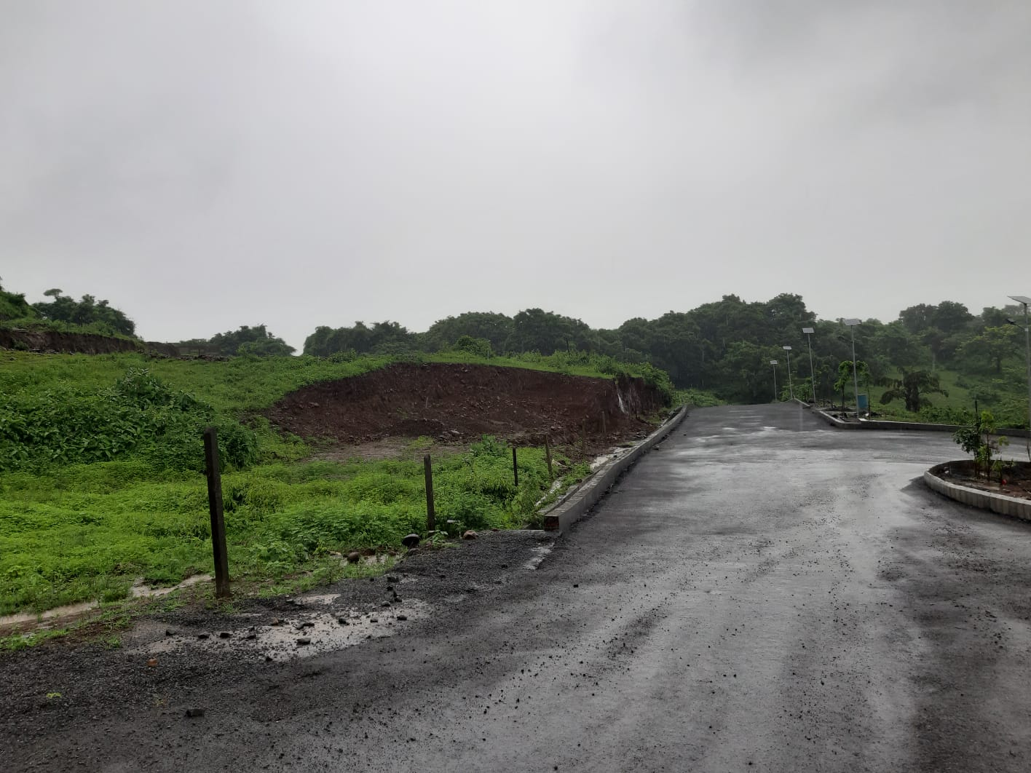
| RESIDENCE AT ALIBAUG | SITE PHOTOGRAPHS – VIEW FROM THE SITE |

Slide 21
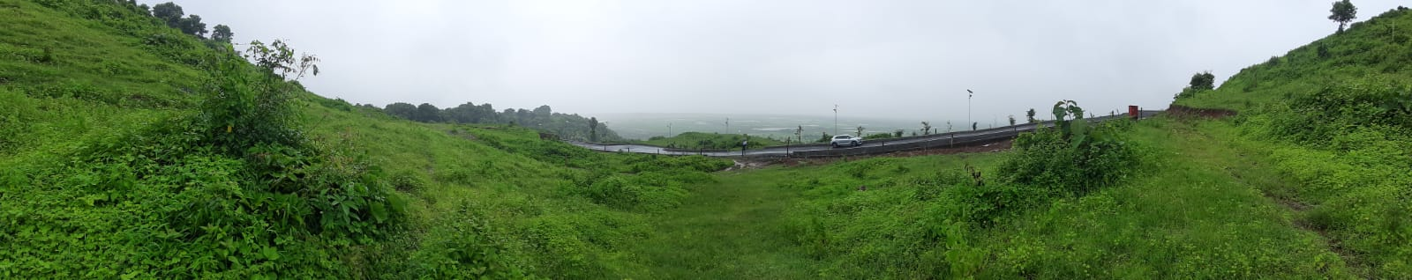
| RESIDENCE AT ALIBAUG | SITE PHOTOGRAPHS – VIEW FROM THE SITE |

Slide 22
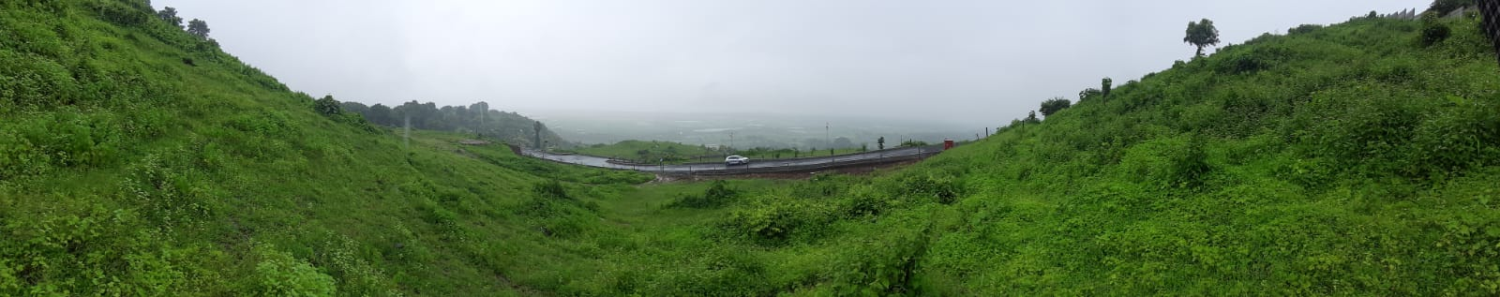
| RESIDENCE AT ALIBAUG | SITE PHOTOGRAPHS – VIEW FROM THE SITE |

Slide 23
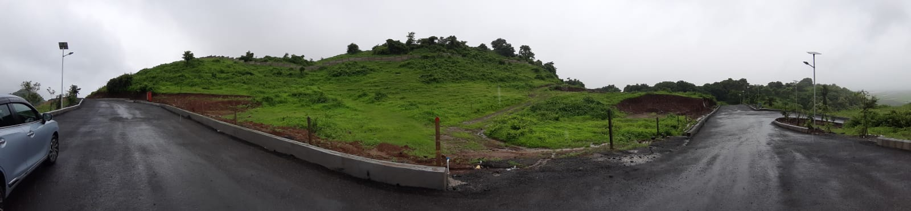
| RESIDENCE AT ALIBAUG | SITE PHOTOGRAPHS – VIEW FROM THE SITE |

Slide 24
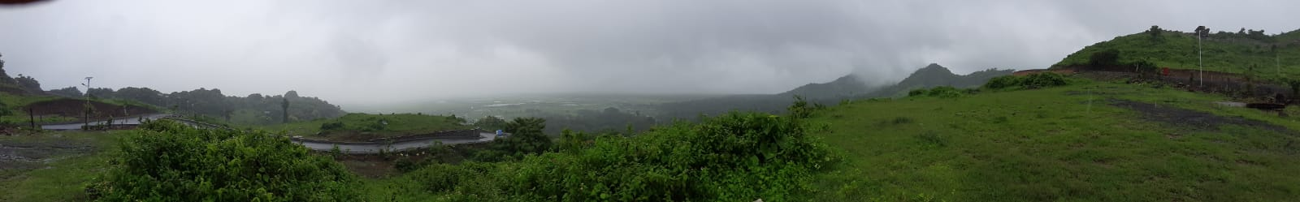
| RESIDENCE AT ALIBAUG | SITE PHOTOGRAPHS – VIEW FROM THE SITE |

Slide 25
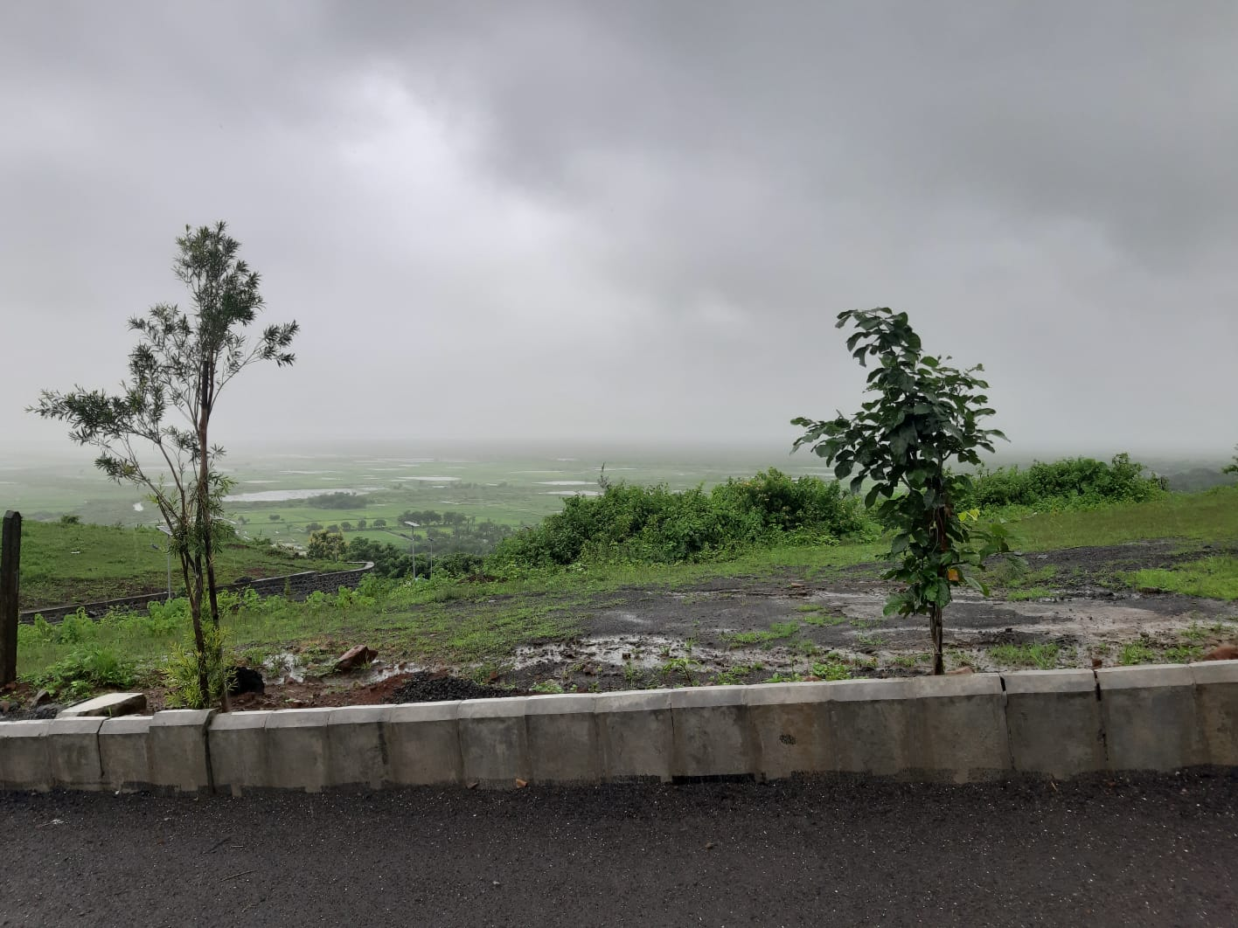
| RESIDENCE AT ALIBAUG | SITE PHOTOGRAPHS – VIEW FROM THE SITE |

Slide 26
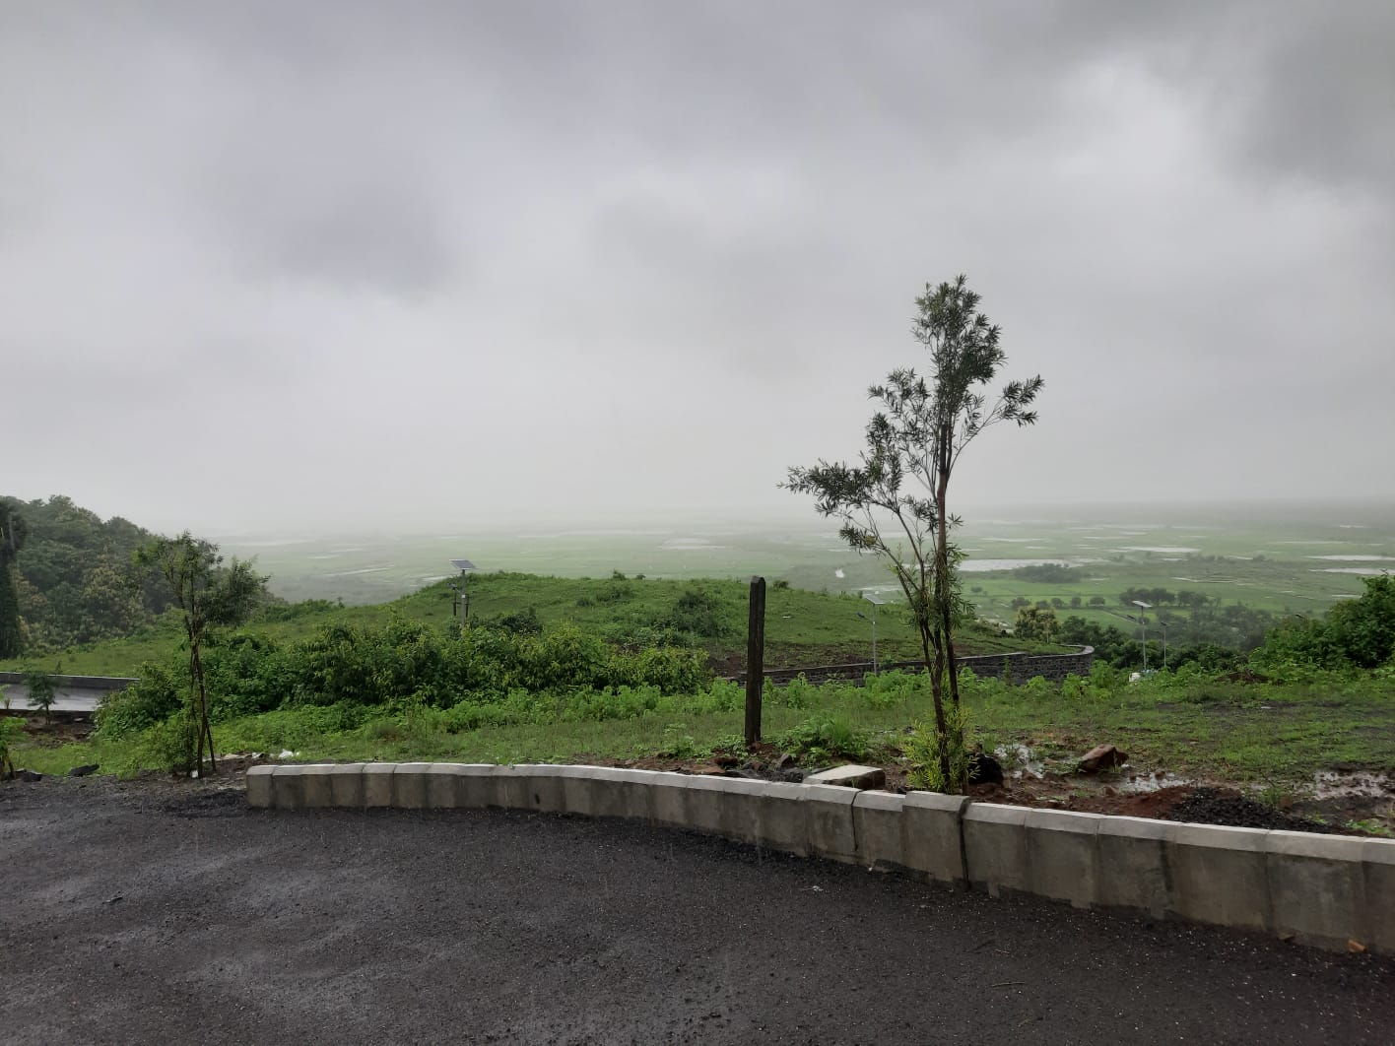
| RESIDENCE AT ALIBAUG | SITE PHOTOGRAPHS – VIEW FROM THE SITE |

Slide 27
THANK YOU

