Slide 1
AL-BANDAR MIXED-USE DEVELOPMENT PROJECT - CASE STUDIES
February 2022

Slide 2
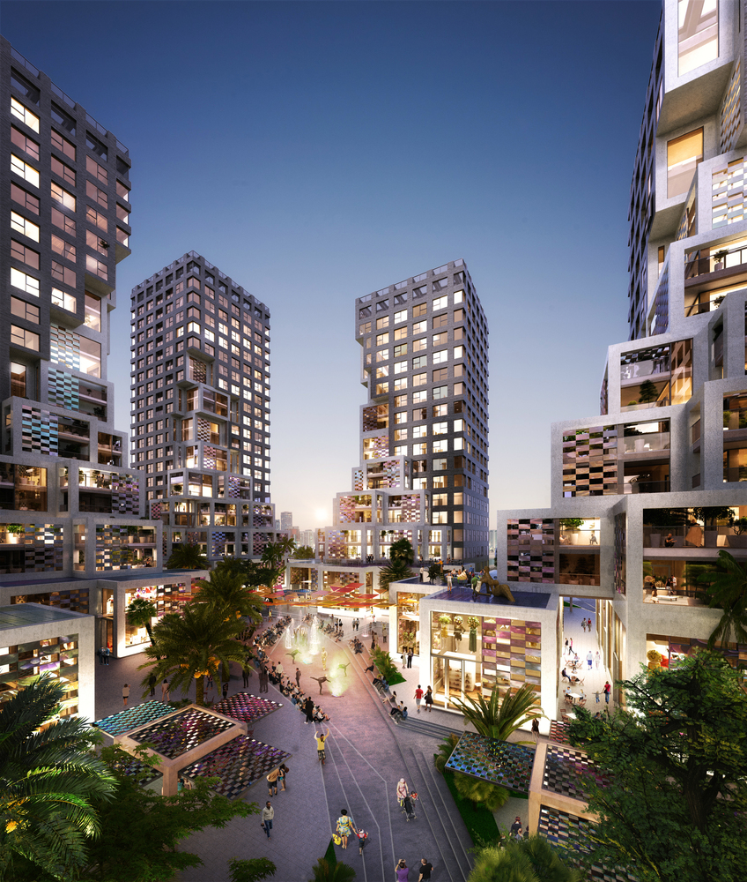
PIXEL - Mixed Used Development in Abu Dhabi

Slide 3
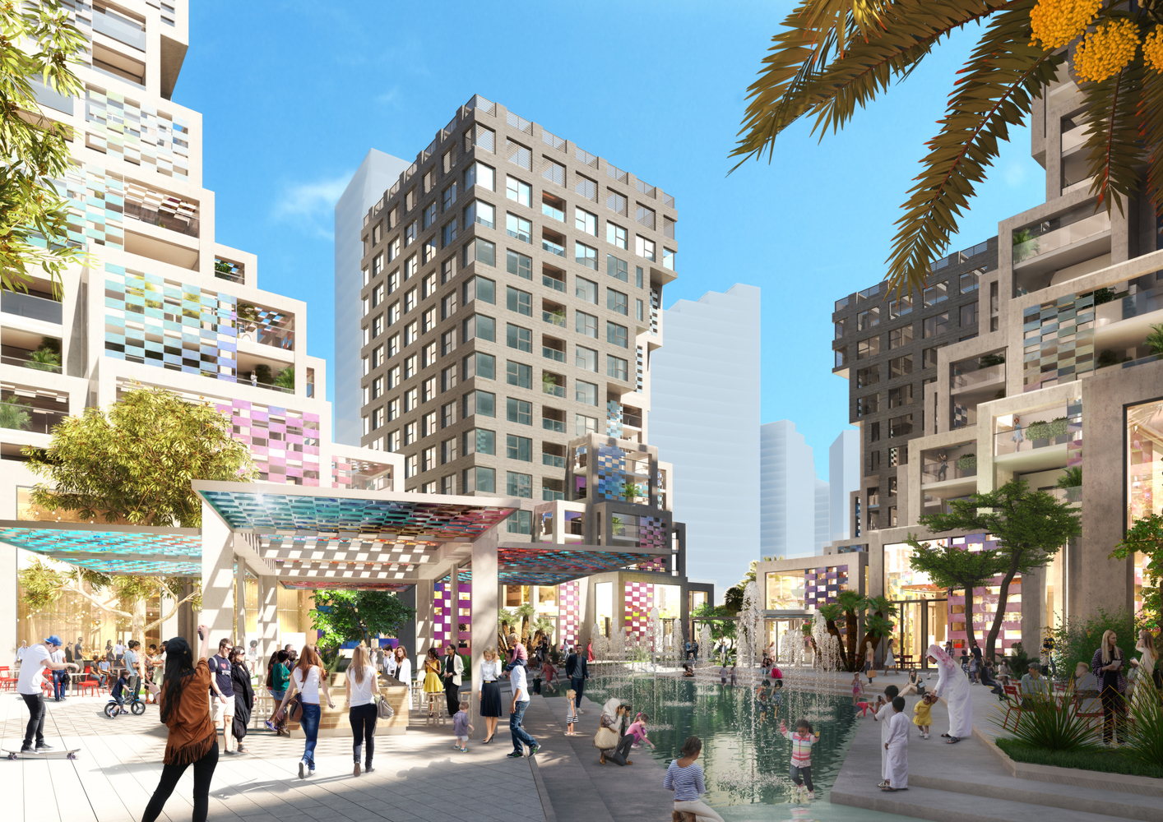
PIXEL - Mixed Used Development in Abu Dhabi
AL BANDAR MIXED USE DEVELOPMENT
PLOT AREA - 110HA

Slide 4
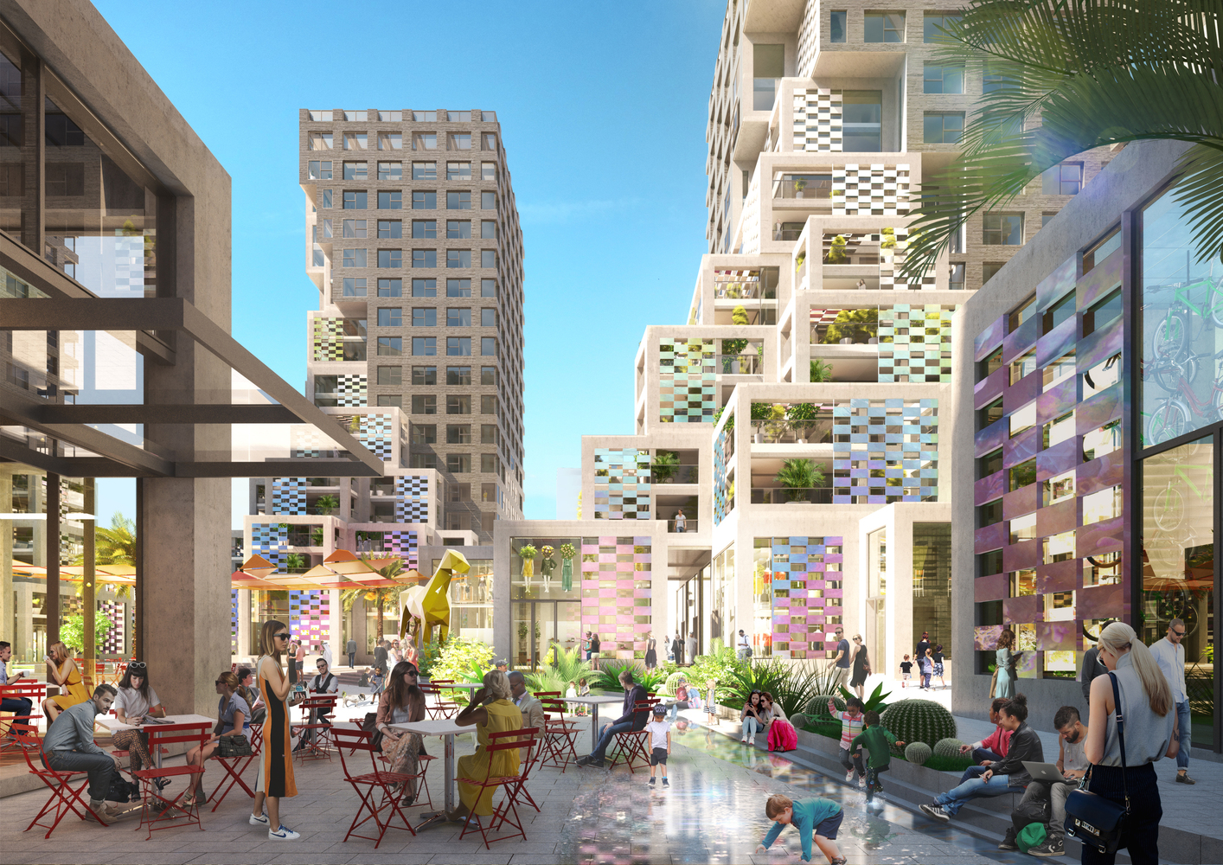
PIXEL - Mixed Used Development in Abu Dhabi
AL BANDAR MIXED USE DEVELOPMENT
PLOT AREA - 110HA

Slide 5
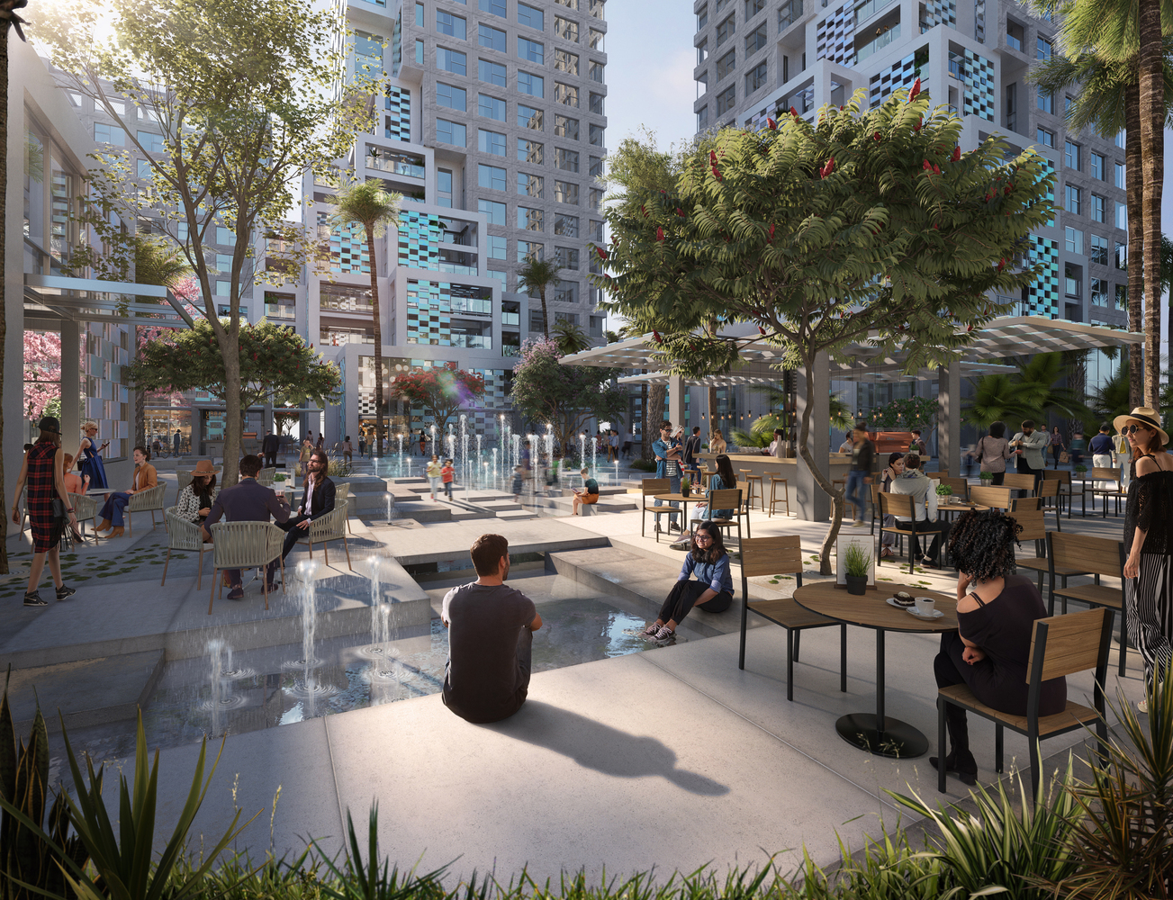
PIXEL - Mixed Used Development in Abu Dhabi
AL BANDAR MIXED USE DEVELOPMENT
PLOT AREA - 110HA

Slide 6
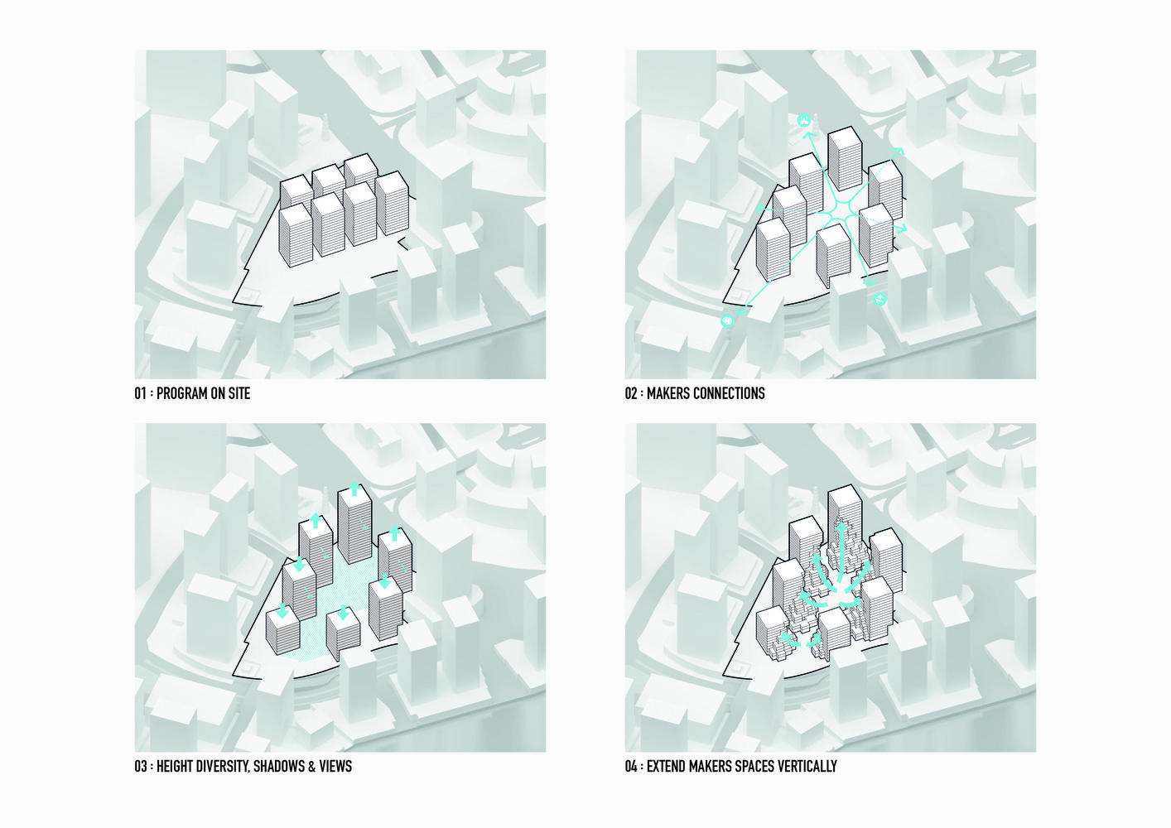
PIXEL - Mixed Used Development in Abu Dhabi
AL BANDAR MIXED USE DEVELOPMENT
PLOT AREA - 110HA

Slide 7
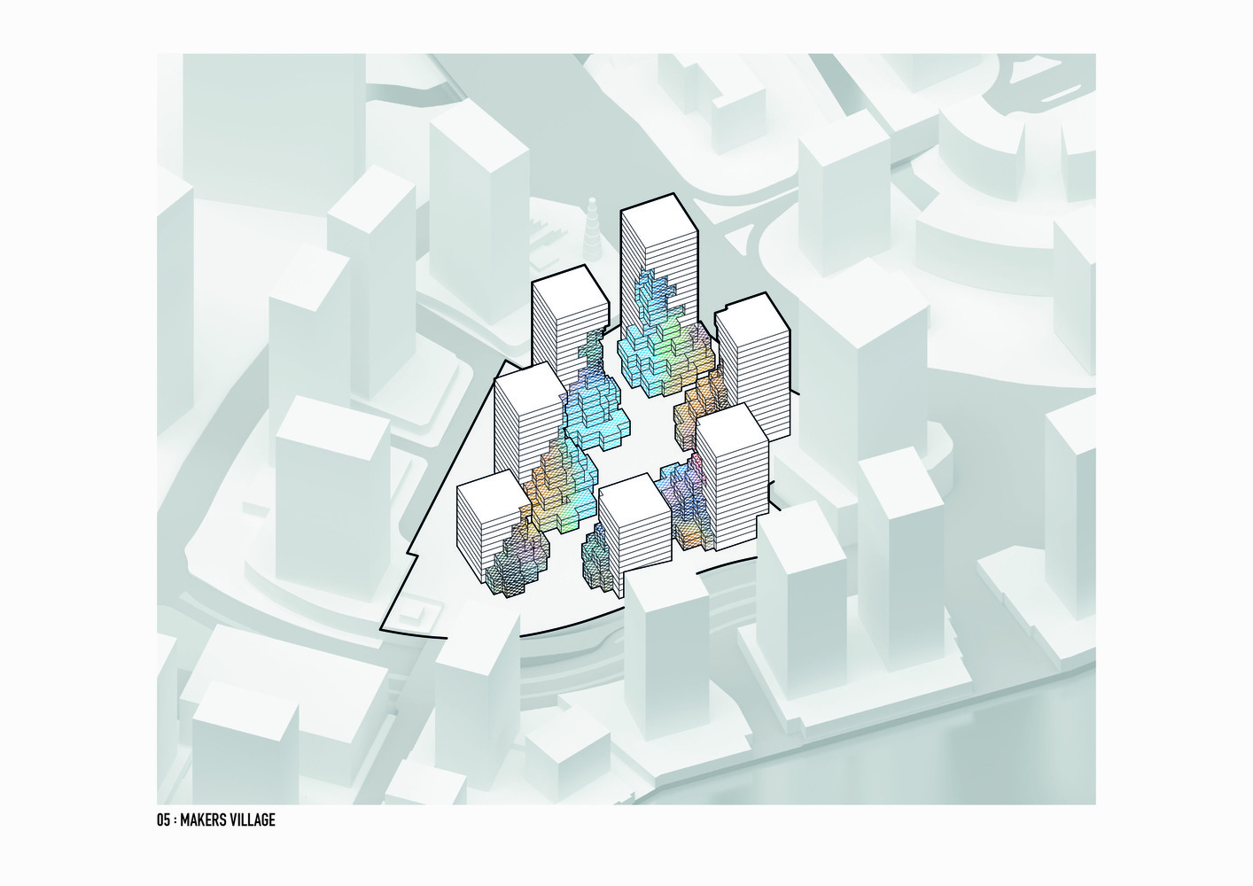
PIXEL - Mixed Used Development in Abu Dhabi
AL BANDAR MIXED USE DEVELOPMENT
PLOT AREA - 110HA

Slide 8
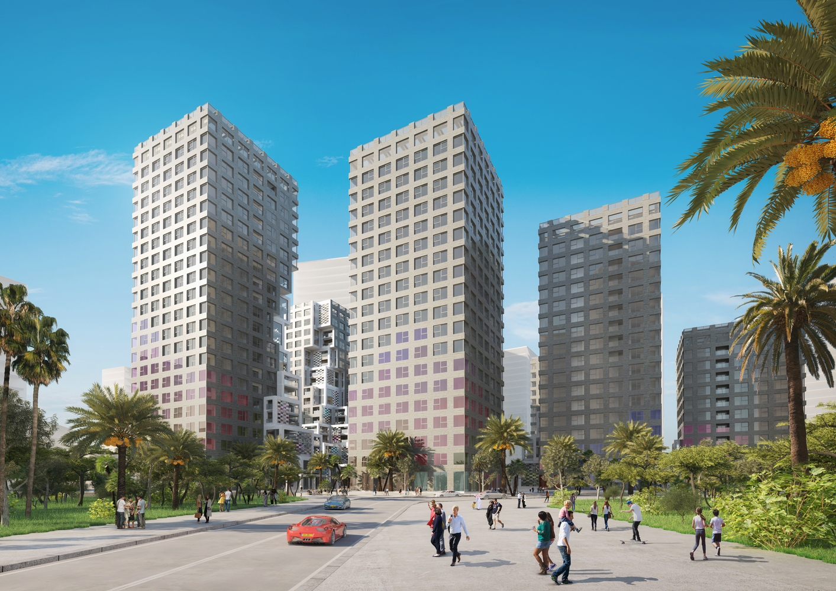
PIXEL - Mixed Used Development in Abu Dhabi
AL BANDAR MIXED USE DEVELOPMENT
PLOT AREA - 110HA

Slide 9
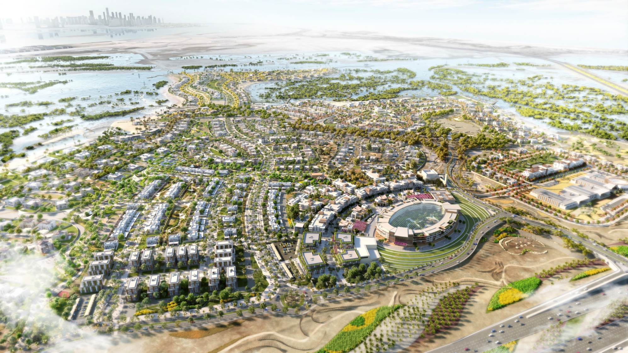
Jubail Island, Abu Dhabi
AL BANDAR MIXED USE DEVELOPMENT
PLOT AREA - 110HA

Slide 10
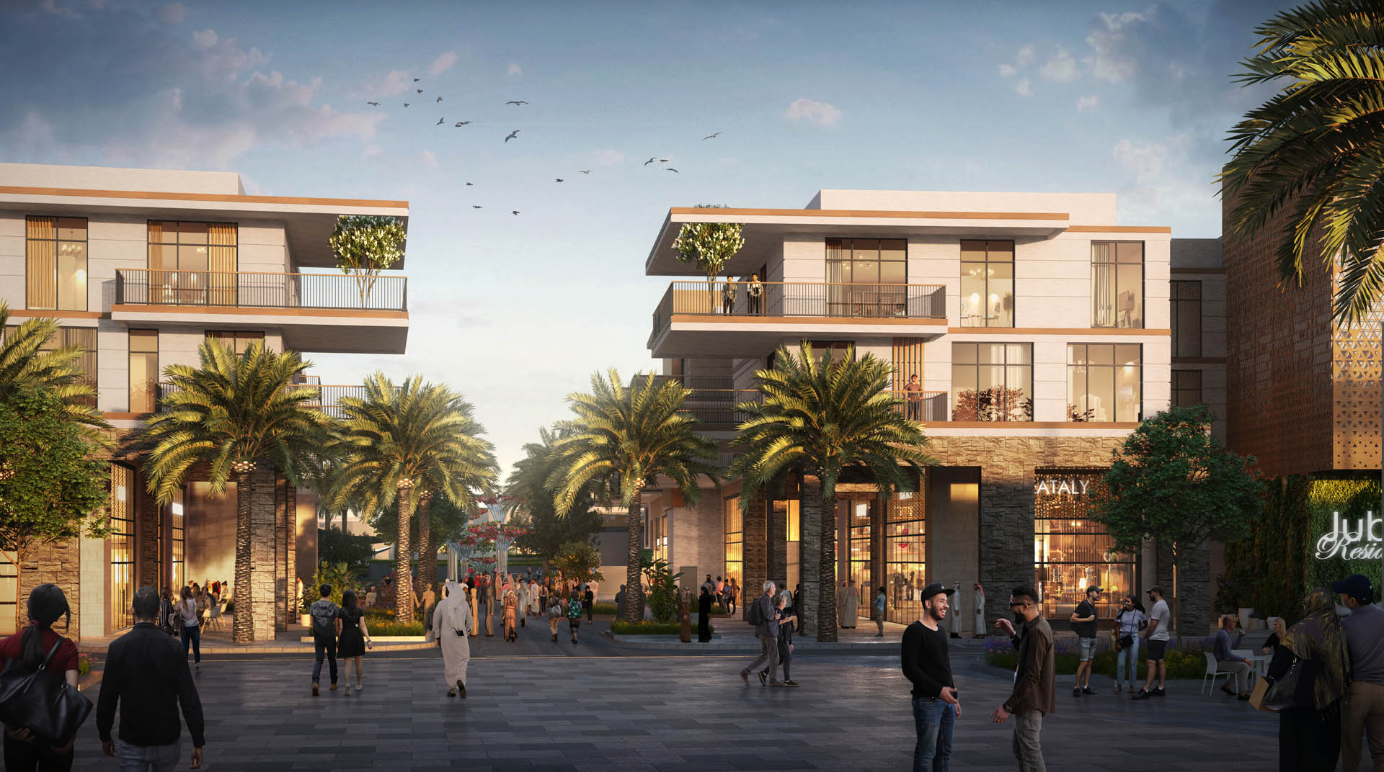
Jubail Island, Abu Dhabi
AL BANDAR MIXED USE DEVELOPMENT
PLOT AREA - 110HA

Slide 11
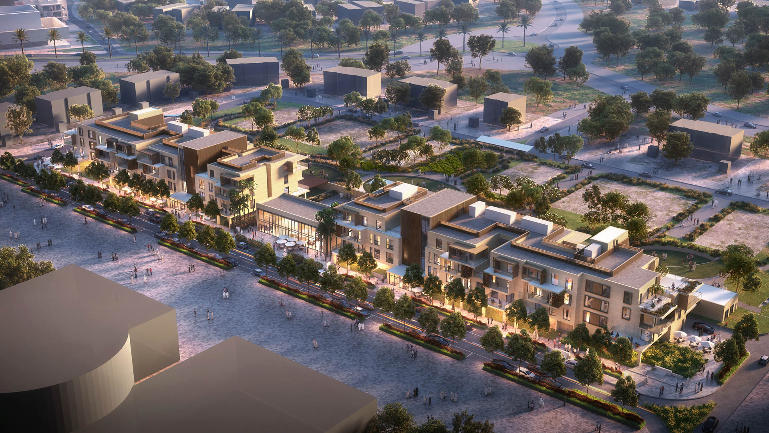
Jubail Island, Abu Dhabi
AL BANDAR MIXED USE DEVELOPMENT
PLOT AREA - 110HA

Slide 12
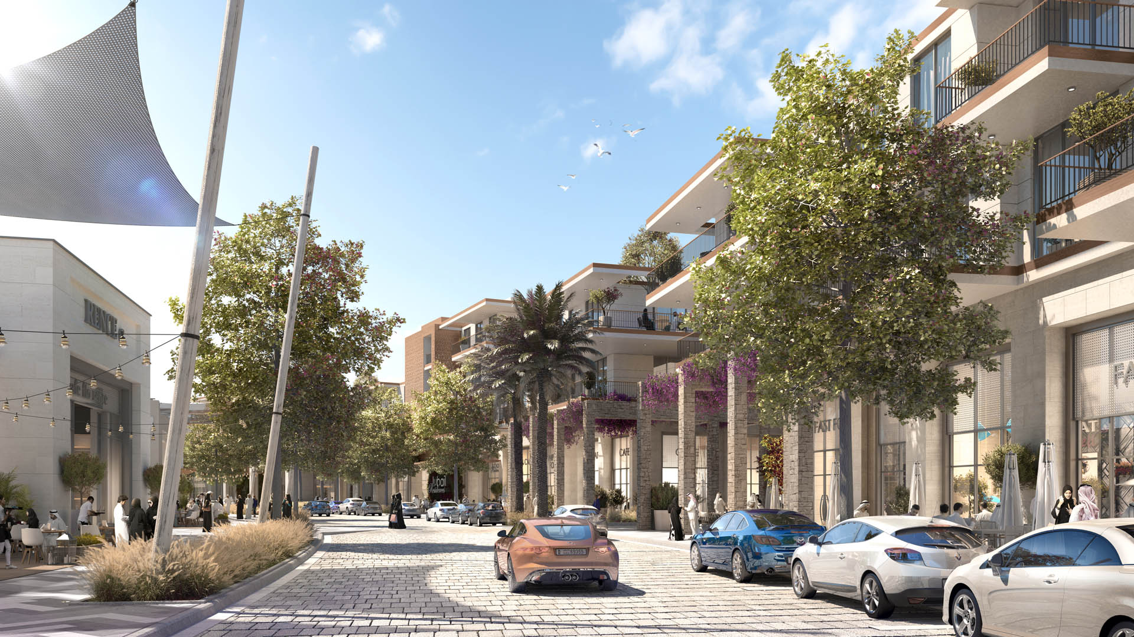
Jubail Island, Abu Dhabi
AL BANDAR MIXED USE DEVELOPMENT
PLOT AREA - 110HA

Slide 13
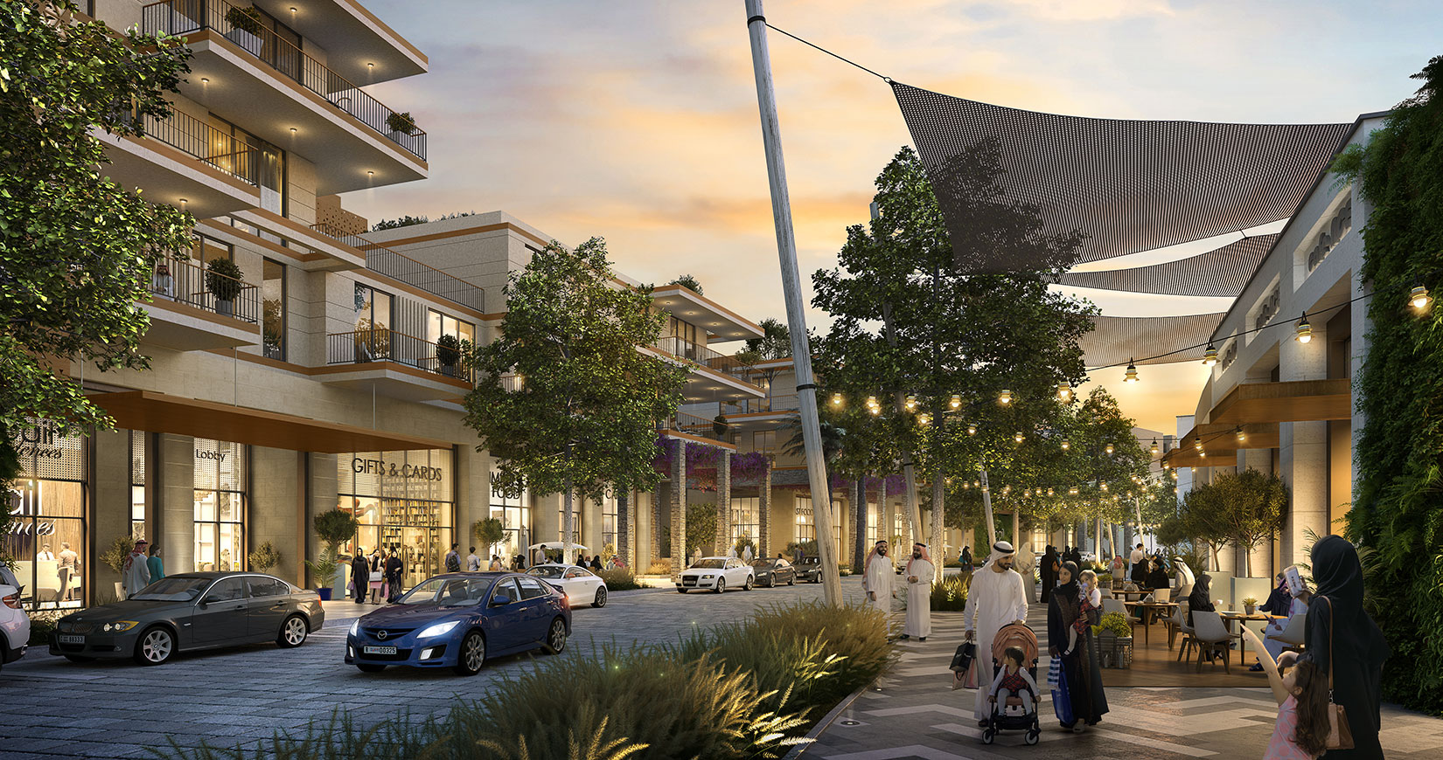
Jubail Island, Abu Dhabi
AL BANDAR MIXED USE DEVELOPMENT
PLOT AREA - 110HA

Slide 14
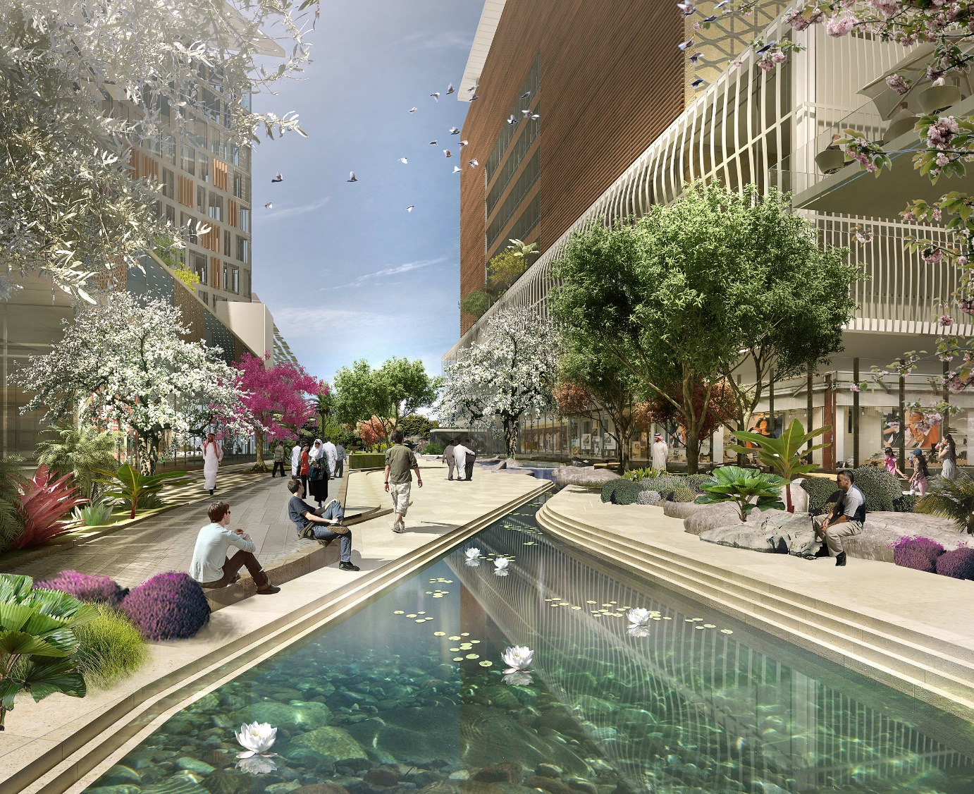
Al Kifaf, Dubai
AL BANDAR MIXED USE DEVELOPMENT
PLOT AREA - 110HA

Slide 15
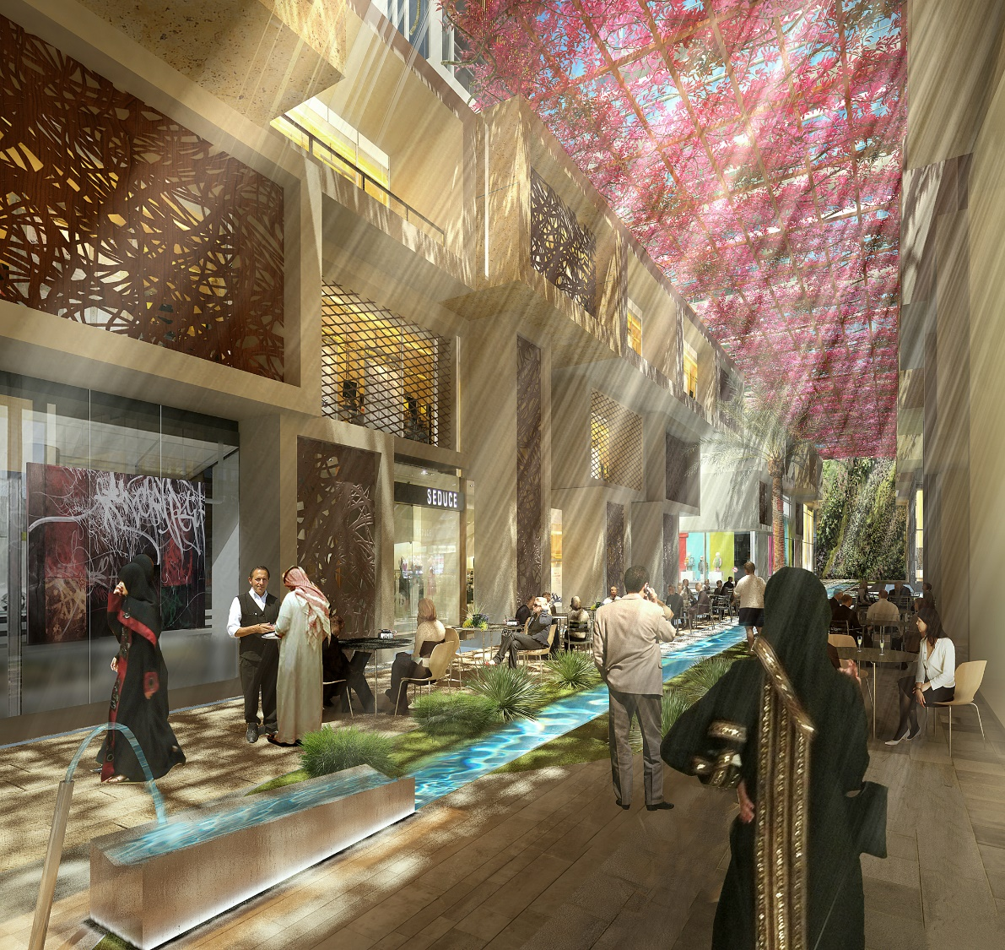
Al Kifaf, Dubai
AL BANDAR MIXED USE DEVELOPMENT
PLOT AREA - 110HA

Slide 16
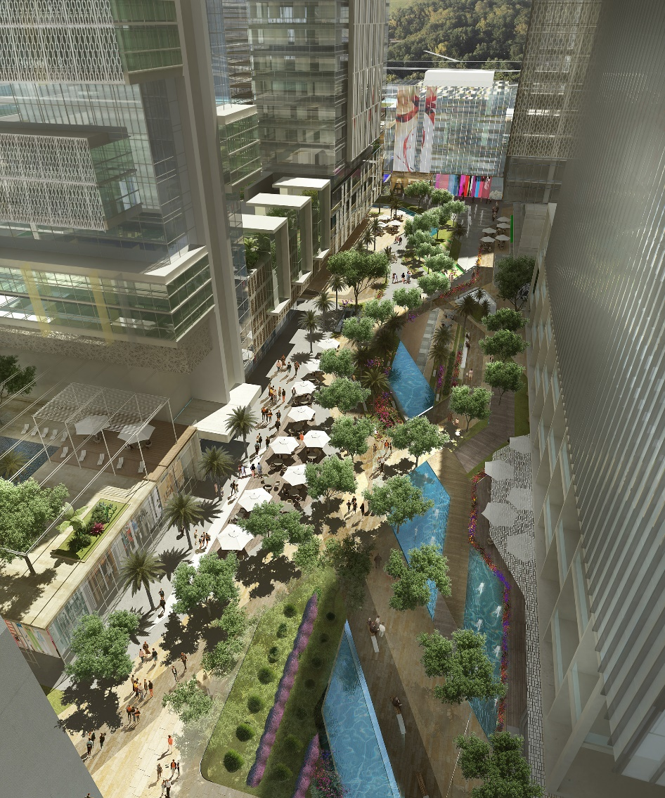
Al Kifaf, Dubai
AL BANDAR MIXED USE DEVELOPMENT
PLOT AREA - 110HA

Slide 17
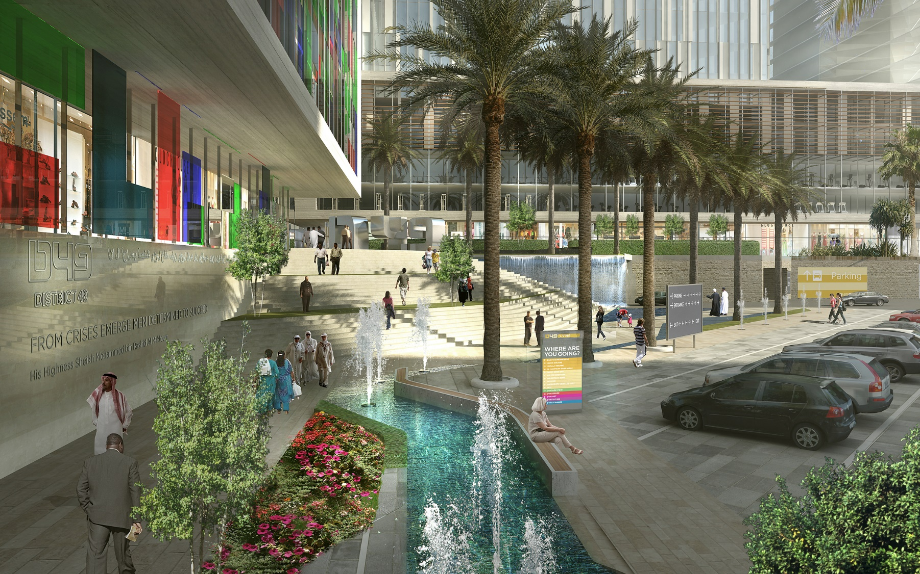
Al Kifaf, Dubai
AL BANDAR MIXED USE DEVELOPMENT
PLOT AREA - 110HA

Slide 18
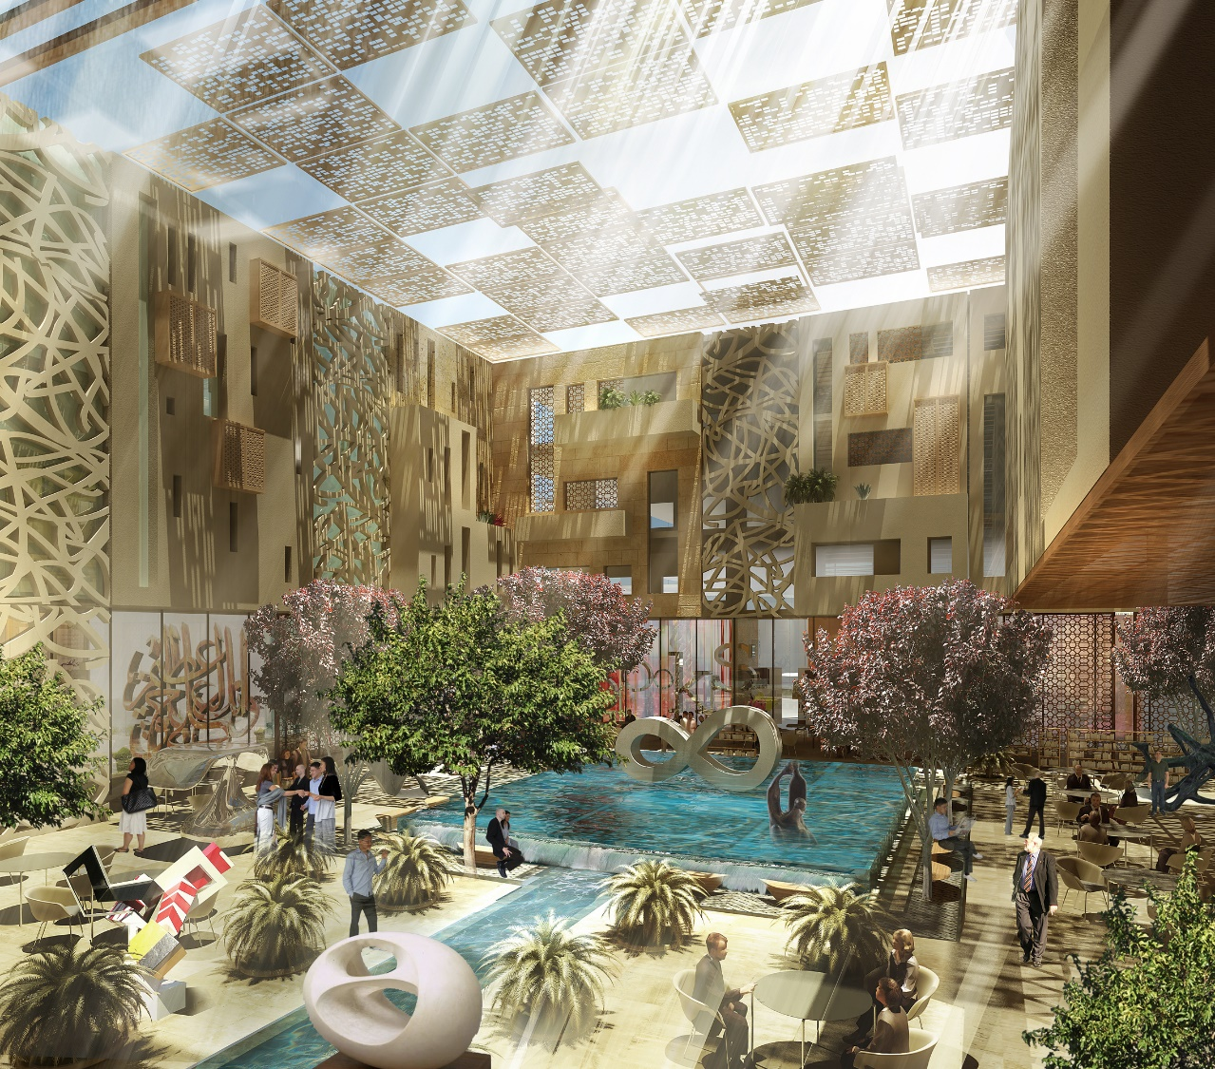
Al Kifaf, Dubai
AL BANDAR MIXED USE DEVELOPMENT
PLOT AREA - 110HA

Slide 19
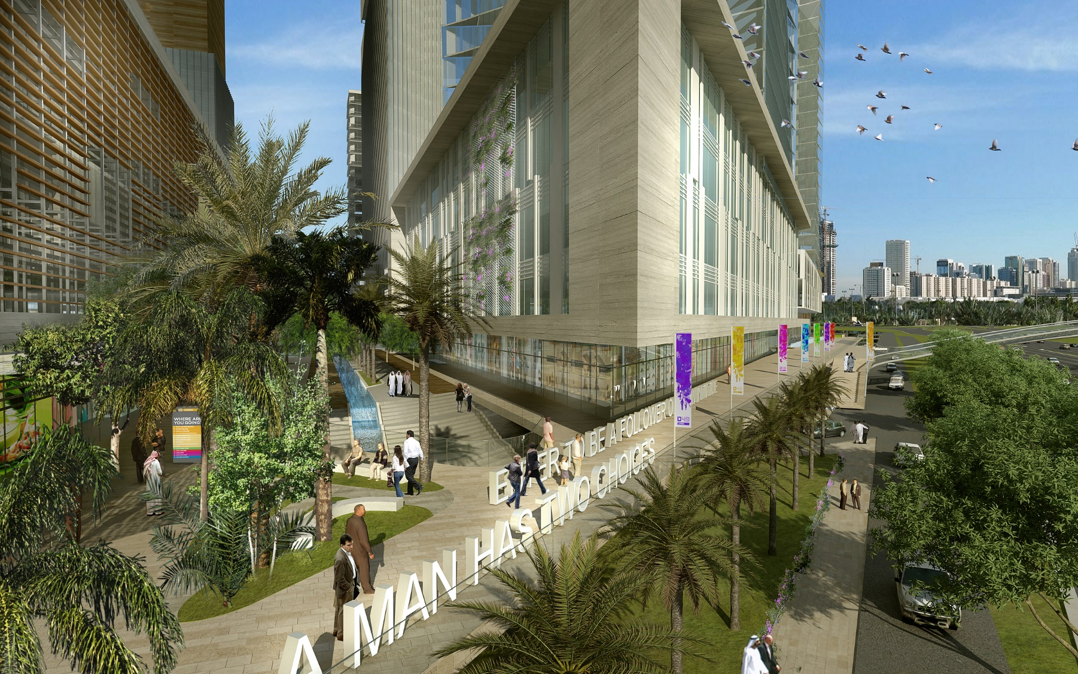
Al Kifaf, Dubai
AL BANDAR MIXED USE DEVELOPMENT
PLOT AREA - 110HA

Slide 20
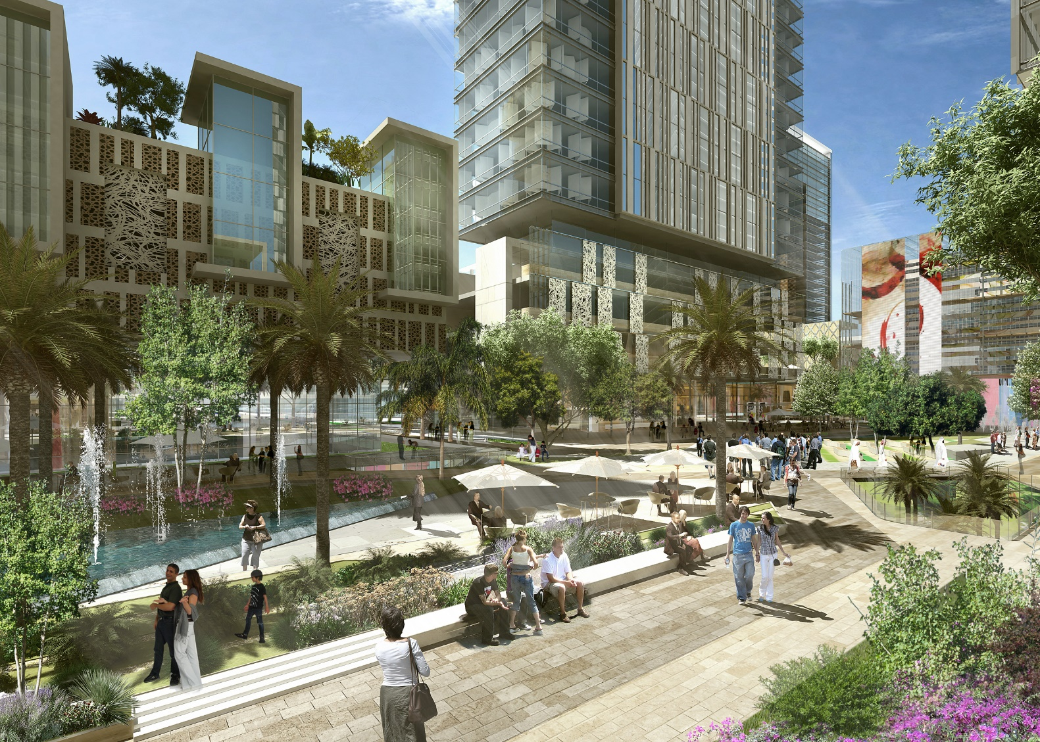
Al Kifaf, Dubai
AL BANDAR MIXED USE DEVELOPMENT
PLOT AREA - 110HA

Slide 21
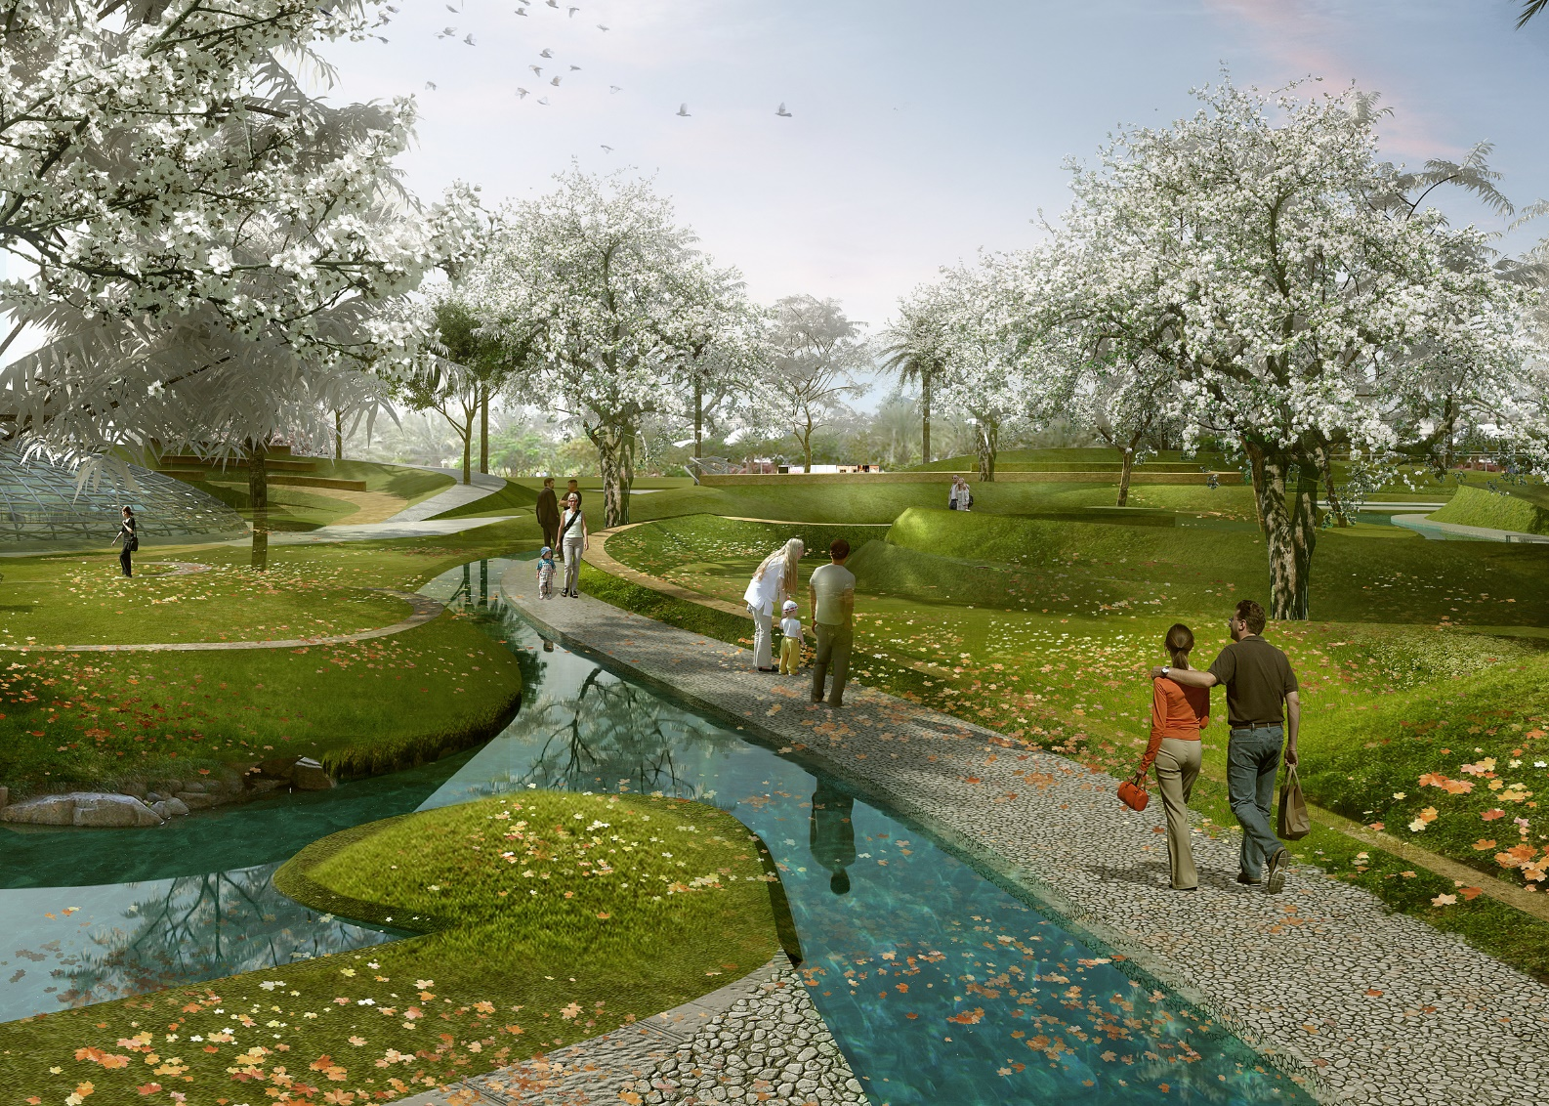
Al Kifaf, Dubai
AL BANDAR MIXED USE DEVELOPMENT
PLOT AREA - 110HA

Slide 22
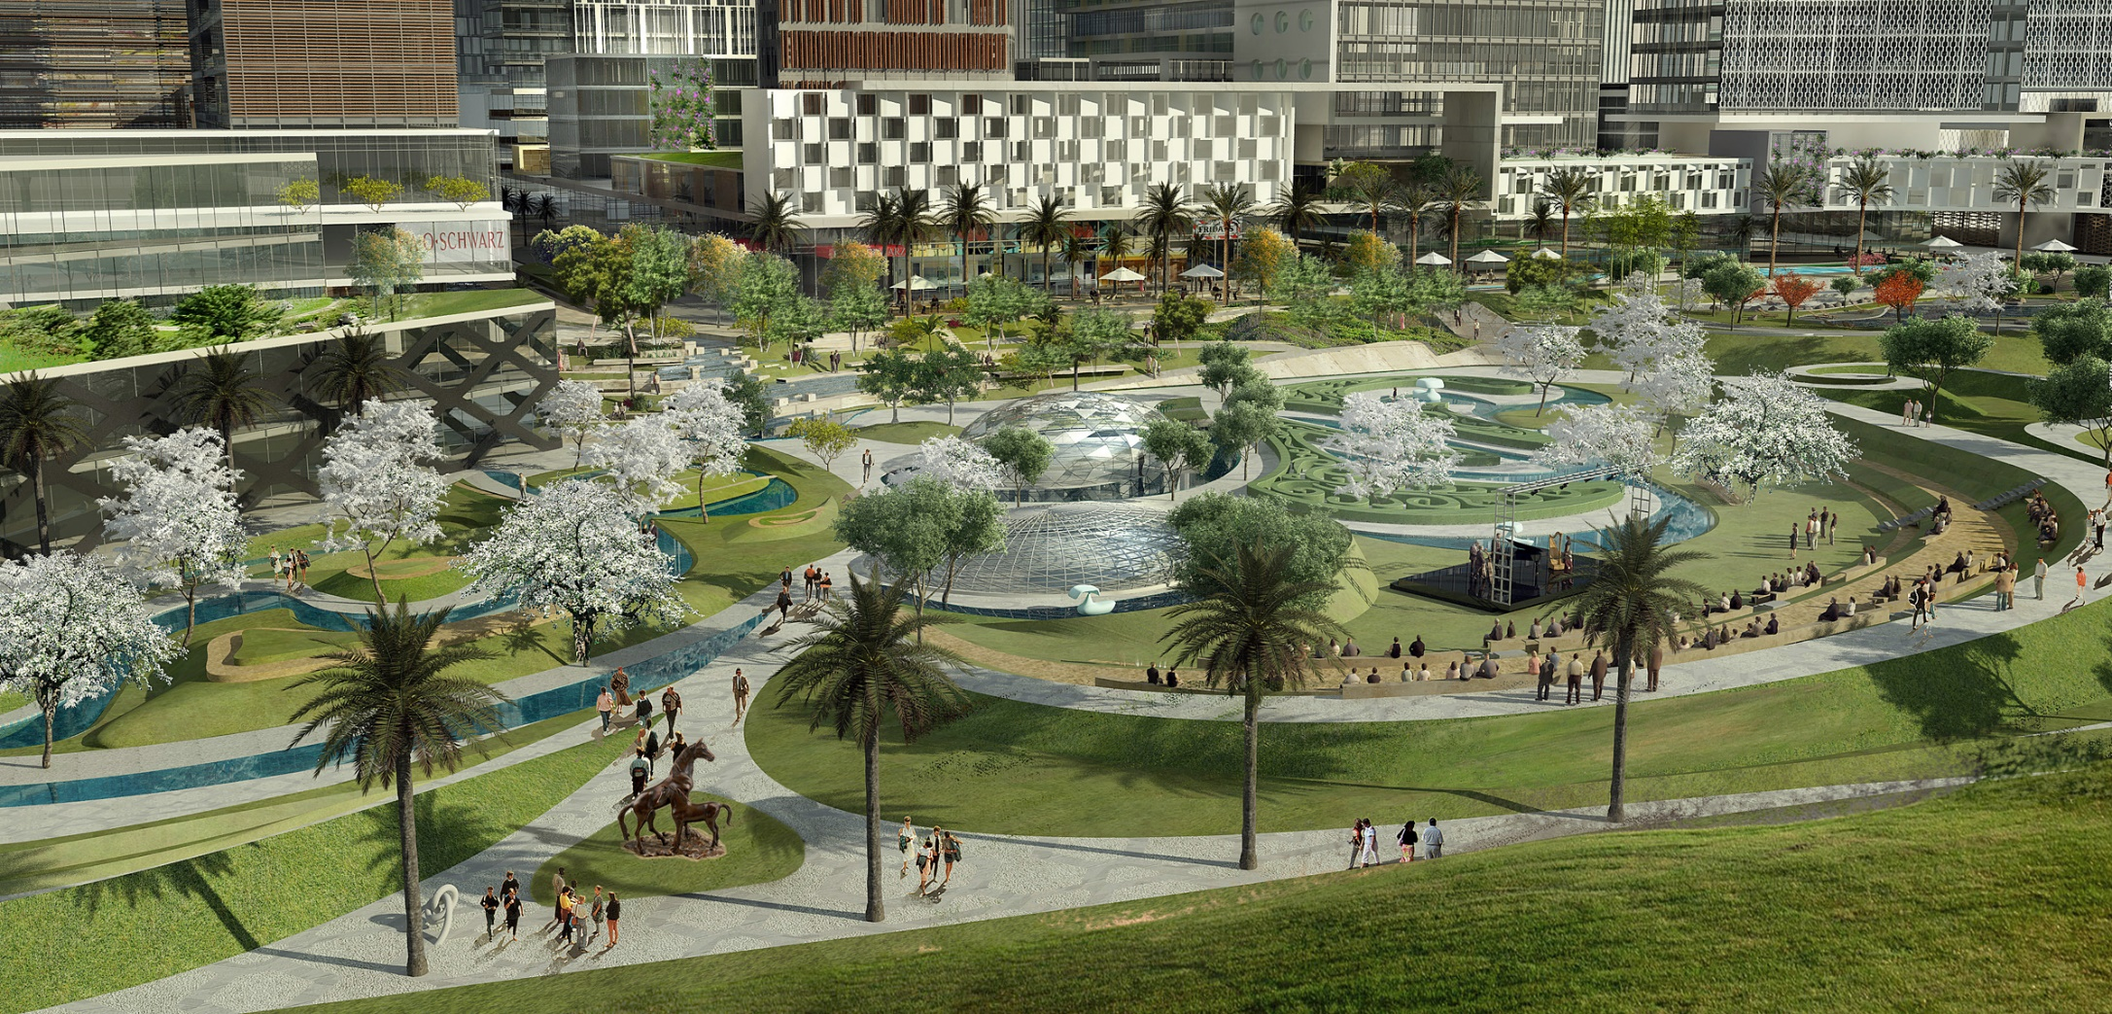
Al Kifaf, Dubai
AL BANDAR MIXED USE DEVELOPMENT
PLOT AREA - 110HA

Slide 23
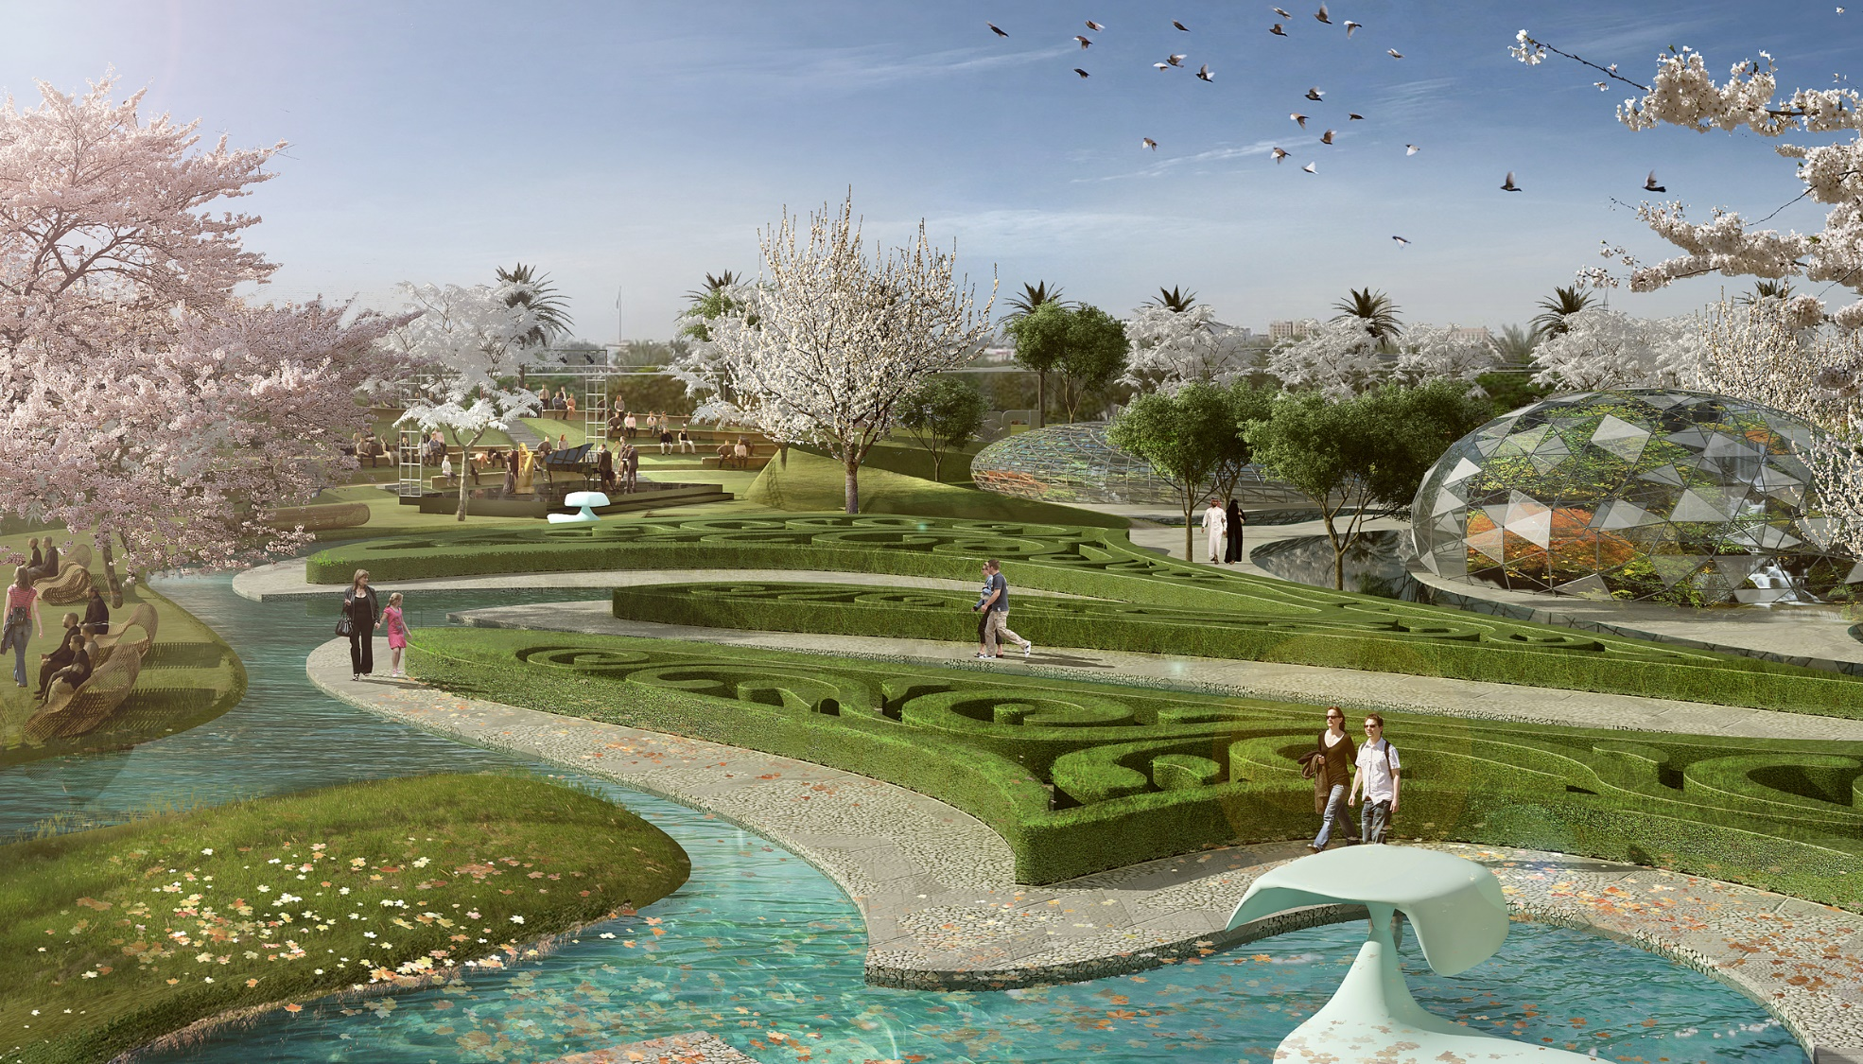
Al Kifaf, Dubai
AL BANDAR MIXED USE DEVELOPMENT
PLOT AREA - 110HA

Slide 24
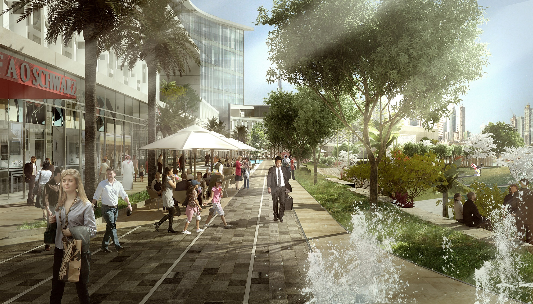
Al Kifaf, Dubai
AL BANDAR MIXED USE DEVELOPMENT
PLOT AREA - 110HA

Slide 25
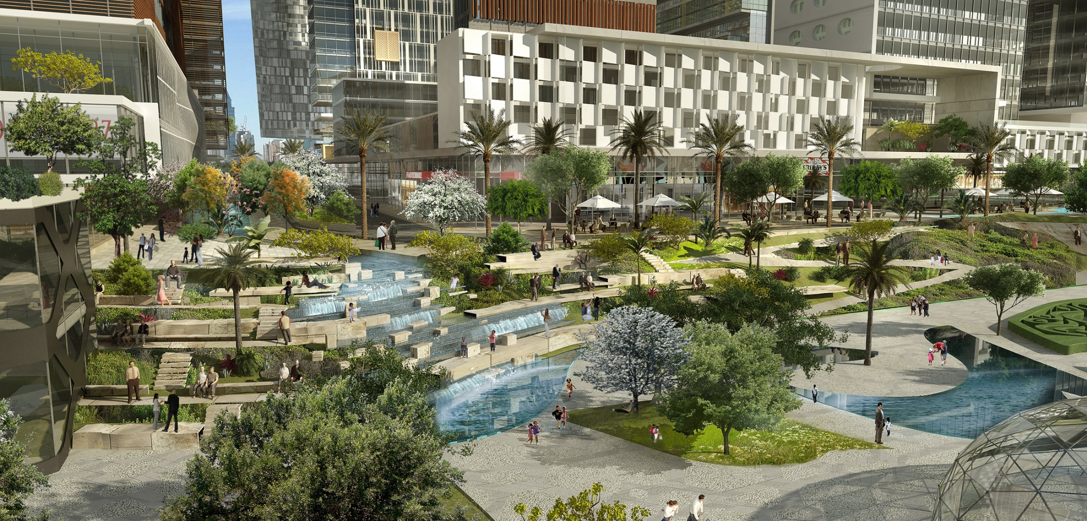
Al Kifaf, Dubai

Slide 26

Al Kifaf, Dubai
AL BANDAR MIXED USE DEVELOPMENT
PLOT AREA - 110HA

Slide 27
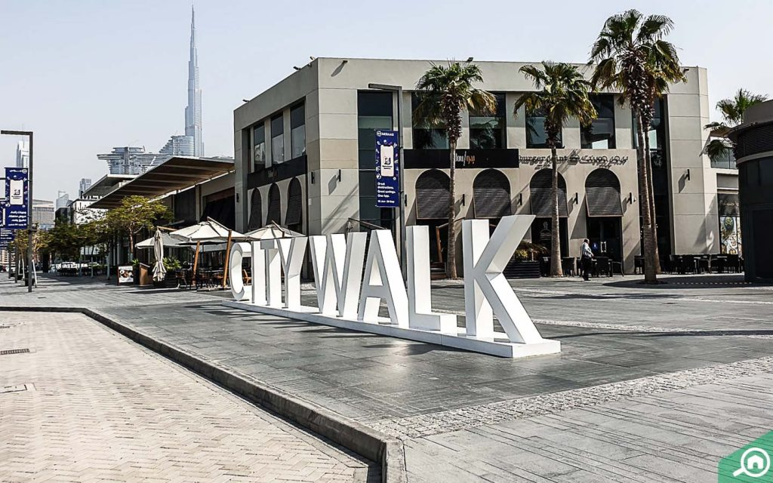
City Walk, Dubai
AL BANDAR MIXED USE DEVELOPMENT
PLOT AREA - 110HA

Slide 28
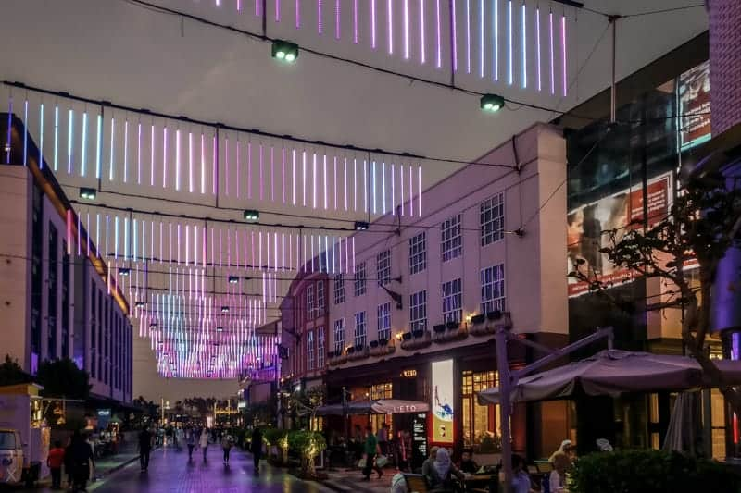
City Walk, Dubai
AL BANDAR MIXED USE DEVELOPMENT
PLOT AREA - 110HA

Slide 29
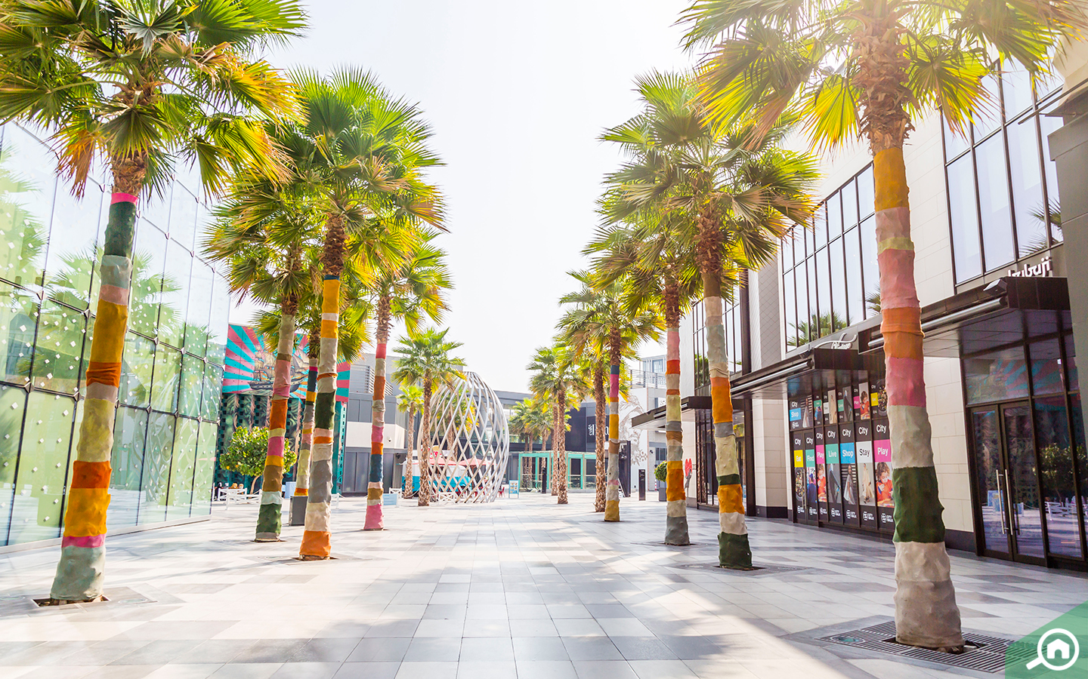
City Walk, Dubai
AL BANDAR MIXED USE DEVELOPMENT
PLOT AREA - 110HA

Slide 30
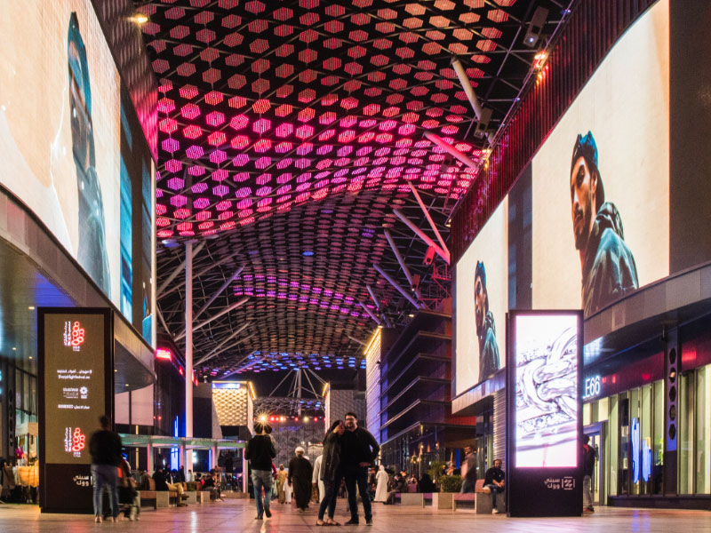
City Walk, Dubai
AL BANDAR MIXED USE DEVELOPMENT
PLOT AREA - 110HA

Slide 31
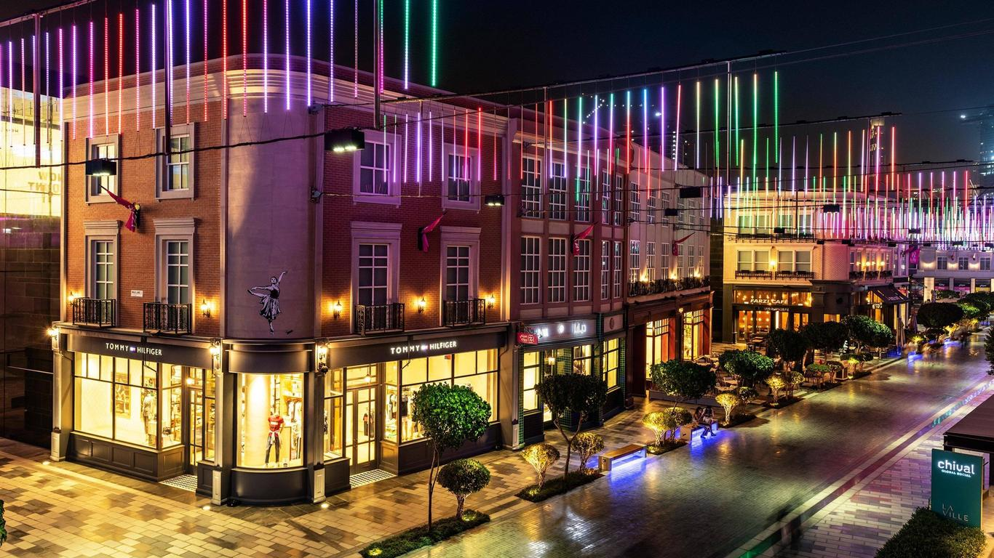
City Walk, Dubai
AL BANDAR MIXED USE DEVELOPMENT
PLOT AREA - 110HA

Slide 32
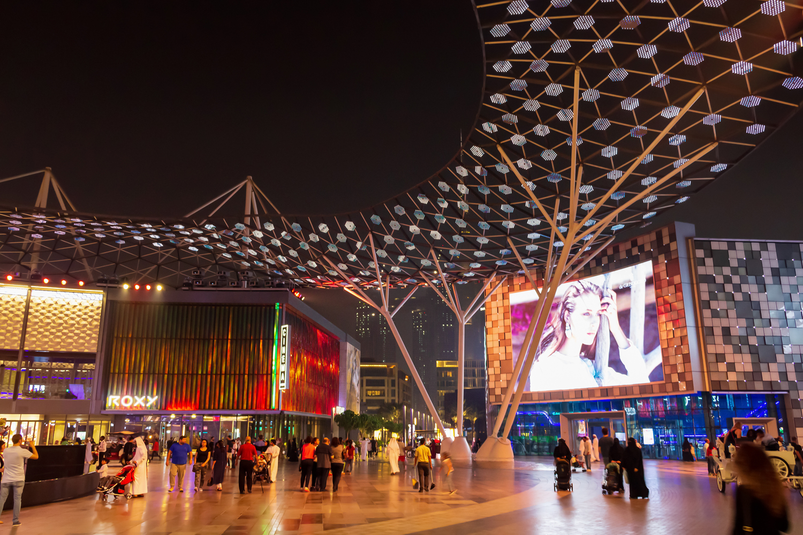
City Walk, Dubai
AL BANDAR MIXED USE DEVELOPMENT
PLOT AREA - 110HA

Slide 33
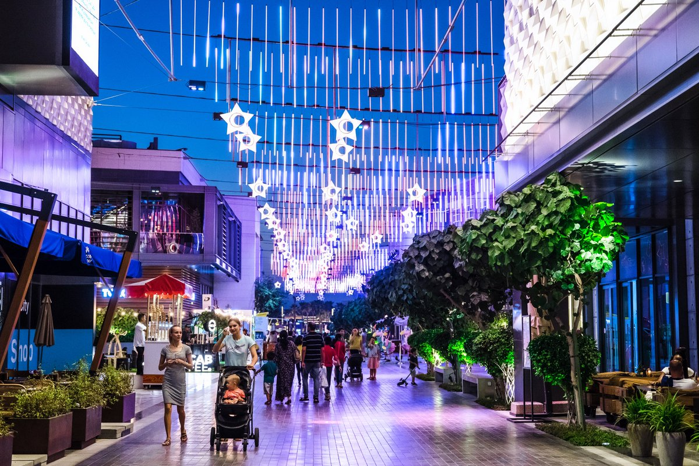
City Walk, Dubai
AL BANDAR MIXED USE DEVELOPMENT
PLOT AREA - 110HA

Slide 34
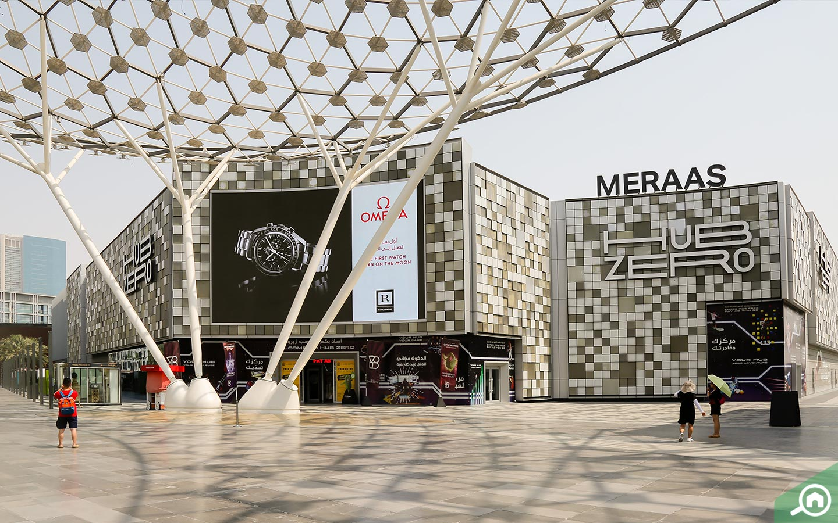
City Walk, Dubai
AL BANDAR MIXED USE DEVELOPMENT
PLOT AREA - 110HA

Slide 35
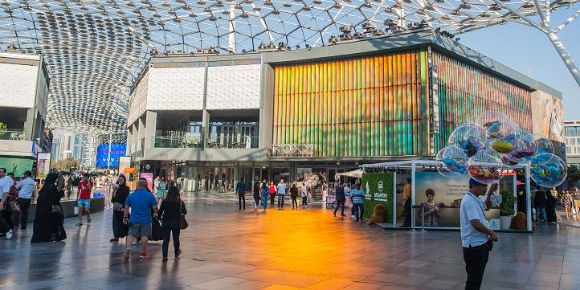
City Walk, Dubai
AL BANDAR MIXED USE DEVELOPMENT
PLOT AREA - 110HA

Slide 36
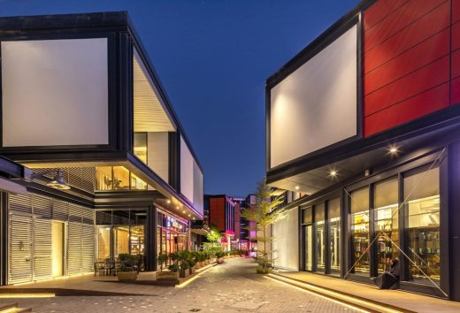
Al Seef, Dubai
AL BANDAR MIXED USE DEVELOPMENT
PLOT AREA - 110HA

Slide 37
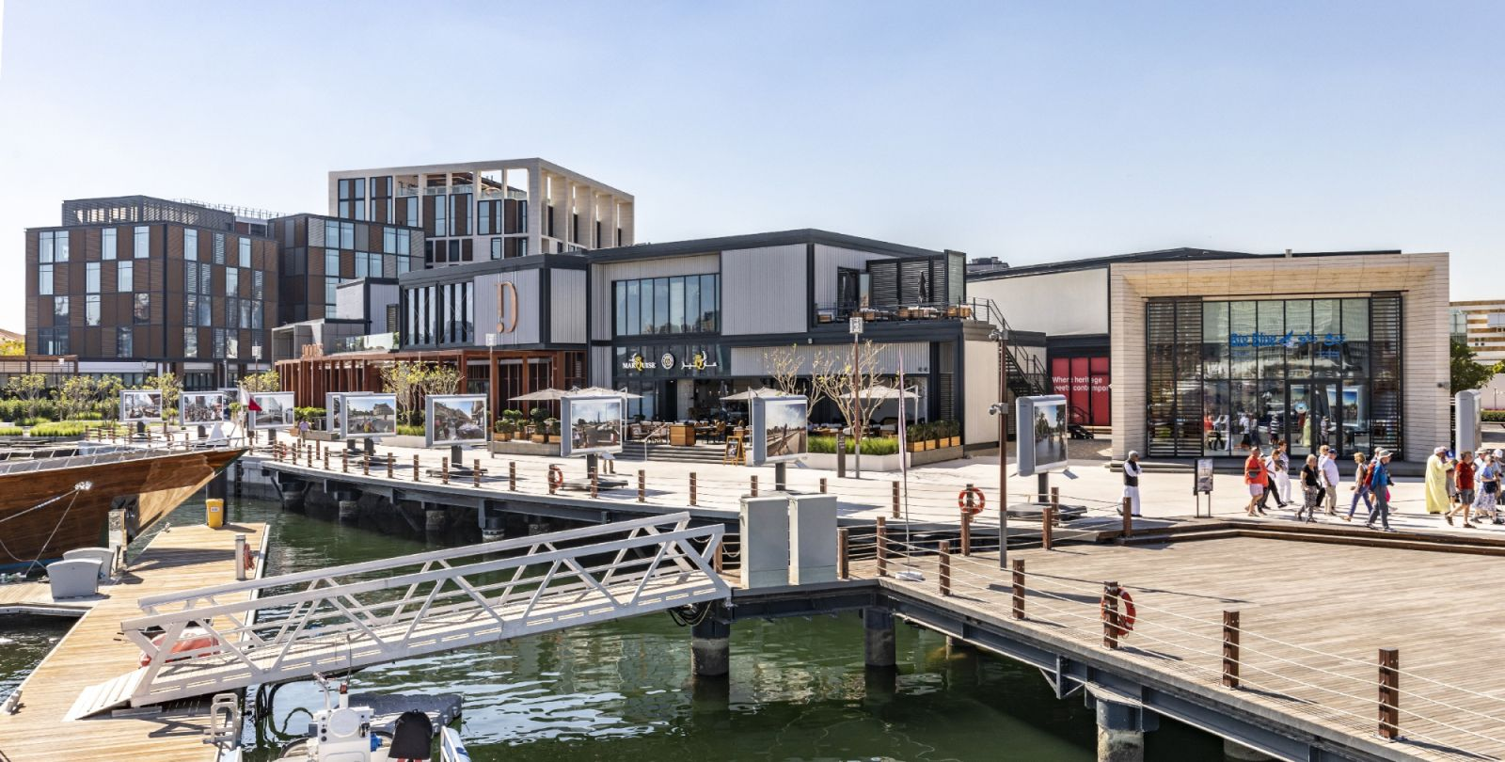
Al Seef, Dubai
AL BANDAR MIXED USE DEVELOPMENT
PLOT AREA - 110HA

Slide 38
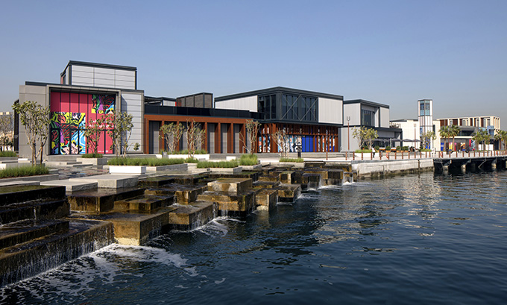
Al Seef, Dubai
AL BANDAR MIXED USE DEVELOPMENT
PLOT AREA - 110HA

Slide 39
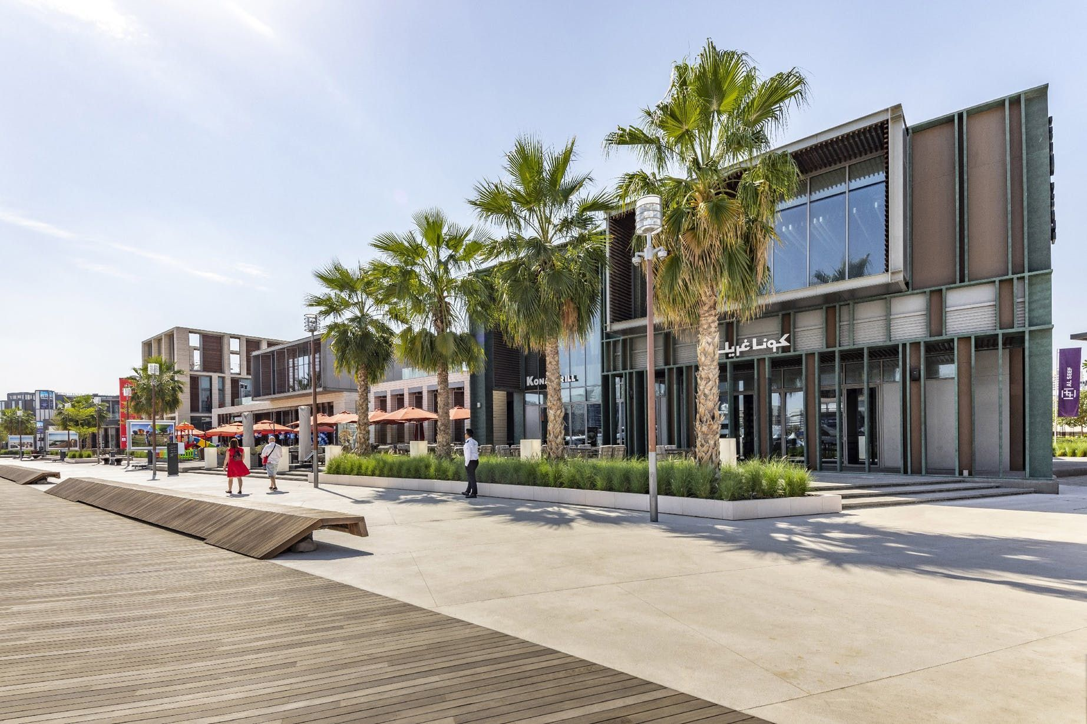
Al Seef, Dubai
AL BANDAR MIXED USE DEVELOPMENT
PLOT AREA - 110HA

Slide 40
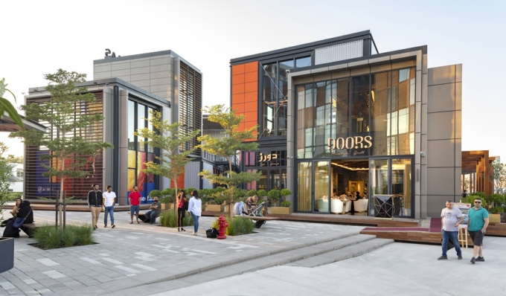
Al Seef, Dubai
AL BANDAR MIXED USE DEVELOPMENT
PLOT AREA - 110HA

Slide 41
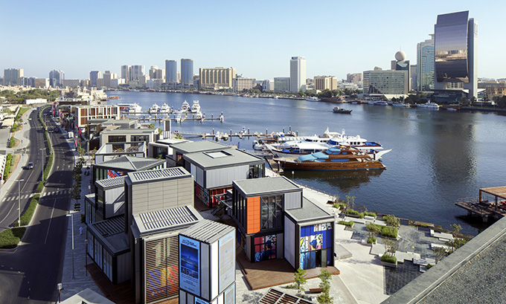
Al Seef, Dubai
AL BANDAR MIXED USE DEVELOPMENT
PLOT AREA - 110HA

Slide 42
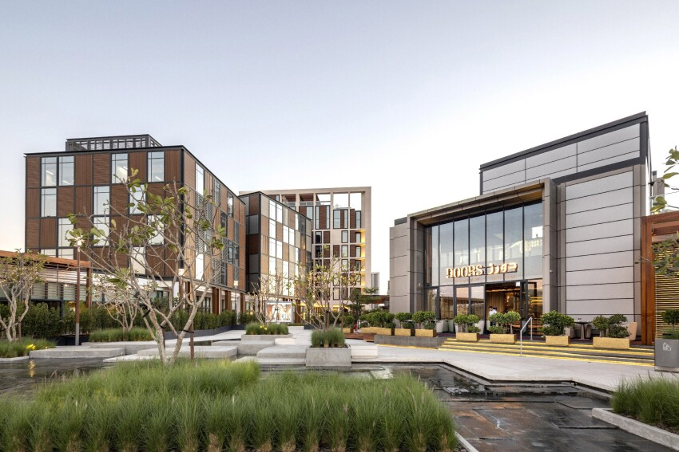
Al Seef, Dubai
AL BANDAR MIXED USE DEVELOPMENT
PLOT AREA - 110HA

Slide 43
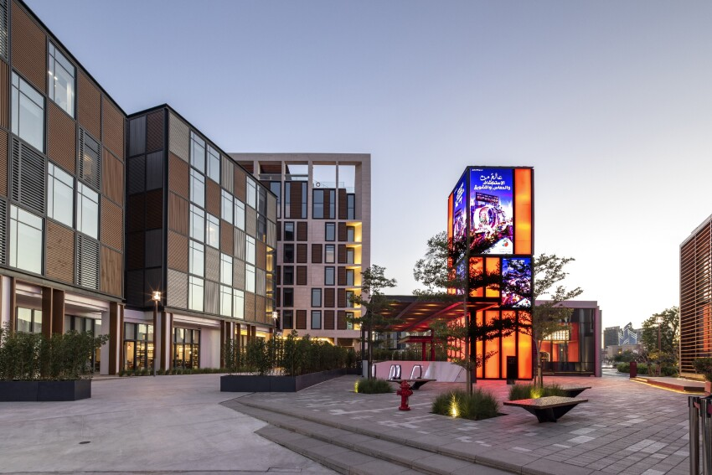
Al Seef, Dubai
AL BANDAR MIXED USE DEVELOPMENT
PLOT AREA - 110HA

Slide 44
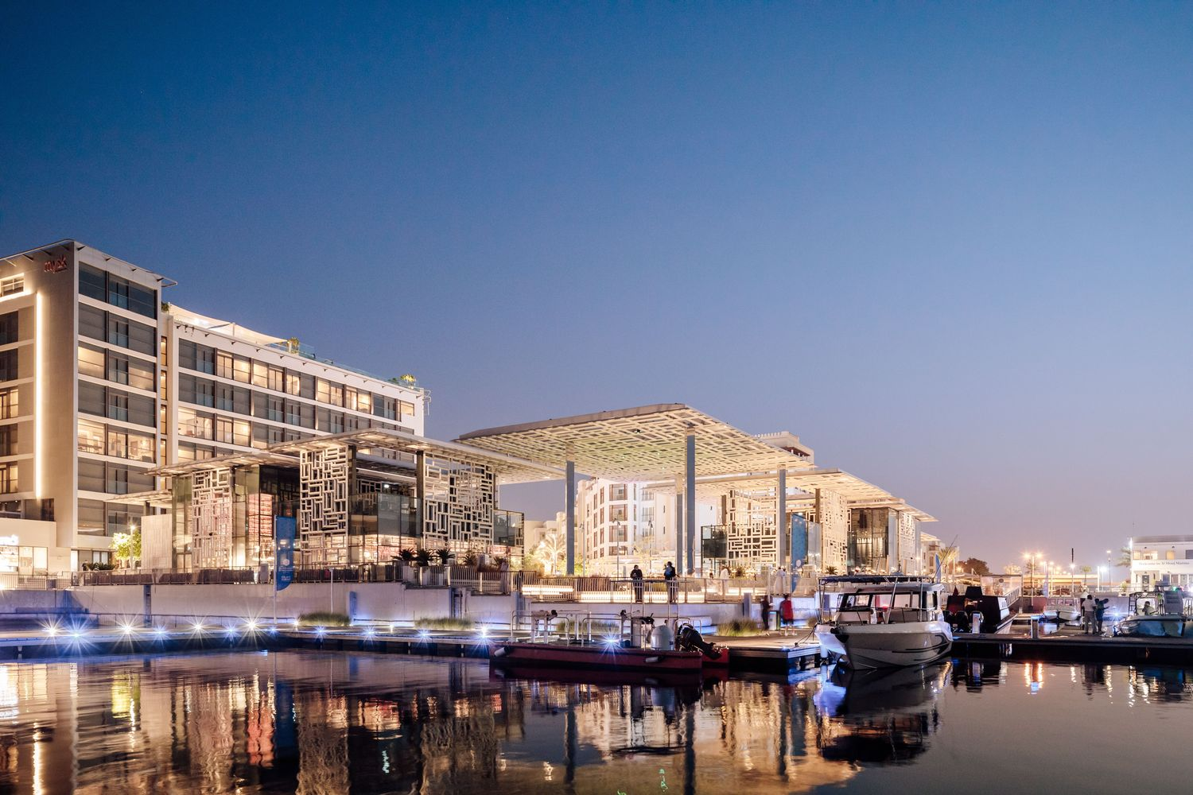
Marsa Plaza, Muscat
AL BANDAR MIXED USE DEVELOPMENT
PLOT AREA - 110HA

Slide 45
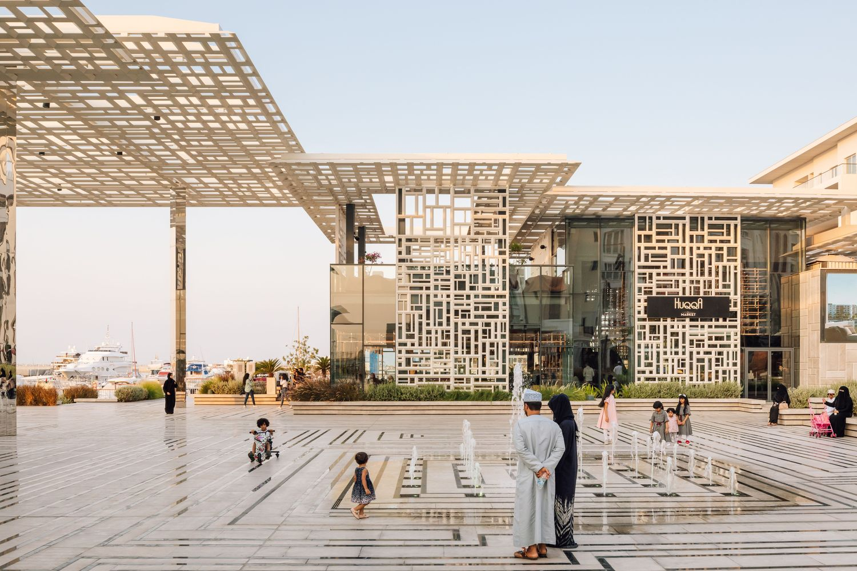
Marsa Plaza, Muscat
AL BANDAR MIXED USE DEVELOPMENT
PLOT AREA - 110HA

Slide 46
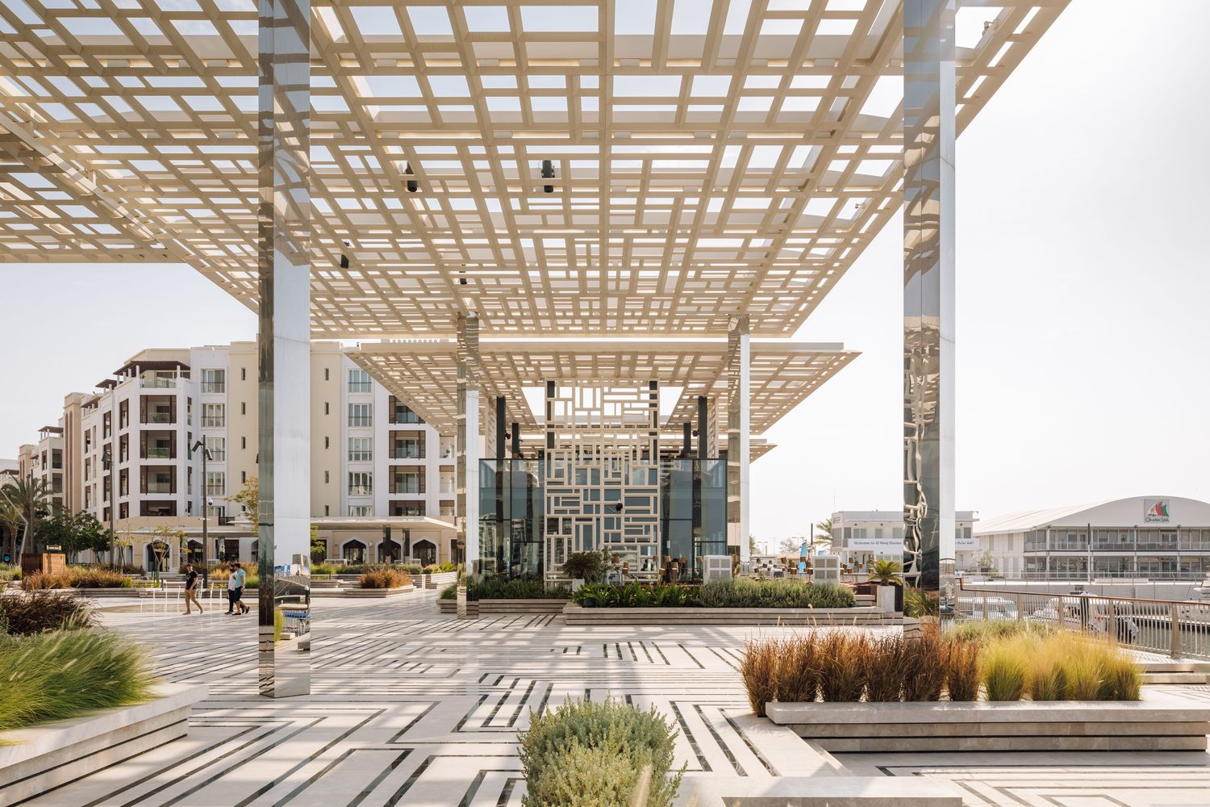
Marsa Plaza, Muscat
AL BANDAR MIXED USE DEVELOPMENT
PLOT AREA - 110HA

Slide 47
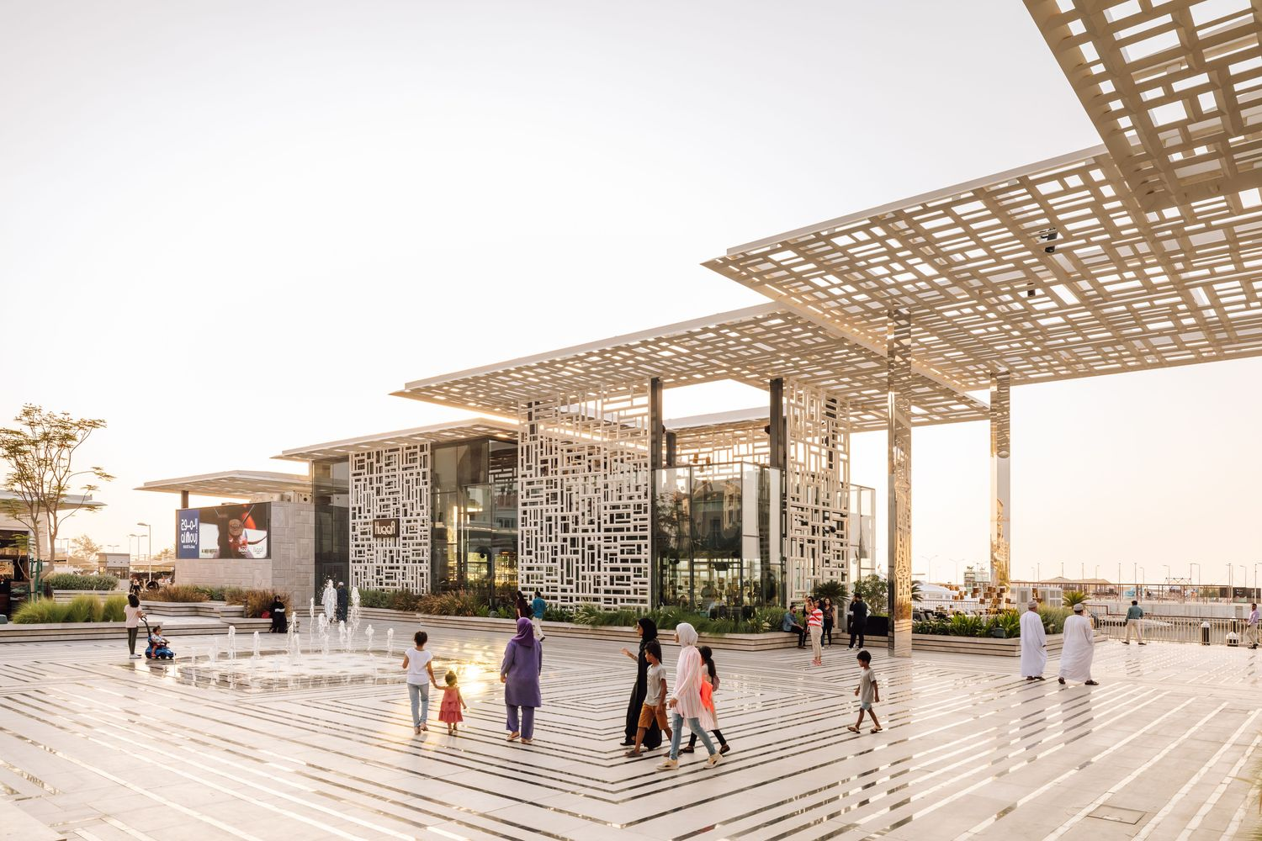
Marsa Plaza, Muscat
AL BANDAR MIXED USE DEVELOPMENT
PLOT AREA - 110HA

Slide 48
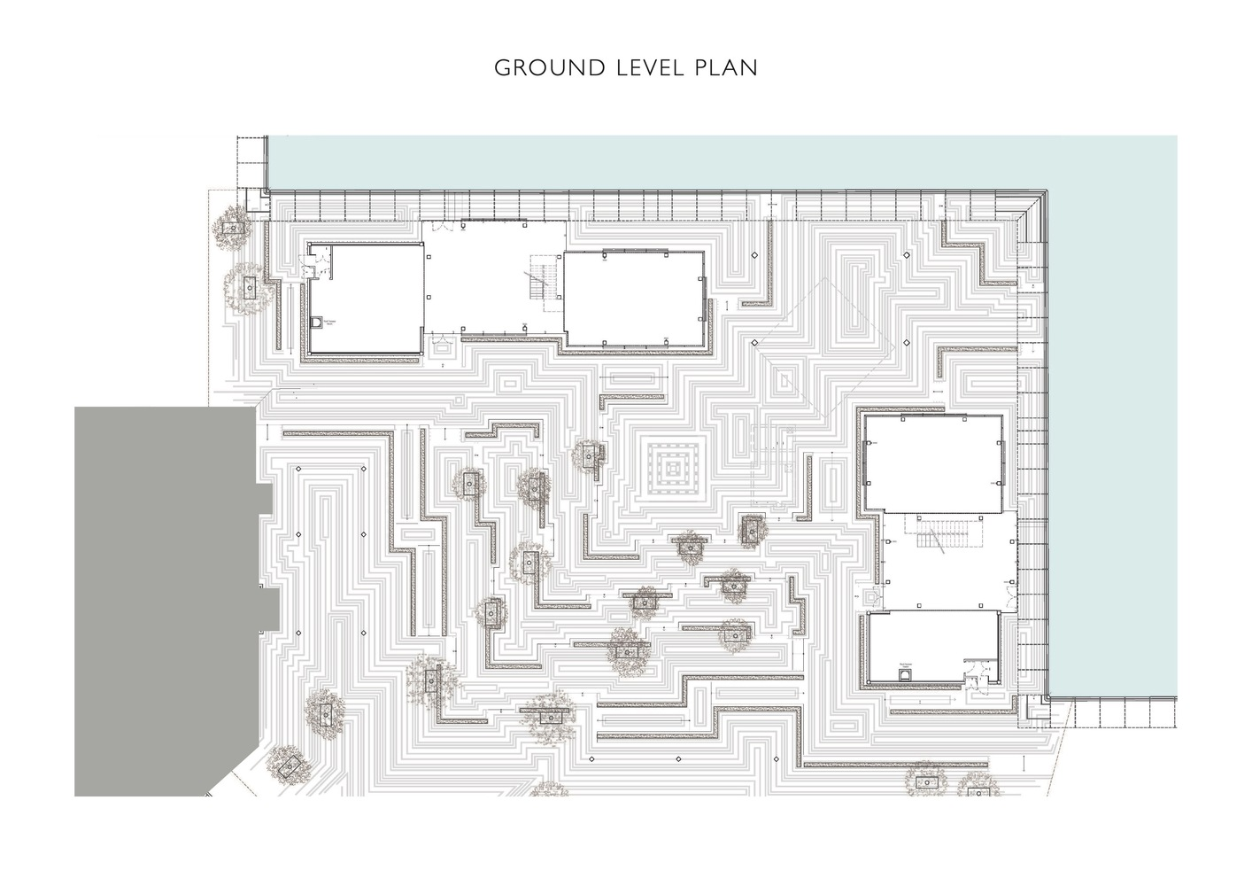
Marsa Plaza, Muscat
AL BANDAR MIXED USE DEVELOPMENT
PLOT AREA - 110HA

Slide 49
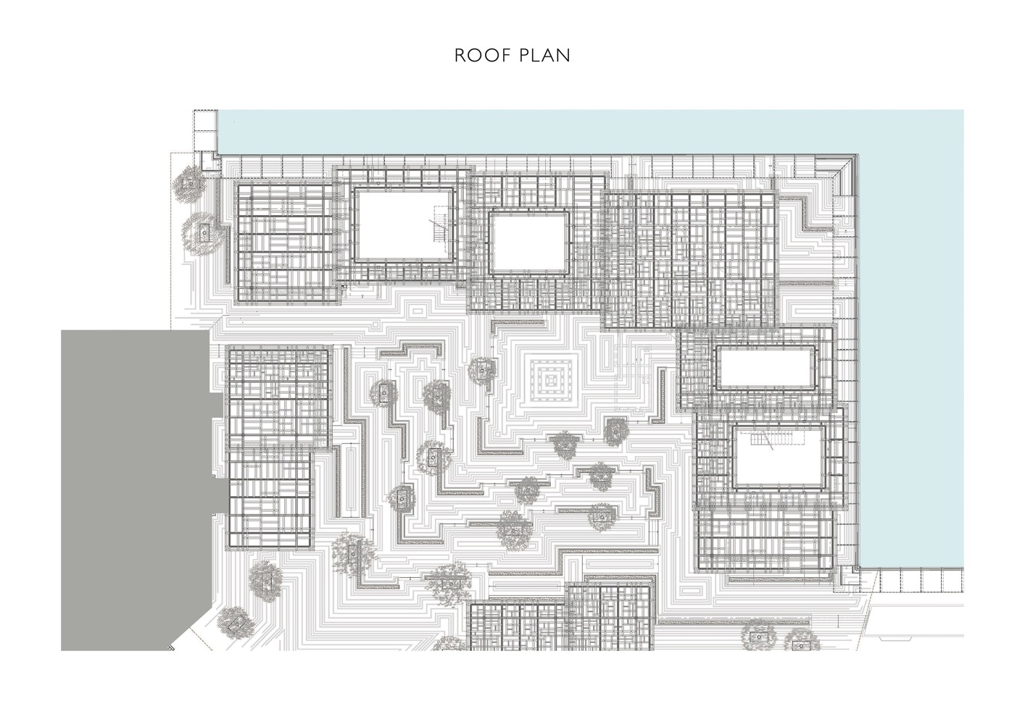
Marsa Plaza, Muscat
AL BANDAR MIXED USE DEVELOPMENT
PLOT AREA - 110HA

Slide 50
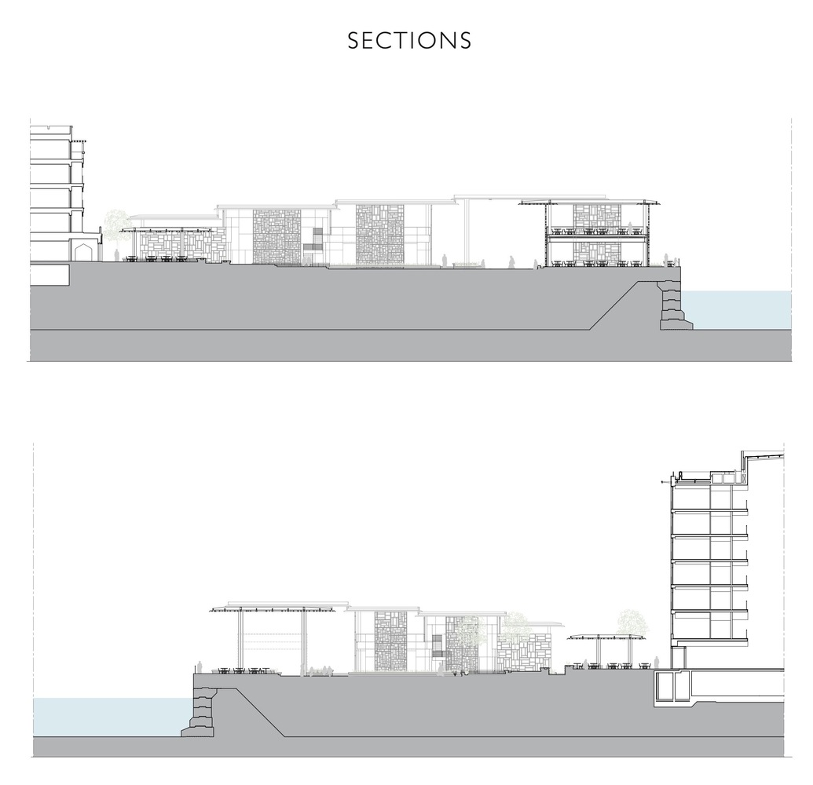
Marsa Plaza, Muscat
AL BANDAR MIXED USE DEVELOPMENT
PLOT AREA - 110HA

Slide 51
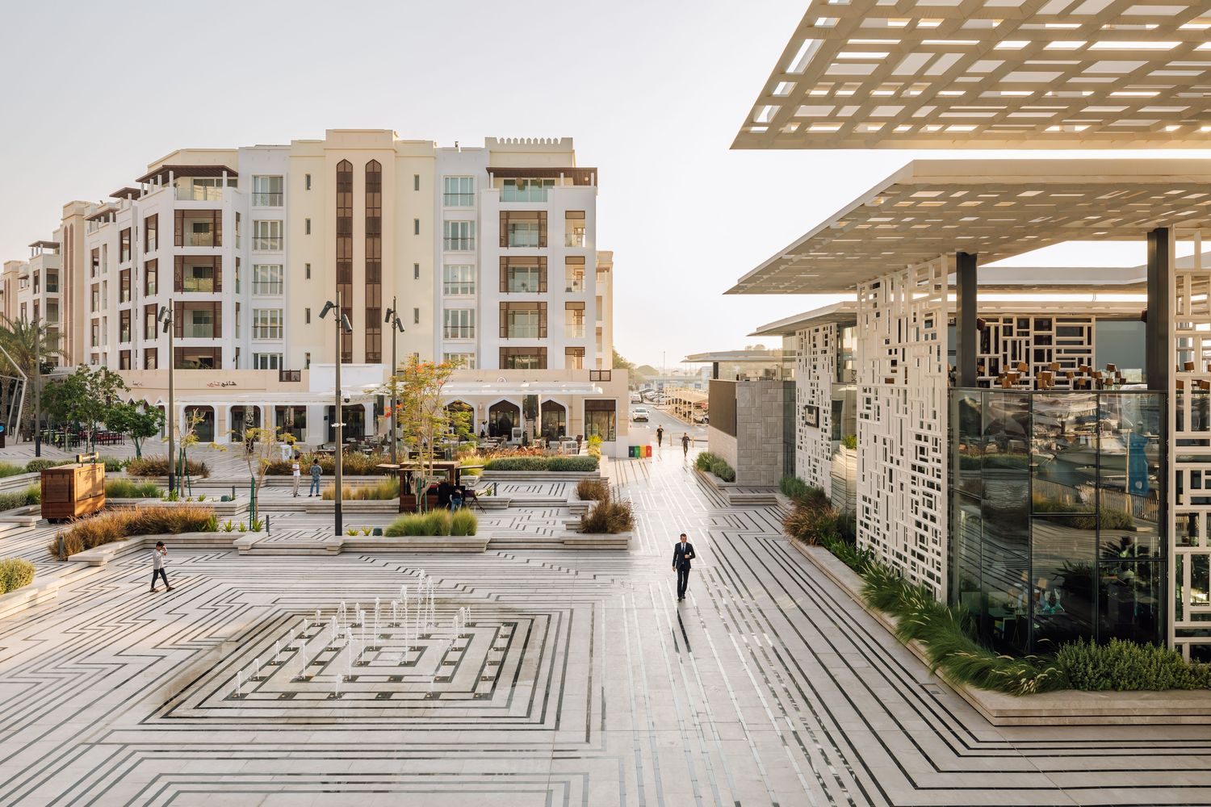
Marsa Plaza, Muscat
AL BANDAR MIXED USE DEVELOPMENT
PLOT AREA - 110HA

Slide 52
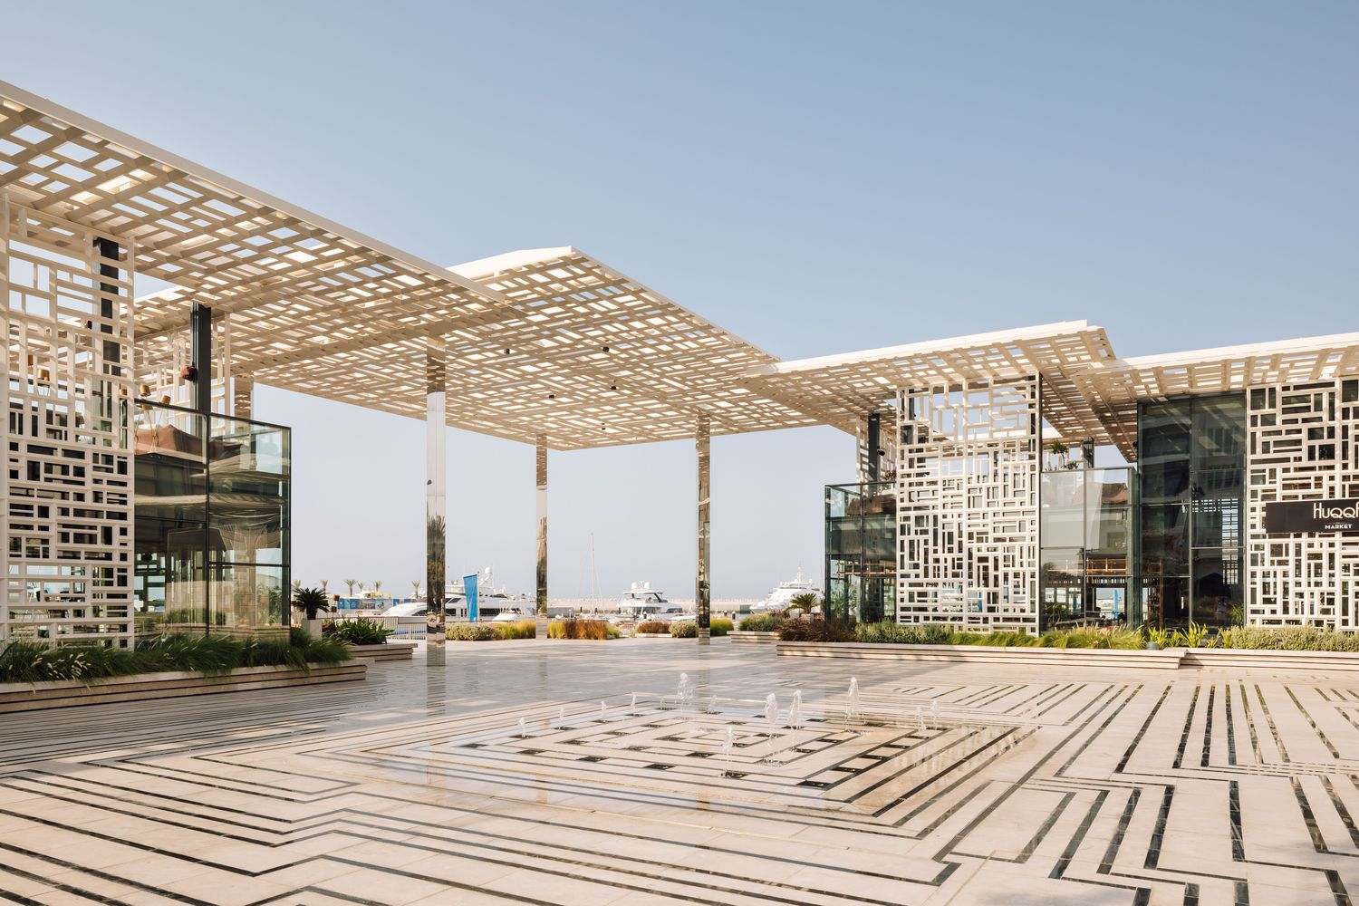
Marsa Plaza, Muscat
AL BANDAR MIXED USE DEVELOPMENT
PLOT AREA - 110HA

Slide 53


Marsa Plaza, Muscat

Slide 54

Marsa Plaza, Muscat
AL BANDAR MIXED USE DEVELOPMENT
PLOT AREA - 110HA

Slide 55

Marsa Plaza, Muscat
AL BANDAR MIXED USE DEVELOPMENT
PLOT AREA - 110HA

Slide 56

Ghala heights, Muscat

Slide 57

Ghala heights, Muscat

Slide 58

Ghala heights, Muscat

Slide 59

Ghala heights, Muscat

Slide 60

Maysan Square,Duqm

Slide 61

Maysan Square,Duqm

Slide 62

Maysan Square,Duqm

Slide 63

Maysan Square,Duqm

Slide 64

Maysan Square,Duqm

Slide 65

Maysan Square,Duqm

Slide 66

Al Ghubrah Complex, Muscat

Slide 67

Al Ghubrah Complex, Muscat

Slide 68

Al Ghubrah Complex, Muscat

Slide 69

Al Ghubrah Complex, Muscat

Slide 70

Fuzhou Shangri-La, China

Slide 71

Fuzhou Shangri-La, China

Slide 72

Fuzhou Shangri-La, China

Slide 73

Fuzhou Shangri-La, China

Slide 74

Fuzhou Shangri-La, China

Slide 75

Fuzhou Shangri-La, China

Slide 76

Shimao ShenKong International Centre, Shenzhen

Slide 77

Shimao ShenKong International Centre, Shenzhen

Slide 78

Shimao ShenKong International Centre, Shenzhen

Slide 79

Shimao ShenKong International Centre, Shenzhen

Slide 80

Shimao ShenKong International Centre, Shenzhen

Slide 81


Shimao ShenKong International Centre, Shenzhen

Slide 82

Shimao ShenKong International Centre, Shenzhen

Slide 83

Mixed Use Development on Rakos Creek, Budapest

Slide 84

Mixed Use Development on Rakos Creek, Budapest

Slide 85

Mixed Use Development on Rakos Creek, Budapest

Slide 86

Mixed Use Development on Rakos Creek, Budapest

Slide 87

Mixed Use Development on Rakos Creek, Budapest

Slide 88

Mixed Use Development on Rakos Creek, Budapest

Slide 89

Innovation QNS, New York City

Slide 90

Innovation QNS, New York City

Slide 91

Innovation QNS, New York City

Slide 92

Innovation QNS, New York City

Slide 93

Innovation QNS, New York City

Slide 94

Innovation QNS, New York City

Slide 95

Innovation QNS, New York City

Slide 96

Innovation QNS, New York City

Slide 97

Seoul Valley, South Korea

Slide 98

Seoul Valley, South Korea

Slide 99

Seoul Valley, South Korea

Slide 100

Seoul Valley, South Korea

Slide 101

Seoul Valley, South Korea

Slide 102

Seoul Valley, South Korea

Slide 103

Seoul Valley, South Korea

Slide 104


Seoul Valley, South Korea

Slide 105


Seoul Valley, South Korea

Slide 106

Lincoln’s Yard,Chicago

Slide 107

Lincoln’s Yard,Chicago

Slide 108

Lincoln’s Yard,Chicago

Slide 109

Lincoln’s Yard,Chicago

Slide 110

Lincoln’s Yard,Chicago

Slide 111

Lincoln’s Yard,Chicago

Slide 112

Lincoln’s Yard,Chicago

Slide 113

Lincoln’s Yard,Chicago

Slide 114

Lincoln’s Yard,Chicago

Slide 115

Thank You

